Slide 1

XAMARIN ❤️ ️ ml.net
Cihan YAKAR
cihanyakar@gmail.com

Slide 2
Makine öğrenmesi
public static decimal FiyatTahmini(Ev ev)
{
return *** ML ***
}

Slide 3
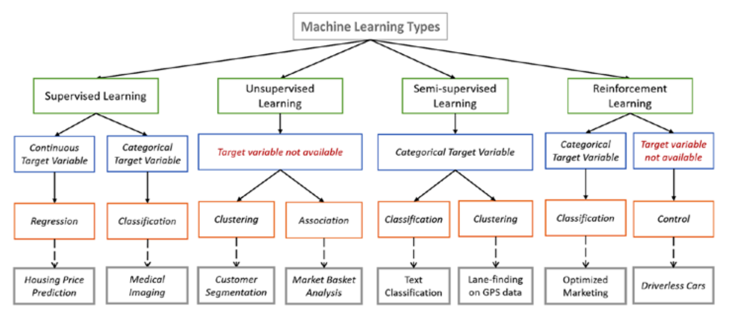
Makine öğrenmesi

Slide 4
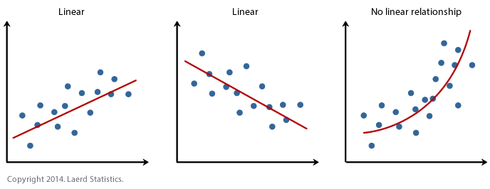
Regresyon
public static float Sicaklik(DateTime tarih)
{
return 45;
}

Slide 5
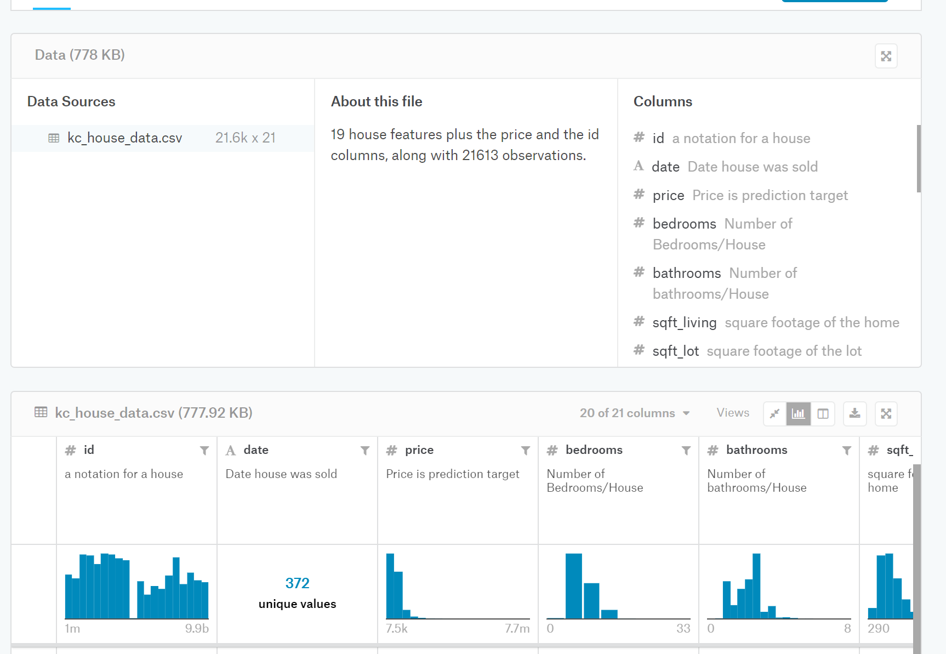
VERİ SETİ
https://www.kaggle.com/harlfoxem/housesalesprediction

Slide 6
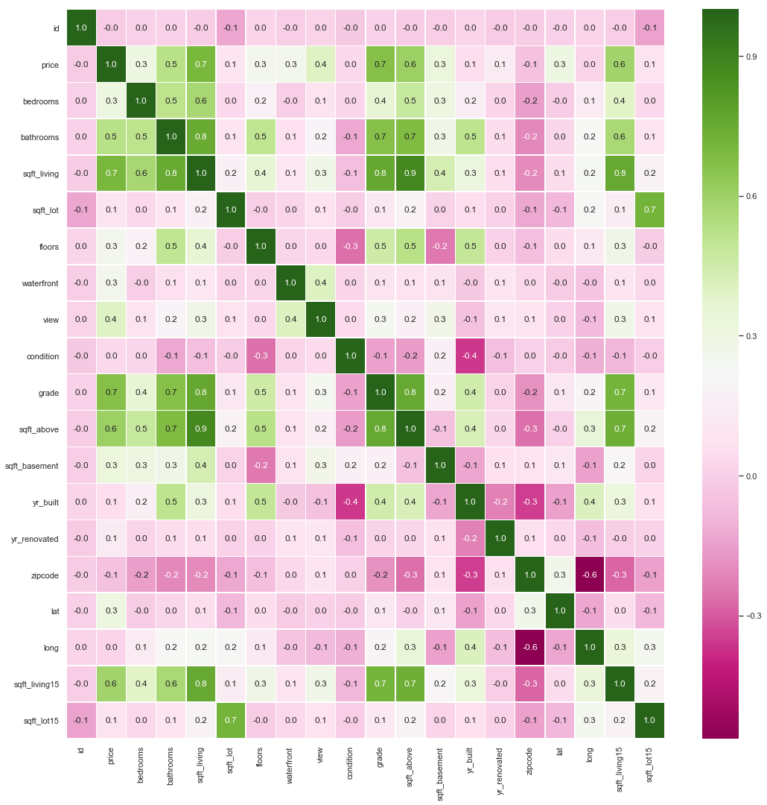
İNCELEME

Slide 7
ML.NET
Load Data IDataView
Transform Data ITransformer
Choose Algorithm IEstimator
Train Model
Evaluate Model
PredictionEngine
Deploy Model

Slide 8
XAMARIN ❤️ ml.net
DEM💗

Slide 9
Teşekkürler
WWW.TEKNOLOT.COM

