Slide 1

Eaglehagen CO₂ Monitor
Ornhagen
Basic setup
CO2 Waveform
FCO2
A short guide to getting started with the monitor:
screen, web page, alarms, LabVIEW and the PC monitor page.
4.3
kPa
O2
20.9
%
Prepared for Dr. Örnhagen · September 2026
PUMP
LEAK
OCCL
SSID: EAGLEHAGEN
IP: 192.168.4.1
Out: LabVIEW
by Teknosofen

Slide 2
Getting started in four steps
From power-on to live values on your phone or tablet
1
2
3
4
Connect
›
Wait ~15 s
›
Join WiFi
›
Open the page
Attach the sample line, O₂ and volume sensors. Switch on the +12 V supply.
The screen shows “Initializing”, “Connecting sensor”, then “Ready!” and the main screen.
On the phone or tablet, join the network EAGLEHAGEN. There is no password.
In the browser, go to the web address shown below.
Web address
http://eaglehagen.local or http://192.168.4.1
Tip: if the PUMP badge is red, press the pump button (IO14) on the device, or tap Start Pump on the web page.
by Teknosofen
· Eaglehagen CO₂ Monitor · Basic setup
2

Slide 3
Reading the device screen
Everything important is visible without a phone or PC
Ornhagen
1
Title and WiFi Green dot: the WiFi network is on.
2
CO₂ waveform Scrolling curve of every breath, scaled automatically.
CO2 Waveform
FCO2
3
FCO2 Current CO₂ value in kPa.
4.3
kPa
O2
4
O₂ Oxygen concentration in %.
20.9
%
PUMP
LEAK
OCCL
5
Alarm badges Green = OK, red = problem. See next page.
SSID: EAGLEHAGEN
6
Network and output WiFi name, web address and the USB format (“Out:”).
IP: 192.168.4.1
Out: LabVIEW
by Teknosofen
· Eaglehagen CO₂ Monitor · Basic setup
3

Slide 4
Buttons and alarms
Two buttons on the board, three alarm badges on the screen and web page
Buttons
Alarm badges
Pump button (IO14)
Sample pump stopped
PUMP
Press the pump button or Start Pump on the web page.
Starts the sample pump. Use it when the PUMP badge is red.
BOOT button
Leak in the sample line
LEAK
Check the sample line and its connectors.
Switches the USB output between LabVIEW and ASCII (see “Out:”).
Caution: do not hold BOOT while switching the device on. It then starts in programming mode and the monitor will not run. Just switch off and on again.
Sample line blocked
OCCL
Check for kinks, water or a full water trap. Then restart the pump.
All green means the analyser is sampling normally.
by Teknosofen
· Eaglehagen CO₂ Monitor · Basic setup
4

Slide 5
The web page
Live values, charts, pump control and data export on any phone, tablet or laptop
eaglehagen.local
Start Pump
Örnhagens Monitor
Connected
Pump
Leak
Occl
Starts the analyser’s sample pump.
EtCO₂
CO₂
RR
O₂
Vol
Zero Calibration
5.3
4.1
14
20.9
320
Zeroes the CO₂ reading. Only with room air in the sample line, never with breath.
CO₂ (kPa)
Save CSV / JSON
Downloads the recorded data (spreadsheet, or for Python/MATLAB).
O₂ (%)
Clear Data
Empties the recording and resets the charts.
Volume (mL)
Recording lives in the browser
The page keeps the last 2 minutes: save soon after an event and keep the page open. For longer recordings, use the PC monitor page (page 7).
Start Pump
Zero Cal
Save CSV
Save JSON
Clear
by Teknosofen
· Eaglehagen CO₂ Monitor · Basic setup
5

Slide 6
Connecting the LabVIEW PC
The existing LabVIEW program works unchanged, over one USB-C cable
Monitor
USB-C
PC
VISA
LabVIEW
Screen shows
“Out: LabVIEW”
COM port
115200 baud, 8N1
Your program,
no changes
1
Connect the monitor’s USB-C port to the PC. Use a data cable, not a charge-only cable.
2
Check that the screen shows “Out: LabVIEW”. If it shows “Out: ASCII”, press the BOOT button once.
3
In LabVIEW, select the monitor’s COM port (Windows Device Manager → Ports: “USB Serial Device”).
4
F1 (restart pump) and F2 (zero CO₂) work as before. The web page can be used at the same time.
ASCII format: plain text lines (CO₂ kPa, O₂ %, RR, volume, status) for Excel, Python or a terminal. Lines starting with # are messages and can be skipped. No LabVIEW? See the next page.
by Teknosofen
· Eaglehagen CO₂ Monitor · Basic setup
6

Slide 7
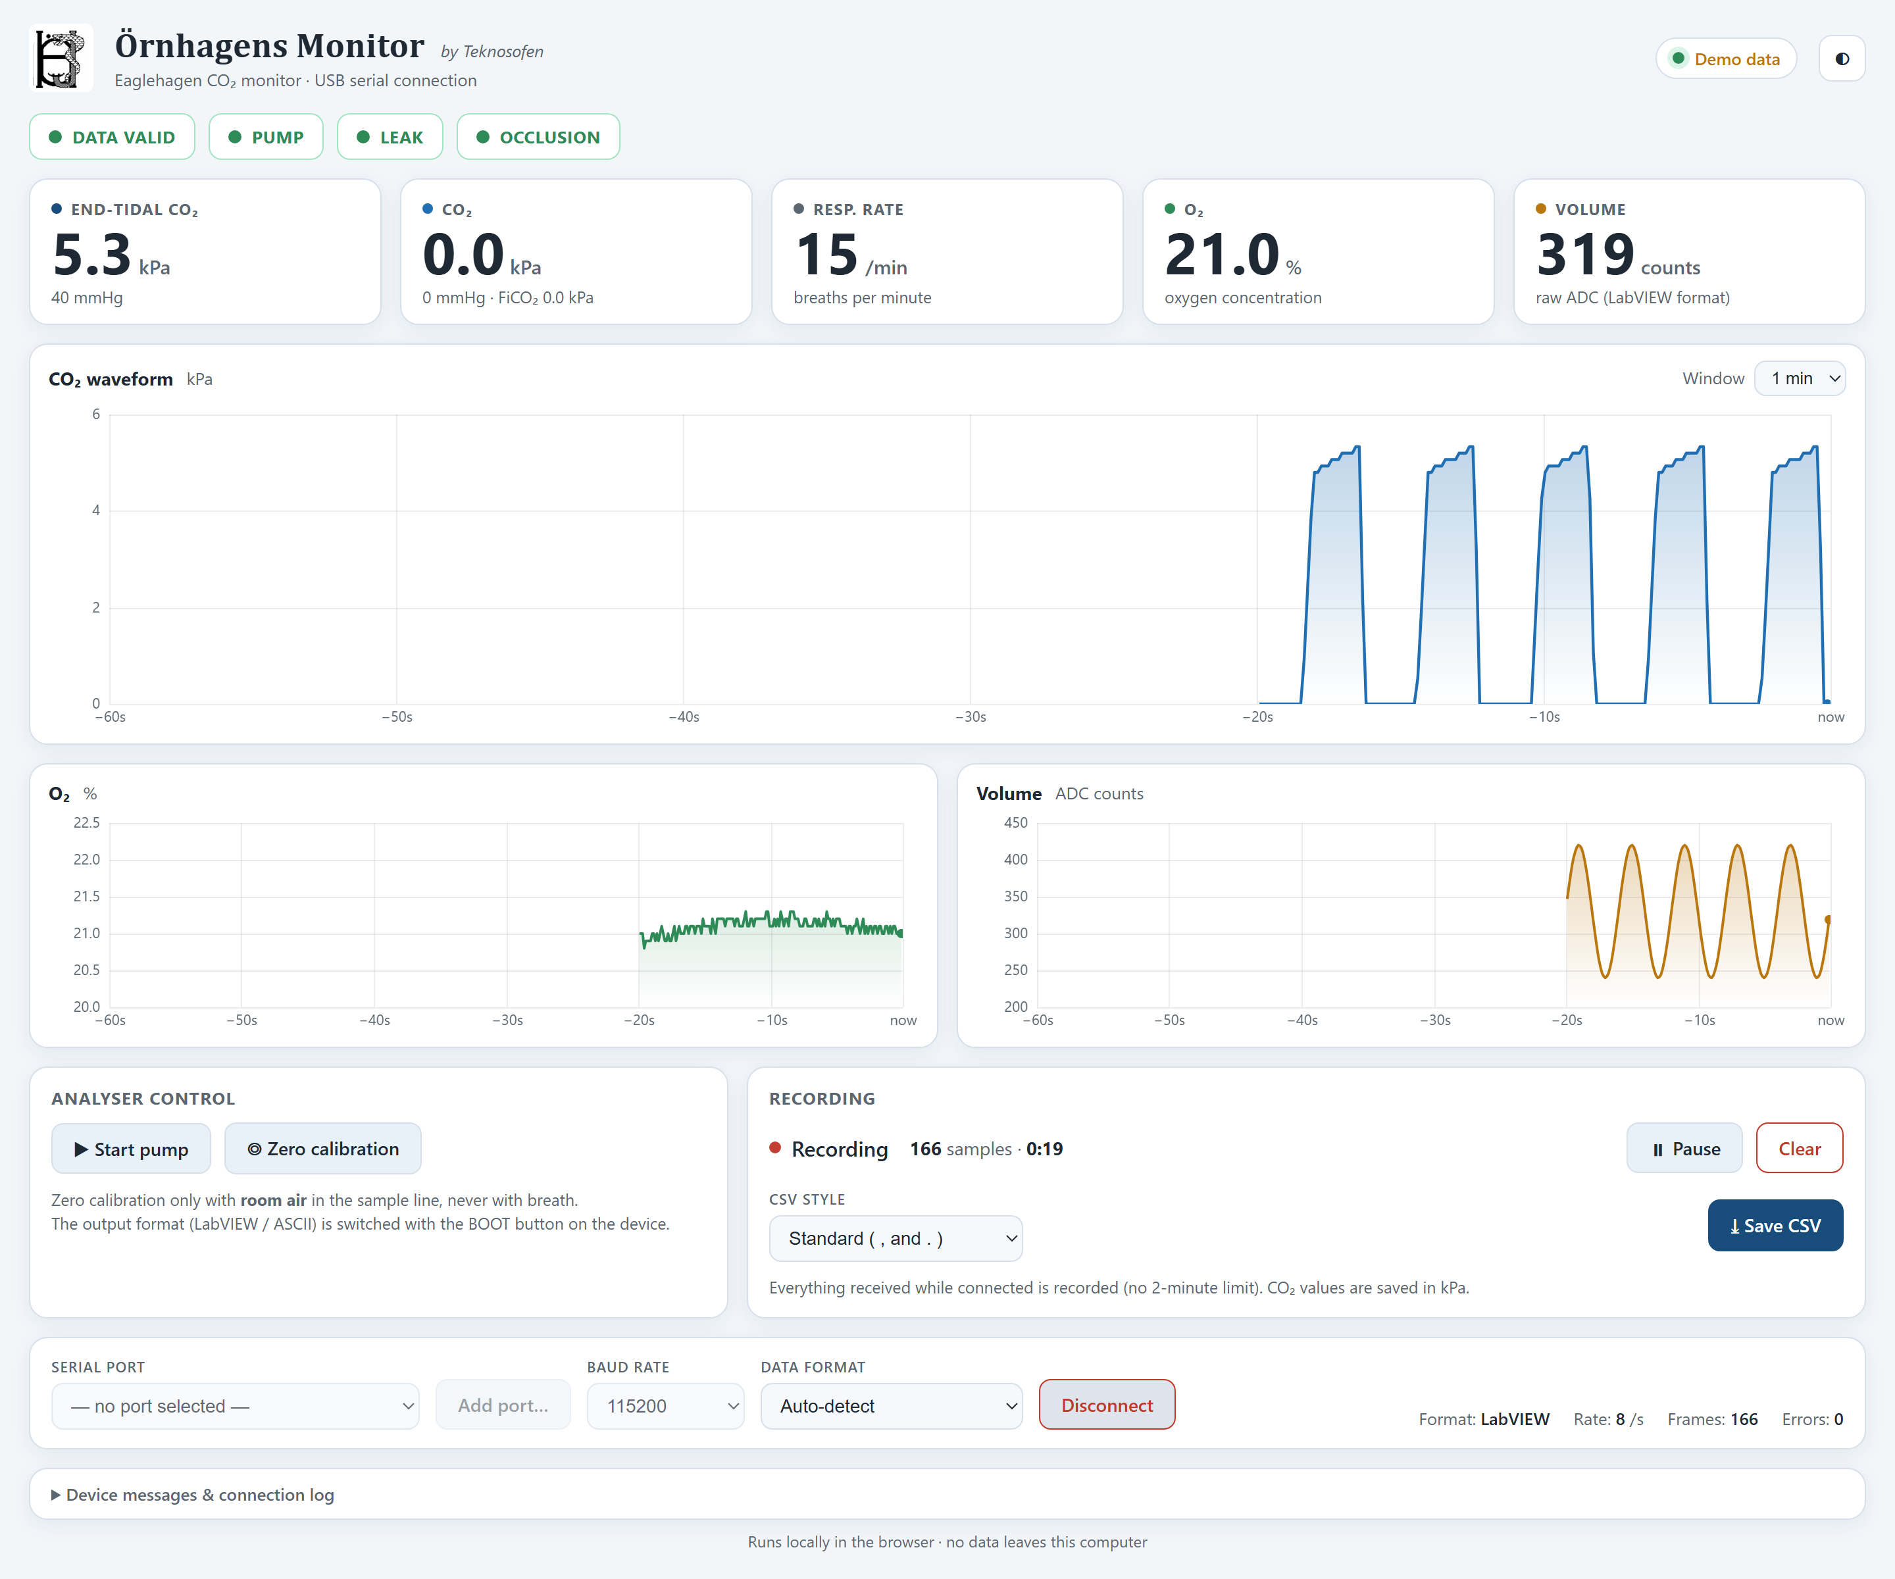
Monitoring on a PC without LabVIEW
A ready-made page for Chrome or Edge: live values, charts and CSV recording over USB
Accepts both output formats
LabVIEW and ASCII are detected automatically, even if BOOT is pressed while connected.
1
Download it over WiFi (once)
Join EAGLEHAGEN, open eaglehagen.local and click “Download” at the bottom.
2
Plug in the USB cable
Close LabVIEW first: only one program can use the COM port.
3
Open the saved file
In Chrome or Edge. First time: “Add port…” and choose the monitor.
4
Connect and record
The monitor page, light theme
Click “Connect selection”. Everything is recorded; “Save CSV” stores it.
The monitor carries its own copy of this page, so no other files are needed. Start pump and Zero calibration work here too.
by Teknosofen
· Eaglehagen CO₂ Monitor · Basic setup
7

Slide 8
If something is wrong
The most common situations and what to do
Problem | What to do
Screen stays dark | Check the +12 V supply and the power lead to the board.
Stuck on “Connecting sensor” | It continues after 10 s. If no values appear, check the analyser’s power and serial cable.
Flat CO₂ line, no values | Is the sample line connected and the PUMP badge green? Try Start Pump.
CO₂ reads high with no breath | Run Zero Calibration with room air in the sample line.
OCCL or LEAK badge red | Kinked, wet or loose sample line, or a full water trap. Fix, then Start Pump.
EAGLEHAGEN network missing | Wait for the main screen, move closer, or switch the device off and on.
Web page does not load | Is the phone still on EAGLEHAGEN? Allow it to stay on a network without internet. Try http://192.168.4.1.
LabVIEW gets no or garbled data | Data-capable USB cable? Correct COM port? Screen must show “Out: LabVIEW”.
PC monitor page cannot connect | Close LabVIEW (only one program per port). Use Chrome or Edge.
by Teknosofen
· Eaglehagen CO₂ Monitor · Basic setup
8

Slide 9
Quick reference
Keep this page next to the monitor
WiFi network
Web address
Pump button
BOOT button
EAGLEHAGEN
eaglehagen.local
IO14
LabVIEW ⇄ ASCII
no password
or 192.168.4.1
starts the sample pump
USB output format
Normal EtCO₂
Room air O₂
USB serial
Web recording
4.5–6.0 kPa
20.9 %
115200 8N1
2 minutes
≈ 35–45 mmHg, adult
reference check
~10 frames per second
longer: PC monitor page
by Teknosofen
· Eaglehagen CO₂ Monitor · Basic setup
9

