Slide 1
LundaLoggern
Uncomplicated Data Logging for Intensive Care Ventilators
Åke @ IaT | 2026-05-28

Slide 2
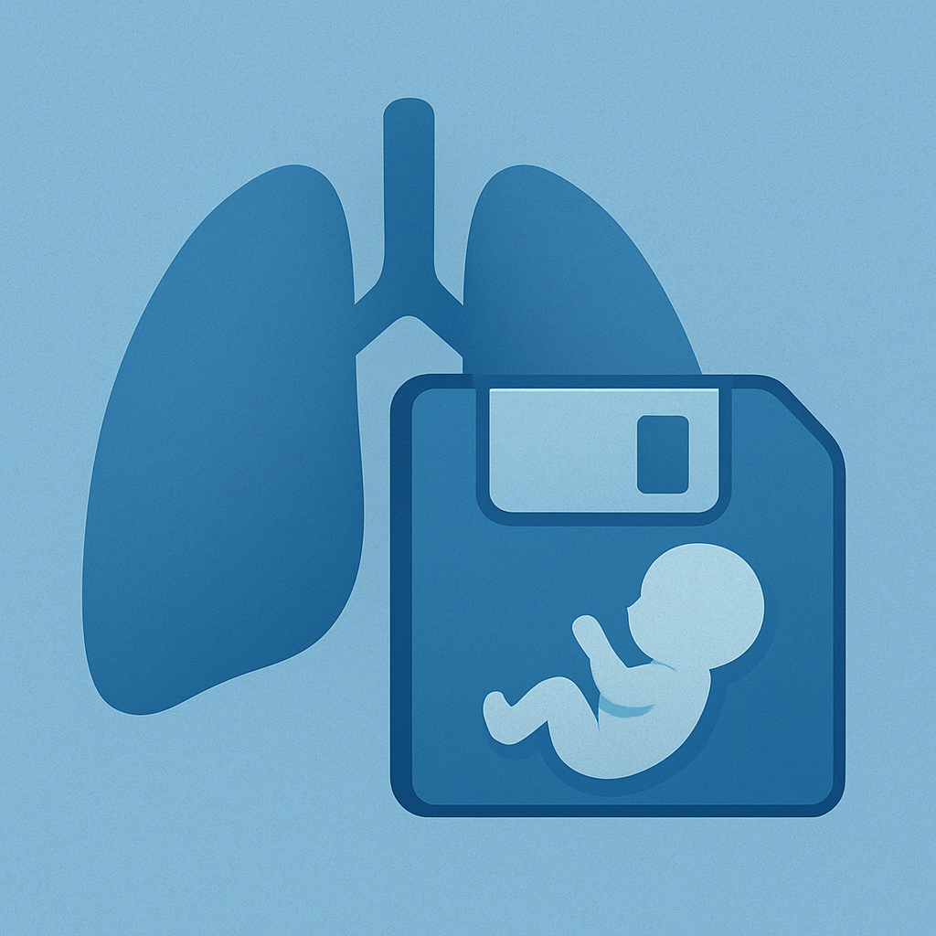
The Problem
Why ventilator data capture needs to be easier
Intensive care ventilators generate critical patient data — but capturing it consistently is hard
  Long term data logging in SERVO very limited.
  The Getinge ServoTracker requires a PC bedside
Manual data recording is error-prone and time-consuming for clinical staff
Existing solutions are often expensive, complex, or tied to proprietary hospital IT systems
How can we make ventilator data logging simple, portable, and independent?
Are there similar needs for data logging also within R&D?
Notes:
JK Länsberg och Fredrik Lundberg, NEO Lund

Slide 3
Research tool chain
Product
Recording
Analysis
CIE
ServoTracker 4.2
Servo-i
Export to Excel and Matlab
Excel Macro
Event Logs, Trends
PCMCIA
Lundalogger
ServoAnalysisTool
SCI
ServoTracker SCI 1.0/1.1
SERVO-U/n/air
Needs PC
Servo Record Viewer
Event Logs, Trends, Recordings, Recruitment
USB stick
72h limit

Slide 4
Introducing LundaLoggern
A plug-and-play data logger for SERVO ventilators
Small, self-contained device — no hospital network or IT integration needed
Connects directly to the ventilator’s CIE port, powered by the ventilator
Automatically records breath-by-breath data, settings, alarms, and waveforms to SD card
Built-in colour display shows live status at a glance
Built-in WiFi lets you download data from your phone or laptop
Uncomplicated, inexpensive offering complementing high-end Talis/DTS solutions
No need for a PC or SW installations

Slide 5
How It Works
Four simple steps — no training required
Step 1 — Plug in
  Connect LundaLoggern to the ventilator’s CIE port
  Data collection configuration can be made off-line
  Data collection autostarts and auto resumes
  Data time stamped with SERVO time
Step 2 — Auto-detect
  The device identifies the ventilator and starts logging immediately
Step 3 — Enable WiFi
  Press the button and scan the QR code on the display
Step 4 — Download
  Open the web dashboard on your phone or laptop to review and download data files
  Remove the SD-card and copy data files directly
Optional – connect a terminal to USB-c port, stream CSV or JSON data directly to PC host

Slide 6
What Gets Logged
Comprehensive, configurable data capture
Breath metrics
  Tidal volume, respiratory rate, minute ventilation, FiO₂, PEEP, peak pressure, and more
Ventilator settings
  Mode, patient category, compliance compensation, I:E ratio, and more
Alarms
  Notifications, levels,
Waveforms
  Flow, airway pressure, volume, CO₂, Edi — fully configurable
All data timestamped automatically using the ventilator’s own clock
Choose which parameters to track via simple text files on the SD card

Slide 7
Key Features & Benefits
Designed for simplicity, privacy, and portability
Plug-and-play
  No setup, training, or IT support needed
WiFi off by default
  Minimizes RF interference in the ICU
  Connection possible only when requested
  WiFi disabled automatically
Portable & compact
  Fits in a pocket; move between ventilators
SD card storage
  Standard, removable, unlimited capacity
QR code connectivity
  Connect to WiFi in seconds
Configurable logging
  Adapt to research or clinical needs
Live display
  Connection status, ventilator ID, timestamps
No cloud dependency
  Data stays local — patient privacy ensured

Slide 8
Target Markets & Use Cases
Clinical / Adult / Neonatal ICU
  Continuous monitoring for quality assurance
  Research data collection during clinical studies
Biomedical Engineering
  Performance verification and troubleshooting
  Long-term trend analysis during service calls
R&D and service data logger
Medical Device R&D
  Bench testing and field validation of prototypes
  Rapid data capture without proprietary software
Education & Training
  Teaching tool for respiratory therapy programs
  Live data demonstration during training sessions

Slide 9
Competitive Advantages
Why LundaLoggern stands out
No recurring costs
  No licenses, subscriptions, or cloud fees
Vendor-independent data
  Plain text files — open and portable
  Files can be encrypted with various levels of ambition
No hospital IT involvement
  Standalone device with its own WiFi access point
Privacy by design
  Data never leaves the device unless the user downloads it
Low-cost hardware
  Built on the widely available ESP32-S3 platform
Fast deployment
  Working in under a minute, zero configuration required

Slide 10
Product Demo
What you see on the device and on your phone
Setup
  Connect to SCI and USB
  Start WiFi – local point to point – no internet connection
  Connect to WiFi
  Point browser to URL
  Check settings
  Download data

Slide 11
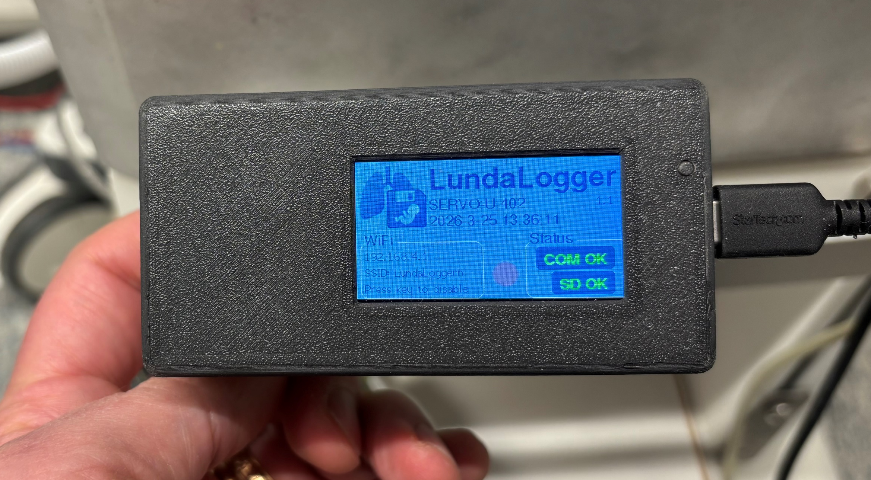
Device Demo
What you see on the device and on your phone
TFT display shows:
  Ventilator type and serial number
  SD card and COM status indicators
  WiFi IP address and QR code

Slide 12
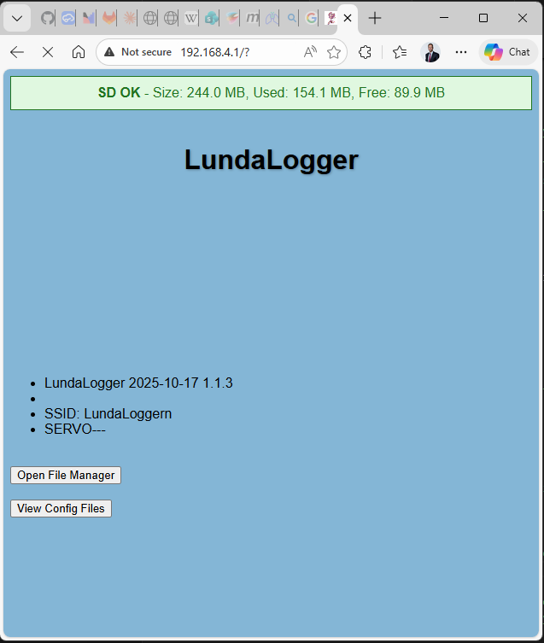
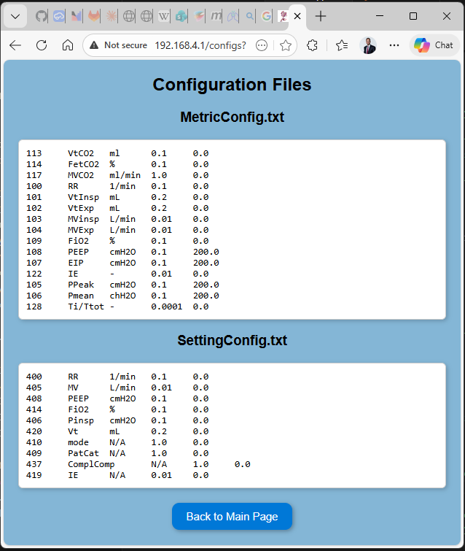
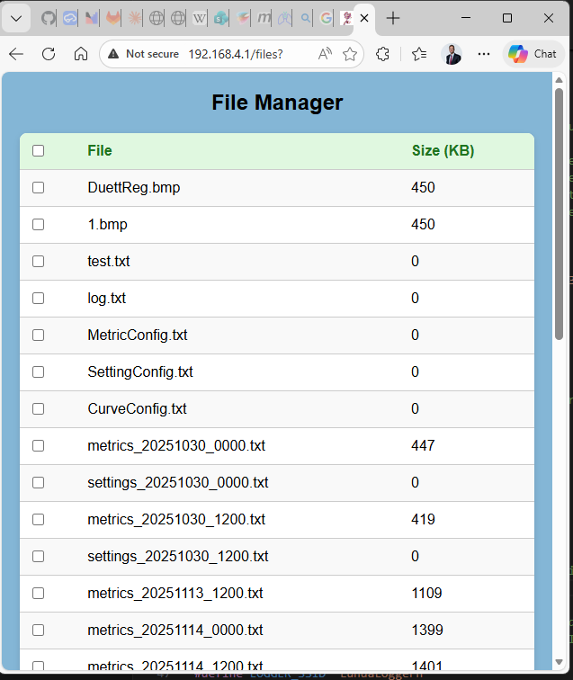
Product Demo
Status and data retrieval
Web dashboard on any device:
  SERVO Connection status
  SD card storage status
  File listing with timestamps
    One-tap download and delete
  Configuration viewer

Slide 13
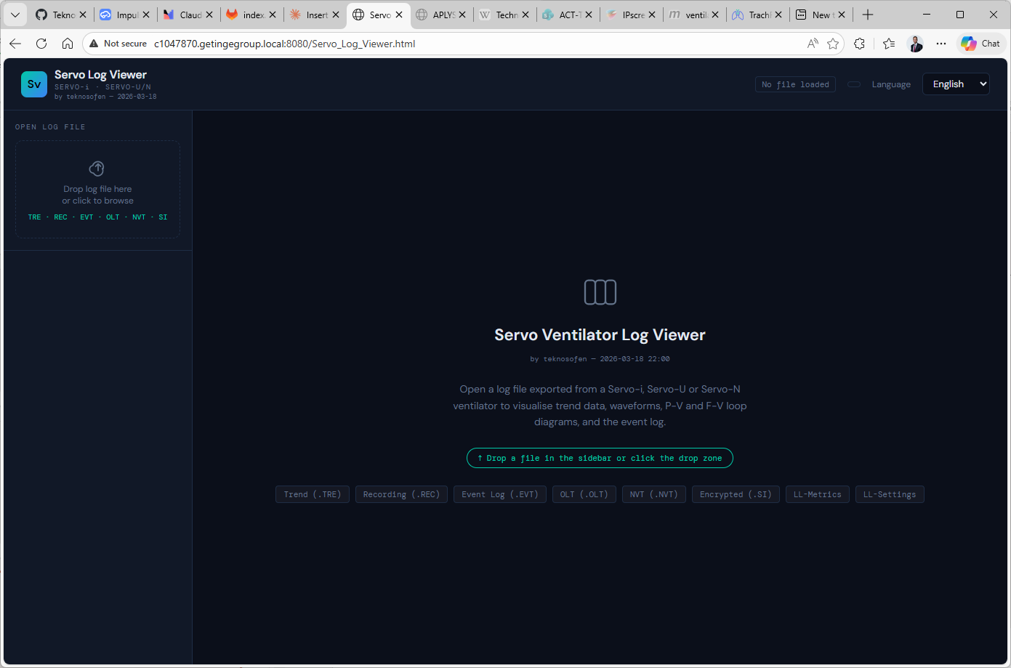
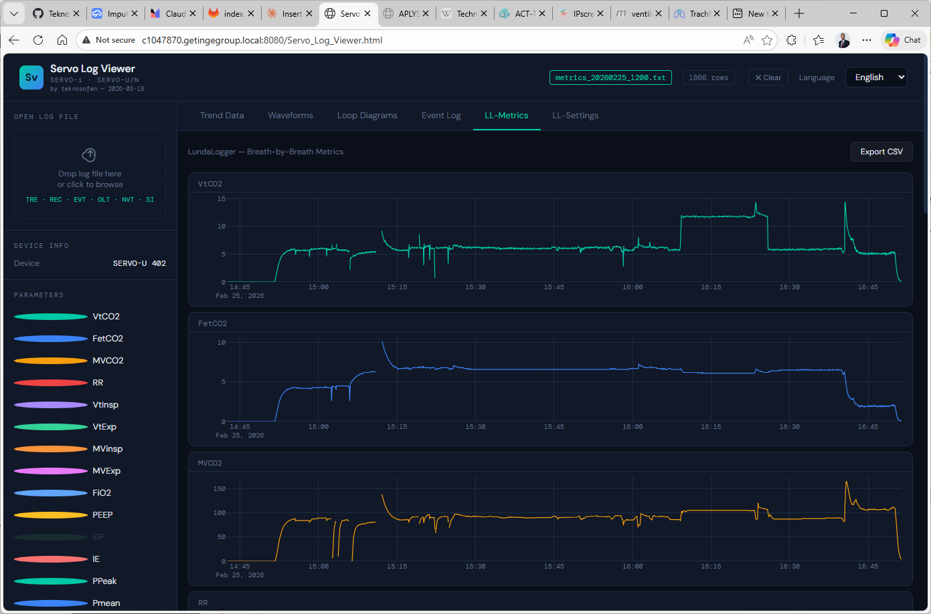
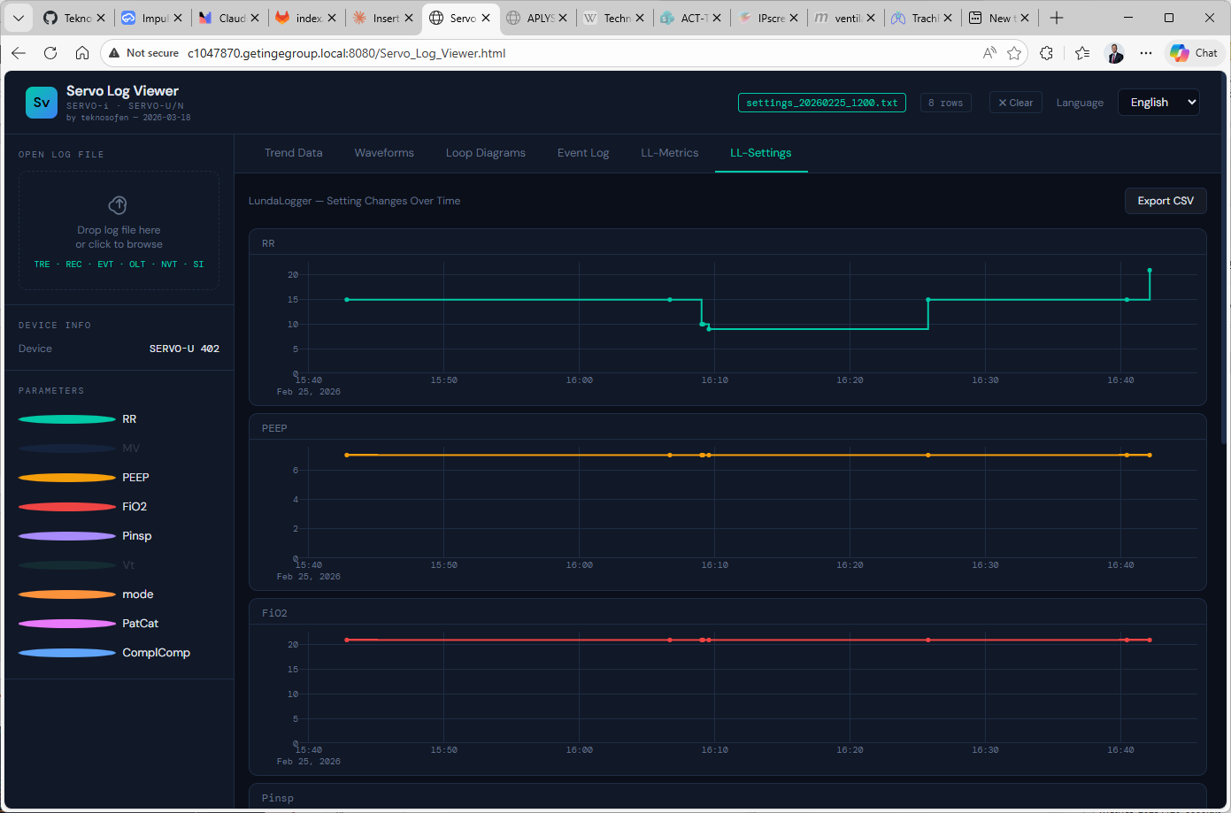
Product Demo
Data viewing
SERVO Log Viewer
  Device data viewer
  Possible successor the “Excel macro”
    Event logs
    OLT
    Recordings
    .si krypterade loggar
    Trend loggar
    …
  Can translate Event logs back into English

Slide 14
Technical Snapshot
Quick reference — key specs at a glance
Hardware
  LilyGo T-Display S3 (ESP32-S3), SD card reader, RS232 interface
Display
  320 × 170 px colour TFT
Connectivity
  WiFi access point — no internet needed
Protocol
  SERVO CIE interface (standard on newer SERVO ventilators)
Power
  USB-C — can be powered from the ventilator’s USB port
    Uses power only USB cable, i.e. no communication to ventilator Panel
Software
  Open-source Arduino / PlatformIO firmware

Slide 15
Roadmap
Future possibilities
WiFi auto-shutoff after 5 minutes of inactivity
Bluetooth connectivity for direct mobile app integration
Multi-ventilator support — expand beyond SERVO to other brands
Prepared for battery operation for transport and ambulance use
Regulatory pathway — CE marking / FDA clearance for clinical deployment
Data file compatibility with ServoTracker, use ST spec and test concept
Optional (light) data file encryption?
Cloud sync option (opt-in) for centralized research data collection
Real-time trend graphs on the web dashboard
Live data presentation, Servo twin-light?

Slide 16
Call to Action
“We have a working prototype — let’s bring it to market.”
What we need from marketing:
  Market sizing and customer segmentation feedback
  Input on branding, naming, and visual identity
  Channel strategy — direct sales, distributors, OEM partnerships?
  Pricing model validation

Slide 17
Q & A
Thank you!

Slide 18
Notes:
## Speaker Notes & Tips
- **Keep it visual** — show the device, show the dashboard, minimize bullet-heavy slides.
- **Lead with the problem** — clinical staff and researchers struggle with data capture today.
- **Emphasize simplicity** — the product's biggest selling point is that it "just works".
- **Avoid deep technical details** — point to the Design Summary document for engineering specifics.
- **Prepare a 30-second elevator pitch** version for stakeholders who can't attend.

Slide 19
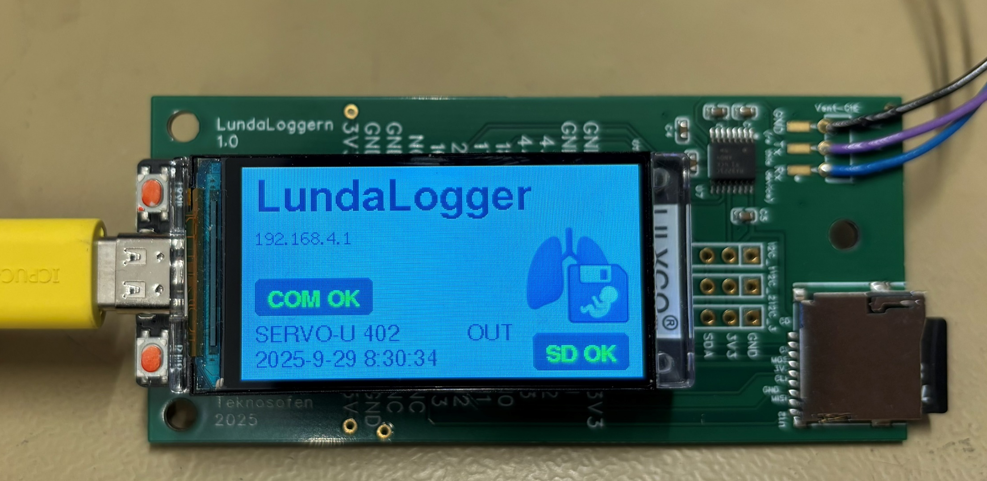
LundaLoggern

