Slide 1
LundaLoggern
Uncomplicated Data Logging for Intensive Care Ventilators
Åke @ IaT | 2026-05-28

Slide 2

Introducing LundaLoggern
A plug-and-play data logger for SERVO ventilators
Small, self-contained device — no hospital network or IT integration needed
Connects directly to the ventilator’s CIE port, powered by the ventilator
Automatically records breath-by-breath data, settings, alarms, and waveforms to SD card
Built-in colour display shows live status at a glance
Built-in WiFi lets you download data from your phone or laptop
Uncomplicated, inexpensive offering complementing high-end Talis/DTS solutions
No need for a PC or SW installations

Slide 3
How It Works
Four simple steps — no training required
Step 1 — Plug in
  Connect LundaLoggern to the ventilator’s CIE port
  Data collection configuration can be made off-line
  Data collection autostarts and auto resumes
  Data time stamped with SERVO time
Step 2 — Auto-detect
  The device identifies the ventilator and starts logging immediately
Step 3 — Enable WiFi
  Press the button and scan the QR code on the display
Step 4 — Download
  Open the web dashboard on your phone or laptop to review and download data files
  Remove the SD-card and copy data files directly
Optional – connect a terminal to USB-c port, stream CSV or JSON data directly to PC host

Slide 4
What Gets Logged
Comprehensive, configurable data capture
Breath metrics
  Tidal volume, respiratory rate, minute ventilation, FiO₂, PEEP, peak pressure, and more
Ventilator settings
  Mode, patient category, compliance compensation, I:E ratio, and more
Alarms
  Notifications, levels,
Waveforms
  Flow, airway pressure, volume, CO₂, Edi — fully configurable
All data timestamped automatically using the ventilator’s own clock
Choose which parameters to track via simple text files on the SD card

Slide 5
Key Features & Benefits
Designed for simplicity, privacy, and portability
Plug-and-play
  No setup, training, or IT support needed
WiFi off by default
  Minimizes RF interference in the ICU
  Connection possible only when requested
  WiFi disabled automatically
Portable & compact
  Fits in a pocket; move between ventilators
SD card storage
  Standard, removable, unlimited capacity
QR code connectivity
  Connect to WiFi in seconds
Configurable logging
  Adapt to research or clinical needs
Live display
  Connection status, ventilator ID, timestamps
No cloud dependency
  Data stays local — patient privacy ensured

Slide 6
Product Demo
What you see on the device and on your phone
Setup
  Connect to SCI and USB
  Start WiFi – local point to point – no internet connection
  Connect to WiFi
  Point browser to URL
  Check settings
  Download data

Slide 7
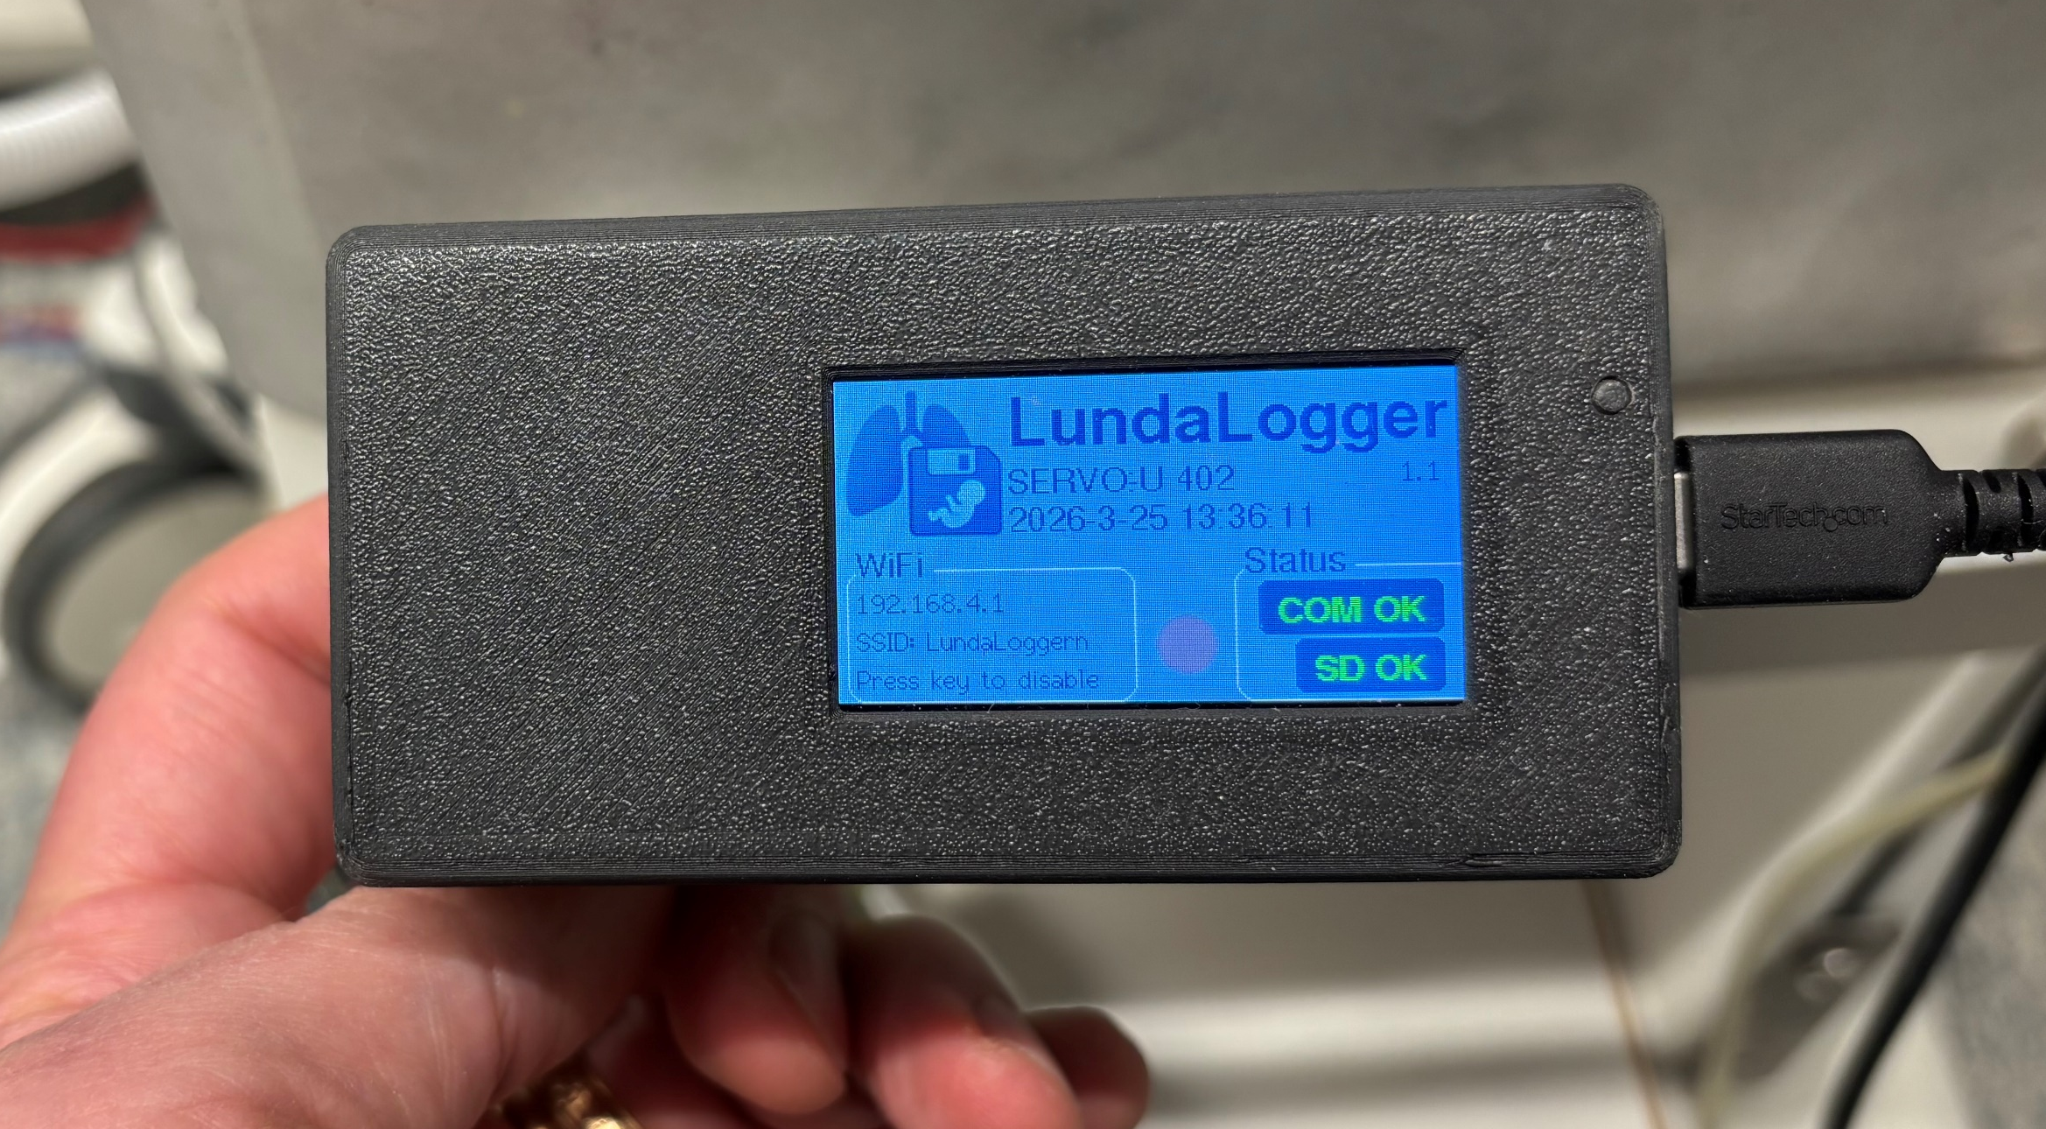
Device Demo
What you see on the device and on your phone
TFT display shows:
  Ventilator type and serial number
  SD card and COM status indicators
  WiFi IP address and QR code

Slide 8
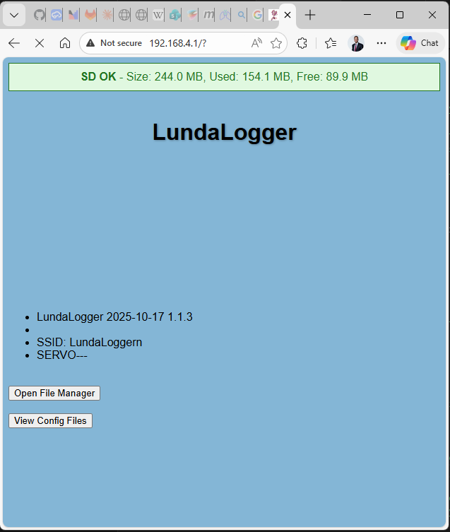
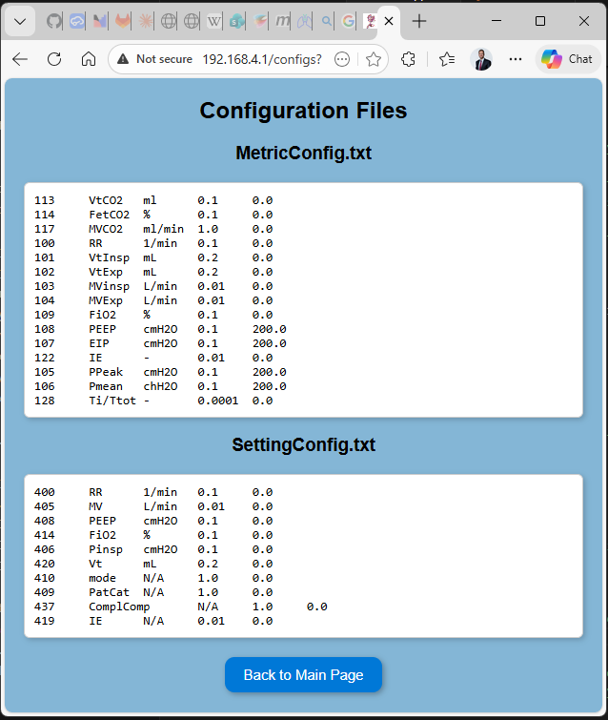
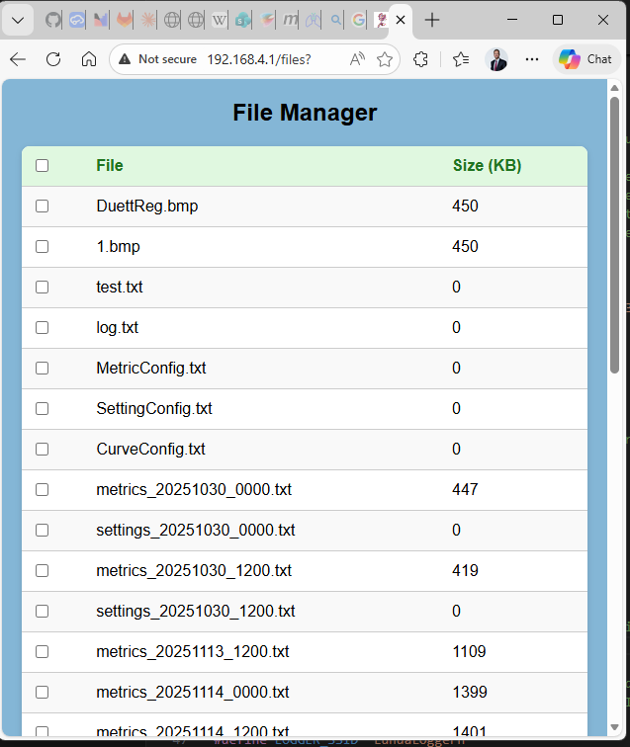
Product Demo
Status and data retrieval
Web dashboard on any device:
  SERVO Connection status
  SD card storage status
  File listing with timestamps
    One-tap download and delete
  Configuration viewer

Slide 9
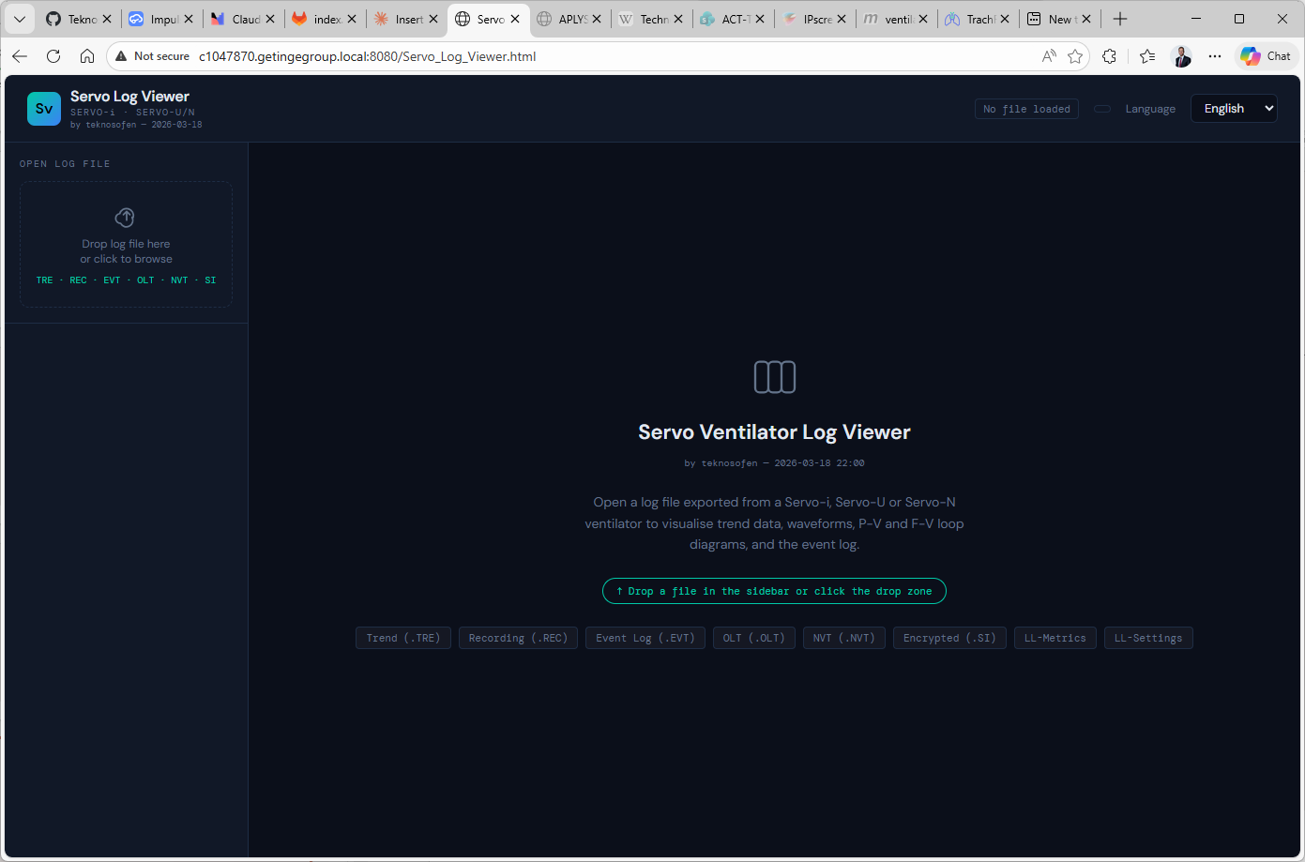
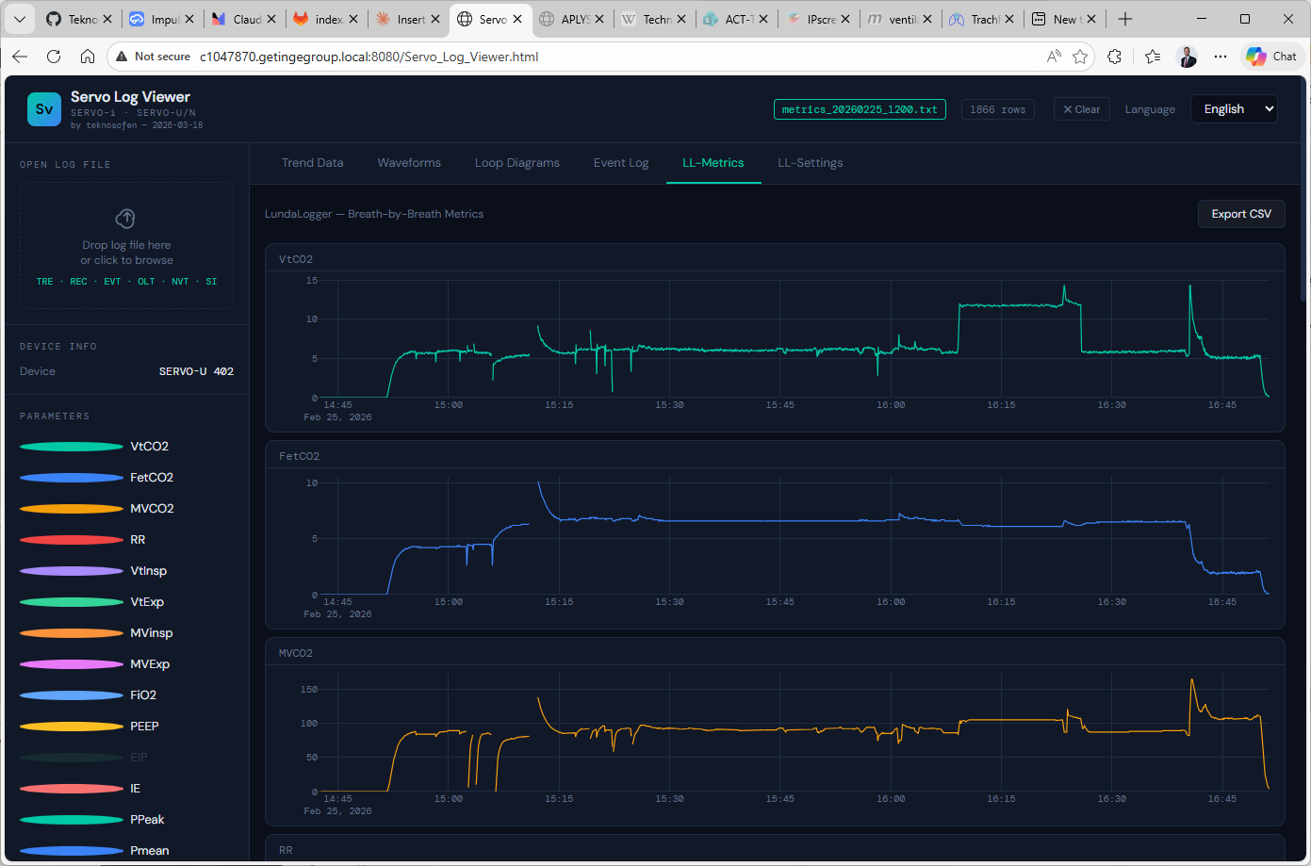
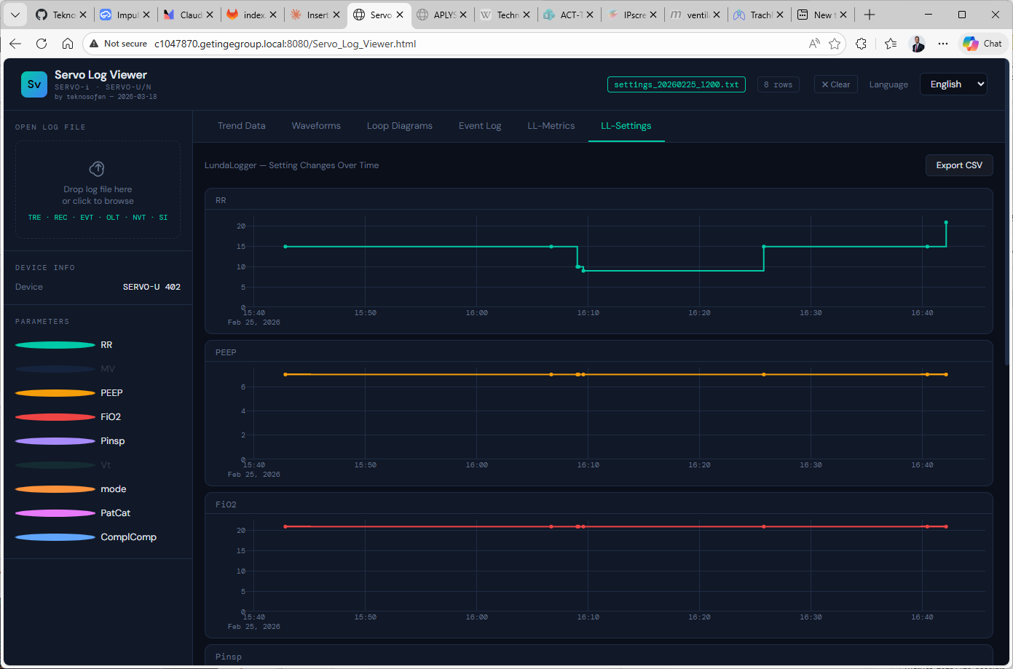
Product Demo
Data viewing
SERVO Log Viewer
  Device data viewer
  Possible successor the “Excel macro”
    Event logs
    OLT
    Recordings
    .si krypterade loggar
    Trend loggar
    …
  Can translate Event logs back into English

Slide 10
Technical Snapshot
Quick reference — key specs at a glance
Hardware
  LilyGo T-Display S3 (ESP32-S3), SD card reader, RS232 interface
Display
  320 × 170 px colour TFT
Connectivity
  WiFi access point — no internet needed
Protocol
  SERVO CIE interface (standard on newer SERVO ventilators)
Power
  USB-C — can be powered from the ventilator’s USB port
    Uses power only USB cable, i.e. no communication to ventilator Panel
Software
  Open-source Arduino / PlatformIO firmware

