Slide 1
The one mode Ventilator
Control Architecture
A modular, setpoint-driven approach
Åke L

Slide 2
Architecture Overview
Layer 4: UI
Equation solver from RR, I:E, Vt to parameters
Maneuvres
(intermittent change)
Layer 3: High-Level Controller (HLC)
8-state ventilation mode control
Layer 2: Low-Level Controller (LLC)
Breathing phase control (insufflation/exsufflation)
Layer 1: PID Controllers
Actuator control (O2, Air, Exp Valve, Blower)
Control Philosophy: Indirect control through setpoint manipulation

Slide 3
Architecture Overview
Three-layer hierarchy
Layer 1 — Actuator Layer: fast PID loops for individual valves and blower
Layer 2 — LLC: breathing phase state machine (insufflation / exsufflation)
Layer 3 — HLC: ventilation mode logic, 8-state cycle
Layer 4 — UI: Conversion User settings to generic parameter interface, equation solving
Core philosophy: indirect control through setpoint manipulation
Higher layers never issue explicit commands — they change setpoints only
Lower layers react automatically when trigger conditions are met
Update rates
Layer 1: 100 – > 1000 Hz Layer 2: ~100 Hz Layer 3: 10 – 50 Hz Layer 4: User events

Slide 4
Layer 1: PID Controllers
O2 Flow
Air Flow
Exp Valve
Blower
Controls oxygen flow rate
Controls air flow rate
Controls expiratory pressure
Controls blower flow rate
Characteristics:
Independent operation
Sensor scaling and linearization
Receives setpoints from LLC
Fast, stable control loops

Slide 5
Layer 1: Actuator Controllers
Four independent PID controllers
O2 Flow Controller — controls O2 valve
Air Flow Controller — controls air valve, handles linearisation tables
Expiratory Valve Controller — controls exp pressure / valve position
Blower Flow Controller — controls blower flow rate
Key characteristics
Each controller operates independently at the highest loop rate
Handles sensor & actuator non-linearities via piecewise lookup tables
No knowledge of breathing phases or ventilation modes
All setpoints received from LLC — outputs go directly to hardware drivers
Responsibilities
Sensor scaling and compensation
Actuator linearization
Setpoint tracking with PID (or more advanced) control

Slide 6
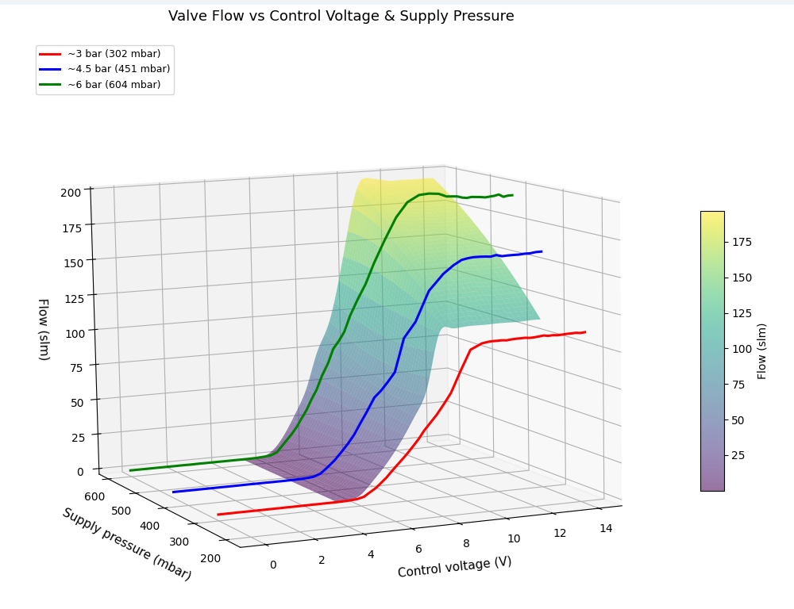
Layer 1: PID Controllers

Slide 7
Layer 2
Low-Level Controller (LLC)
Breathing Phase Control

Slide 8
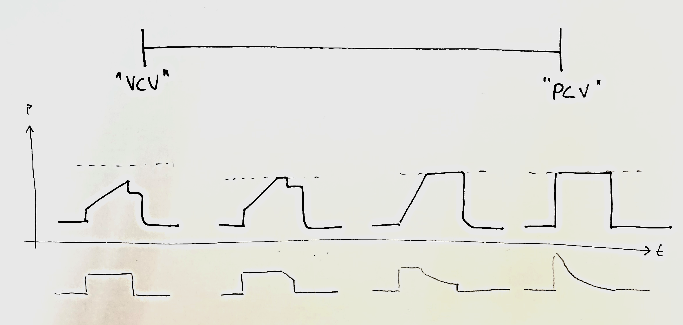
LLC –
Pressure and flow control are end-points on a continous scale
Flow control
Pressure limited Flow control
Flow limited Pressure control
Pressure control
Pressure
Flow
Notes:
Insufflation Flow – Target flow rate during insufflation

Slide 9
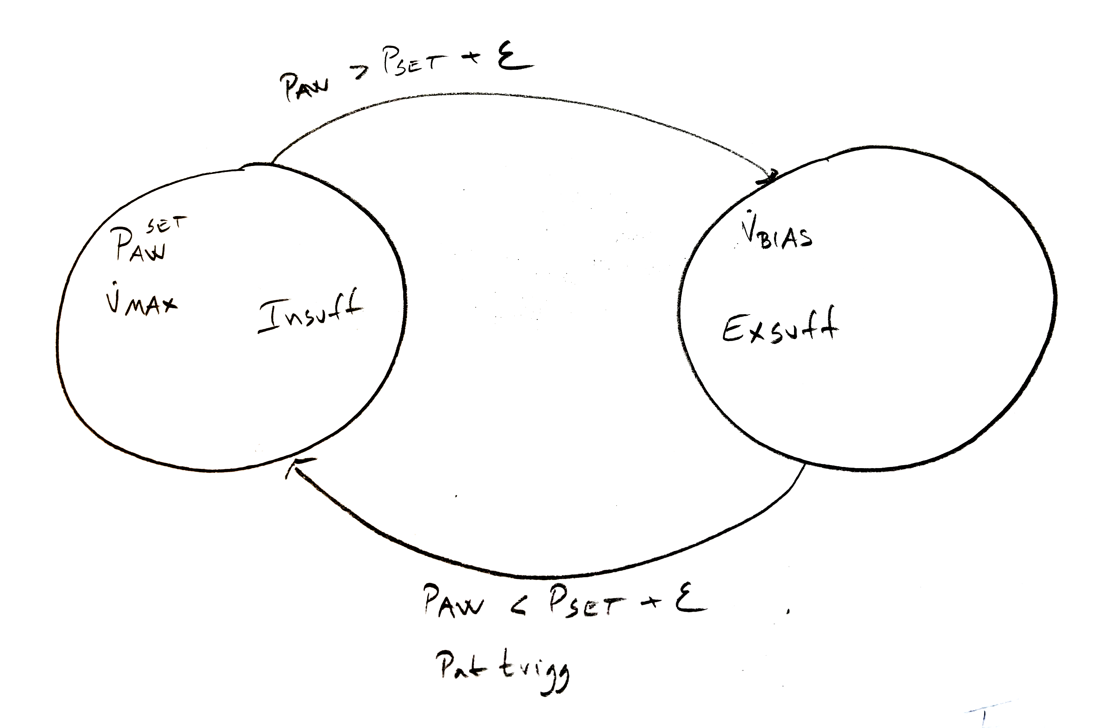
LLC – Parameters (Set by HLC)
All parameters written by HLC – no explicit commands
LLC settings
FiO2
PawSet
FlowSet
Flow/Press Trigger
FlowBias
Notes:
Insufflation Flow – Target flow rate during insufflation

Slide 10
LLC – Breathing Phase States
Two alternating states controlled by setpoints and triggers
Insufflation
Controls airway pressure by inspiratory flow control using FiO2, PawSet and max flow limit
Delivers pressure/flow to patient
Maintains target inspiratory pressure given a set flow limitation
Controls flow using O₂ and Air flow controllers
(Exp valve could be used for pressure limitation)
Exsufflation (Expiration)
Controls airway pressure using expiratory valve and bias flow
Releases pressure/flow from patient
Controls pressure using expiratory valve
Maintains PEEP (baseline pressure)

Slide 11
LLC – Parameters (Set by HLC)
All parameters written by HLC – no explicit commands
FiO₂ – Fraction of inspired oxygen (0.21 – 1.0)
Set Airway Pressure – Target during insufflation
Max Inspiratory Flow – Maximum allowed inspiratory flow
Set Airway Pressure (derived from PEEP by HLC) – Target during exsufflation
Bias Flow – Continuous flow during exsufflation
Flow/Pressure Trigger Thresholds – Detects patient effort
There might be a separate absolute pressure limit forcing => Exsufflation state
Notes:
Insufflation Flow – Target flow rate during insufflation

Slide 12
LLC – Transitions & Communication
Purely reactive controller – no explicit commands from HLC
State Transitions
Patient Effort Detection
Monitors flow & pressure vs trigger thresholds
Inspiratory effort → triggers insufflation
Expiratory effort → triggers exsufflation
Setpoint-Induced Transitions
HLC modifies setpoints → trigger criteria fulfilled
Patient
Example: HLC sets PEEP = 5 cmH₂O → LLC shifts to exsufflation
Signals to HLC
State change events (insuff ↔ exsuff)
Measured tidal volume (integrated flow)
Pressure limit events

Slide 13
OK, todays presentation will likely not touch:
Pressure support cycle off
B2B tidal volume control
UI parameter equation solving

Slide 14
Layer 3
High-Level Controller (HLC)

Slide 15
Layer 3: High-Level Controller, HLC
8-State Sequential State Machine
Inspiration Sequence
Expiration Sequence
1. Non-triggerable
8. Pause
Fixed mandatory breath
Expiratory pause
2. Support
7. Synch
Patient can trigger pressure support
Patient-synchronized transition
3. Synch
6. Support
Patient-synchronized transition
Patient can trigger support
4. Pause
5. Non-triggerable
Inspiratory plateau
Fixed expiration phase

Slide 16
HLC – 8-State Sequential Machine
Two phases × four states per phase
Inspiration Sequence
1. Non-triggerable – Fixed inspiration, triggers ignored
2. Support – Patient can trigger pressure support
3. Synch – Patient-synchronized transition (default: 0)
4. Pause – Inspiratory hold for plateau measurement
Expiration Sequence
5. Non-triggerable – Fixed expiration, triggers ignored
6. Support – Patient can trigger expiratory support (rare)
7. Synch – Patient-synchronized transition (default: 0)
8. Pause – Expiratory hold for measurements

Slide 17
HLC – Inspiration States
States 1–4 of the ventilation cycle
1. Non-triggerable
Delivers mandatory breath
Patient triggers are ignored
Duration set by timing parameters
2. Support
Patient can trigger additional inspiratory support pressure
Allows patient to augment mechanical breath
3. Synch (Synchronization)
LLC exsufflation signal → HLC advances to Pause
Allows patient to terminate inspiration
4. Pause (Inspiratory Plateau)
Holds delivered volume – no gas added or released
Can be used for plateau pressure measurement

Slide 18
HLC – Expiration States
States 5–8 of the ventilation cycle
5. Non-triggerable
Ensures minimum expiration time
Patient triggers are ignored
6. Support
Patient can trigger expiratory support pressure
Rare in typical ventilation modes
7. Synch (Synchronization)
LLC insufflation signal → HLC advances to Pause
Allows patient to initiate next breath
8. Pause (Expiratory)
Maintains expiratory state
Used for breath holds or measurements

Slide 19
HLC – State Transition Logic
Simple, deterministic transitions – no parameter interpretation
States advance based on:
Time elapsed – each state has a pre-calculated absolute duration
Zero-duration skipping – states with time = 0 are immediately skipped
Patient synchronization – during Synch states, LLC signals trigger advance
Insp Synch: LLC exsufflation signal → advance to Insp Pause
Exp Synch: LLC insufflation signal → advance to Exp Pause
Key design principle
The HLC operates exclusively on absolute times (ms/s)
It does NOT interpret RR, I:E ratio, pause %, or any user parameters
All parameter-to-time conversion is done by the UI Layer above

Slide 20
HLC – Timing Interface
Eight absolute durations – the only timing inputs to the HLC
Inspiration phase
Time_Insp_NonTrig – Mandatory inspiration duration
Time_Insp_Support – Inspiration support window
Time_Insp_Synch – Max wait for patient-synchronized termination
Time_Insp_Pause – Inspiratory pause / plateau hold
Expiration phase
Time_Exp_NonTrig – Mandatory expiration duration
Time_Exp_Support – Expiration support window
Time_Exp_Synch – Max wait for patient-synchronized termination
Time_Exp_Pause – Expiratory pause / hold
Sum of all 8 durations = one complete breathing cycle
Active Insp. Time = NonTrig + Support + Synch (pause excluded for Vt calc)

Slide 21
User Interface Layer
Translates clinician parameters into HLC absolute times
UI Layer accepts user parameters
Respiratory Rate (RR)
I:E Ratio
Inspiratory Pause %
Expiratory Pause %
Non-triggerable / Support / Synch fractions
Tidal Volume, FiO₂, pressures, etc.
UI Layer solves the equations
Cycle Time = 60 / RR
Insp Time = Cycle × I/(I+E)
Exp Time = Cycle × E/(I+E)
Distributes durations across 8 states
Writes absolute times + setpoints to HLC
Benefit: different UIs (touchscreen, remote,
automated protocols) share the same
deterministic HLC interface

Slide 22
Tidal Volume Control
Initial Flow Calculation
Insufflation Flow = Vt / Active Inspiration Time
Breath-to-Breath Adaptive Control:
1. Measure actual delivered tidal volume (Vt_measured)
2. Calculate error: ΔVt = Vt_target - Vt_measured
3. Gradually adjust flow setpoint for next breath:
• If Vt_measured < Vt_target → increase flow
• If Vt_measured > Vt_target → decrease flow
Pressure-Limited Volume Control
When pressure reaches limit → flow reduced → volume sacrificed for safety

Slide 23
Tidal Volume Control
Breath-to-breath adaptive control with pressure safety
Initial Flow Calculation
Insufflation Flow = Vt / Active Inspiration Time
Active Insp. Time = Time(Non-trig) + Time(Support) + Time(Synch)
Breath-to-Breath Adaptation
At each inspi→expi transition:
Measure actual Vt_measured
Calculate ΔVt = Vt_target − Vt_measured
Gradually adjust insufflation flow setpoint
Prevents oscillations, compensates for compliance changes
Pressure-Limited Volume Control
LLC pressure controllers auto-reduce flow near Pressure Limit
Vt_measured < Vt_target → volume sacrificed for safety
Two modes: Volume-controlled / Pressure-limited volume-controlled
HLC attempts to increase flow next breath; if persistent: volume sacrificed
Patient safety (pressure) prioritised over volume target

Slide 24
Pressure Support Mechanism
Rewarding patient effort through pressure boosts
Inspiration Support State
When patient trigger detected during Insp Support state:
LLC Insuff Pressure = Inspiratory Pressure + Insp Support Pressure
Provides additional pressure boost rewarding inspiratory effort
Common in PSV (Pressure Support Ventilation) modes
Expiration Support State
When patient trigger detected during Exp Support state:
LLC Insuff Pressure = PEEP + Exp Support Pressure
Less common – available for specific clinical scenarios

Slide 25
Inspiratory Pause Implementation
setpoint manipulation – no special pause logic in LLC
Purpose
Hold delivered volume for plateau pressure measurement
Assess static lung compliance
Equilibrate airway and alveolar pressures
Mechanism (setpoint manipulation)
Bias Flow → 0 (no gas added by insufflation controllers)
PEEP setpoint → 100 cmH₂O (forces LLC into exsufflation mode)
Actual pressure ≪ 100 → expiratory valve stays closed
Result: system is mechanically "locked"
No gas flows in, no gas escapes
Volume held constant

Slide 26
HLC – Indirect Control Philosophy
HLC controls LLC exclusively by changing setpoints — never by explicit command
HLC controls LLC by:
Setting insufflation pressure based on state & triggers
Setting pressure limit for safety
Setting insufflation flow (Vt, timing, adaptation)
Adjusting bias flow & PEEP for pause phases
Adjusting trigger thresholds per HLC state
State-Dependent Setpoints (key states)
Insp Non-trig: Insp Pressure | Normal PEEP | Normal Bias
Insp Support (triggered): Insp Press + Support | Normal PEEP
Insp Pause: N/A | PEEP=100 cmH₂O | Bias=0
Exp states: N/A or PEEP+Support | Normal PEEP | Normal Bias

Slide 27
Indirect Control: State-Dependent Setpoints
HLC controls LLC exclusively by changing setpoints — never by explicit command
HLC State Insp Pressure PEEP Bias Flow
Insp Non-trig Insp Pressure Normal PEEP Normal
Insp Support Insp P + Support * Normal PEEP Normal
Insp Synch Insp Pressure Normal PEEP Normal
Insp Pause — 100 cmH2O (lock) 0 (lock)
Exp Non-trig — PEEP Normal
Exp Support PEEP + Support * PEEP Normal
Exp Pause — PEEP Normal
* Only applied when patient trigger is detected in that state
Setpoint change → LLC trigger criteria may be instantly fulfilled
LLC transitions automatically — no command needed from HLC

Slide 28
Communication Between Layers
Clean interfaces with minimal coupling
HLC → LLC (Setpoints)
Pressure setpoints (insp, PEEP, limit)
Flow setpoints (insufflation, bias, max insp)
Trigger thresholds (flow & pressure)
LLC → HLC (Signals)
State change events (insufflation ↔ exsufflation)
Measured tidal volume (integrated flow)
Pressure limit events
LLC → Layer 1 (Setpoints)
Individual flow controller setpoints
Expiratory valve pressure setpoint

Slide 29
Example Ventilation Modes
Various clinical modes via timing & parameter configuration
Volume Control (VC)
Insp Non-trig delivers full breath
Support & Synch skipped (time=0)
Time-triggered, volume-cycled
Assist Control (AC)
Backup mandatory breath timing
Exp Synch active → patient triggering
Full support on every breath
Pressure Support (PSV)
Insp Support active with pressure
Insp & Exp Synch active
Fully patient-triggered & cycled
SIMV
Mandatory (Non-trig) + Supported breaths
Synch states coordinate with patient
Combines mandatory & spontaneous

Slide 30
Safety & Design Advantages
Safety Considerations
Pressure limiting always active (barotrauma prevention)
Non-trig states ensure minimum ventilation
Gradual adaptation prevents sudden volume changes
Setpoint sanity checks in HLC
Watchdog timers per state
Design Advantages
Modularity – clear layer responsibilities
No direct commands – reduced coupling
Extensibility – new modes via config only
Patient synchronization built-in
Breath-to-breath adaptability

Slide 31
Implementation Notes
Practical considerations for system design
Execution Rates
Layer 1 PID loops: 100 – 1000 Hz
LLC: event-driven architecture
HLC: fixed time base (10 – 50 Hz)
Parameter Updates
Validate all parameter changes before applying
Rate-limit parameter changes to prevent instability
Log all setpoint changes for debugging & clinical review
Testing Strategy
Test each layer independently first
Verify LLC response to setpoint changes
Verify HLC state sequences for all modes
Patient simulator testing with varying compliance/resistance

Slide 32
Design Advantages
Modularity
Clear separation of responsibilities across layers
No Direct Commands
Simplifies interfaces and reduces coupling
Extensibility
New ventilation modes via timing/parameter configuration
Patient Synchronization
Built into state machine architecture
Safety
Multiple protection layers (LLC pressure limiting, HLC limits)
Adaptability
Breath-to-breath learning handles patient variability

