Slide 1
LundaLoggern
En datalogger
Åke 2026-02-27

Slide 2

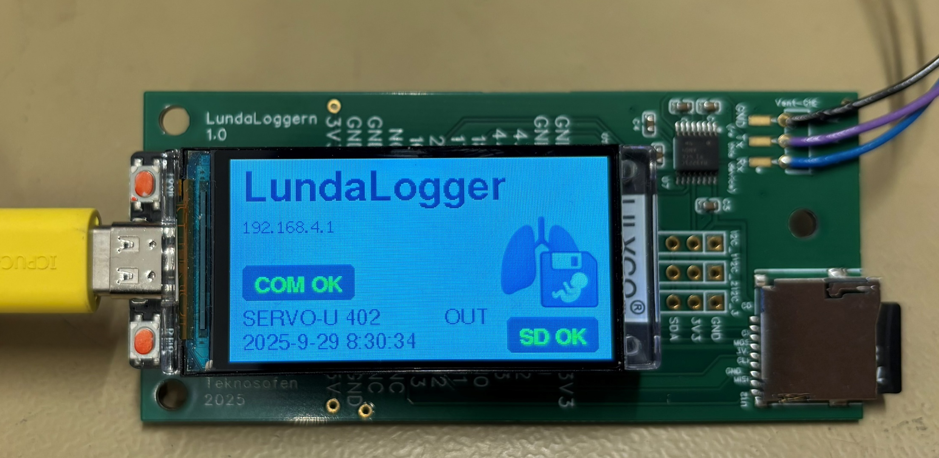
LundaLoggern

Slide 3
LundaLoggern

Slide 5
Layer 1 – Characteristics
Fast, independent control loops
Each controller operates independently
Handles non-linearities in sensors and actuators
Provides fast, stable control loops (100–1000 Hz)
No knowledge of breathing phases or ventilation modes
Responsibilities
Sensor scaling and compensation
Actuator linearization
Setpoint tracking with PID (or more advanced) control

Slide 6
Layer 2
Low-Level Controller (LLC)
Breathing Phase Control

Slide 7
LLC – Breathing Phase States
Two alternating states controlled by setpoints and triggers
Insufflation (Inspiration)
Delivers pressure/flow to patient
Controls gas via O₂ and Air flow controllers
Maintains target inspiratory pressure
Pressure limiting: reduces flow when pressure approaches limit
Exsufflation (Expiration)
Releases pressure/flow from patient
Controls expiratory valve for pressure release
Maintains PEEP (baseline pressure)

Slide 8
LLC – Parameters (Set by HLC)
All parameters written by HLC – no explicit commands
FiO₂ – Fraction of inspired oxygen (0.21 – 1.0)
Insufflation Pressure – Target during insufflation
Pressure Limit – Maximum allowed airway pressure
Exsufflation Pressure (PEEP) – Target during exsufflation
Insufflation Flow – Target flow rate during insufflation
Bias Flow – Continuous flow during exsufflation
Max Inspiratory Flow – Maximum allowed inspiratory flow
Flow Trigger Threshold – Detects patient effort (flow)
Pressure Trigger Threshold – Detects patient effort (pressure)

Slide 9
LLC – Transitions & Communication
Purely reactive controller – no explicit commands from HLC
State Transitions
Patient Effort Detection
Monitors flow & pressure vs trigger thresholds
Inspiratory effort → triggers insufflation
Expiratory effort → triggers exsufflation
Setpoint-Induced Transitions
HLC modifies setpoints → trigger criteria fulfilled
Example: HLC sets PEEP=100 cmH₂O → LLC shifts to exsufflation
Signals to HLC
State change events (insuff ↔ exsuff)
Measured tidal volume (integrated flow)
Pressure limit events

Slide 10
Layer 3
High-Level Controller (HLC)
Ventilation Mode Control

Slide 11
HLC – 8-State Sequential Machine
Two phases × four states per phase
Inspiration Sequence
1. Non-triggerable – Fixed inspiration, triggers ignored
2. Support – Patient can trigger pressure support
3. Synch – Patient-synchronized transition (default: 0)
4. Pause – Inspiratory hold for plateau measurement
Expiration Sequence
5. Non-triggerable – Fixed expiration, triggers ignored
6. Support – Patient can trigger expiratory support (rare)
7. Synch – Patient-synchronized transition (default: 0)
8. Pause – Expiratory hold for measurements

Slide 12
HLC – Inspiration States
States 1–4 of the ventilation cycle
1. Non-triggerable
Delivers mandatory breath
Patient triggers are ignored
Duration set by timing parameters
2. Support
Patient can trigger additional inspiratory support pressure
Allows patient to augment mechanical breath
3. Synch (Synchronization)
LLC exsufflation signal → HLC advances to Pause
Allows patient to terminate inspiration
4. Pause (Inspiratory Plateau)
Holds delivered volume – no gas added or released
Used for plateau pressure measurement

Slide 13
HLC – Expiration States
States 5–8 of the ventilation cycle
5. Non-triggerable
Ensures minimum expiration time
Patient triggers are ignored
6. Support
Patient can trigger expiratory support pressure
Rare in typical ventilation modes
7. Synch (Synchronization)
LLC insufflation signal → HLC advances to Pause
Allows patient to initiate next breath
8. Pause (Expiratory)
Maintains expiratory state
Used for breath holds or measurements

Slide 14
HLC – Transitions & Timing
State advances by time, zero-duration skip, or patient sync
Transition Logic
Time elapsed per configured duration
Zero-duration states → immediately skipped
Patient synchronization via LLC signals
Insp Synch: LLC exsuff → advance
Exp Synch: LLC insuff → advance
Timing Parameters
Respiratory Rate (RR) → cycle = 60/RR s
I:E Ratio → inspiration / expiration split
Inspiratory Pause Fraction → pause time
Active Insp. Time = Non-trig + Support + Synch
(Pause excluded from Vt calculations)

Slide 15
Tidal Volume Control
Breath-to-breath adaptive control with pressure safety
Initial Flow Calculation
Insufflation Flow = Vt / Active Inspiration Time
Active Insp. Time = Time(Non-trig) + Time(Support) + Time(Synch)
Breath-to-Breath Adaptation
At each inspi→expi transition:
Measure actual Vt_measured
Calculate ΔVt = Vt_target − Vt_measured
Gradually adjust insufflation flow setpoint
Prevents oscillations, compensates for compliance changes
Pressure-Limited Volume Control
LLC pressure controllers auto-reduce flow near Pressure Limit
Vt_measured < Vt_target → volume sacrificed for safety
Two modes: Volume-controlled / Pressure-limited volume-controlled

Slide 16
Pressure Support Mechanism
Rewarding patient effort through pressure boosts
Inspiration Support State
When patient trigger detected during Insp Support state:
LLC Insuff Pressure = Inspiratory Pressure + Insp Support Pressure
Provides additional pressure boost rewarding inspiratory effort
Common in PSV (Pressure Support Ventilation) modes
Expiration Support State
When patient trigger detected during Exp Support state:
LLC Insuff Pressure = PEEP + Exp Support Pressure
Less common – available for specific clinical scenarios

Slide 17
Inspiratory Pause Implementation
Elegant setpoint manipulation – no special pause logic in LLC
Purpose
Hold delivered volume for plateau pressure measurement
Assess static lung compliance
Equilibrate airway and alveolar pressures
Mechanism (setpoint manipulation)
Bias Flow → 0 (no gas added by insufflation controllers)
PEEP setpoint → 100 cmH₂O (forces LLC into exsufflation mode)
Actual pressure ≪ 100 → expiratory valve stays closed
Result: system is mechanically "locked"
No gas flows in, no gas escapes
Volume held constant

Slide 18
HLC – Indirect Control Philosophy
No explicit commands – only setpoint manipulation
HLC controls LLC by:
Setting insufflation pressure based on state & triggers
Setting pressure limit for safety
Setting insufflation flow (Vt, timing, adaptation)
Adjusting bias flow & PEEP for pause phases
Adjusting trigger thresholds per HLC state
State-Dependent Setpoints (key states)
Insp Non-trig: Insp Pressure | Normal PEEP | Normal Bias
Insp Support (triggered): Insp Press + Support | Normal PEEP
Insp Pause: N/A | PEEP=100 cmH₂O | Bias=0
Exp states: N/A or PEEP+Support | Normal PEEP | Normal Bias

Slide 19
Communication Between Layers
Clean interfaces with minimal coupling
HLC → LLC (Setpoints)
Pressure setpoints (insp, PEEP, limit)
Flow setpoints (insufflation, bias, max insp)
Trigger thresholds (flow & pressure)
LLC → HLC (Signals)
State change events (insufflation ↔ exsufflation)
Measured tidal volume (integrated flow)
Pressure limit events
LLC → Layer 1 (Setpoints)
Individual flow controller setpoints
Expiratory valve pressure setpoint

Slide 20
Example Ventilation Modes
Various clinical modes via timing & parameter configuration
Volume Control (VC)
Insp Non-trig delivers full breath
Support & Synch skipped (time=0)
Time-triggered, volume-cycled
Assist Control (AC)
Backup mandatory breath timing
Exp Synch active → patient triggering
Full support on every breath
Pressure Support (PSV)
Insp Support active with pressure
Insp & Exp Synch active
Fully patient-triggered & cycled
SIMV
Mandatory (Non-trig) + Supported breaths
Synch states coordinate with patient
Combines mandatory & spontaneous

Slide 21
Safety & Design Advantages
Safety Considerations
Pressure limiting always active (barotrauma prevention)
Non-trig states ensure minimum ventilation
Gradual adaptation prevents sudden volume changes
Setpoint sanity checks in HLC
Watchdog timers per state
Design Advantages
Modularity – clear layer responsibilities
No direct commands – reduced coupling
Extensibility – new modes via config only
Patient synchronization built-in
Breath-to-breath adaptability

Slide 22
Implementation Notes
Practical considerations for system design
Execution Rates
Layer 1 PID loops: 100 – 1000 Hz
LLC: event-driven architecture
HLC: fixed time base (10 – 50 Hz)
Parameter Updates
Validate all parameter changes before applying
Rate-limit parameter changes to prevent instability
Log all setpoint changes for debugging & clinical review
Testing Strategy
Test each layer independently first
Verify LLC response to setpoint changes
Verify HLC state sequences for all modes
Patient simulator testing with varying compliance/resistance

