Slide 1
Predictive Modeling for Solar Energy Production in Europe
Team Members:
Siri Chandana Errabelli (se2596)
Sai Akhil Tekuri (st5050)
Sai Aravind Yanamadala (sy3902)
CS-GY 6513

Slide 2
PROBLEM STATEMENT
Leveraging historic weather data, solar irradiance data and solar energy data to predict the solar energy generation in real-time
Goals
Use PySpark to pre-process the historic data, extract features and build an ML model using spark ML.
Use Kafka to get real time features using Weather API call and predict the solar energy predictions
Visualize data in dashboard using Tableau

Slide 3
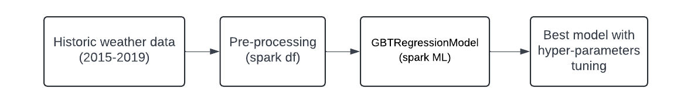
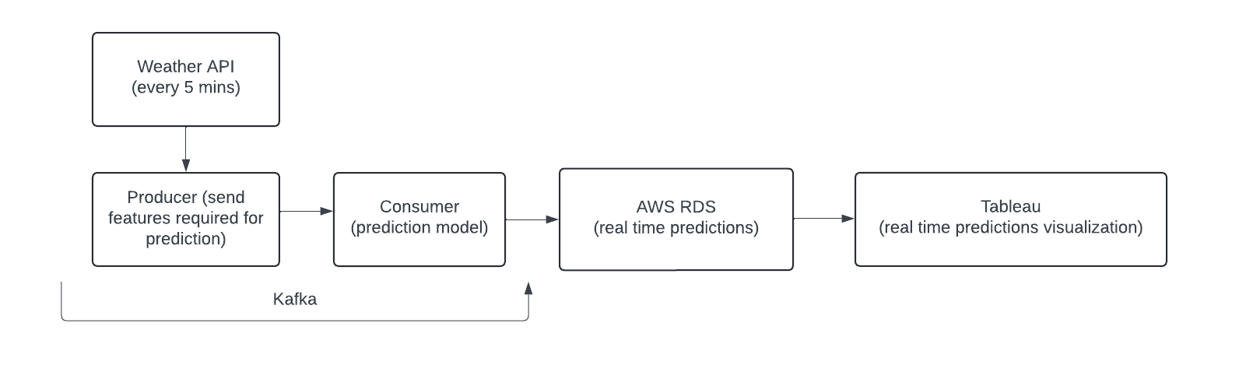
Birds Eye View
ML model using historical data:
Real time predictions:

Slide 4







Data Sources & Technologies Used
Open Power System Data
AWS RDS

Slide 5
Machine Learning
using historical data
Load datasets
Pre-Processing
Model training
Save the Best model
Weather data
Solar energy output
Loaded from parquet
Data cleaning
Joined two data sources on timestamp and extracted relevant features
Feature normalization
Saved to parquet file
Split dataset into train and test sets
Use GBTRegressor
Hyper parameters tuning on #trees and max_depth
#trees = 150
max_depth = 15
RMSE on test data: 0.236

Slide 6
Real time predictions
Real time data
Producer
Kafka
Consumer
Kafka
Real time visualization
OpenWeatherMap API
Weather and Solar Irradiance data
Every 5 mins
Get weather data from API call
Send only required features for prediction along with timestamp
Receives features and predicts the solar energy output using the ML model
Stored the solar energy output along with timestamp in AWS RDS
Connect live to AWS RDS and shows the time series of real-time solar energy output predictions

Slide 7
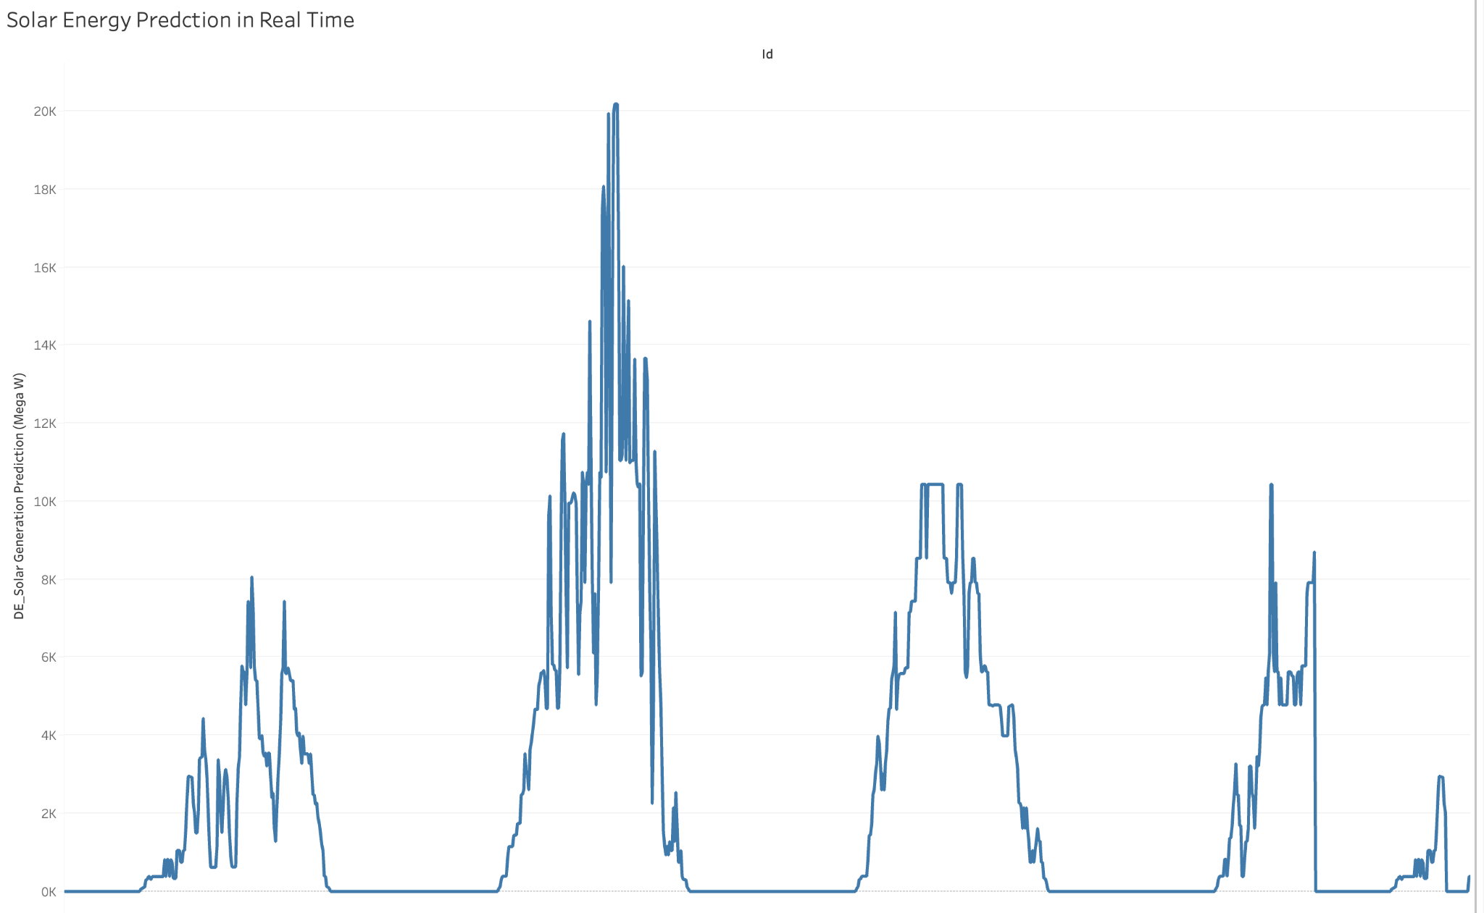
RESULTS

Slide 8
THANK YOU

