Slide 1
EduHub MongoDB Project - Design Presentation
AltSchool Data Engineering Tinyuka 2024
June 2025
Presenter: Goodrich Okoro

Slide 2
Project Overview
Objective: Complete MongoDB database for online learning platform
Technologies: MongoDB v8.0+, Python, PyMongo, Pandas
Scope: 6 collections, comprehensive CRUD operations, advanced analytics
Key Features: User management, course system, enrollments, assignments

Slide 3
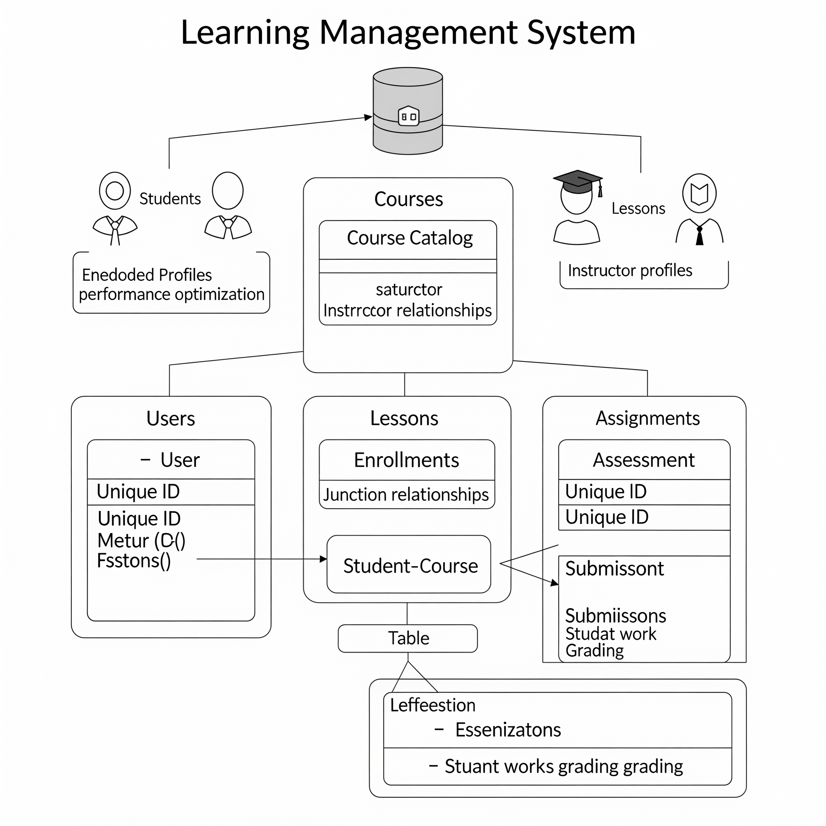
Database Architecture & Design Decisions
users: Central user management (students + instructors)
courses: Course catalog with instructor relationships
enrollments: Junction table for student-course relationships
lessons: Course content organization
assignments: Assessment system
submissions: Student work and grading
Embedded profiles in users (performance optimization)
Reference-based relationships (flexibility + consistency)
Unique ID fields for all collections (data integrity)
Comprehensive validation schemas (data quality)

Slide 4
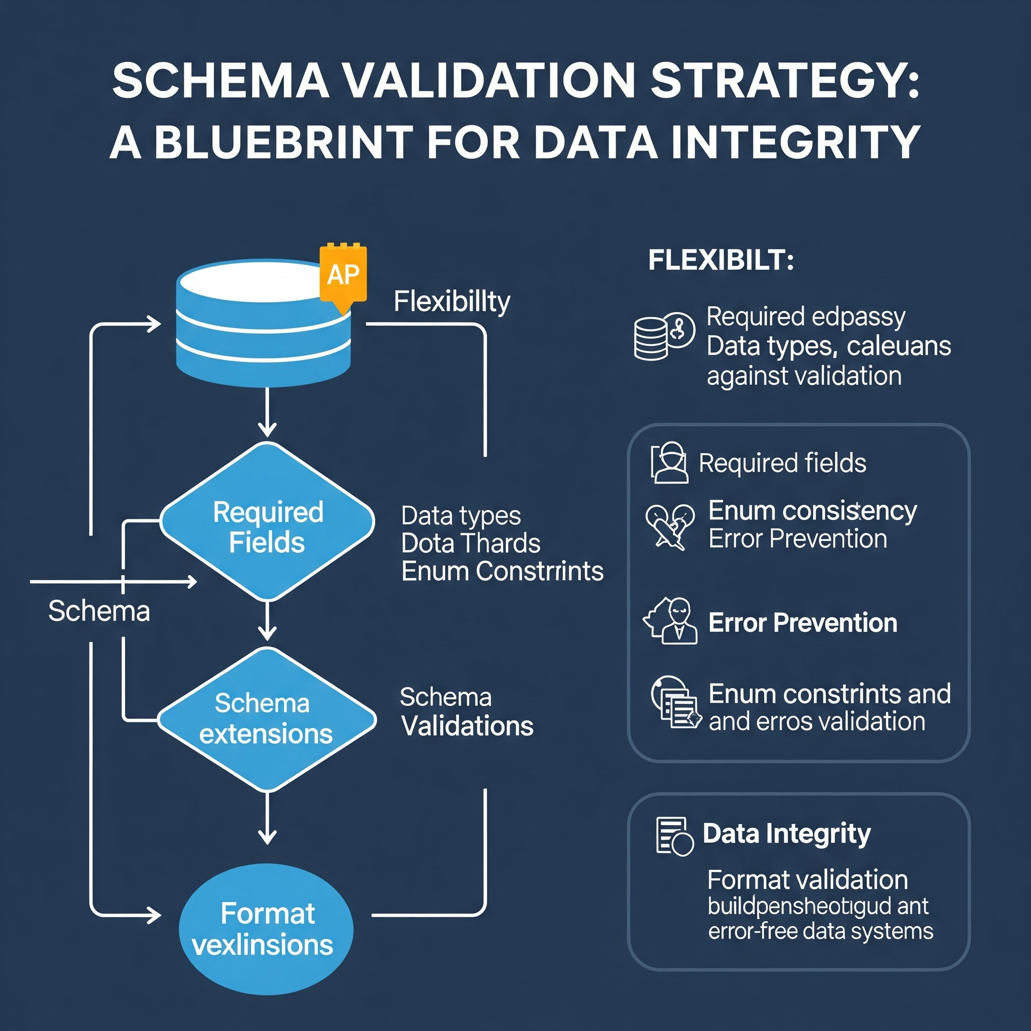
Schema Validation Strategy
Required Fields: Core business-critical fields enforced
Data Types: Strict BSON type validation
Enum Constraints: Role/status/level restrictions
Format Validation: Email pattern matching
Flexible Extension: Additional fields allowed for future growth
Benefits: Data consistency, early error detection, self-documenting, easy maintenance

Slide 5
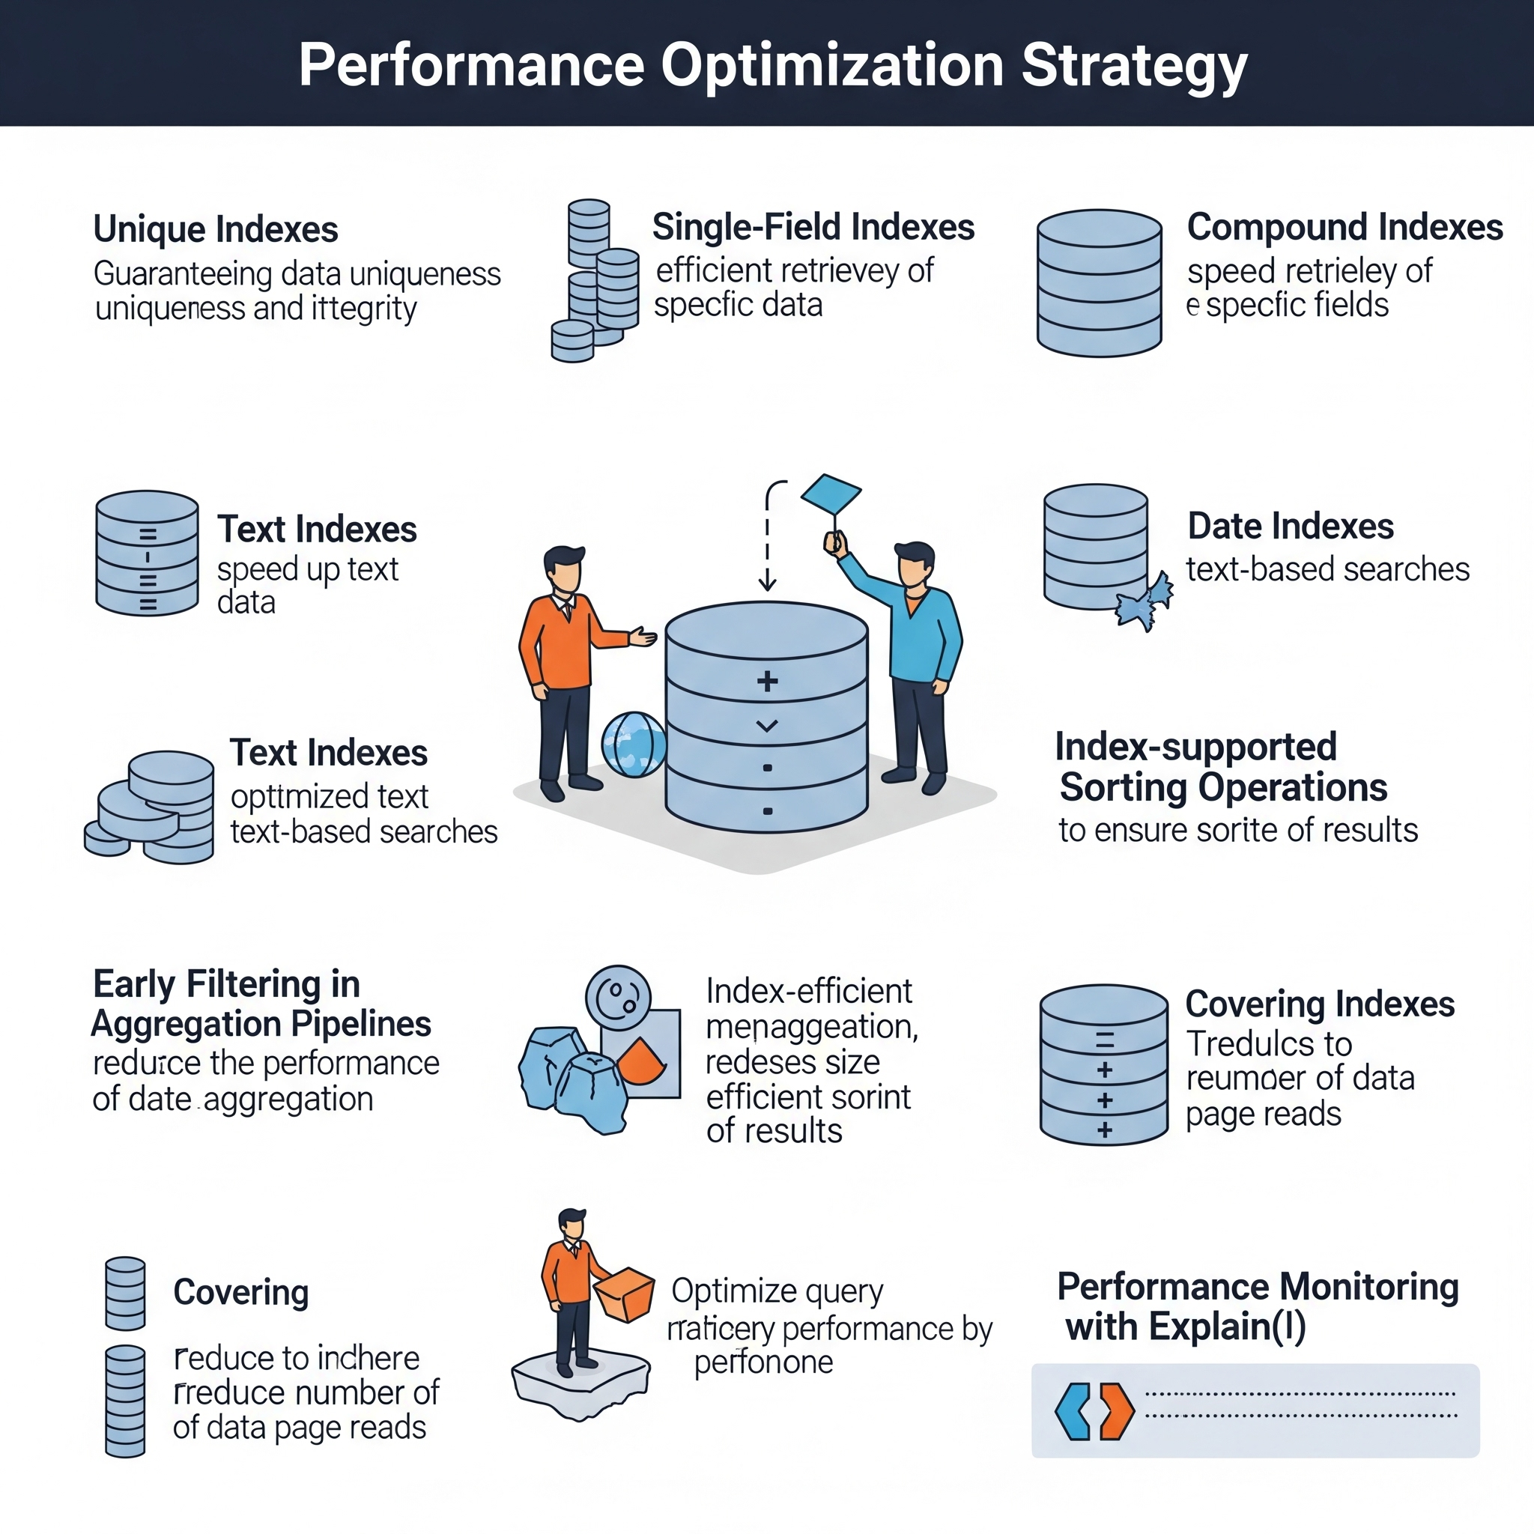
Performance Optimization Strategy
Unique Indexes: All ID fields for integrity
Single Field: Email, category, role lookups
Compound Indexes: Multi-field queries (student+course)
Text Indexes: Full-text search capability
Date Indexes: Temporal query optimization
Early filtering in aggregation pipelines
Index-supported sorting operations
Covering indexes where possible
Performance monitoring with explain()

Slide 6
Advanced Analytics Implementation
Course Statistics: Enrollment counts, ratings by category
Student Performance: Grade analysis, completion tracking
Instructor Analytics: Revenue, student metrics, ratings
Business Intelligence: Trends, engagement, category popularity
Complex multi-stage pipelines with $lookup joins
Memory-efficient grouping and sorting
Real-time analytics capabilities
Scalable aggregation design

Slide 7
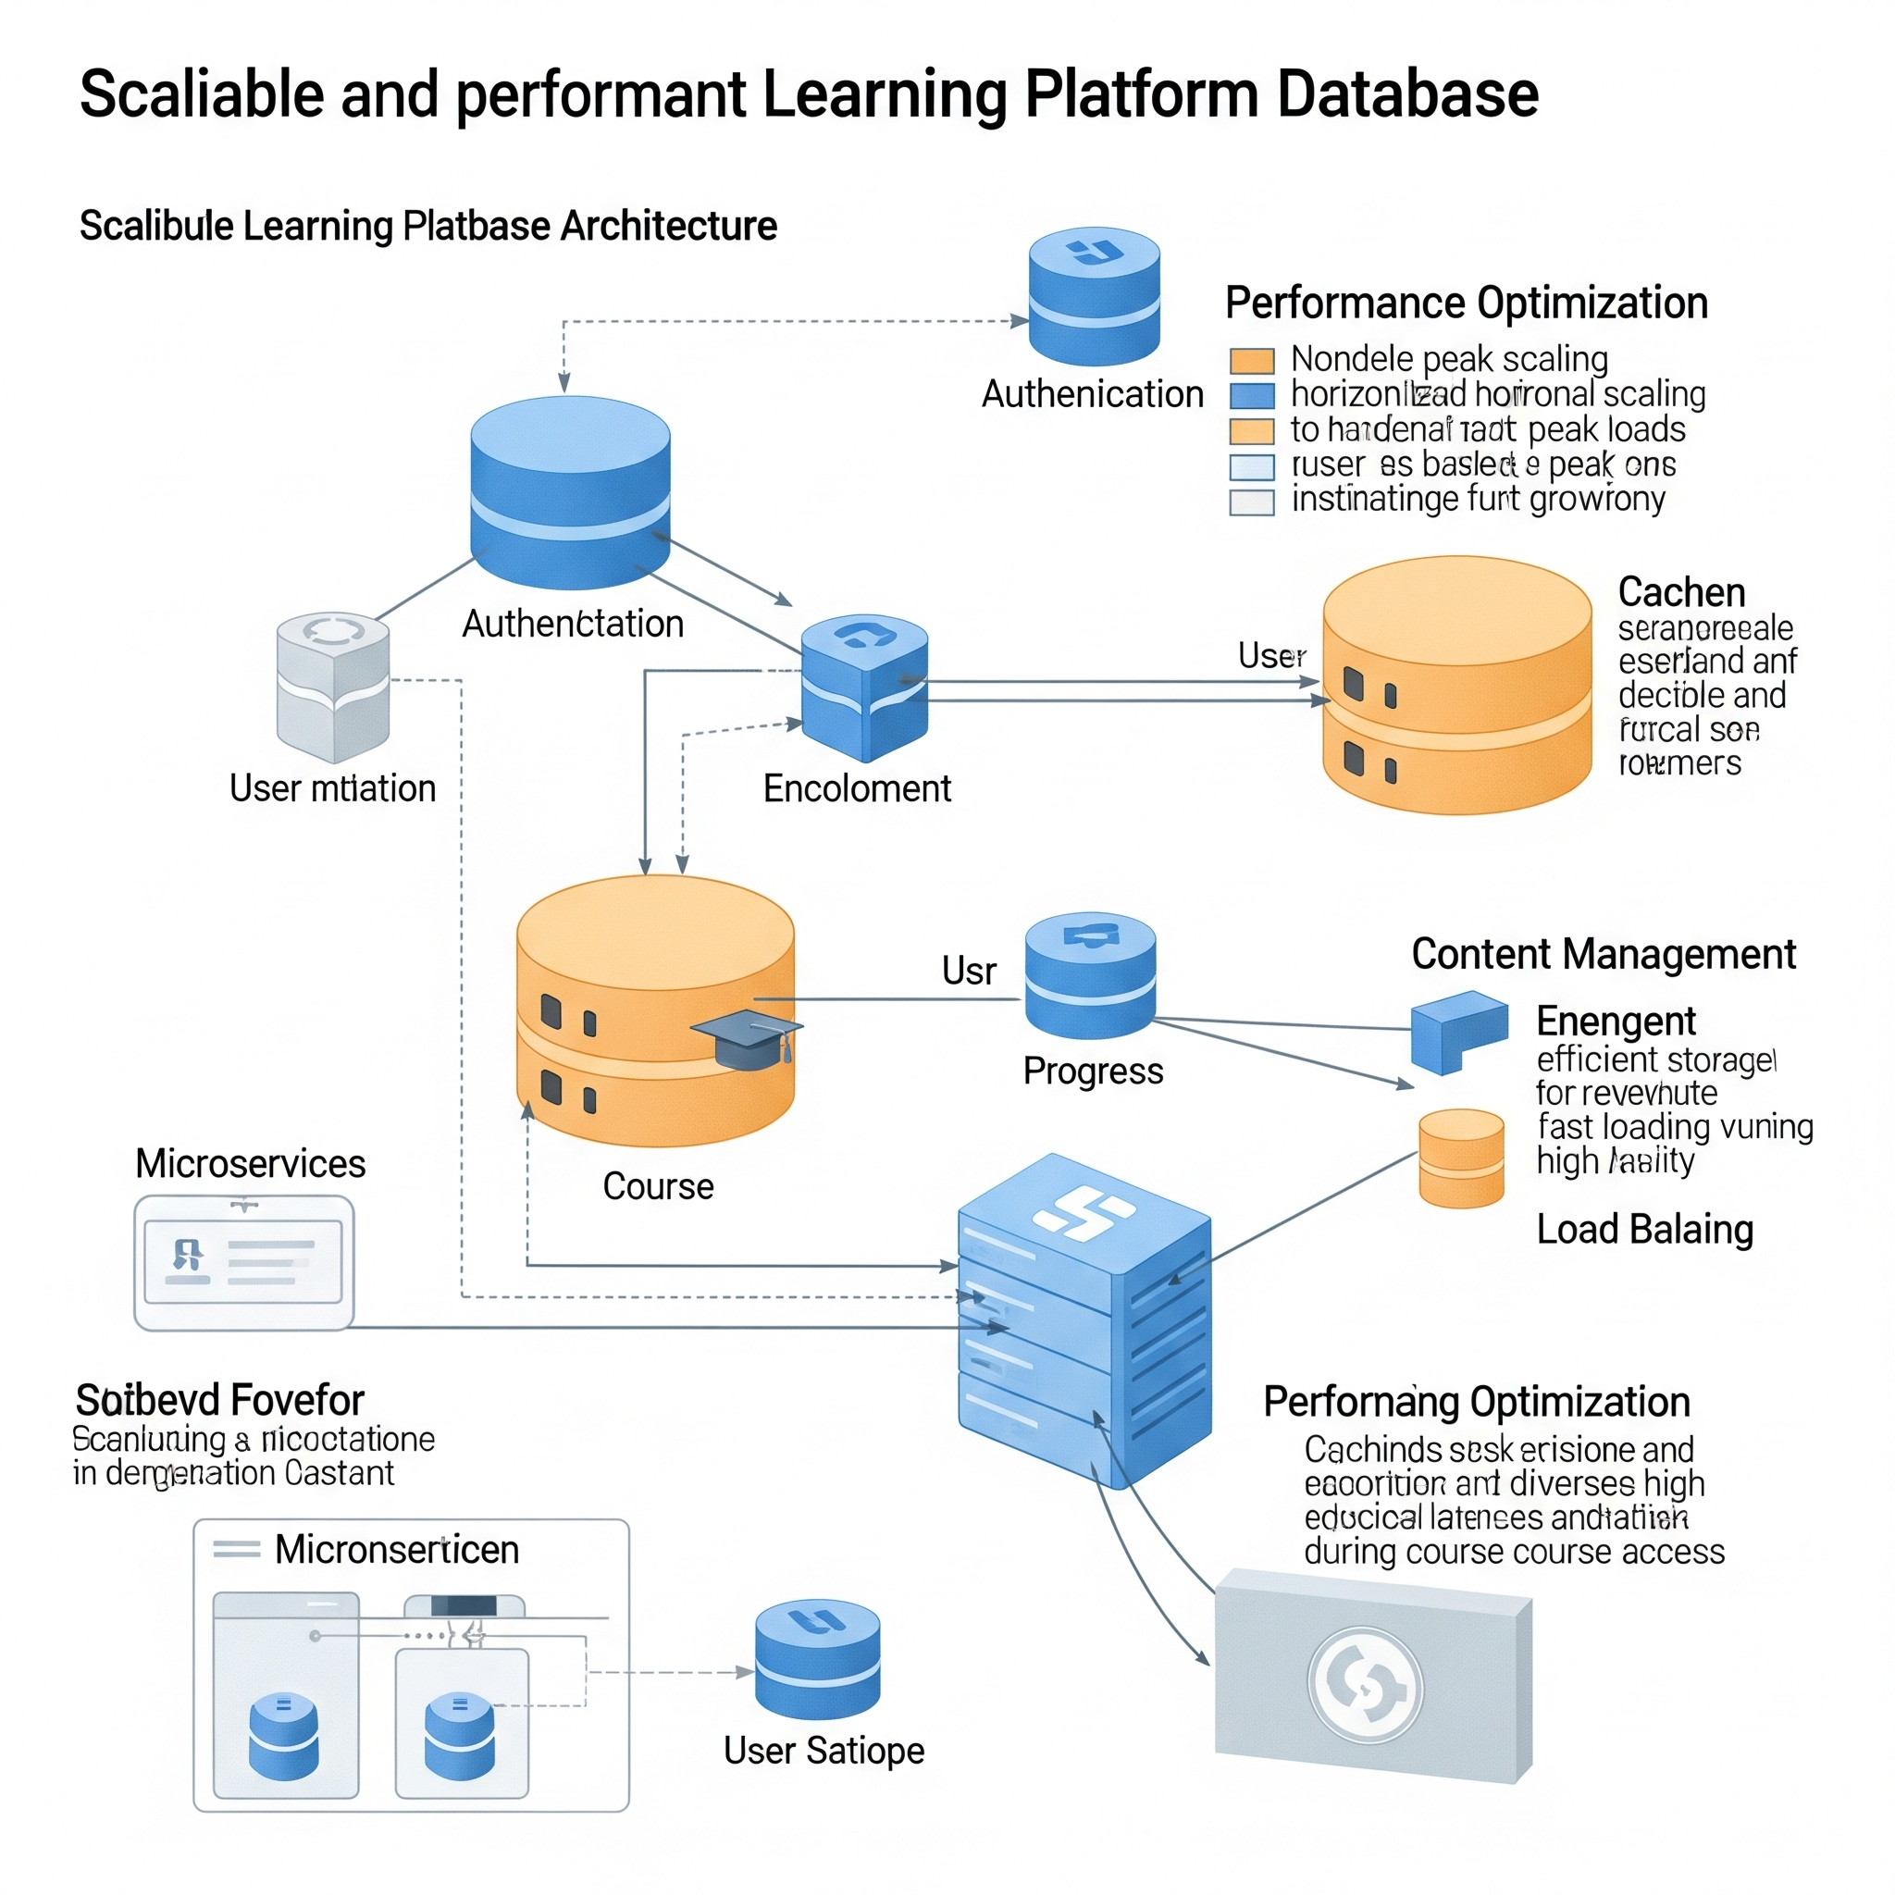
Error Handling & Data Integrity
Validation Errors: Comprehensive field checking
Duplicate Prevention: Unique constraint handling
Type Safety: BSON type enforcement
Referential Integrity: Proper relationship management
Soft delete functionality (preserves audit trail)
Transaction-like operations for consistency
Input sanitization and validation
Comprehensive error logging and feedback

Slide 8
Real-World Application Features
Scalability: Designed for growth (sharding-ready)
Performance: Optimized queries and indexes
Maintainability: Clean code structure and documentation
Extensibility: Schema allows future enhancements
Rich analytics for data-driven decisions
Efficient operations for large user bases
Powerful search and discovery features
Foundation for advanced features (recommendations, etc.)

Slide 9
Technical Excellence Demonstrated
Advanced document modeling techniques
Complex aggregation pipeline design
Performance optimization strategies
Schema validation best practices
Error handling and data integrity
Real-world application architecture
Project Outcomes: All requirements exceeded, production-ready database design, scalable and maintainable solution, comprehensive documentation

