Slide 1
Federated QoS-Risk Learning for
Heterogeneous Indoor-Outdoor Access Selection
Nguyen Van Thieu, Ti Ti Nguyen, Ons Aouedi, Zerihun Huruy, Vu Nguyen Ha, and Symeon Chatzinotas.
Interdisciplinary Centre for Security, Reliability and Trust (SnT), University of Luxembourg, Luxembourg
    {vanthieu.nguyen, titi.nguyen, ons.aouedi, huruy.zerihun, vu-nguyen.ha, symeon.chatzinotas}@uni.lu
September 04th 2026

Slide 2
Outline
1
2
3
4
5
6
Motivation
Related work & gap
FedQoS solution
Experiments
Results
Conclusion

Slide 3
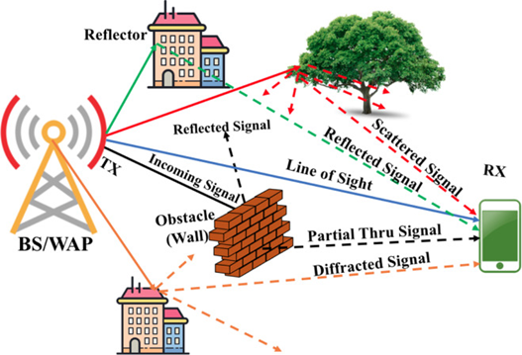
Motivation
1. Why Access Selection Matters in Indoor-Outdoor Networks
Users continuously move across rooms, corridors, entrances, outdoor walkways, and crowded areas.
Candidate serving nodes are heterogeneous: indoor APs, terrestrial BSs, and UAV-mounted access nodes.
The selected access node directly affects:
  throughput,
  reliability / BLER,
  load balancing,
  handover behavior,
  and ultimately user QoS.
Therefore, access selection is not simply a question of which node has the strongest signal now.
The important
The real objective is to keep the user’s service requirement satisfied after the access decision.
Notes:
BLER: Block Error Rate

Slide 4
Motivation
2. Why Is Indoor-Outdoor Access Selection Difficult?
Radio heterogeneity
Traffic heterogeneity
Walls and floor transitions
NLoS / blockage
Different AP / BS / UAV coverage
Different user densities
Dynamic PRB utilization
Temporary congestion and events
Mobility
Service heterogeneity
Indoor ⬅ ➔ outdoor transitions
Candidate set changes over time
Handover and ping-pong risk
Users have different rate requirements
The same link quality may be sufficient for one user but insufficient for another
Takeaway
The best candidate is determined by a combination of radio quality, load, mobility, service demand, and handover context - not by a single instantaneous metric.
Notes:
PRB: Physical Resource Block (Khối tài nguyên vật lý)
Dynamic PRB utilization có nghĩa là Mức độ sử dụng khối tài nguyên vật lý động.
NLoS: Non-Line-of-Sight

Slide 5
Related work
3. How is Access Selection Solved?
Signal-based association
RSRP / SINR / biased received power [1]
+ Simple, fast, and interpretable
− Does not capture whether the link will satisfy future service requirements
Load / QoS-aware optimization
Jointly models achievable rate, load, resources, or delay [2]
+ Explicit system objective and QoS constraints
− Requires an analytical association model/objective
− Does not learn candidate-wise future failure risk from distributed network logs
DRL-based association
Learns the access action directly from state and reward [3]
+ Suitable for nonlinear and sequential control
− Strongly dependent on reward design
− Action policy is less directly interpretable than candidate-wise QoS risk
Federated wireless control
Trains policies/models without pooling raw data
+ Matches distributed wireless data
− Existing work [4] mainly targets control/policy learning rather than supervised future QoS-risk prediction at access nodes
[1] Y. Kim, J. Jang, and H. J. Yang, “Distributed resource allocation and user association for max-min fairness in hetnets,” IEEE TVT, 2023.
[2] T. Zhou, Y. Huang, W. Huang, S. Li, Y. Sun, and L. Yang, “Qos-aware user association for load balancing in heterogeneous cellular networks,” IEEE VTC, 2014.
[3] N. Zhao, Y.-C. Liang, D. Niyato, Y. Pei, M. Wu, and Y. Jiang, “Deep reinforcement learning for user association and resource allocation in heterogeneous cellular networks,” IEEE TWC, 2019.
[4] P. Tehrani, F. Restuccia, and M. Levorato, “Federated deep reinforcement learning for the distributed control of NextG wireless networks,” IEEE DySPAN, 2021.
Notes:
Federated DRL / FL control: Primarily learns policies/control; does not explicitly address access-node-side supervised future QoS-risk learning under heterogeneous local logs.
Load/QoS-aware optimization: Requires an explicit analytical objective/model; does not learn candidate-specific future QoS-failure probability from distributed logs
Conventional QoS-aware methods specify how QoS metrics affect association; FedQoS learns from data which candidate is likely to violate QoS in the future.

Slide 6
Related work
4. Research Gap
Existing methods provide either:
Explicit association optimization
Direct learned control
➔ What is less explored is:
Network model
Optimize association
State
Action
Distributed network logs
Future candidate-wise QoS risk
Explicit access decision
Note
Future QoS outcomes are not explicitly predicted for each candidate.
AP/BS/UAV observations are naturally heterogeneous and non-IID.
The learning and handover-control layers are often tightly coupled.
We seek an interpretable, federated, candidate-wise risk model that can be reused by an explicit access controller.
Notes:
Federated DRL / FL control: Primarily learns policies/control; does not explicitly address access-node-side supervised future QoS-risk learning under heterogeneous local logs.
Load/QoS-aware optimization: Requires an explicit analytical objective/model; does not learn candidate-specific future QoS-failure probability from distributed logs.
Future candidate-wise QoS risk: Dự đoán trước rủi ro về chất lượng dịch vụ (QoS risk) cho từng trạm ứng cử viên trong tương lai trước khi thiết bị đưa ra quyết định truy cập hoặc handover

Slide 7
Proposed FedQoS solution
5. FedQoS: Predict Risk First, Then Select Access
Local network logs
Federated QoS-risk learning
Candidate-wise failure probabilities
Handover-aware controller
Selected access node
Each AP / BS / UAV acts as a federated client.
Each client learns from local user-candidate observations.
FedQoS predicts failure probabilities.
QoS-aware aggregation emphasizes both:
  statistically important large clients;
  failure-rich clients.
The access controller then combines predicted risk with explicit handover cost.
Key design principle
Learning estimates future reliability; control converts reliability into an action.

Slide 8
Proposed FedQoS solution
6. FedQoS: Contributions
Federated QoS-Risk Prediction
  Predict QoS-failure probability for each candidate link
  Learn a shared model from local access-node logs
Handover-Aware Access Selection
  Use predicted QoS risk as decision input
  Consider current association and handover cost
  Select the access node with the best expected service quality
Contributions:
  Formulate access selection as a two-stage prediction–decision problem
  Develop federated QoS-risk learning across heterogeneous access nodes
  Design a handover-aware policy using predicted risk
  Build a Sionna-based indoor–outdoor evaluation pipeline
  Evaluate both prediction accuracy and system-level access performance

Slide 9
Proposed FedQoS solution
7. FedQoS: System Design

Slide 10

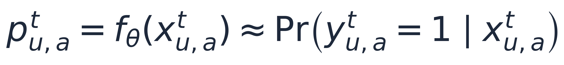
Proposed FedQoS solution
8. FedQoS: Features and Labels
Feature groups
The supervised target is defined over a prediction window, not a single SINR value
User context: zone, floor, mobility state
Node attributes: AP/BS/UAV type, carrier, power, antenna, height
Link measurements: RSRP, RSSI, SINR, CQI, BLER, rate indicators
Load: active users, PRB utilization
Service demand and handover history
Label is 1 if the future average throughput falls below the service demand or BLER exceeds the maximum tolerable value.
The predictor outputs a probability of failure for each user-candidate link.
This keeps the decision interpretable: lower predicted risk means a more reliable candidate.
Notes:
RSRP (Reference Signal Received Power): Công suất thu tín hiệu tham chiếu, đo cường độ tín hiệu sóng từ trạm phát.
RSSI (Received Signal Strength Indicator): Tổng cường độ tín hiệu thu được, bao gồm cả tín hiệu hữu ích, nhiễu và tạp âm trên băng tần.
SINR (Signal-to-Interference-plus-Noise Ratio): Tỷ lệ tín hiệu trên nhiễu cộng tạp âm, phản ánh chất lượng thực tế của đường truyền.
CQI (Channel Quality Indicator): Chỉ báo chất lượng kênh truyền do thiết bị đầu cuối (UE) gửi về trạm gốc để hỗ trợ việc lựa chọn sơ đồ điều chế và mã hóa (MCS).
BLER (Block Error Rate): Tỷ lệ lỗi khối, đo tỷ lệ các khối dữ liệu truyền bị lỗi.
Rate indicators: Các chỉ báo về tốc độ truyền dữ liệu.

Slide 11
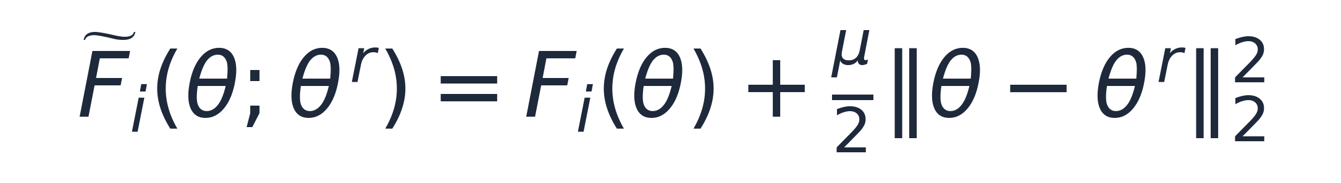
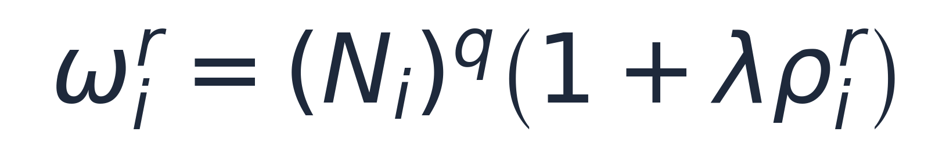
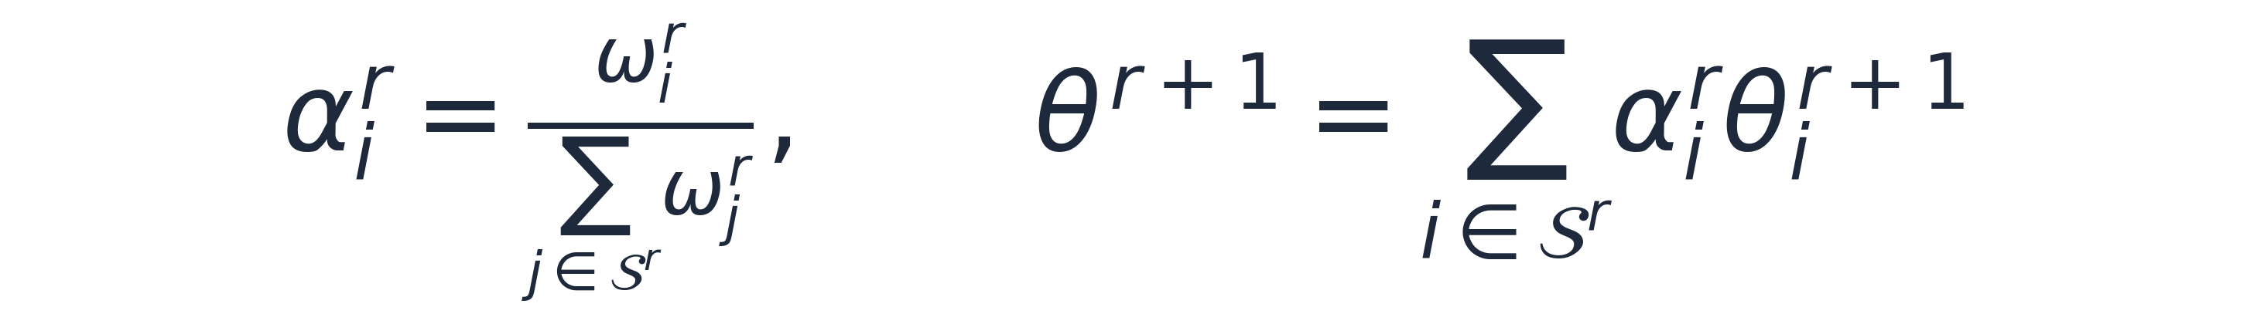
Proposed FedQoS solution
9. FedQoS: Learning Rule
Local update
Training stabilization
A proximal local objective reduces drift under heterogeneous client data.
Role of q
Aggregation
Controls how strongly large local datasets dominate aggregation.
Role of λ
Increases the contribution of clients that observe more QoS failures.
Why it helps
Rare failure-rich clients are not ignored, while larger datasets still provide statistical reliability.

Slide 12
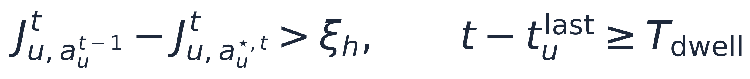
Proposed FedQoS solution
10. FedQoS: Handover-aware access selection
The controller converts risk scores into a serving-node decision
Score = predicted QoS-failure risk + handover penalty.
The selected candidate minimizes the score over the candidate set.
Hysteresis and dwell time avoid ping-pong handovers.
Design focus
Reliability first: avoid future QoS violations, not chase peak instantaneous rate.
Notes:
J is risk score, smaller is better.
T^last is most recent handover time of user u

Slide 13
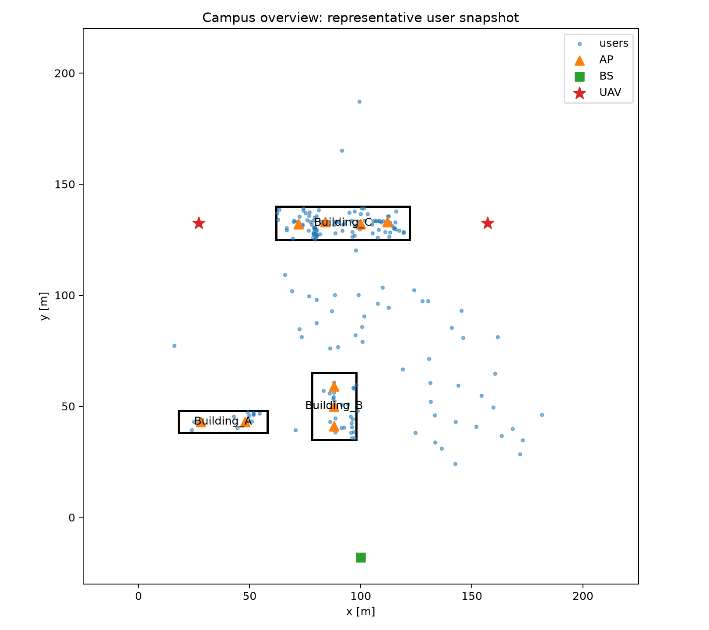
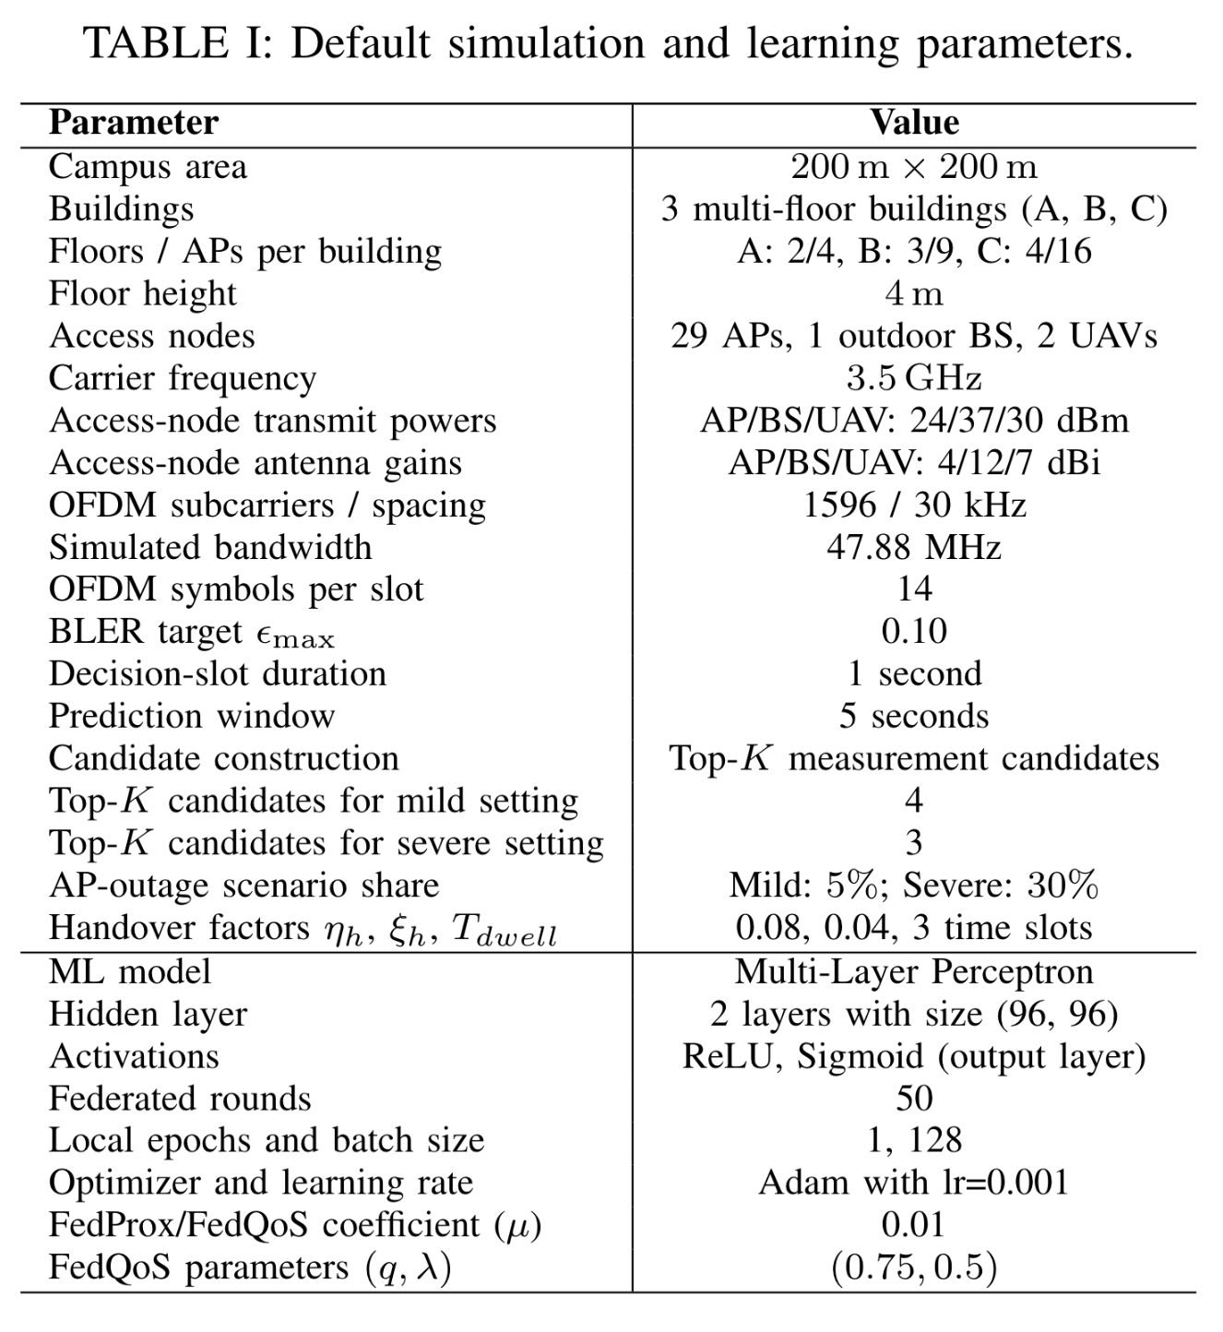
Experiment
11. Experimental Setup: Sionna-based campus datasets

Slide 14
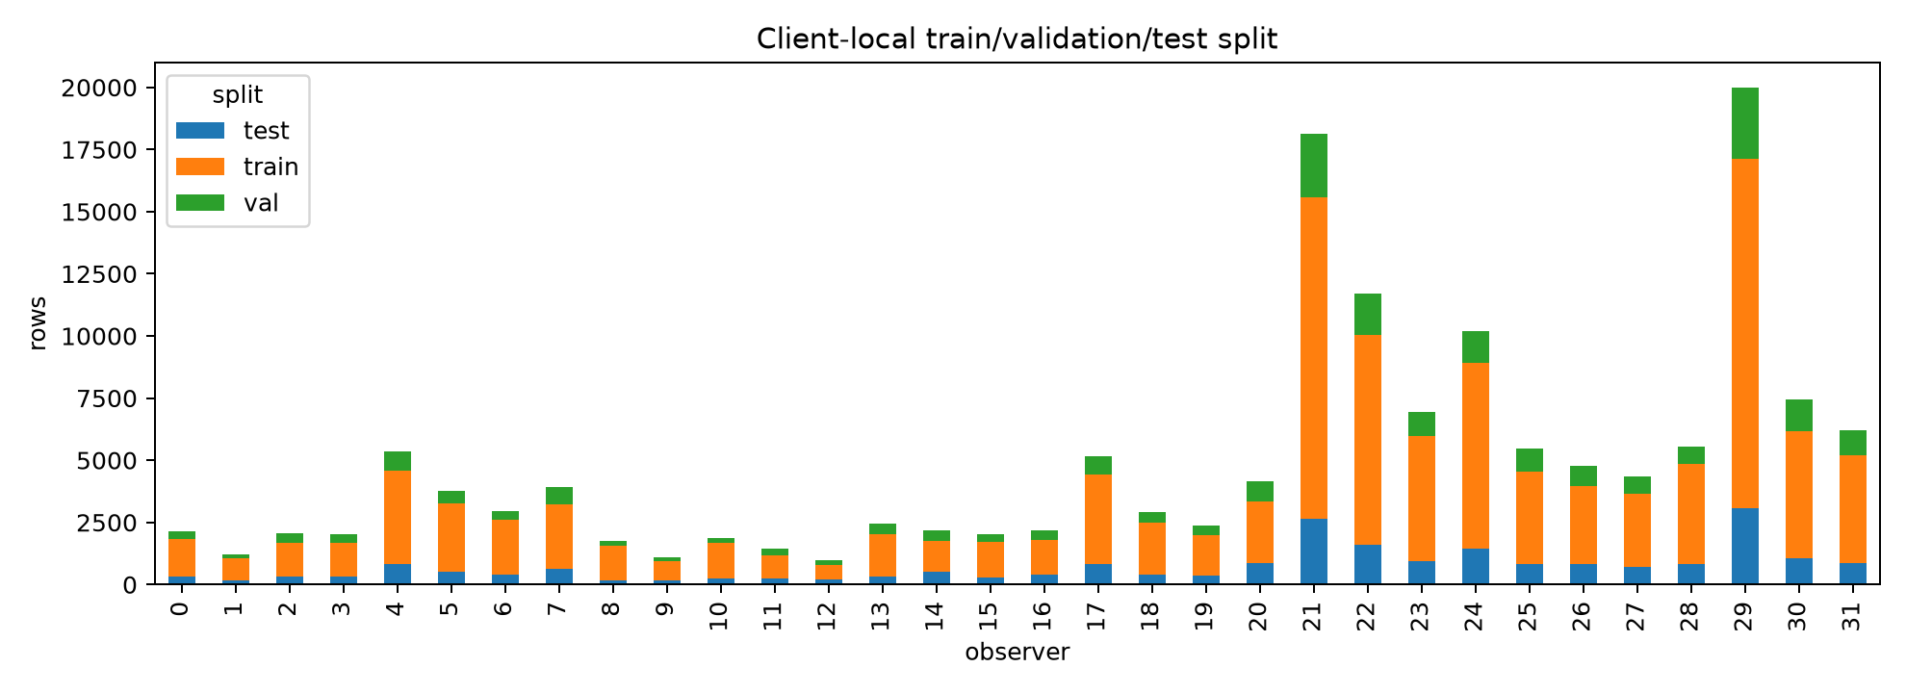
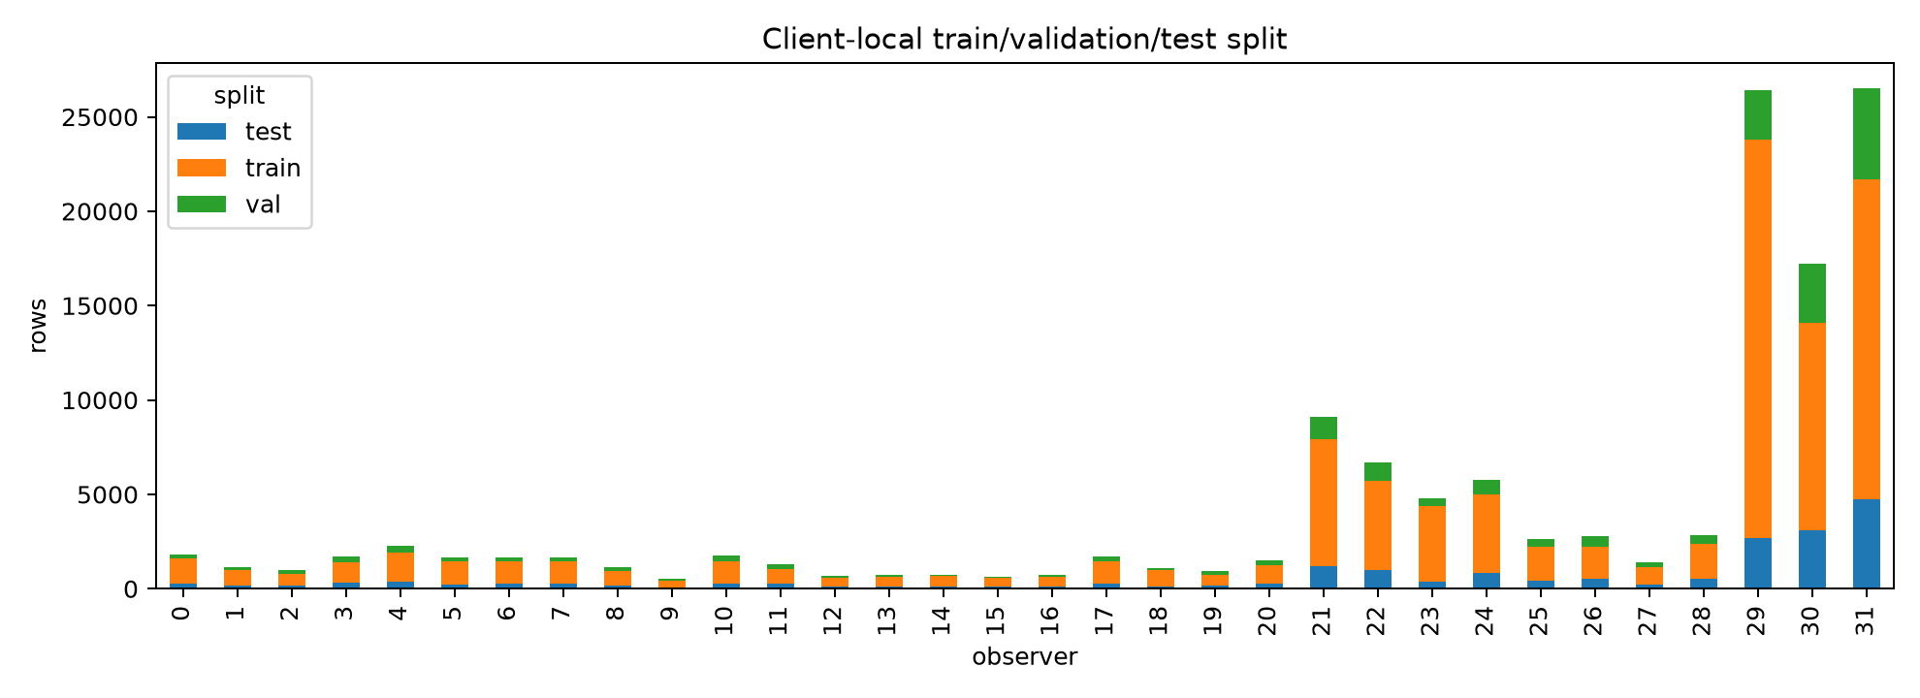
Experiment
12. Scenarios, baselines, and metrics
Two operating conditions using Sionna RT and Sionna SYS to generate network logs
Mild non-IID
Mostly normal/class-transition traffic;
service rates 1/5/10 Mbps;
rare AP outages;
Top-K candidate : 4
Severe non-IID
Higher service rates 2/8/15 Mbps;
more event/stress/outage traffic;
Top-K candidate: 3
stronger room skew and reduced candidate sets.

Slide 15
Experiment
12. Scenarios, baselines, and metrics
Learning baselines
Heuristic policies
Centralized: upper learning reference
Local-only: no model aggregation
FedAvg: sample-size weighted FL
FedProx: proximal regularization
FedQoS: Our proposed
Current serving
Strongest SINR
Load-aware RSRP
AP-first
Historical QoS
Oracle: future-outcome reference
Reported metrics
Prediction: BAcc, Recall, F1
Policy: Failure rate, BLER
Throughput for data-rate context

Slide 16
Experiment
13. Before results: what should improve?
Prediction
Policy
Robustness
Can FedQoS detect future failures better than local training and standard FL?
Do predicted risks reduce actual QoS failures and BLER after access selection?
Does performance depend on a narrowly tuned q and λ?

Slide 17
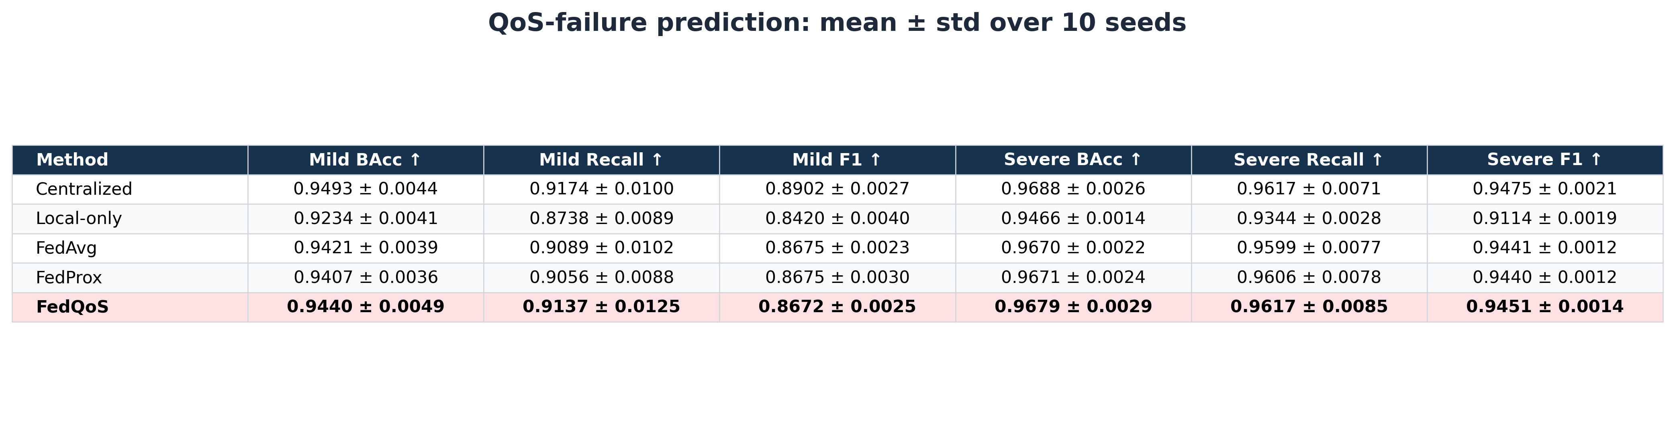
Results
14. Prediction results
Interpretation
High recall matters because missed QoS failures can directly cause unreliable access decisions.
Key observation
FedQoS is strongest on failure-oriented prediction, especially under severe non-IID.

Slide 18
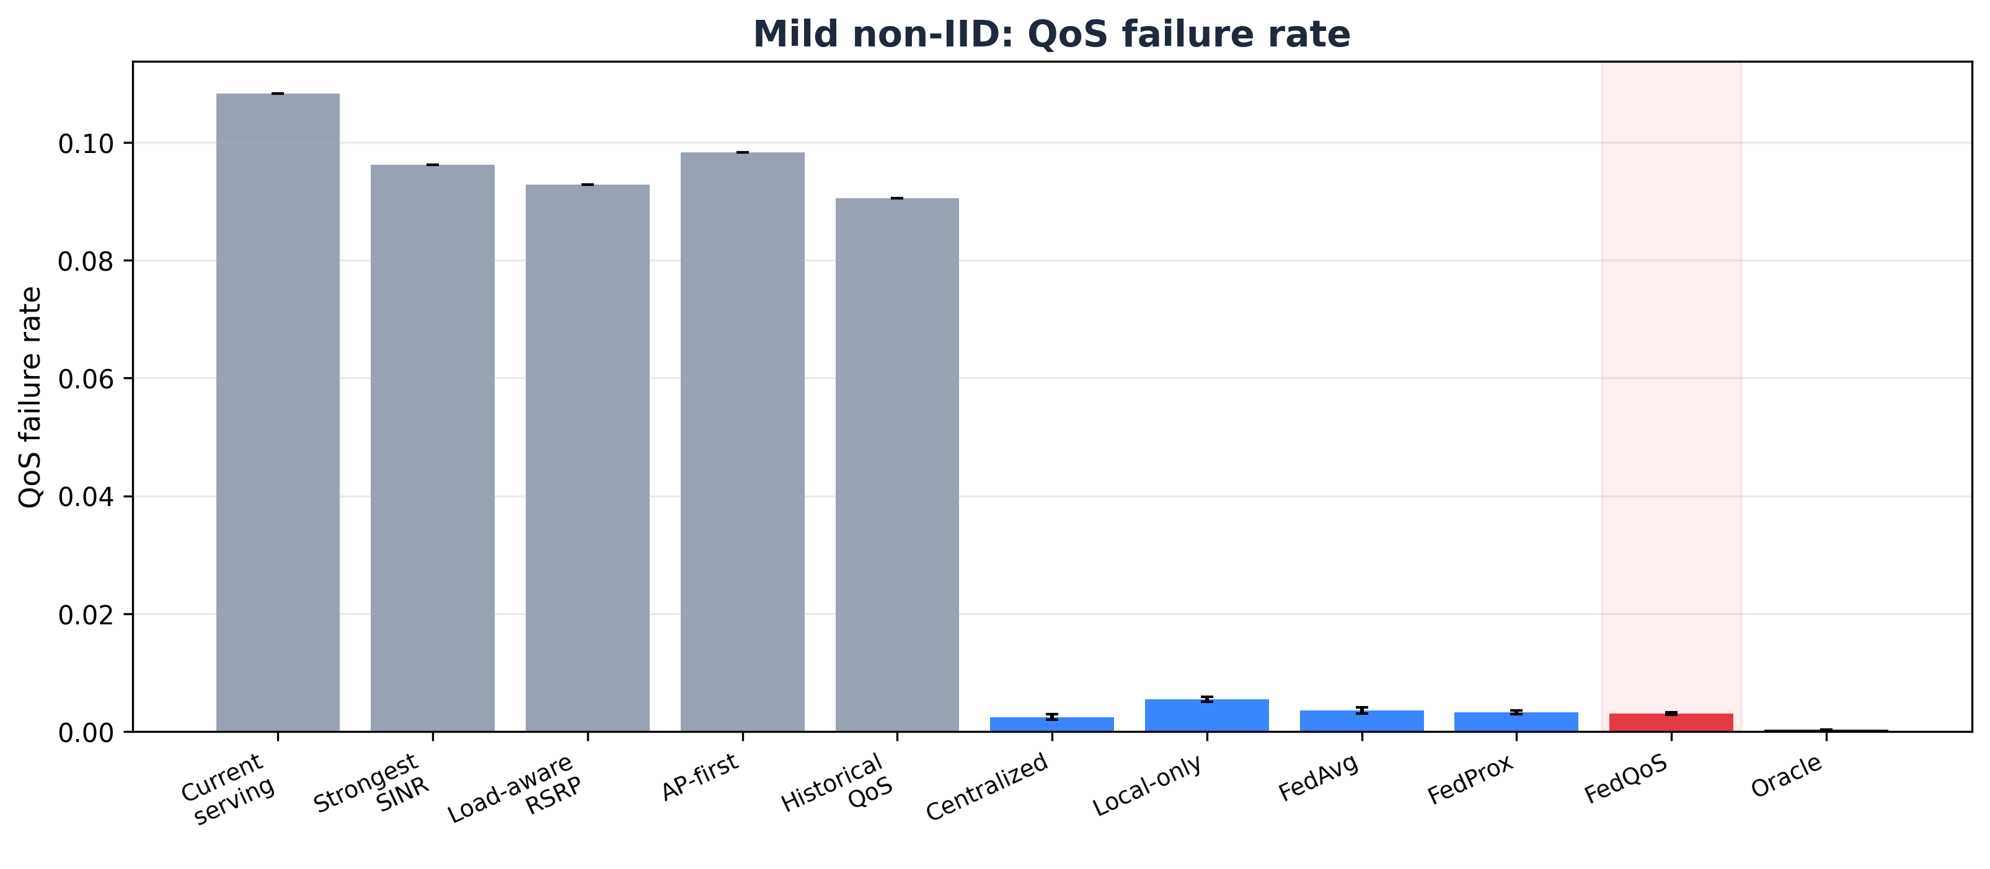
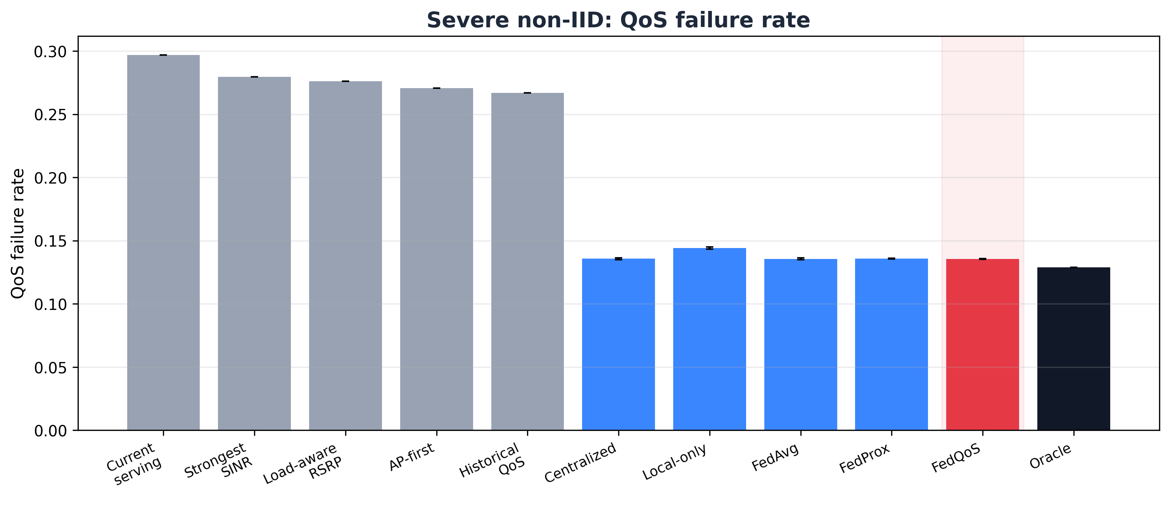
Experiment
15. Access selection results
Mild non-IID
Severe non-IID
FedQoS reduces failure by 13.9% vs FedAvg and 6.1% vs FedProx.
FedQoS ties FedAvg at displayed precision and remains robust under stronger heterogeneity.

Slide 19
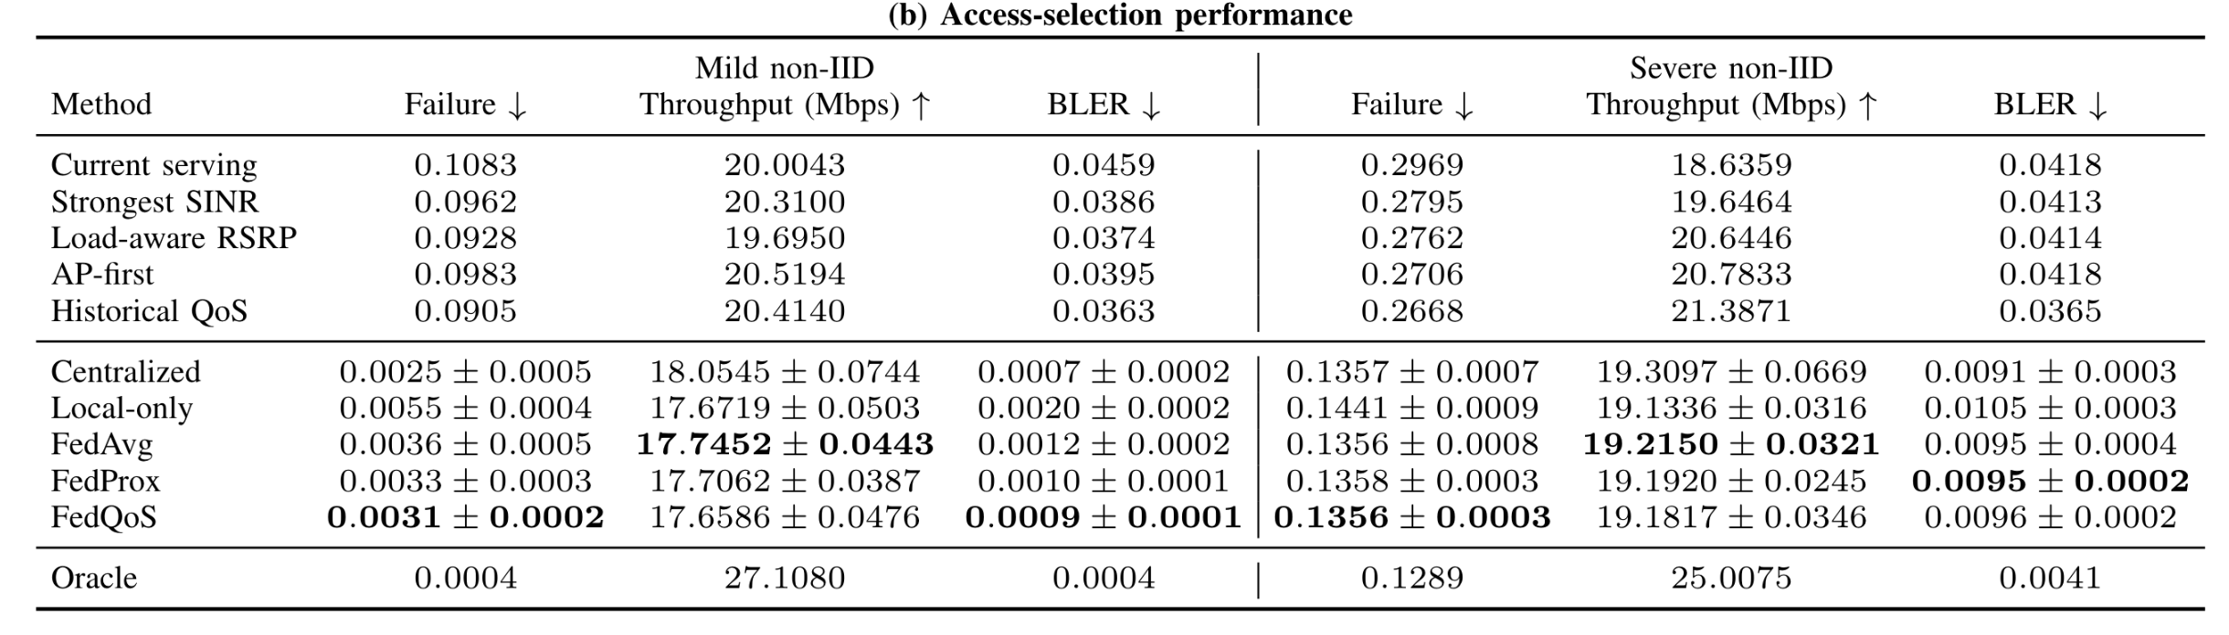
Experiment
15. Access selection results
Mild non-IID: FedQoS achieves the lowest federated QoS-failure rate and BLER, reducing failures by 13.9% vs. FedAvg and 6.1% vs. FedProx.
Severe non-IID: FedQoS remains highly competitive, tying FedAvg for the lowest displayed federated failure rate.
Key observation
Learning-based policies strongly reduce failure and BLER relative to heuristics; FedQoS gives the clearest reliability gain under mild non-IID.

Slide 20
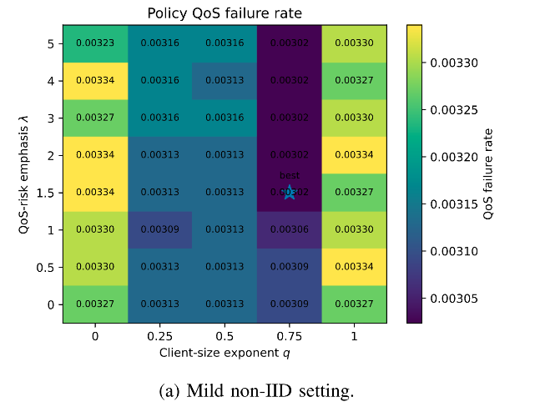
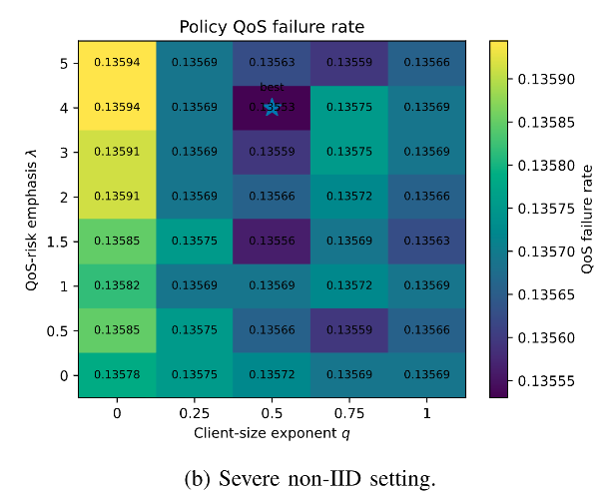
Experiment
16. Sensitivity analysis
FedQoS does not rely on a fragile parameter optimum
QoS-failure rate varies only within narrow ranges in both settings.
The adopted setting (q, λ) = (0.75, 0.5) lies in a stable low-failure region.
q has a stronger effect than λ when local dataset sizes are highly unequal.
Takeaway
The gains do not depend on narrowly tuned aggregation parameters.

Slide 21
Experiment
17. Conclusions
FedQoS reframes access selection as future QoS-risk prediction rather than instantaneous signal maximization.
It learns from distributed AP/BS/UAV observations without centralizing raw user-level data.
QoS-aware aggregation balances local data volume and QoS-failure exposure.
Experiments show near-centralized prediction, strong gains over heuristics, and stable behavior across q and λ.
Questions?
Thank you
Contact: vanthieu.nguyen@uni.lu

