Slide 1




Resilient Decentralized Wireless Federated Learning via Gradient Tracking with AdamW
Van Thieu NGUYEN
PhD student (vanthieu.nguyen@uni.lu)

Slide 2
Overview
Problem and Motivation
Related Work
System Model
Proposed Algorithm
Experiment Design
Results and Discussion
Conclusions
Notes:
The central question behind this work is simple: how can we make decentralized collaborative learning effective when devices have different data, wireless communication is limited, and some messages never arrive? We approach this question by jointly considering the optimization algorithm and the communication system. Rather than assuming perfect information exchange, we explicitly account for practical wireless constraints. I will first explain why these constraints matter, then introduce our method and discuss the empirical results.

Slide 3
1. Problem and Motivation

Slide 4
1.1 Why collaborative intelligence at the edge?
1. Problem and Motivation
Start from the deployment problem, not from the equations.
Data remain distributed
Central collection can be costly
Local training alone is incomplete
IoT devices and edge nodes observe different portions of the environment and retain local training samples.
Uploading all training data burdens networks and may introduce privacy and governance issues.
Each device may lack enough representative examples to learn a useful, generalizable model.
Notes:
The main challenges arise from where data are generated, how devices communicate, and how heterogeneous local information influences optimization.

Slide 5
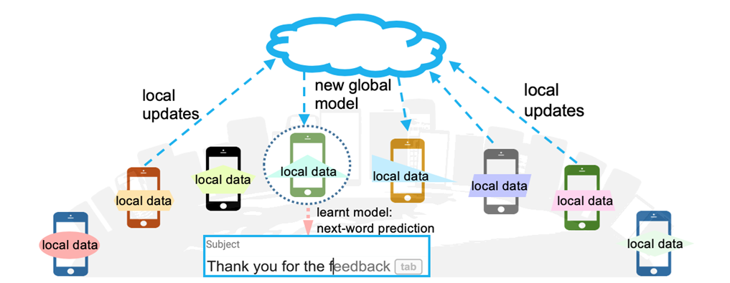
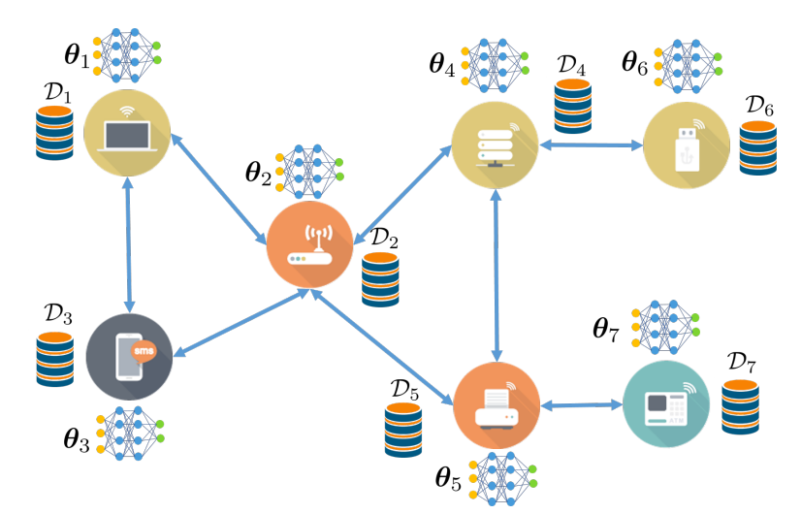
1.2 Centralized Federated Learning vs Decentralized Federated Learning
1. Problem and Motivation
Notes:
The architectural distinction is about where information mixes. In a centralized design, devices
send updates to a coordinating server. In the decentralized setting studied here, every device
mixes information from neighbors and continues to update its own model. This avoids
depending on one aggregation server, but it puts more responsibility on local protocol design.
There is no server that automatically collects every update and repairs a missing neighbor
exchange.

Slide 6
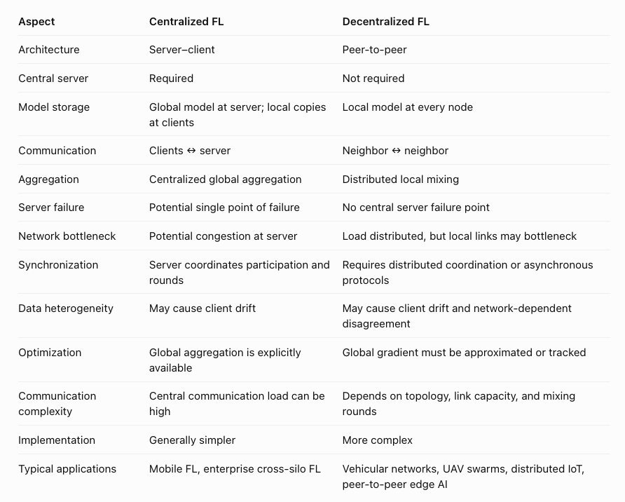
1.2 Centralized Federated Learning vs Decentralized Federated Learning
1. Problem and Motivation

Slide 7
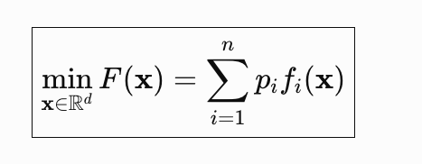
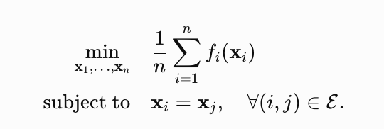
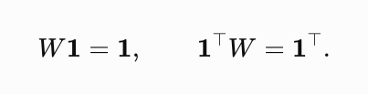
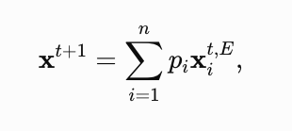
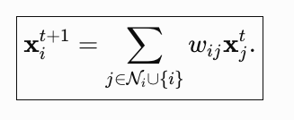
1.2 Centralized Federated Learning vs Decentralized Federated Learning
1. Problem and Motivation
Global Objective of Federated Learning and Consensus Averaging.

Slide 8
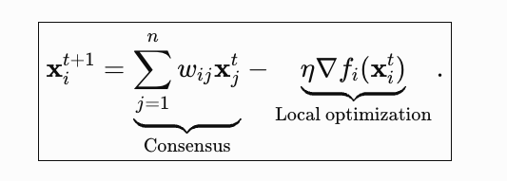
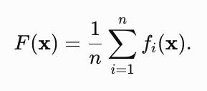
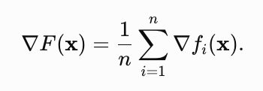
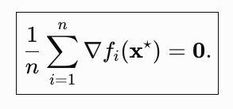
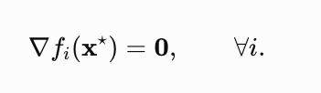
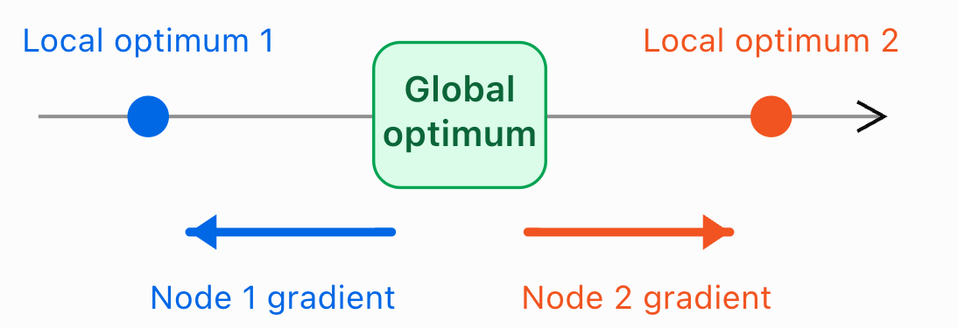
1.3 Decentralized Gradient Descent
1. Problem and Motivation
Each node performs two operations: it averages neighboring models and follows its local gradient.
In heterogeneous networks, different nodes generally have different objective functions and therefore different gradients.

Slide 9
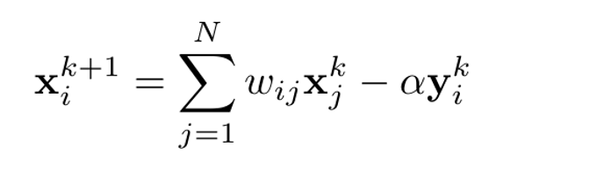
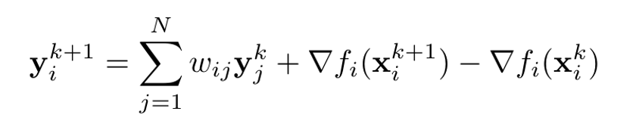
1.4 Gradient Tracking Algorithm
1. Problem and Motivation
Model stream x : neighbor consensus
Tracking stream y : gradient information across heterogeneous data
Each node maintains a model xᵢ and an additional tracker yᵢ.
Neighbors mix both streams; the tracker adds a local gradient-difference correction.
The tracker is designed to follow the network-level gradient despite heterogeneous objectives.
The improvement has a cost: it doubles the types of state that must be exchanged.

Slide 10
1.5 The Wireless Learning Problem
1. Problem and Motivation
Heterogeneous local data
Different label distributions create different local descent directions.
Learning speed
Local learning is slow and unstable when loss function is non-convex.
Wireless feasibility
A larger transmitted payload requires higher spectral efficiency for the same airtime.
Limited airtime and unreliable links
Computation time, fading and packet losses restrict each learning round.

Slide 11
1.6 Motivation for QEF-GT-AdamW
1. Problem and Motivation
Heterogeneous local data ➔ Gradient Tracking (Non-IID drift)
Learning speed ➔ AdamW optimizer (Adaptive momentum)
Wireless feasibility ➔ Top-K quantization + Error Feedback
Top-K reduce packet size ➔ But increase compression loss ➔ Error Feedback can be used to correct compression loss
Limited airtime and unreliable links ➔ Node local fallback mechanism

Slide 12
2. Related Work

Slide 13
2.1 Four lines of related work
2. Related Work
Decentralized SGD / gossip
Gradient tracking
Neighbor mixing avoids a central parameter server but may struggle with strongly heterogeneous objectives.
Koloskova et al. (2021).
Corrects heterogeneous local gradient directions using an extra tracking state.
Pu and Nedić (2021);
Adaptive gradient tracking
Communication compression
Combines GT with adaptive momentum/preconditioning
Carnevale et al., GTAdam (2022).
Quantizes/sparsifies exchanged variables to reduce payload, potentially creating biased updates.
Koloskova et al., CHOCO-SGD (2019); EF21 (2021).

Slide 14
2.2 Related work solves parts of the puzzle
2. Related Work
Method
Gradient
tracking
Adaptive
optimizer
Quantized
exchange
EF + outage
strategy
Decentralized
SGD
CHOCO-SGD
✓
–
–
✓
–
GT-AdamW
✓
✓
–
–
✓
QGT-AdamW
✓
✓
✓
✓
–
QEF-GT-AdamW
✓
✓
✓
✓
✓

Slide 15
3. System Model

Slide 16
3.1 System overview
3. System Model
N wireless nodes
Neighbor graph
Each node stores a local dataset and a trainable model.
Nodes communicate only across allowed wireless links.
Synchronized time slots
Outage-limited exchanges
Local computation occurs before broadcast within each round.
Received messages depend on packet size, power, channel gain and available airtime.

Slide 17
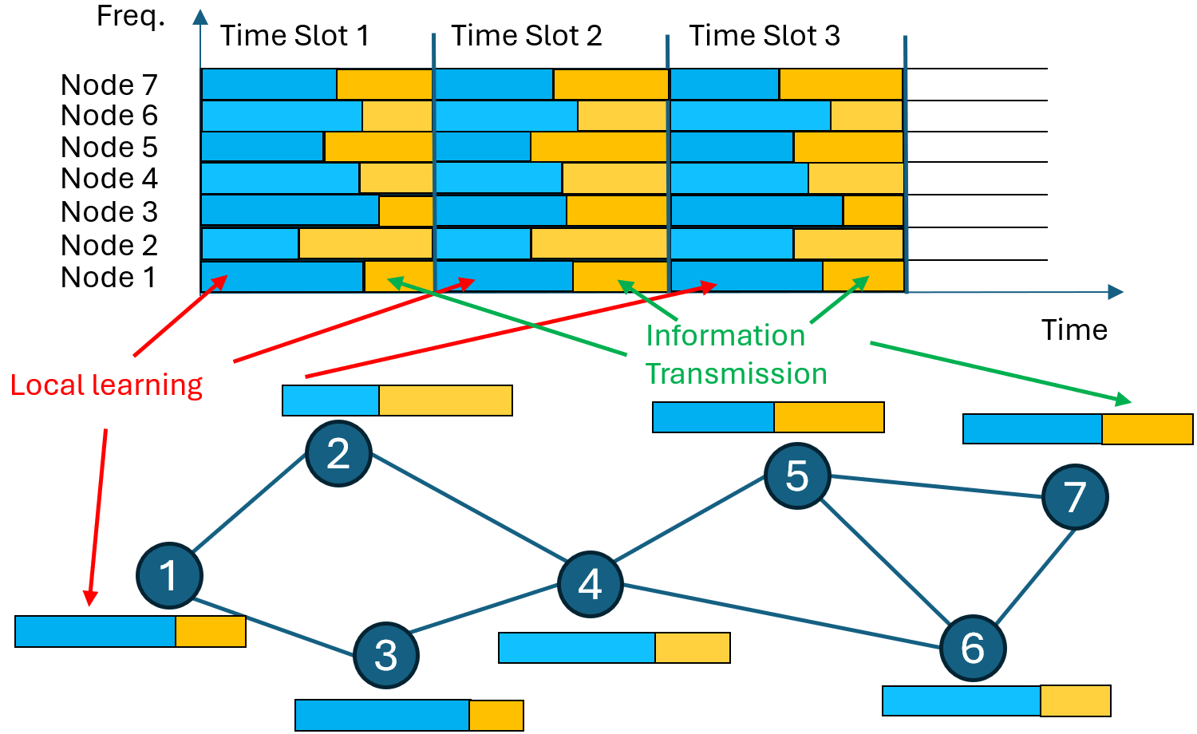

3.2 Time-slot based learning and information exchange
3. System Model
One synchronized iteration has local learning and transmission phases.
Nodes have different computation durations.
Residual airtime controls transmission feasibility.
Communication uses orthogonal subcarriers as modeled in the paper.
A slower local update leaves less transmission time under the same deadline.
Smaller airtime requires a higher information rate to transmit Dᵢ bits.

Slide 18
3.3 Wireless channel assumptions
3. System Model
Large-scale loss
Small-scale fading
Received signal decreases with distance according to a pathloss law.
The paper assumes a Rician fading channel with factor κ.
Power and bandwidth
Average link SNR
Each transmitter i has power Pᵢ and bandwidth Bᵢ.
A function of Pᵢ, propagation gain νᵢⱼ, noise density N₀, and Bᵢ.

Slide 19
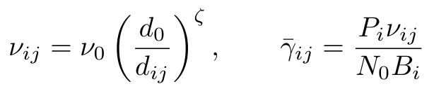
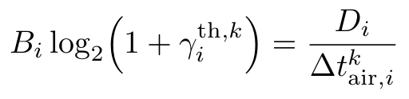

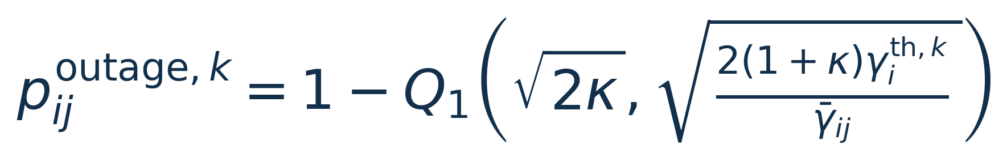
3.4 Wireless Model
3. System Model
Distance-dependent propagation
Longer distance can lower effective SNR and worsen packet reception.
Packet bits determine the SNR threshold
A smaller payload lowers the required SNR threshold under the same bandwidth and deadline.
Rician fading determines outage probability
Q₁ is the first-order Marcum Q-function; κ is the Rician factor. The average SNR is evaluated from the pathloss, power, bandwidth, and noise model.

Slide 20
4. Proposed Algorithm

Slide 21
4.1 QEF-GT-AdamW at a glance
4. Proposed Algorithm
1 · Reception
2 · Robust mixing
3 · Adaptive optimization
Validate neighbor packets using delivery events and sequence numbers.
Combine accepted compressed neighbor states with local fallback.
Feed mixed tracker Y into the AdamW moments and model update.
4 · Tracker correction
5 · Dual EF compression
6 · Broadcast
Update y using the change in the local gradient.
Compress updated x and y with their respective residuals.
Transmit sequence number and both compressed streams.
Repeat each communication round

Slide 22
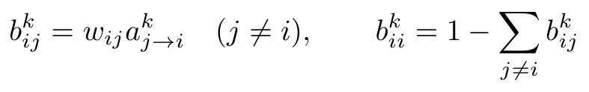
4.2 Local fallback preserves stochastic mixing
4. Proposed Algorithm
Contribution | Baseline weight | Weight after reception
Local node | 0.4 | 0.7
Neighbor 1: received | 0.3 | 0.3
Neighbor 2: missing | 0.3 | 0.0
Illustrative weights. Every realized row still sums to 1.
If every neighbor packet is missing, the node uses its local state.

Slide 23
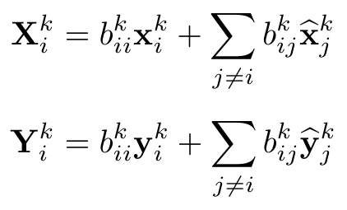
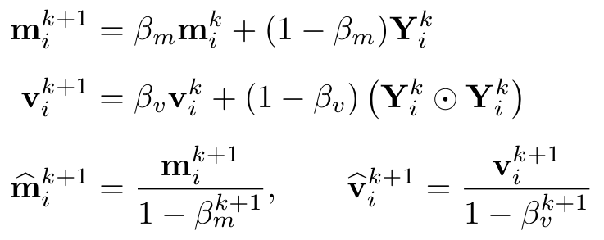
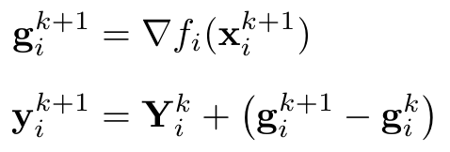
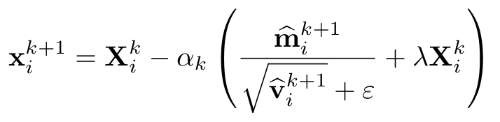
4.3 Robust Mixing with AdamW Gradient tracking
4. Proposed Algorithm

Slide 24
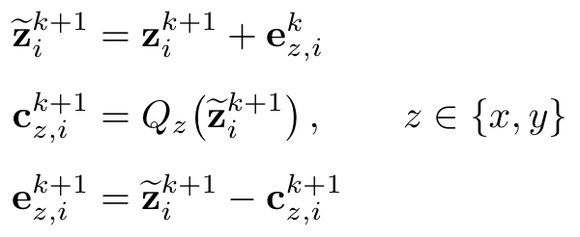
4.4 Dual Error Feedback with Compression
4. Proposed Algorithm
Illustrative corrected input | Top-2 output | New residual
(0.2, -0.8, 0.1, 0.6, 0.3, 0.5) | (0, -0.8, 0, 0.6, 0.5) | (0.2, 0, 0.1, 0, 0)
Default experiments retain 10% of the coordinates in each stream.

Slide 25
5. Experimental Design

Slide 26
5.1 Experiment questions
5. Experimental Design
Study | Varied factor | Delivery condition | Question
Compression | Retained fraction | Perfect communication | At perfect communication, how does Top-K retention affect accuracy and training loss?
Bandwidth | Bandwidth per node | Modeled wireless outage | How do accuracy and packet drop change as available MHz increases?
Power | Transmit power | Modeled wireless outage | How do accuracy and packet drop change as node power increases?

Slide 27
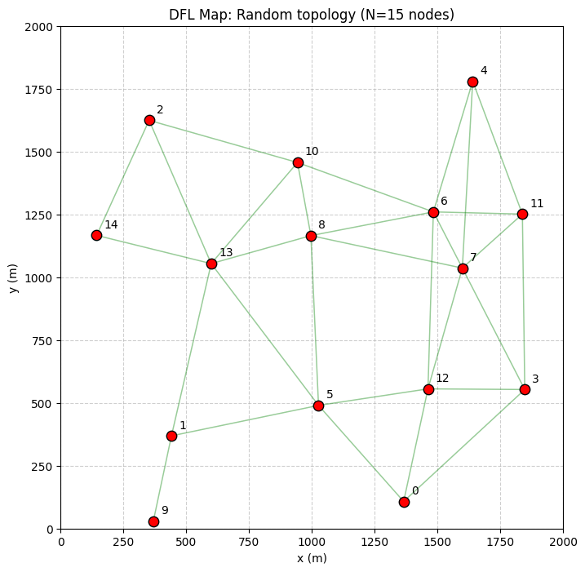
5.2 Network and wireless setup
5. Experimental Design
Parameter | Reported setting
Number of nodes | 15
Deployment area | 2000 m × 2000 m
Placement | Poisson-disk random, minimum distance 250 m
Potential directed links | Node separation within 750 m
Default transmit power | 0.2 W
Channel and timing constants | Not fully listed in the supplied experiment section

Slide 28
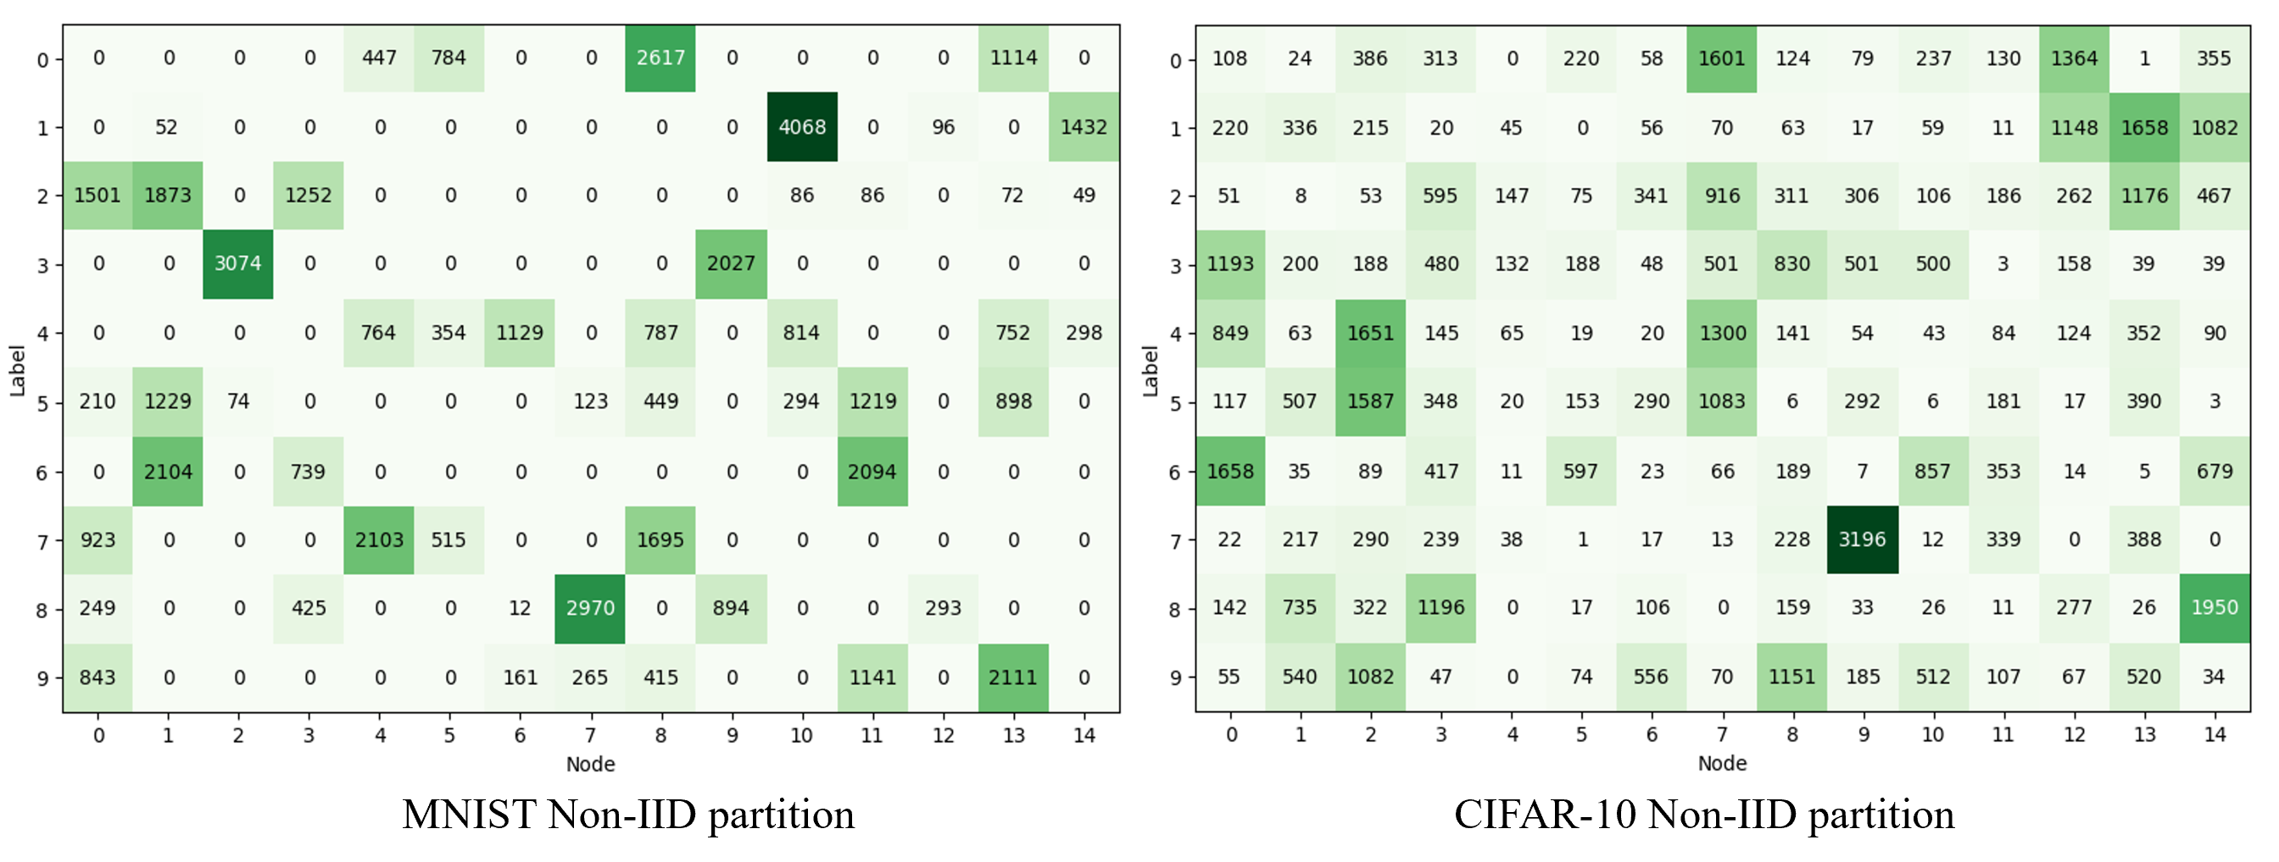
5.3 Model and datasets
5. Experimental Design
Aspect | MNIST | CIFAR-10
Train/Test samples | 50,000 / 10,000 | 50,000 / 10,000
Local partition | 2-5 labels per node | Dirichlet concentration 0.5
Model: Logistic Regression, Training Iterations: 1000 epochs, Task: Heterogeneous Image Classification

Slide 29
5.4 Comparison algorithms and hyperparameters
5. Experimental Design
Method | Communicated states | Compression / EF role
CHOCO-SGD | Model information | Compressed gossip baseline
GT-AdamW | Model + tracker | Full-precision two-stream reference
QGT-AdamW | Model + tracker | Top-K without proposed dual EF
QEF-GT-AdamW | Model + tracker | Top-K with separate model / tracker EF
QGT and QEF use the same retained fraction in the wireless sweeps.
Setting | MNIST | CIFAR-10
Learning rate η | 0.005 | 0.001
AdamW β_m / β_v | 0.9 / 0.999 | 0.9 / 0.999
Weight decay λ | 0.01 | 0.01
CHOCO consensus γ | 0.001 | 0.001
Wireless Top-K retention | 10% in each stream | 10% in each stream

Slide 30
5.5 Metrics and comparison logic
5. Experimental Design
Metric | What it answers | What it cannot establish alone
Test accuracy | Does the learned classifier generalize here? | Why a component caused the gain
Training loss | How does optimization progress? | Wireless efficiency or delivery
Packet drop rate | How often is information missing? | Whether received information is useful
Learning quality and delivery reliability need to be interpreted together.

Slide 31
6. Results and Discussion

Slide 32
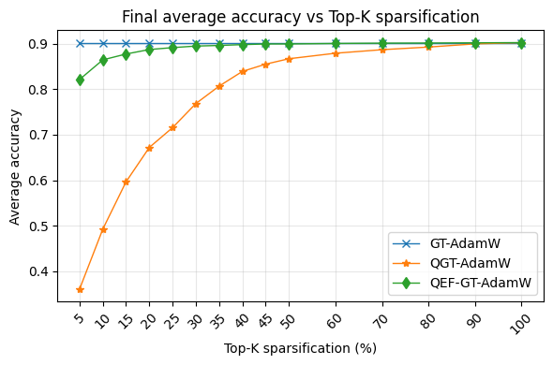
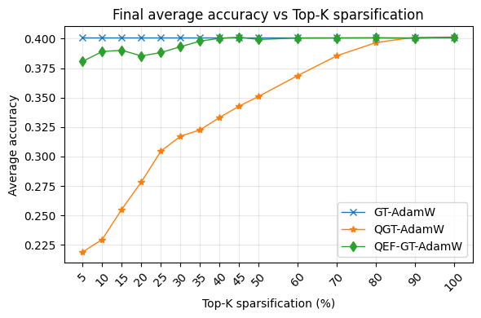
6.1 Exp 1: Performance accuracy vs Top-K
6. Results and Discussion
MNIST
CIFAR-10
Near-reference: ~30% MNIST / ~35% CIFAR-10 retention.
QGT needs about 90% in the reported comparison (approximate).

Slide 33
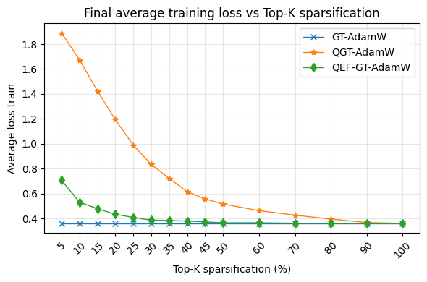
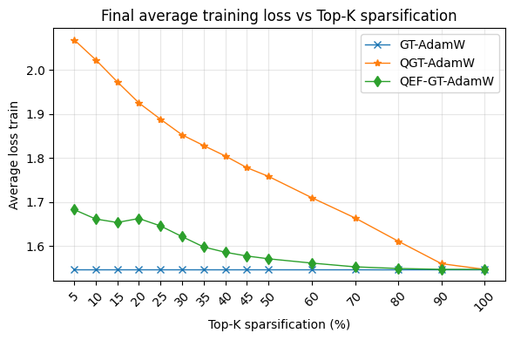
6.2 Exp 1: Training loss vs Top-K
6. Results and Discussion
MNIST
CIFAR-10
At perfect delivery, the difference comes from compression quality.
Error feedback reduces the compression-induced optimization loss

Slide 34
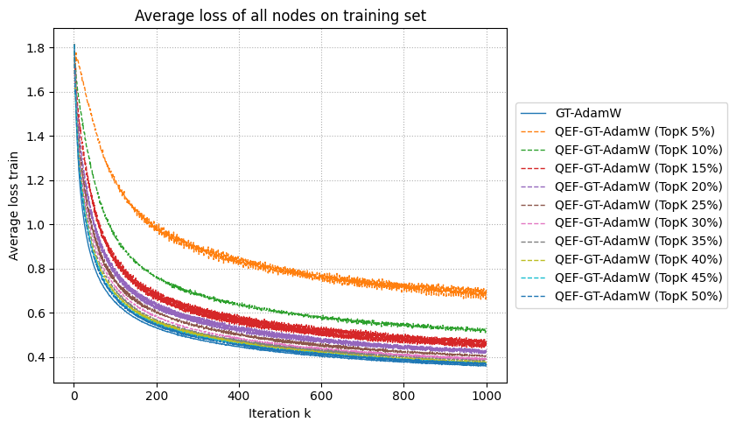
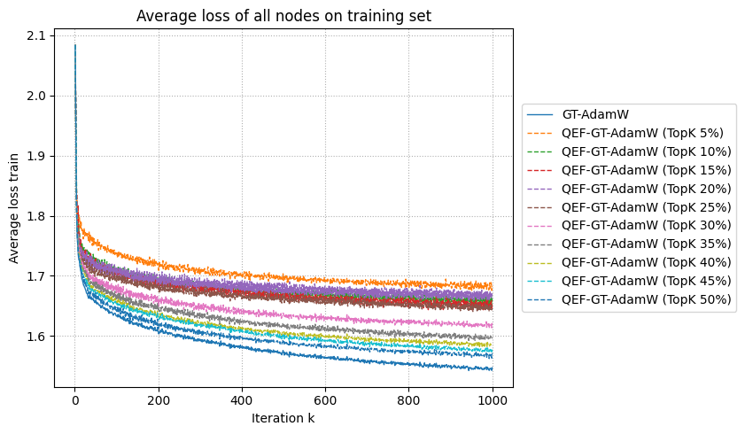
6.3 Exp 1: Convergence curve vs Top-K
6. Results and Discussion
MNIST
CIFAR-10
Less compression reduces loss

Slide 35
6.4 Exp 2: Bandwidth-sweep protocol
6. Results and Discussion
Controlled factor | Setting
Bandwidth values (MHz) | 0.05, 0.1, 0.2, 0.5, 1, 2, 10
Transmit power | 0.2 W
Compressed GT retention | 10% for model and tracker
Observed outcomes | Final test accuracy and average packet drop rate
The resource sweep tests how payload size affects usable collaboration.

Slide 36
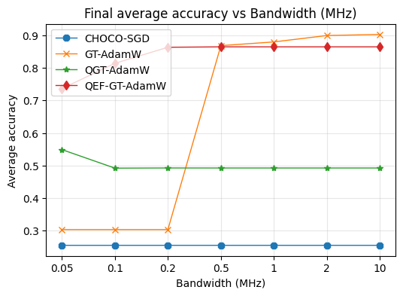
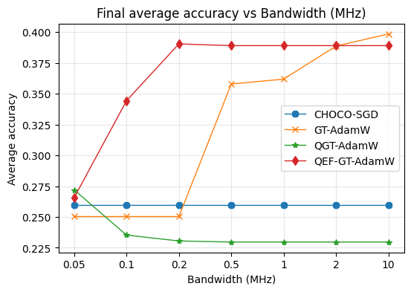
6.5 Exp 2: Accuracy under limited bandwidth
6. Results and Discussion
MNIST
CIFAR-10
Dense GT vs sparse GT: Large payloads can become a wireless bottleneck.
QGT vs QEF: EF improves learning at similar sparse delivery.
CHOCO vs GT methods: Low drop rate alone does not ensure high accuracy.

Slide 37
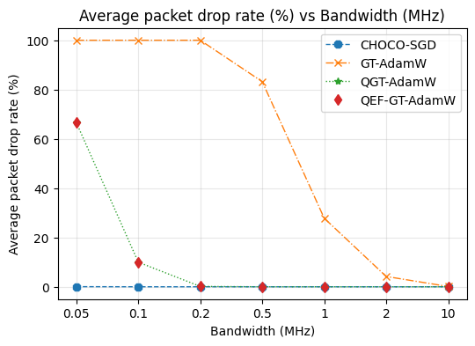
6.6 Exp 2: Packet drops across bandwidth sweep
6. Results and Discussion
GT-AdamW has ~100% drops at 0.05–0.2 MHz.
GT-AdamW still shows ~83% drops at 0.5 MHz.
QGT and QEF-GT drops become essentially zero from ~0.2 MHz.
The two quantized variants have similar drop curves because their payload sizes are similar.

Slide 38
6.7 Exp 3: Transmit-power sweep protocol
6. Results and Discussion
Controlled factor | Setting
Bandwidth values (MHz) | 0.05, 0.1, 0.2, 0.5, 1, 2, 10
Bandwidth | 1 MHz
Compressed GT retention | 10% for model and tracker
Observed outcomes | Final test accuracy and average packet drop rate
The resource sweep tests how payload size affects usable collaboration.

Slide 39
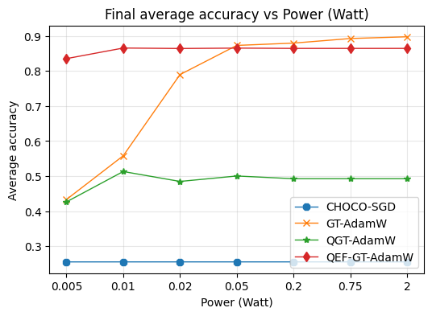
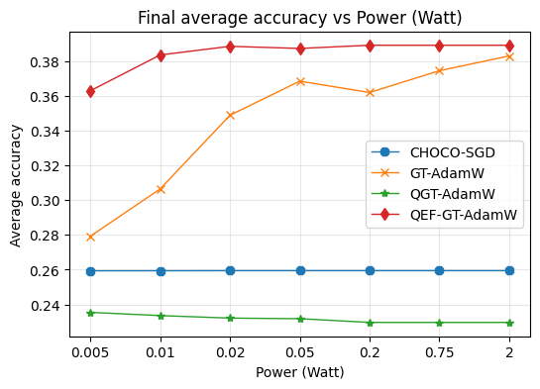
6.8 Exp 3: Accuracy under limited Transmit Power
6. Results and Discussion
MNIST
CIFAR-10
GT-AdamW: Strong optimization but wireless outages destroy much of the benefit.
CHOCO-SGD has 0 packet drop but due to quantization error and the absence of gradient tracking.

Slide 40
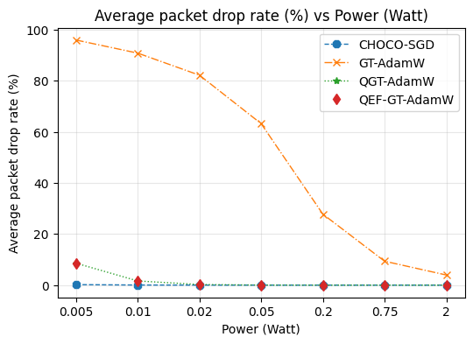
6.9 Exp 3: Packet drops across power sweep
6. Results and Discussion
GT-AdamW: ~96% packet drop at 0.005 W.
GT-AdamW: ~82% drop at 0.02 W and ~63% at 0.05 W.
Compressed GT variants: ~8% drop at 0.005 W and ~1% at 0.01 W.
At 0.02 W and higher, quantized drop is nearly zero in the reported setup.

Slide 41
7. Conclusions

Slide 42
7.1 Direct role of each resilience mechanism
7. Conclusions
Mechanism | Direct action | Evidence here
Compression | Reduce transmitted coordinate count | Wireless drop curves
Error feedback | Change sparse information across rounds | Perfect-link QGT / QEF comparison
Fallback | Reassign missing weights to self | Algorithm and conditional analysis
GT and AdamW | Form cross-node information and adaptive steps | Combined-method evaluation

Slide 43
7.2 Three findings
7. Conclusions
Compression is not free
Full precision is not always practical
End-to-end co-design matters
Biased Top-K can strongly degrade GT-AdamW without EF.
GT-AdamW needs enough airtime to send both large states.
QEF-GT-AdamW provides a favorable accuracy–communication–robustness trade-off.

Slide 44
7.3 Takeaway
7. Conclusions
Optimization
Communication
Convergence
Gradient tracking is valuable under non-IID data, but an extra tracking stream has a wireless cost.
Algorithmic sophistication must be accounted for in packet size and time-slot feasibility.
Aggressive Top-K compression can make wireless reception feasible, but biased compression can weaken training.
Dual error feedback targets that distortion without introducing a third transmitted stream.
A packet-loss fallback can change the effective network objective.

Slide 45



Thanks. Any questions?
Van Thieu NGUYEN
PhD Student, SnT, University of Luxembourg
vanthieu.nguyen@uni.lu
Connect with us
Acknowledgment
Supported by Luxembourg FNR:
CHIST-ERA SHIELD: INTER/CHIST24/19023763/SHIELD
AFR FULFIL: 2000141

Slide 46
7.2 Three findings
7. Conclusions
Compression is not free
Full precision is not always practical
End-to-end co-design matters
Biased Top-K can strongly degrade GT-AdamW without EF.
GT-AdamW needs enough airtime to send both large states.
QEF-GT-AdamW provides a favorable accuracy–communication–robustness trade-off.

Slide 47
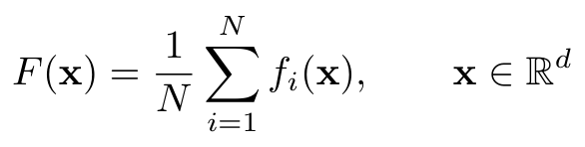
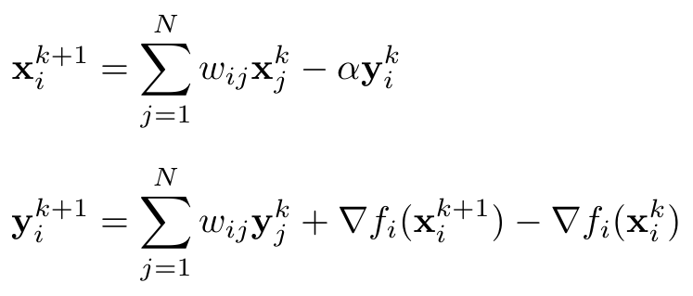
Appendix: notation and classical GT
N: nodes d: model dimension x: model y: tracker
W is the fixed doubly stochastic baseline. B varies with accepted packets.
Appendix / Paper, Section II-A, Eq. (1)
81
Notes:
APPENDIX
Purpose
Appendix: notation and classical GT
Suggested narration
This appendix defines the nominal objective and the classical gradient-tracking background. There are N nodes, and each model and tracker has dimension d. The fixed baseline W is doubly stochastic. The realized packet-dependent matrix used by the proposal is a different object and is generally only row-stochastic.
Explanation and discussion
There are several distinct uses of similar symbols in the paper. D_i is payload size, whereas bold D_i^(k+1) is the diagonal AdamW preconditioner. Bold A^k is the off-diagonal mixing matrix, while calligraphic A^k is the adaptive discrepancy energy. The optimizer alpha differs from the CIFAR-10 Dirichlet concentration. The presentation preserves the paper's definitions and uses calligraphic notation to distinguish error energies.
Sources
Nguyen Van Thieu, Ti Ti Nguyen, Ons Aouedi, Vu Nguyen Ha, and Symeon Chatzinotas. Resilient Decentralized Wireless Federated Learning via Gradient Tracking with AdamW. Supplied GLOBECOM 2026 paper. Paper, Section II-A, Eq. (1).

Slide 48
Appendix: airtime and transmission threshold
D_i: payload bits. B_i: bandwidth. Computation leaves the airtime budget.
Appendix / Paper, Section II-B, Eqs. (2)-(3)
82
Notes:
APPENDIX
Purpose
Appendix: airtime and transmission threshold
Suggested narration
Remaining airtime is the deadline minus computation time. To send D bits in that interval, the rate must be D divided by airtime. Substituting into the spectral-efficiency relation gives the explicit SNR threshold. At fixed bandwidth and positive airtime, reducing D lowers that threshold.
Explanation and discussion
Derivation of the threshold: start with B_i log_2(1+gamma_i^(th,k)) = D_i/Delta t_air,i^k. Divide both sides by B_i. Apply 2 to the power of each side to obtain 1+gamma_i^(th,k) = 2^[D_i/(B_i Delta t_air,i^k)]. Subtract one. Then substitute the threshold and gamma_bar = P_i nu_ij/(N_0 B_i) into the reported Rician CDF expression. Nu_ij = nu_0(d_0/d_ij)^zeta. The supplied paper does not numerically list kappa, zeta, nu_0, N_0, and the slot deadline in Section IV.
Sources
Nguyen Van Thieu, Ti Ti Nguyen, Ons Aouedi, Vu Nguyen Ha, and Symeon Chatzinotas. Resilient Decentralized Wireless Federated Learning via Gradient Tracking with AdamW. Supplied GLOBECOM 2026 paper. Paper, Section II-B, Eqs. (2)-(3).

Slide 49
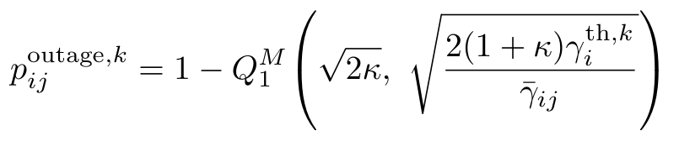
Appendix: Rician outage model
Pathloss depends on distance. Rician fading creates receiver-specific outages.
Appendix / Paper, Section II-B, Eq. (3)
83
Notes:
APPENDIX
Purpose
Appendix: Rician outage model
Suggested narration
The mean SNR uses transmit power, pathloss, noise spectral density, and bandwidth. The Rician cumulative distribution gives the probability that the actual SNR falls below the threshold required by the payload and airtime. The first-order Marcum Q function appears in the stated expression.
Explanation and discussion
Derivation of the threshold: start with B_i log_2(1+gamma_i^(th,k)) = D_i/Delta t_air,i^k. Divide both sides by B_i. Apply 2 to the power of each side to obtain 1+gamma_i^(th,k) = 2^[D_i/(B_i Delta t_air,i^k)]. Subtract one. Then substitute the threshold and gamma_bar = P_i nu_ij/(N_0 B_i) into the reported Rician CDF expression. Nu_ij = nu_0(d_0/d_ij)^zeta. The supplied paper does not numerically list kappa, zeta, nu_0, N_0, and the slot deadline in Section IV.
Sources
Nguyen Van Thieu, Ti Ti Nguyen, Ons Aouedi, Vu Nguyen Ha, and Symeon Chatzinotas. Resilient Decentralized Wireless Federated Learning via Gradient Tracking with AdamW. Supplied GLOBECOM 2026 paper. Paper, Section II-B, Eq. (3).

Slide 50
Appendix: realized mixing and local fallback
Row stochasticity survives. Double stochasticity generally does not.
Appendix / Paper, Eqs. (4)-(6)
84
Notes:
APPENDIX
Purpose
Appendix: realized mixing and local fallback
Suggested narration
An off-diagonal weight is retained only when the fresh packet is accepted. The self weight is one minus the accepted off-diagonal weights. The same realized row mixes models and trackers. Local self states remain uncompressed, while received neighbor states are compressor outputs.
Explanation and discussion
Every realized row sums to one. Let A^k contain only the off-diagonal entries of B^k and let chi_z^k be decoded minus local z. Then the stacked mixed state is (B^k tensor I_d)z^k + (A^k tensor I_d)chi_z^k. Column sums generally change under asymmetric reception, so uniform-average preservation does not follow.
Sources
Nguyen Van Thieu, Ti Ti Nguyen, Ons Aouedi, Vu Nguyen Ha, and Symeon Chatzinotas. Resilient Decentralized Wireless Federated Learning via Gradient Tracking with AdamW. Supplied GLOBECOM 2026 paper. Paper, Eqs. (4)-(6).

Slide 51
Appendix: AdamW recursions
Moment input: mixed tracker Y. Decay input: mixed model X.
Appendix / Paper, Eqs. (7)-(9)
85
Notes:
APPENDIX
Purpose
Appendix: AdamW recursions
Suggested narration
The moment recursions use the mixed tracker Y. Bias correction uses the iteration index k plus one. The new model starts from the mixed model X, subtracts the coordinatewise adaptive direction, and applies decoupled decay to X.
Explanation and discussion
All products, squares, square roots, and divisions in the adaptive direction are coordinatewise. Beta_m and beta_v lie in (0,1), epsilon is positive, and lambda is nonnegative. The convergence analysis treats deviation from the mixed tracker, including the adaptive scale and moments, as an explicit perturbation.
Sources
Nguyen Van Thieu, Ti Ti Nguyen, Ons Aouedi, Vu Nguyen Ha, and Symeon Chatzinotas. Resilient Decentralized Wireless Federated Learning via Gradient Tracking with AdamW. Supplied GLOBECOM 2026 paper. Paper, Eqs. (7)-(9).

Slide 52

Appendix: tracking and dual-stream EF
Appendix / Paper, Eqs. (10)-(13)
86
Notes:
APPENDIX
Purpose
Appendix: tracking and dual-stream EF
Suggested narration
Evaluate the new local gradient after the model update, then add its difference from the previous gradient to the mixed tracker. For each updated stream, add the previous residual, compress, and store the omitted part. Broadcast a sequence number and the two outputs.
Explanation and discussion
The compressor inputs are full updated states plus residuals. The method does not compress only model differences or only gradient differences. The x and y residuals are separate. Receivers mix the decoded outputs directly according to Eq. (6).
Sources
Nguyen Van Thieu, Ti Ti Nguyen, Ons Aouedi, Vu Nguyen Ha, and Symeon Chatzinotas. Resilient Decentralized Wireless Federated Learning via Gradient Tracking with AdamW. Supplied GLOBECOM 2026 paper. Paper, Eqs. (10)-(13).

Slide 53
Appendix: complete initialization
Order | Initialization operation
1 | Choose the initial model. Compute its gradient and initialize the tracker.
2 | Set both moments and both pre-initialization residuals to zero.
3 | Set own Seq to 0 and neighbor LastSeq values to -1.
4 | Compress both initial states and store both new residuals.
5 | Broadcast the initial compressed packet with sequence 0.
Appendix / Paper, Algorithm 1
87
Notes:
APPENDIX
Purpose
Appendix: complete initialization
Suggested narration
Initialization sets the tracker equal to the gradient of the initial model, zeroes the moments and pre-initialization residuals, and initializes freshness metadata. Both initial streams are then compressed. Their compression residuals are stored before sequence zero is broadcast.
Explanation and discussion
For z in {x,y}, first set e_z,i^(-1)=0. Form ztilde_i^0 = z_i^0 + e_z,i^(-1). Compute c_z,i^0 = Q_z(ztilde_i^0). Set e_z,i^0 = ztilde_i^0 - c_z,i^0. Set Seq_i=0 and LastSeq_i[j]=-1. Broadcast (Seq_i,c_x,i^0,c_y,i^0). The local model self-state remains x_i^0 and the local tracker remains y_i^0. The decoded neighbor states are compressor outputs. Do not overwrite the residuals with zero after the warm-start compression.
Sources
Nguyen Van Thieu, Ti Ti Nguyen, Ons Aouedi, Vu Nguyen Ha, and Symeon Chatzinotas. Resilient Decentralized Wireless Federated Learning via Gradient Tracking with AdamW. Supplied GLOBECOM 2026 paper. Paper, Algorithm 1.

Slide 54
Appendix: complete round dependency order
Stage | Exact dependency
Reception | Accept only successful packets with a newer sequence.
Mixing | Form the realized weights, then mix self states and decoded peers.
AdamW | Update moments from the mixed tracker, then update the mixed model.
Tracking | Evaluate the new local gradient and apply its difference.
Compression | Add each old residual, compress, store each new residual.
Broadcast | Send sequence k+1 and both outputs, then retain the new gradient.
Appendix / Paper, Algorithm 2
88
Notes:
APPENDIX
Purpose
Appendix: complete round dependency order
Suggested narration
The order of operations prevents several implementation ambiguities. Receive and mix before updating moments. Evaluate the new gradient after updating the model. Correct the tracker before compressing it. Update both EF residuals using the actual compressor outputs. Increment the sequence number before broadcasting the next packet. Finally, retain the new local gradient for the next gradient-difference correction.
Explanation and discussion
More explicitly: decode only accepted fresh packets. Construct b_ij^k from w_ij and reception indicators, with missing weights placed on b_ii^k. Form X_i^k and Y_i^k. Update m and v using Y_i^k, apply bias correction, and compute x_i^(k+1). Evaluate g_i^(k+1). Compute y_i^(k+1)=Y_i^k+g_i^(k+1)-g_i^k. For both streams, add the previous residual, compress, and store the new residual. Send the new packet and replace the cached previous local gradient with g_i^(k+1).
Sources
Nguyen Van Thieu, Ti Ti Nguyen, Ons Aouedi, Vu Nguyen Ha, and Symeon Chatzinotas. Resilient Decentralized Wireless Federated Learning via Gradient Tracking with AdamW. Supplied GLOBECOM 2026 paper. Paper, Algorithm 2.

Slide 55
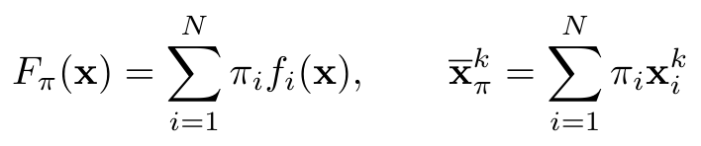
Appendix: weighted averages and node influence
Perron average: the aggregate used by the analysis.
Node influence can differ when reception is asymmetric.
Appendix / Paper, Section III-C, Eqs. (14)-(16)
89
Notes:
APPENDIX
Purpose
Appendix: weighted averages and node influence
Suggested narration
Let Bbar be the expected effective mixing matrix. Its normalized left Perron vector pi defines the weighted average. Primitivity ensures a positive unique normalized vector under the stated assumptions. This weighting reflects the influence induced by expected communication, not an arbitrary reweighting selected for the experiment.
Explanation and discussion
B^k is row-stochastic. Therefore Bbar times the all-ones vector equals that vector. Its left eigenvector pi need not be uniform. The disagreement projector subtracts the pi-weighted consensus component. The expected-mixing balance should not be confused with a per-round column-sum identity.
Sources
Nguyen Van Thieu, Ti Ti Nguyen, Ons Aouedi, Vu Nguyen Ha, and Symeon Chatzinotas. Resilient Decentralized Wireless Federated Learning via Gradient Tracking with AdamW. Supplied GLOBECOM 2026 paper. Paper, Section III-C, Eqs. (14)-(16).

Slide 56
Appendix: nominal and analyzed objectives
Nominal uniform target
Target in the lossy-mixing analysis
Uniform weights are a special case of the analyzed objective.
Appendix / Paper, Eqs. (1), (14)-(16)
90
Notes:
APPENDIX
Purpose
Appendix: nominal and analyzed objectives
Suggested narration
The nominal objective assigns equal weight to each local loss. The analyzed objective uses the Perron weights of expected effective mixing. They coincide when the relevant Perron vector is uniform, such as the doubly stochastic special case. Under asymmetric losses and fallback they need not coincide.
Explanation and discussion
This distinction limits the interpretation of exact convergence. A convergence statement for F_pi is not automatically a statement about the minimizer of the uniform F. Controlling this bias would require additional balance assumptions or an algorithmic correction that is not present here.
Sources
Nguyen Van Thieu, Ti Ti Nguyen, Ons Aouedi, Vu Nguyen Ha, and Symeon Chatzinotas. Resilient Decentralized Wireless Federated Learning via Gradient Tracking with AdamW. Supplied GLOBECOM 2026 paper. Paper, Eqs. (1), (14)-(16).

Slide 57
Appendix: convergence assumptions
Assumption | Requirement | Used for
Losses | Convex, differentiable, L-smooth | Descent and averaging bounds
Compressors | Contractive in mean square | Residual and decoded-error bounds
Random mixing | IID, primitive mean, contraction, independence | Weighted disagreement control
States | Bounded state energies and mixed tracker | Finite residual / adaptive bounds
The PL condition is an additional assumption for the stronger corollary.
Appendix / Paper, Assumptions 1-4
91
Notes:
APPENDIX
Purpose
Appendix: convergence assumptions
Suggested narration
The theorem is conditional. Local losses must be convex and L-smooth. Compressors satisfy a mean-square contraction property. The effective mixing matrices are independent and identically distributed with primitive mean and a mean-square disagreement contraction. Current packet randomness must be independent of the precommunication states and compression variables. Finally, the state energies and tracker magnitudes are bounded.
Explanation and discussion
The bounded-state assumption supplies finite R_x, R_y, and G_infinity. The mixing assumptions are stronger than simply saying each realized row sums to one. They must be assessed for any extension involving correlated outages, mobility, or adaptive communication. Boundedness alone does not imply that the aggregate perturbation vanishes.
Sources
Nguyen Van Thieu, Ti Ti Nguyen, Ons Aouedi, Vu Nguyen Ha, and Symeon Chatzinotas. Resilient Decentralized Wireless Federated Learning via Gradient Tracking with AdamW. Supplied GLOBECOM 2026 paper. Paper, Assumptions 1-4.

Slide 58
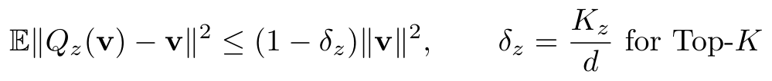
Appendix: compressor contractivity and EF identity
Deterministic Top-K: δ_z = K_z / d
The residual identity concerns compression, before receiver-specific packet loss.
Appendix / Paper, Eqs. (17), (21)-(24)
92
Notes:
APPENDIX
Purpose
Appendix: compressor contractivity and EF identity
Suggested narration
For each stream, compressor error is bounded by one minus delta times the input energy. Deterministic Top-K has delta equal to the retained fraction. From the residual definition, decoded minus local state equals previous residual minus current residual. Thus compression errors have an exact residual-difference identity across rounds.
Explanation and discussion
The identity telescopes over sender outputs. It does not imply that every receiver receives the same sequence, nor that a lost packet is acknowledged and recovered. The bounded residual result is derived on the next slide.
Sources
Nguyen Van Thieu, Ti Ti Nguyen, Ons Aouedi, Vu Nguyen Ha, and Symeon Chatzinotas. Resilient Decentralized Wireless Federated Learning via Gradient Tracking with AdamW. Supplied GLOBECOM 2026 paper. Paper, Eqs. (17), (21)-(24).

Slide 59
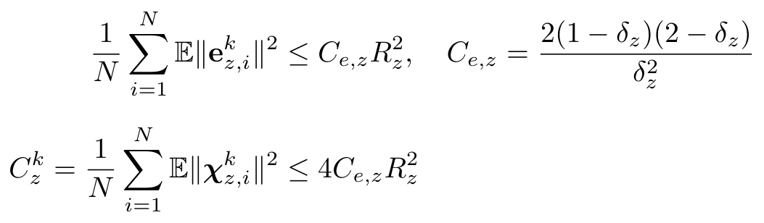
Appendix: proof of EF residual bounds
Proof steps
Apply compressor contraction. Use Young's inequality.
Unroll the residual recursion. Bound the residual difference.
Appendix / Paper, Lemma 1, Eqs. (22)-(26)
93
Notes:
APPENDIX
Purpose
Appendix: proof of EF residual bounds
Suggested narration
The compression assumption bounds the squared compressor error relative to its input. Deterministic Top-K satisfies this with delta equal to the retained-coordinate fraction. The EF recursion gives an exact identity: the difference between decoded and original states is the difference between two successive residuals. Under the bounded-state assumption, the paper bounds the residual energy and then bounds the decoded-state error energy.
Explanation and discussion
Step 1: write e_z,i^k = z_i^k+e_z,i^(k-1)-Q_z(z_i^k+e_z,i^(k-1)). Apply the compressor inequality. Step 2: for 0<delta<1, use Young's inequality ||u+v||² <= (1+tau)||u||²+(1+1/tau)||v||² with u=e^(k-1), v=z^k, and tau=delta/[2(1-delta)]. This yields E||e^k||² <= (1-delta/2)E||e^(k-1)||² + [(1-delta)(2-delta)/delta]E||z^k||². Step 3: average across nodes and use the bounded-state energy R_z². Since e^(-1)=0, the geometric sum is at most 2/delta, producing C_e,z R_z². Step 4: chi^k=e^(k-1)-e^k, so ||chi^k||² <= 2||e^(k-1)||²+2||e^k||² and C_z^k <= 4 C_e,z R_z². For delta=1 the compressor is exact and both bounds equal zero. These are bounded-error statements and do not on their own prove vanishing errors.
Sources
Nguyen Van Thieu, Ti Ti Nguyen, Ons Aouedi, Vu Nguyen Ha, and Symeon Chatzinotas. Resilient Decentralized Wireless Federated Learning via Gradient Tracking with AdamW. Supplied GLOBECOM 2026 paper. Paper, Lemma 1, Eqs. (22)-(26).

Slide 60

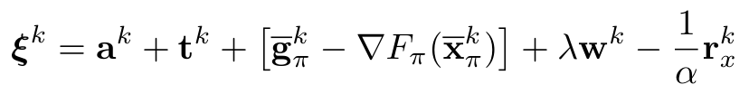
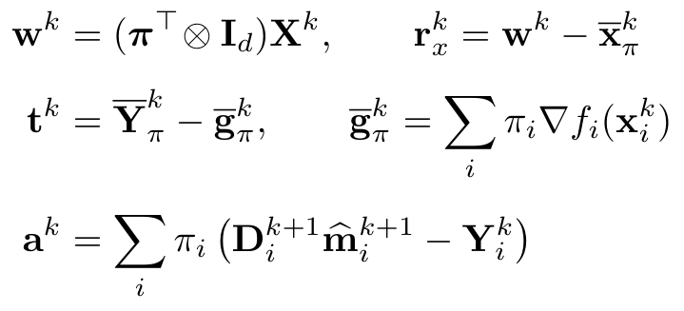
Appendix: exact inexact-gradient recursion
Appendix / Paper, Eqs. (27)-(31)
94
Notes:
APPENDIX
Purpose
Appendix: exact inexact-gradient recursion
Suggested narration
The analysis rewrites the average update as a gradient step plus a combined perturbation. The perturbation separates the AdamW update discrepancy, tracker mismatch, disagreement between local and aggregate gradients, weight decay, and the communication-induced change in the average mixed model. This decomposition is exact before bounding the terms.
Explanation and discussion
Let xbar_pi^k be the weighted average and w^k the weighted mixed model. Averaging Eq. (9) gives xbar_pi^(k+1)=w^k-alpha[sum_i pi_i D_i^(k+1)mhat_i^(k+1)+lambda w^k]. By the definition of a^k, the adaptive sum equals Ybar_pi^k+a^k. By the definition of t^k, Ybar_pi^k=gbar_pi^k+t^k. By the definition of r_x^k, w^k=xbar_pi^k+r_x^k. Substitute all three identities. Add and subtract grad F_pi(xbar_pi^k) inside the square bracket. Factor -alpha, which changes the separate r_x^k term into -r_x^k/alpha within xi^k. This yields the displayed recursion and perturbation expression.
Sources
Nguyen Van Thieu, Ti Ti Nguyen, Ons Aouedi, Vu Nguyen Ha, and Symeon Chatzinotas. Resilient Decentralized Wireless Federated Learning via Gradient Tracking with AdamW. Supplied GLOBECOM 2026 paper. Paper, Eqs. (27)-(31).

Slide 61
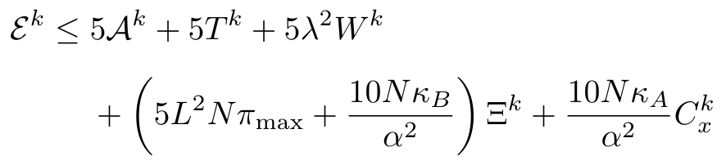
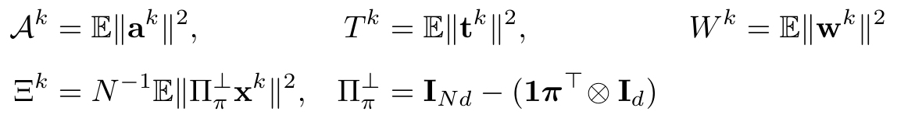
Appendix: aggregate perturbation budget
The budget includes optimizer, tracking, decay, disagreement, and model errors.
Appendix / Paper, Eqs. (29)-(32)
95
Notes:
APPENDIX
Purpose
Appendix: aggregate perturbation budget
Suggested narration
The budget shows why the guarantee is conditional. Adaptive mismatch and tracking mismatch appear directly. Weight decay contributes through the squared weighted mixed model. Disagreement affects the gradient approximation and the random mixing term. Model-stream compression enters separately. Tracking-stream compression is already part of the post-mixing tracker mismatch. Each of these terms can influence the residual objective gap.
Explanation and discussion
Define Acal^k=E||a^k||², T^k=E||t^k||², W^k=E||w^k||², Xi^k=N^(-1)E||Pi_perp x^k||², and C_x^k=N^(-1)sum_i E||chi_x,i^k||². Pi_perp=I_Nd-(1 pi^T tensor I_d). Pi_max=max_i pi_i. Kappa_B=E||pi^T(B^k-Bbar)||_2² and kappa_A=E||pi^T A^k||_2², where bold A^k contains only off-diagonal realized weights. Bound the norm of the five-part xi sum by five times the sum of squared norms. Insert the model-average communication bound and smoothness disagreement bound to obtain Eq. (32). The bounded preconditioner controls Acal^k, but does not imply it tends to zero. Similarly, fixed positive lambda is not automatically a vanishing perturbation relative to unregularized F_pi.
The bounded preconditioner satisfies h_min I <= D_i^(k+1) <= h_max I, with h_min = 1/(G_infinity + epsilon) and h_max = 1/epsilon. The adaptive discrepancy bound uses M^k and the scale mismatch h_delta. The tracker-stream compression is included inside T^k because Y is already post-mixing.
Sources
Nguyen Van Thieu, Ti Ti Nguyen, Ons Aouedi, Vu Nguyen Ha, and Symeon Chatzinotas. Resilient Decentralized Wireless Federated Learning via Gradient Tracking with AdamW. Supplied GLOBECOM 2026 paper. Paper, Eqs. (29)-(32).

Slide 62


Appendix: smooth convex convergence bound
Step size: 0 < α ≤ 1/(2L).
Zero perturbations recover O(1/K). Bounded errors can leave a floor.
Appendix / Paper, Theorem 1, Eqs. (33)-(34)
96
Notes:
APPENDIX
Purpose
Appendix: smooth convex convergence bound
Suggested narration
For a constant step size no larger than one over two L, the expected gap at the averaged Perron iterate is bounded by an initial-distance term and two terms involving the average perturbation energy. With zero perturbations, the first term gives the standard order-one-over-K rate. With bounded nonzero errors, a residual remains. Vanishing average perturbation is a sufficient condition for convergence in this bound.
Explanation and discussion
All assumptions on slide 91 apply. R_star bounds the expected distance to an F_pi minimizer. The statement does not establish an O(1/K) total rate for arbitrary slowly vanishing errors, because the square-root error term can dominate. The full proof follows in two slides.
Sources
Nguyen Van Thieu, Ti Ti Nguyen, Ons Aouedi, Vu Nguyen Ha, and Symeon Chatzinotas. Resilient Decentralized Wireless Federated Learning via Gradient Tracking with AdamW. Supplied GLOBECOM 2026 paper. Paper, Theorem 1, Eqs. (33)-(34).

Slide 63



Appendix: convex proof, one-step inequality
Appendix / Paper, Theorem 1 proof, Eqs. (35)-(37)
97
Notes:
APPENDIX
Purpose
Appendix: convex proof, one-step inequality
Suggested narration
The convex proof begins with the squared distance to a minimizer of F_pi. Substitute the inexact gradient recursion and expand the square. Smooth convexity lower-bounds the gradient inner product by the objective gap plus a gradient-norm term. Young's inequality bounds the mixed gradient and perturbation norm. With the stated step size, the remaining gradient-norm coefficient is nonpositive and can be dropped, leaving the one-step bound.
Explanation and discussion
Set x^k=xbar_pi^k, x*=x_pi*, and g^k=grad F_pi(x^k). Expand ||x^k-x*-alpha(g^k+xi^k)||² exactly to obtain Eq. (35). Apply <g^k,x^k-x*> >= F_pi(x^k)-F_pi* + ||g^k||²/(2L). Bound -<x^k-x*,xi^k> by ||x^k-x*||||xi^k||. Apply Young to ||g^k+xi^k||² with tau=1/(2L alpha): its g coefficient is 1+1/(2L alpha) and its xi coefficient is 1+2L alpha. After multiplication by alpha², the total g coefficient is alpha²+alpha/(2L)-alpha/L = alpha²-alpha/(2L), which is nonpositive for alpha<=1/(2L). Remove this nonpositive contribution and rearrange to get Eq. (37).
Sources
Nguyen Van Thieu, Ti Ti Nguyen, Ons Aouedi, Vu Nguyen Ha, and Symeon Chatzinotas. Resilient Decentralized Wireless Federated Learning via Gradient Tracking with AdamW. Supplied GLOBECOM 2026 paper. Paper, Theorem 1 proof, Eqs. (35)-(37).

Slide 64



Appendix: convex proof, averaging
Appendix / Paper, Theorem 1 proof, Eqs. (33)-(38)
98
Notes:
APPENDIX
Purpose
Appendix: convex proof, averaging
Suggested narration
Next we take expectations and control the distance-times-error term with Cauchy-Schwarz and the bounded-state assumption. Summing the one-step inequality makes the distance terms telescope. Divide by two alpha K, drop the nonnegative final distance, and average the perturbation energies. Jensen's inequality converts the average of function values into a function value at the averaged iterate. Concavity of the square root bounds the average square-root energy.
Explanation and discussion
First E[||x^k-x*||||xi^k||] <= sqrt(E||x^k-x*||²)sqrt(E||xi^k||²) <= R_star sqrt(E^k). The paper chooses R_star²=2N pi_max R_x²+2||x_pi*||² using ||xbar_pi^k||²<=N pi_max R_x² and ||a-b||²<=2||a||²+2||b||². Sum Eq. (37) for k=0,...,K-1. The squared distances cancel except the initial minus final distances. Divide by 2 alpha K and remove the nonpositive final-distance term. Apply (1/K)sum sqrt(E^k)<=sqrt((1/K)sum E^k). Finally use convexity F_pi((1/K)sum x^k)<= (1/K)sum F_pi(x^k). These steps give Eq. (34), including both residual-error terms. With E^k=0 the bound is exactly the initial-distance term of order 1/K. Vanishing Ebar_K permits convergence, but its decay speed determines the overall rate.
Sources
Nguyen Van Thieu, Ti Ti Nguyen, Ons Aouedi, Vu Nguyen Ha, and Symeon Chatzinotas. Resilient Decentralized Wireless Federated Learning via Gradient Tracking with AdamW. Supplied GLOBECOM 2026 paper. Paper, Theorem 1 proof, Eqs. (33)-(38).

Slide 65



Appendix: additional PL condition
Appendix / Paper, Corollary 1, Eqs. (39)-(41)
99
Notes:
APPENDIX
Purpose
Appendix: additional PL condition
Suggested narration
The PL condition adds a gradient-dominance property for F_pi over the visited region. With the smaller step-size limit, it converts the one-step descent estimate into a contraction of the expected objective gap plus an additive error term. Unrolling the recursion separates the initial transient from accumulated perturbations.
Explanation and discussion
Let Delta_k=E[F_pi(xbar_pi^k)-F_pi*]. L-smoothness gives F(x-alpha(g+xi))<=F(x)-alpha<g,g+xi>+(L alpha²/2)||g+xi||². Use -<g,xi><=||g||²/4+||xi||² and ||g+xi||²<=2||g||²+2||xi||². The coefficient of ||g||² is at most -3alpha/4+L alpha² <= -alpha/2 for alpha<=1/(4L). The xi coefficient is alpha+L alpha²<=5alpha/4. Substitute ||g||²>=2 mu_PL(F-F*) and take expectations to obtain Delta_(k+1)<=rho Delta_k+5alpha E^k/4. Unroll by substitution. If E^k<=Ebar, the geometric sum is at most 1/(1-rho)=1/(alpha mu_PL), giving the floor 5Ebar/(4mu_PL). If E^k tends to zero, the weighted accumulated error tends to zero. If E^k=O(gamma^k) with gamma not equal to rho, the rate is max(rho,gamma). If gamma=rho, the bound is O(K rho^K). The paper does not prove the PL condition for every reported experimental objective.
Sources
Nguyen Van Thieu, Ti Ti Nguyen, Ons Aouedi, Vu Nguyen Ha, and Symeon Chatzinotas. Resilient Decentralized Wireless Federated Learning via Gradient Tracking with AdamW. Supplied GLOBECOM 2026 paper. Paper, Corollary 1, Eqs. (39)-(41).

Slide 66

Appendix: PL proof and residual regimes
Proof structure
L-smoothness bounds the next objective.
Young's inequality separates gradient and error.
PL converts the gradient term to an objective-gap contraction.
Appendix / Paper, Corollary 1 proof, Eqs. (42)-(43)
100
Notes:
APPENDIX
Purpose
Appendix: PL proof and residual regimes
Suggested narration
Smoothness and Young's inequality control the mixed gradient-error terms. Under the step-size condition, PL yields the contraction. Bounded error gives a residual floor. A perturbation tending to zero gives exact convergence in this recursion. Geometrically decaying error gives a geometric characterization with an extra K factor when its rate equals the contraction rate.
Explanation and discussion
Let Delta_k=E[F_pi(xbar_pi^k)-F_pi*]. L-smoothness gives F(x-alpha(g+xi))<=F(x)-alpha<g,g+xi>+(L alpha²/2)||g+xi||². Use -<g,xi><=||g||²/4+||xi||² and ||g+xi||²<=2||g||²+2||xi||². The coefficient of ||g||² is at most -3alpha/4+L alpha² <= -alpha/2 for alpha<=1/(4L). The xi coefficient is alpha+L alpha²<=5alpha/4. Substitute ||g||²>=2 mu_PL(F-F*) and take expectations to obtain Delta_(k+1)<=rho Delta_k+5alpha E^k/4. Unroll by substitution. If E^k<=Ebar, the geometric sum is at most 1/(1-rho)=1/(alpha mu_PL), giving the floor 5Ebar/(4mu_PL). If E^k tends to zero, the weighted accumulated error tends to zero. If E^k=O(gamma^k) with gamma not equal to rho, the rate is max(rho,gamma). If gamma=rho, the bound is O(K rho^K). The paper does not prove the PL condition for every reported experimental objective.
Sources
Nguyen Van Thieu, Ti Ti Nguyen, Ons Aouedi, Vu Nguyen Ha, and Symeon Chatzinotas. Resilient Decentralized Wireless Federated Learning via Gradient Tracking with AdamW. Supplied GLOBECOM 2026 paper. Paper, Corollary 1 proof, Eqs. (42)-(43).

Slide 67
Appendix: selected references, optimization
Koloskova, Stich, and Jaggi. ICML 2019
Decentralized Stochastic Optimization and Gossip Algorithms with Compressed Communication.
Pu and Nedic. Mathematical Programming 187, 2021.
Distributed Stochastic Gradient Tracking Methods.
Carnevale et al. IEEE TCNS 10(3), 2023
GTAdam: Gradient Tracking with Adaptive Momentum for Distributed Online Optimization.
Karimireddy et al. ICML 2019
Error Feedback Fixes SignSGD and other Gradient Compression Schemes.
Richtarik, Sokolov, and Fatkhullin. NeurIPS 2021
EF21: A New, Simpler, Theoretically Better, and Practically Faster Error Feedback.
Chen et al. IEEE TSP 72, 2024
Communication-Efficient Design for Quantized Decentralized Federated Learning.
Appendix / Primary publications, full links in speaker notes
103
Notes:
APPENDIX
Purpose
Appendix: selected references, optimization
Suggested narration
These references support the compressed-gossip, stochastic-GT, and adaptive-GT foundations used in the related-work discussion.
Explanation and discussion
Koloskova, Stich, and Jaggi. Decentralized Stochastic Optimization and Gossip Algorithms with Compressed Communication. ICML 2019. https://proceedings.mlr.press/v97/koloskova19a.html
Pu and Nedic. Distributed Stochastic Gradient Tracking Methods. Mathematical Programming 187, 409-457, 2021. https://arxiv.org/abs/1805.11454
Carnevale, Farina, Notarnicola, and Notarstefano. GTAdam: Gradient Tracking with Adaptive Momentum for Distributed Online Optimization. IEEE TCNS 10(3), 2023 (online 2022). https://arxiv.org/abs/2009.01745
Sources
Primary publications, full links in speaker notes

