Slide 1
vCDN Infrastructure Optimization Simulator
OpenStack oriented
Written in Python
Free Open-Source, under MIT licence
Programing : Ignacio Tamayo, jose.tamayo@telecom-sudparis.eu
Algorithm : Hatem, hatem.ibn_khedher@telecom-sudparis.eu

Slide 2
This is a demo implementation of HMAC algorithm for Optimal vCDN Migration on an OpenStack environment.
It uses Operator topologie information, live OpenStack statistics and the demands for a vCDN service as inputs.
The objective of HMAC is to determine where to migrate a VM in order not to saturate the network links capacity neither the OpenStack capacity.
The simulator helps to determine the overall impact of optimizations, external changes in the infrastructure or the demands of the vCDN service.
.
vIOSimulator
Ignacio Tamayo, Telecom SudParis - 2016 | Version 1.3 | August 2016

Slide 3
Context – Use Case
Running Platform
Concepts
Demo
Future extensions
vIOSimulator
Ignacio Tamayo, Telecom SudParis - 2016 | Version 1.3 | August 2016

Slide 4
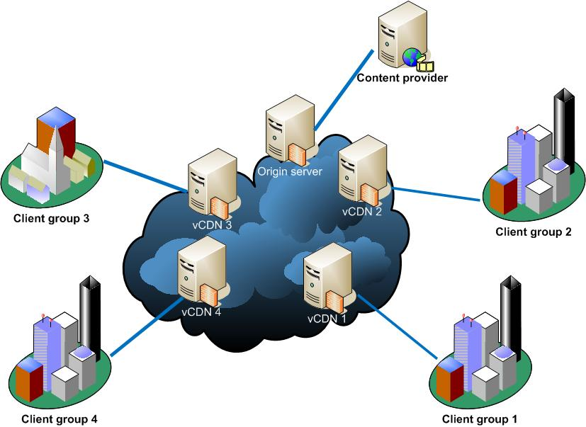
Context / Use Case
vIOSimulator
Ignacio Tamayo, Telecom SudParis - 2016 | Version 1.3 | August 2016
Notes:
Operator offers a NVF or Virtualization platform
Several OpenStack Multi-tenant DataCenters
Video CDN operators make use of this platform
Demands are aggregated over a period of time
Demands are a forecast to analyze
Demands are fictional demands
Objective: Optimize the placement of the vCDN instances in the infrastructure to better serve the clients (closer location), minimizing Infrastructure network load
Data Centers are highly dynamic and shared, so live metrics are used from OpenStack Data Centers

Slide 5



Platform
$ bin/vIOSimulator.py -h
Usage: vIOSimulator.py [-d] -f <INI file> [-f <INI file>] [-l <LOG file>]
-d|--debug
-f|--config-file <INI configuration file>
-l|--log-file <LOG file>
vIOSimulator
Ignacio Tamayo, Telecom SudParis - 2016 | Version 1.3 | August 2016
Notes:
vIOS can be run from any host with minimal requirements :
Python 2.7
MySQL DB (locally or remote)
This host must be able to reach via HTTP the OpenStack Controllers and KeyStone API from all the OpenStack DataCenters.
vIOS operates like a Server, is configured completely from an INI file, and is able to write log messages

Slide 6
Notes:
Show console launch options
Launch Service
Go To Web

Slide 7


Concepts
Topologie
VCDN
POP
Demand
Migration
Redirect
Instance
vIOSimulator
Ignacio Tamayo, Telecom SudParis - 2016 | Version 1.3 | August 2016
Notes:
Topologie: The network topologie is described by the Locations where the infrastructure has an installation, and by the Network Links that connect those locations, having a certain link BW capacity. ClientGroups is an aggregate of clients with common characteristics that are associated to a Location where they connect to the infrastructure.
vCDN: The client for the operator's infrastructure is a CDN provider, identified by an OpenStack Tenant/Project credentials. This tenant/project can login on one or more of the POPs. The vCDN also identifies the amount of resources it would deploy when instantiated in a POP.
The assemble of servers and resources used by a vCDN in a POP is called an Instance.
POP: The infrastructure has Points of Presence where an Open Stack DC is deployed, in certain Location.
The POP is identified by the OpenStack Keystone Public endpoint and admin credentials, along with the installed capacity (might defer from the values obtained directly via the OpenStack API)
Demand: Periodically either the vCDN or the operator feeds HMAC with the existing Demands, the requests for service.
A Demand comes from a ClientGroup and targets a vCDN in a specific POP. This is to relate to the fact that CDN internals take care of client request redirection to the appropriate cache server.
Migrations: As a result from the HMAC optimization, for each Demand presented there is possibly a Migration suggested.
All suggested Migrations have a Cost and Delay associated, and a minimum BW available in the migration path. The list of Migrations can be sorted on any of these parameters.
Redirections: As a result from the HMAC optimization, it could be detected that the Demands requesting a vCDN in a POP could be redirected to the another POP where the same vCDN is already instantiated.
There is no actual Migration in this case, but the Demands could be redirected to the optimal POP.
Instantiations: As a result from the HMAC optimization, it could be detected that the Demands request a vCDN in a POP where it is no instantiated yet instantiated.
There is no actual Migration in this case, but the vCDN could be instantiated in the optimal POP.

