Slide 1
Agent Orchestration
Checks, handoffs and shared skills
Sergei Telegin
github.com/TeleginS/agent-orchestration
Notes:
Agent Orchestration
0:00–0:15
Hi, I’m Sergei Telegin. I’ll show you one real task from my AI development workflow: what the agents checked, why the work came back, and what those extra passes cost.

Slide 2
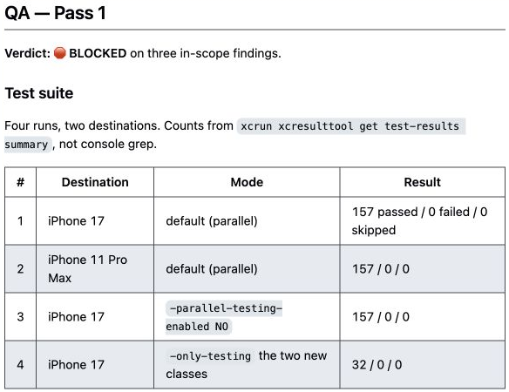
157 tests passed. QA blocked the PR
TrafficRulesApp: my iOS app for the Spanish driving theory exam
32 new tests
Review approved
the change
QA questioned what
the tests proved
PR #198 · Recorded evidence captured on 6 September 2026
02
Notes:
157 tests passed. QA blocked the PR.
0:15–1:00
TrafficRulesApp is my personal iOS app for the Spanish driving theory exam. In this task, agents were adding tests. The reviewer approved the change. All 157 tests passed. QA still blocked the pull request.
The problem was in what some of those tests could prove. We’ll follow the task through one map, see the finding and its repair, and look at the cost. The question to keep in mind is: what evidence should one stage give the next?
SOURCES
https://github.com/TeleginS/TrafficRulesApp/pull/198
https://github.com/TeleginS/TrafficRulesApp/pull/198#issuecomment-5500803440
https://github.com/TeleginS/TrafficRulesApp/issues/199
https://github.com/TeleginS/TrafficRulesApp/issues/200
https://github.com/TeleginS/TrafficRulesApp/issues/201
Historical reports captured 6 September 2026; private originals may require access. Local snapshots: /Users/sergei/Developer/agent-orchestration/docs/talks/resources/trafficrulesapp

Slide 3
An agent is a loop
A model decides. The execution environment runs tools and returns results.
Context
Model
Tool call
Tool result
Result becomes new context for the next decision
The harness manages the loop, permissions and tool execution.
A skill supplies instructions. The host supplies execution.
03
Notes:
An agent is a loop
1:00–2:00
An agent works through a loop. The model receives context and chooses an action. A tool reads a file, edits code, or runs a test. The execution environment, often called a harness, performs that action and returns the result.
The model can then choose another action. A developer might inspect code, make a change, read a test failure and try again.
For this talk, that is enough theory. The next question is how several such loops work together. Someone must provide the task and decide what result allows the next role to begin. My orchestrator coordinates that through written instructions. The diagram we’ll use describes those instructions; it does not enforce them.
SOURCES
/Users/sergei/Developer/agent-orchestration/docs/talks/resources/transcripts/ai-agents-harness.md
/Users/sergei/Developer/agent-orchestration/docs/talks/manychat-meetup-agent-orchestration-talk-graph-walkthrough.md

Slide 4
One map, four responsibilities
Current documented workflow · Full steps in the backup
Plan
Develop
Review
QA
Acceptance criteria
and dependencies
PR and
check results
Prioritized findings
or approval
Test evidence
and verdict
Orchestrator
Clarify decisions, pass artifacts, choose the next stage
Project profile
Shared commands and constraints
Preparation and completion checks surround this route. PIPELINE.md documents the instructions.
04
Notes:
One map, four responsibilities
2:00–3:30
Here is the map we’ll keep using. Four responsibilities: planning, implementation, review and QA.
The planner turns the request into acceptance criteria and work items. The developer implements those requirements and supplies the change and its checks. The reviewer examines the actual diff against the task. QA runs the suite and checks the acceptance criteria and relevant behavior.
These responsibilities overlap. Separate contexts do not make the agents statistically independent: they can share a model and repeat an assumption. The useful distinction is the additional check each role is asked to perform.
The orchestrator coordinates the whole route. It carries the task, the project profile and previous results between stages. It also handles preparation and completion: clarification, branch hygiene, artifact review and issue cleanup. We’ll keep those details on a backup slide.
Notice the labels between the boxes. A stage hands over something another stage can inspect. A message saying “done” is not enough to explain why the task should move forward.
SOURCES
/Users/sergei/Developer/agent-orchestration/README.md
/Users/sergei/Developer/agent-orchestration/PIPELINE.md
/Users/sergei/Developer/agent-orchestration/PIPELINE-GRAPH.md
/Users/sergei/Developer/agent-orchestration/skills/README.md
/Users/sergei/Developer/agent-orchestration/adapters/README.md
/Users/sergei/Developer/agent-orchestration/adapters/codex/README.md
/Users/sergei/Developer/agent-orchestration/memory/RULES.md

Slide 5
Changed code needs fresh evidence
Current documented workflow · Both return routes include code review
Plan
Develop
Review
QA
Review findings
Rule 11
Develop → Review
Review QA fixes
before retesting
QA findings
Develop → Review → QA
Added 26 August 2026
Up to 3 iterations per repair loop, then escalate unresolved blockers. These are prompt instructions.
05
Notes:
Changed code needs fresh evidence
3:30–5:00
There are two ways back. Review findings can send the patch to the developer. QA findings can also send it back, but a QA fix goes through review before QA tests it again.
The reason is simple: the fix changes the code. Approval of an earlier version does not cover that change automatically.
There is a short history behind this rule. In July, QA found double-counted session time after a reviewer had approved PR 143. On August 26, a versioned change explicitly added review of QA fixes to the instructions: rule eleven.
That establishes a documented process change. It does not establish that the July bug was its only cause, or reconstruct every setting in the old sessions.
Today, both repair loops have a three-iteration limit, then escalation with the remaining blockers. Those limits and transitions are instructions the orchestrator must follow. Now we can look at a later run where the additional review is visible in the reports.
SOURCES
https://github.com/TeleginS/TrafficRulesApp/pull/143
https://github.com/TeleginS/TrafficRulesApp/issues/144
https://github.com/TeleginS/TrafficRulesApp/commit/47fe4917052c82e7181e9de5321511ed8194c11c
/Users/sergei/Developer/agent-orchestration/README.md
/Users/sergei/Developer/agent-orchestration/PIPELINE.md
/Users/sergei/Developer/agent-orchestration/PIPELINE-GRAPH.md
/Users/sergei/Developer/agent-orchestration/skills/README.md
/Users/sergei/Developer/agent-orchestration/adapters/README.md
/Users/sergei/Developer/agent-orchestration/adapters/codex/README.md
/Users/sergei/Developer/agent-orchestration/memory/RULES.md
Historical reports captured 6 September 2026; private originals may require access. Local snapshots: /Users/sergei/Developer/agent-orchestration/docs/talks/resources/trafficrulesapp

Slide 6
32 new tests. One delivery route.
PR #198 · ProgressStore and TestSession coverage
Plan
Develop
Review
QA
125 → 157
Scope
Tests + project profile
No application code changes
Tests for cumulative progress
and terminal session paths
The historical run used role agents. The current skill packaging appears later in this talk.
06
Notes:
32 new tests. One delivery route.
5:00–6:30
The task in PR 198 was to add unit tests for ProgressStore and for recording progress when a test session ends. That included the protection against counting time twice after completion, connecting this work to the earlier bug.
The final change contained 32 new tests. The suite grew from 125 to 157. It also added a project profile, with commands and project-specific constraints. Application code did not need to change.
We are looking at saved reports and screenshots from that run, not a new test session performed for this presentation. The map is our guide to the intended route; the reports show the visits we can actually trace.
Keep the task’s goal in mind: useful tests of existing behavior. Success required more than increasing the test count. A test needed to fail when the behavior it claimed to protect was broken. That is where both review and QA had work to do.
SOURCES
https://github.com/TeleginS/TrafficRulesApp/pull/198
https://github.com/TeleginS/agent-orchestration/blob/693c5cd291e35d773c9f68f99888ca420dbbf30a/examples/run-progress-store-tests/README.md#measured-subagent-tokens
https://github.com/TeleginS/TrafficRulesApp/commit/9a26da875489315c3164ebeb14e1b8af7c57b177
Historical reports captured 6 September 2026; private originals may require access. Local snapshots: /Users/sergei/Developer/agent-orchestration/docs/talks/resources/trafficrulesapp

Slide 7
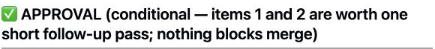
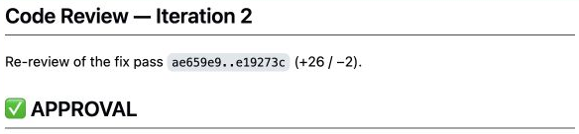
Review improved the patch
Two review passes before the first QA pass
Plan
Develop
Review
QA
Review 1
Review 2
Conditional approval
with quality findings
Developer follow-up
then APPROVAL
The first review was not BLOCKED. QA made the later blocking decision.
07
Notes:
Review improved the patch
6:30–7:30
The first review gave conditional approval with quality findings. It did not report critical blockers. Two findings were worth a short follow-up: a missing integration check for an important progress rule, and a check connecting the expected theme count to the bundled data.
The developer addressed them. The second review approved the patch after examining those changes and running the suite.
That was useful work. The point of the next finding is not that review did nothing. It improved the patch, and QA then found a different weakness.
On our map, we have visited the same reviewer twice. Each visit concerns a different state of the code. The second approval is what takes this task into QA.
SOURCES
https://github.com/TeleginS/TrafficRulesApp/pull/198#issuecomment-5500796064
https://github.com/TeleginS/TrafficRulesApp/pull/198#issuecomment-5500799535
Historical reports captured 6 September 2026; private originals may require access. Local snapshots: /Users/sergei/Developer/agent-orchestration/docs/talks/resources/trafficrulesapp

Slide 8
Green tests. Weak evidence.
QA Pass 1: BLOCKED on three in-scope findings
Plan
Develop
Review
QA
What could still be wrong?
Positive totals can predate the test
Shared storage can leak state
Exit paths need separate checks
Passing the suite establishes the recorded outcomes; it does not establish the quality of every assertion.
08
Notes:
Green tests. Weak evidence.
7:30–9:00
The QA report records successful runs on two simulator destinations, including a full run with parallel testing disabled. It also says BLOCKED, with three in-scope findings.
Two findings belong together. Five tests asserted that accumulated session time was greater than zero. The tests also used shared storage and manually cleared a list of keys.
The task required each terminal action to contribute time. A positive total did not necessarily show that this particular action had contributed anything. Old values could make the assertion pass.
The third finding concerned distinguishing two exit branches. We’ll leave its details for questions.
This does not make all 157 tests useless. QA specifically identified the affected checks and acknowledged checks that were sound. The useful distinction is between a test executing successfully and the test establishing the behavior its name and acceptance criterion promise. Let’s make that distinction concrete.
SOURCES
https://github.com/TeleginS/TrafficRulesApp/pull/198#issuecomment-5500803440
https://github.com/TeleginS/TrafficRulesApp/issues/199
https://github.com/TeleginS/TrafficRulesApp/issues/200
https://github.com/TeleginS/TrafficRulesApp/issues/201
Historical reports captured 6 September 2026; private originals may require access. Local snapshots: /Users/sergei/Developer/agent-orchestration/docs/talks/resources/trafficrulesapp

Slide 9
Prove the change, isolate the state
The assertion and the fixture address connected concerns
Illustrative dirty store
The repair
Before 500 seconds
After 500 seconds
1 Compare before and after
2 Give each test its own store
after > 0 PASS
after > before FAIL
With before = 0, both comparisons
are numerically equivalent.
Isolation removes the original risk.
500 seconds is an illustration, not a measured result. Review 3 explicitly records the zero-baseline caveat.
09
Notes:
Prove the change, isolate the state
9:00–11:00
Imagine the store contains 500 seconds before the call. The call adds nothing. Afterward, the store still contains 500 seconds.
“Is the total greater than zero?” passes. “Did the total increase after this call?” fails. Pause on those two questions: they establish different things. Five hundred is an illustrative value, not a measurement from this QA run.
Why could there be an old value? These tests used UserDefaults.standard, shared application storage. They cleared a known list of keys, but that did not give each test control over every possible source of starting state. The saved findings describe contamination encountered during implementation.
The repair had two parts. Each test received its own temporary storage suite through injection points already present in the application. The assertions captured the value just before the terminal call and checked for an increase afterward.
Isolation controls the starting state. The comparison expresses the contribution of the action under test. Both matter to the explanation; we should examine the fixture and the assertion together.
There is a qualification: in the repaired isolated fixture, the starting value is zero. The two comparisons are numerically equivalent there. We should not credit the whole improvement to the new assertion alone.
The developer made these changes in the test files without changing production code. But the work is not finished when the developer reports the fix. We have changed the patch, so we need fresh review evidence before another QA verdict.
SOURCES
https://github.com/TeleginS/TrafficRulesApp/pull/198#issuecomment-5500803440
https://github.com/TeleginS/TrafficRulesApp/issues/199
https://github.com/TeleginS/TrafficRulesApp/issues/200
https://github.com/TeleginS/TrafficRulesApp/issues/201
https://github.com/TeleginS/TrafficRulesApp/commit/114cb54a883fcfed25f98e08c97d9d3ff9407e20
https://github.com/TeleginS/TrafficRulesApp/pull/198#issuecomment-5500807469
Historical reports captured 6 September 2026; private originals may require access. Local snapshots: /Users/sergei/Developer/agent-orchestration/docs/talks/resources/trafficrulesapp

Slide 10
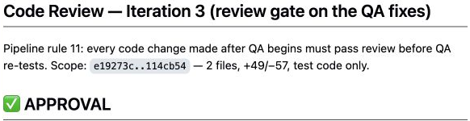
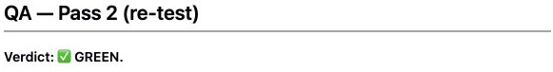
Fix → review → QA
PR #198 · The repaired tests went through the review gate
Developer fix
Review 3: APPROVAL
QA 2: GREEN
114cb54
Delta assertions
and isolated storage
4 full runs
157 passed in each
PR open at capture, 6 September 2026. QA green permits completion checks; it does not establish merge.
10
Notes:
Fix → review → QA
11:00–12:30
The developer pushed the fixes to the same pull request. Review iteration three explicitly invoked rule eleven and checked the QA fixes before the work returned to QA.
The reviewer approved and explicitly made the qualification we just discussed: in the isolated fixture, “before” is zero. The explanation must account for both changes. The delta form expresses the requirement; isolation removes the shared-state problem.
That is useful scrutiny of both the patch and the explanation of what it proves.
QA then returned GREEN. Its report records four full runs with 157 passing tests each, including a deliberately polluted shared store to test the isolation.
At the September 6 screenshot capture, the PR was still open. We have a recorded approval and green QA, not evidence of a merge. Completion work still follows on the map. Now let’s attach costs to the visits we just saw.
SOURCES
https://github.com/TeleginS/TrafficRulesApp/commit/114cb54a883fcfed25f98e08c97d9d3ff9407e20
https://github.com/TeleginS/TrafficRulesApp/pull/198#issuecomment-5500807469
https://github.com/TeleginS/TrafficRulesApp/pull/198#issuecomment-5500811713
Historical reports captured 6 September 2026; private originals may require access. Local snapshots: /Users/sergei/Developer/agent-orchestration/docs/talks/resources/trafficrulesapp

Slide 11
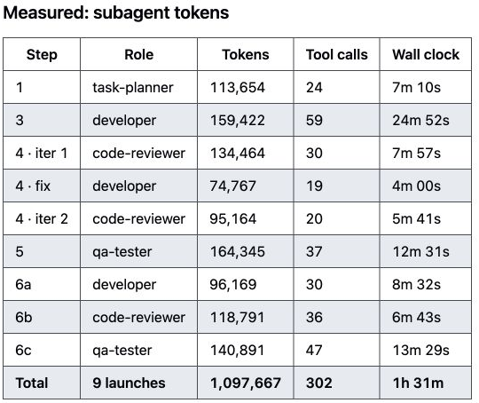
The observed cost
The same ProgressStore coverage task
Measure | Recorded result
Subagent launches | 9
Summed stage time | About 1 h 31 min
Subagent tokens | 1,097,667
Planner ×1 Developer ×3
Reviewer ×3 QA ×2
Orchestrator tokens excluded. No matched single-agent baseline.
11
Notes:
The observed cost
12:30–14:00
The saved report gives us nine subagent launches and 1,097,667 subagent tokens. The recorded stage wall times add up to about one hour and thirty-one minutes. That is the sum of those stage durations, not a separate measurement of my total time on the task.
The visits explain the count: one planner, three developer passes, three reviews and two QA passes. Review used slightly more tokens than implementation in this run.
Orchestrator tokens were mixed into the main conversation and estimated separately, so they are excluded here. I’m also keeping estimated dollar costs off this slide.
For 32 new tests, these are substantial coordination costs. We saw useful findings, but there was no matched single-agent run. This example does not establish a general quality or cost advantage.
What I would measure next is confirmed findings, missed defects and human intervention time, alongside tokens and duration. That would help decide which checks are worth retaining for this kind of task.
SOURCES
https://github.com/TeleginS/agent-orchestration/blob/693c5cd291e35d773c9f68f99888ca420dbbf30a/examples/run-progress-store-tests/README.md#measured-subagent-tokens

Slide 12
How the repository works today
Current structure · 13 September 2026
Canonical skills
Thin host adapters
skills/<role>/SKILL.md
Procedure + expected output
Separate stage agents
Optional model / reasoning settings
Main conversation
Orchestrator stays with the user
Shared context
Project profile + explicitly read role memory
The measured run predates this packaging. Its effect on cost and quality has not been measured.
12
Notes:
How the repository works today
14:00–15:00
The repository has since changed its packaging. The reusable procedures now live in canonical skills. The orchestrator stays in the main conversation, where it can clarify requirements, and delegates the stages to separate agents.
Thin host adapters provide launch behavior and model configuration. Model and reasoning choices can be configured per role where the host supports them; otherwise its defaults apply. A skill contains instructions. Loading it alone does not create an independent agent.
The project profile supplies commands and constraints. Each role explicitly reads relevant shared project memory under common rules.
These changes make the responsibilities of the files clearer. The historical run we just examined predates this packaging. I am not claiming measured improvements in cost or quality from the migration.
SOURCES
/Users/sergei/Developer/agent-orchestration/README.md
/Users/sergei/Developer/agent-orchestration/PIPELINE.md
/Users/sergei/Developer/agent-orchestration/PIPELINE-GRAPH.md
/Users/sergei/Developer/agent-orchestration/skills/README.md
/Users/sergei/Developer/agent-orchestration/adapters/README.md
/Users/sergei/Developer/agent-orchestration/adapters/codex/README.md
/Users/sergei/Developer/agent-orchestration/memory/RULES.md

Slide 13
Define what each stage hands over
Start with one workflow in your own repository
Stage | Concrete result for the next stage
Planner | Acceptance criteria, dependencies and issues
Developer | PR / diff, changed files and check results
Reviewer | Prioritized findings or explicit APPROVAL
QA | Test evidence, classified bugs, GREEN / BLOCKED
The orchestrator verifies the artifacts and routes the next stage. Dry-run uses local drafts.
13
Notes:
Define what each stage hands over
15:00–17:00
Here is the part you can apply without copying my entire workflow: define what each stage hands over.
For the planner, I want criteria someone can actually check, dependencies and linked work items with a clear scope. The developer needs those criteria, project context and execution constraints. It returns a pull request and diff, the version it changed, and what it built or tested.
The reviewer needs the actual diff and requirements, not only the developer’s summary. Its report should identify the reviewed version, prioritized findings or explicit approval. After a fix, the next reviewer also needs the previous findings so it can establish what changed.
QA needs the same requirements and current change. It returns evidence for acceptance criteria, test results, classified bugs and an explicit GREEN or BLOCKED verdict. Calling a bug pre-existing needs evidence from the base version; uncertainty is not a reason to mark the work green.
The orchestrator carries these results onward while preserving the task’s constraints. That includes the branch, ownership, mode and any limits on writes. In a dry run, local plans, diffs and findings replace tracker and PR artifacts.
Today this is largely an instruction contract. A future controller could check that required artifacts exist and refer to the current version. It could reject stale approval. It would still not prove that the review itself was correct.
SOURCES
/Users/sergei/Developer/agent-orchestration/README.md
/Users/sergei/Developer/agent-orchestration/PIPELINE.md
/Users/sergei/Developer/agent-orchestration/PIPELINE-GRAPH.md
/Users/sergei/Developer/agent-orchestration/skills/README.md
/Users/sergei/Developer/agent-orchestration/adapters/README.md
/Users/sergei/Developer/agent-orchestration/adapters/codex/README.md
/Users/sergei/Developer/agent-orchestration/memory/RULES.md

Slide 14
Three things to take back
01
Define the output of each stage
02
Pass artifacts that others can verify
03
Repeat verification after code changes
github.com/TeleginS/agent-orchestration
14
Notes:
Three things to take back
17:00–18:00
Three things to take back.
First, define the output of each stage. Say what it must deliver and what permits the next stage to begin.
Second, pass artifacts that others can verify: requirements, the actual diff, findings and test results. Give the next role something it can inspect.
Third, repeat verification after code changes. A fix needs evidence for the new version, including review before fresh QA.
Start with one type of task and inspect the handoffs in real runs. The repository includes the skills, profiles, workflow and saved examples we discussed. Thank you. I’m happy to take questions after the talk.
SOURCES
/Users/sergei/Developer/agent-orchestration/README.md
/Users/sergei/Developer/agent-orchestration/PIPELINE.md
/Users/sergei/Developer/agent-orchestration/PIPELINE-GRAPH.md
/Users/sergei/Developer/agent-orchestration/skills/README.md
/Users/sergei/Developer/agent-orchestration/adapters/README.md
/Users/sergei/Developer/agent-orchestration/adapters/codex/README.md
/Users/sergei/Developer/agent-orchestration/memory/RULES.md

Slide 15
Full workflow and transition conditions
Backup · Current documented pipeline
0 Design
1 Plan
2 Branch
3 Dev / PR
4 Review
5 QA
Review findings → Develop → Review
Bugs
QA findings → Develop → Review → QA
QA green → Step 7: artifact checks
10 Report
9 Settings*
8 Issues
7 Artifacts
6 Fix, review,
QA retest
Clarify design first. Both repair loops: max 3 iterations, then escalate. * Settings are optional.
15
Notes:
Full workflow and transition conditions
Backup — questions only
This is the complete documented workflow. The main conversation first resolves project context and any missing product decisions. Planning establishes the work, branch preparation protects unrelated changes, and the developer produces the patch.
The review loop permits up to three completed verdicts, counting the initial review. The QA repair loop counts each developer fix and its review as an iteration, even if review blocks a return to QA. Moving between roles does not reset that counter.
A verified pre-existing bug is recorded as separate work and does not block this change. Its classification needs comparable base-version evidence. An unconfirmed origin remains a blocker until classified.
After green QA, artifact review, issue cleanup and any applicable settings work still happen. Unmerged work keeps its issue references and stays open. In dry-run mode, planning and findings stay local and the workflow writes neither to the tracker nor the remote.
The diagram documents these transitions. It is not an executable controller and does not provide automatic recovery.
SOURCES
/Users/sergei/Developer/agent-orchestration/README.md
/Users/sergei/Developer/agent-orchestration/PIPELINE.md
/Users/sergei/Developer/agent-orchestration/PIPELINE-GRAPH.md
/Users/sergei/Developer/agent-orchestration/skills/README.md
/Users/sergei/Developer/agent-orchestration/adapters/README.md
/Users/sergei/Developer/agent-orchestration/adapters/codex/README.md
/Users/sergei/Developer/agent-orchestration/memory/RULES.md

Slide 16
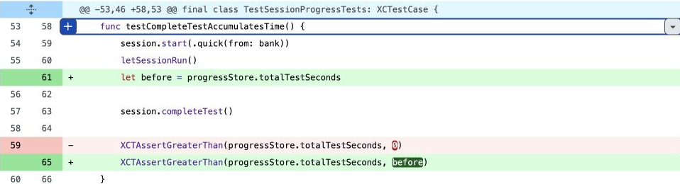
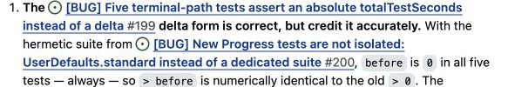
The zero-baseline caveat
Backup · Actual diff and Review 3
In the repaired fixture
before = 0
after > 0
after > before
Numerically equivalent
for these five tests
The dirty-store example describes the original risk, not the repaired fixture.
16
Notes:
The zero-baseline caveat
Backup — questions only
The dirty-store example explains the original risk. If the store was already positive, an assertion on the absolute total could pass when the terminal action added nothing.
The repair also changed the fixture. In the committed isolated tests, the initial value is zero. Therefore greater than zero and greater than the prior value are numerically equivalent in that fixture. The reviewer explicitly pointed this out.
The delta form states the intended contribution and remains useful if a future fixture starts with seeded progress. Isolation removes dependence on shared old values. Both changes are reasonable, but the mutation demonstration with a dirty store should not be presented as the starting state of the repaired suite.
The third finding added checks distinguishing the two exit branches. If you want the full discussion, the saved issues and the final review and QA reports contain the details.
SOURCES
https://github.com/TeleginS/TrafficRulesApp/pull/198#issuecomment-5500803440
https://github.com/TeleginS/TrafficRulesApp/issues/199
https://github.com/TeleginS/TrafficRulesApp/issues/200
https://github.com/TeleginS/TrafficRulesApp/issues/201
https://github.com/TeleginS/TrafficRulesApp/commit/114cb54a883fcfed25f98e08c97d9d3ff9407e20
https://github.com/TeleginS/TrafficRulesApp/pull/198#issuecomment-5500807469
https://github.com/TeleginS/TrafficRulesApp/pull/198#issuecomment-5500811713
Historical reports captured 6 September 2026; private originals may require access. Local snapshots: /Users/sergei/Developer/agent-orchestration/docs/talks/resources/trafficrulesapp

