Slide 1
Agent Orchestration
Sergei Telegin
github.com/TeleginS/agent-orchestration
Notes:
TIMING: about 10–15 seconds, within the first minute of the talk.
Hello, I am Sergei Telegin. Today I will talk about agent orchestration. The project and its role instructions are available on GitHub.
https://github.com/TeleginS/agent-orchestration
This title slide precedes the ten content slides. Keep the original timing checkpoints and the two-minute buffer.

Slide 2
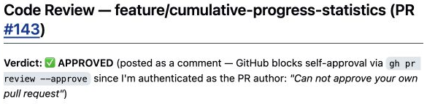
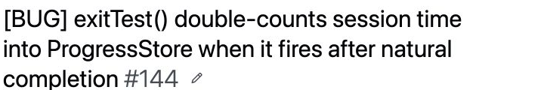
Evolving an AI delivery pipeline
A real case from TrafficRulesApp, my iOS driving-test app
July 2026: QA found a bug after review
Review approved the change
QA found double-counted time
The pipeline changed over time. A later run shows why the new review step matters.
Sergei Telegin / Manychat meetup / July and September 2026 cases
01
Notes:
TIMING: 0:00–1:00. Planned pace, including pauses and discussion of the evidence. Keep 18:00–20:00 free as a buffer. Audience questions follow the talk.
TrafficRulesApp is my personal iOS app for the Spanish driving theory exam. I use a team of AI agents for some development tasks. In July, they implemented cumulative statistics. The reviewer approved the change. QA then found a timing sequence that counted the same session twice: the timer completed the test while the exit dialog remained open, and confirming the dialog added the time again.
I kept changing and tuning the pipeline after that period. Today I will show one versioned change to its rules and a later run where every test passed but QA still blocked the result. We will look at what QA found, why the fixes needed another review, and the cost of that run. This is a history of artifacts and reports, rather than a controlled comparison of two complete pipeline configurations.
SOURCES
https://github.com/TeleginS/TrafficRulesApp/pull/143
https://github.com/TeleginS/TrafficRulesApp/issues/144
GitHub screenshots captured on 6 September 2026. Saved agent reports, not an independent rerun. Original private sources require access. Speaker notes and slide wording are in English.

Slide 3
The agent loop
The model chooses actions. The harness executes allowed calls.
Task: add a regression test
Task
Model
Tool call
Read files
Run tests
Tool result
Harness
Context, permissions, error handling and stopping conditions
02
Notes:
TIMING: 1:00–3:00. Planned pace, including pauses and discussion of the evidence. Keep 18:00–20:00 free as a buffer. Audience questions follow the talk.
For this talk, an agent is a system that chooses actions, uses tools and decides how to continue from their results. Follow one example throughout: adding a test to an iOS project. The model can ask to read a file. A tool performs the actual read. The returned contents become part of the next model context. After a change, the model can request a test run and use the failure to choose another action.
The harness is the software that runs this loop. It assembles context, executes allowed tool calls, handles errors and decides when to continue or stop. Some choices can stay with the model, while the runtime imposes limits on permissions or retries. The model name alone tells us little about these controls.
There is a practical distinction between asking an agent to run tests and having software require a test result before allowing completion. My published repository mainly defines role instructions and a route for an orchestrator agent to follow. It does not itself implement a durable execution engine. Pause on that distinction before moving to several agents.
SOURCES
https://www.anthropic.com/engineering/building-effective-agents
https://github.com/TeleginS/agent-orchestration/blob/693c5cd291e35d773c9f68f99888ca420dbbf30a/PIPELINE.md
../resources/transcripts/ai-agents-harness.md
GitHub screenshots captured on 6 September 2026. Saved agent reports, not an independent rerun. Original private sources require access. Speaker notes and slide wording are in English.

Slide 4
Roles and handoffs
Each stage produces something the next stage can inspect
Role | Responsibility | Handoff
Planner | Define scope and acceptance | Issues and criteria
Developer | Implement the change | PR, diff and check results
Reviewer | Inspect the implementation | Findings or approval
QA | Check behavior and acceptance | Bugs, evidence and verdict
Orchestrator | Pass context and route work | Combined run report
Separate roles can still share the same model and the same blind spots.
03
Notes:
TIMING: 3:00–4:20. Planned pace, including pauses and discussion of the evidence. Keep 18:00–20:00 free as a buffer. Audience questions follow the talk.
The planner turns a request into requirements that someone can actually check. The developer reads those requirements, changes the code and opens a pull request. The reviewer receives the original task and the real diff, then returns findings or explicit approval. QA has a separate assignment to check acceptance and look for problematic behavior. Their responsibilities overlap, but their emphasis differs.
The orchestrator passes the task, project context, issues, pull request and check results between roles. A useful handoff is more than the previous agent saying that everything is done. The next role needs the evidence it will inspect.
Giving the roles separate contexts can focus their attention. It does not make their judgments statistically independent. They may use the same model and repeat the same assumptions. The value of an extra role comes from the additional check it performs.
These prompts and routing instructions changed over time, so today's instructions cannot be treated as a complete description of the earlier run.
SOURCES
https://github.com/TeleginS/agent-orchestration/blob/693c5cd291e35d773c9f68f99888ca420dbbf30a/PIPELINE.md
https://github.com/TeleginS/TrafficRulesApp/pull/143
GitHub screenshots captured on 6 September 2026. Saved agent reports, not an independent rerun. Original private sources require access. Speaker notes and slide wording are in English.

Slide 5
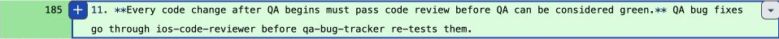
QA fixes go through review again
The August change adds review before the QA retest
Planner
Developer
Reviewer
QA
Report
QA requests a fix
Fixes
Then review the new version before QA runs again
26 August 2026 / Rule 11 in the orchestrator instructions
Prompt-based routing. Current generic pipeline: stop after three unsuccessful iterations per loop.
04
Notes:
TIMING: 4:20–6:00. Planned pace, including pauses and discussion of the evidence. Keep 18:00–20:00 free as a buffer. Audience questions follow the talk.
The normal route runs from planning through development, review and QA to a final report. Review findings go back to the developer. QA findings also go back to the developer, but the changed code must pass review before the next QA run. The added step matters because approval of an earlier version does not cover a later fix automatically.
In July, the cumulative-statistics PR had an approval followed by a QA finding about double-counted time. I continued tuning the pipeline. A commit on 26 August explicitly added rule 11 to the orchestrator instructions: QA fixes need another review before QA can be green. The September test-coverage run contains an explicit report for this review step.
The diagram summarizes the route and leaves out Git and issue housekeeping. The current generic instructions limit each repair loop to three iterations before escalation. These are instructions for the orchestrator, not transitions enforced by this diagram.
I have not recovered the full context of the historical sessions. Versioned files establish this change, but cannot reconstruct uncommitted prompts, model settings or the main conversation. Nor do they establish that the earlier bug was the sole cause of rule 11.
SOURCES
https://github.com/TeleginS/TrafficRulesApp/commit/47fe4917052c82e7181e9de5321511ed8194c11c
https://github.com/TeleginS/TrafficRulesApp/pull/143
https://github.com/TeleginS/TrafficRulesApp/issues/144
https://github.com/TeleginS/TrafficRulesApp/pull/198
https://github.com/TeleginS/agent-orchestration/blob/693c5cd291e35d773c9f68f99888ca420dbbf30a/PIPELINE.md
GitHub screenshots captured on 6 September 2026. Saved agent reports, not an independent rerun. Original private sources require access. Speaker notes and slide wording are in English.

Slide 6
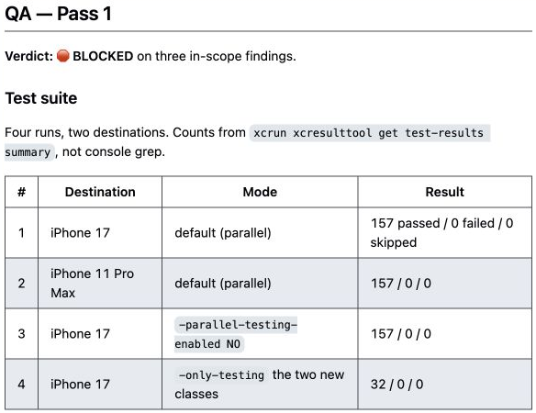
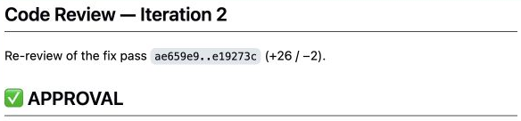
157 tests passed. QA still blocked the PR
ProgressStore coverage: 32 new tests, with application code unchanged
32 new tests
Full suite: 125 to 157
Second review
Saved run reports. The pull request was still open when these screenshots were captured.
05
Notes:
TIMING: 6:00–7:30. Planned pace, including pauses and discussion of the evidence. Keep 18:00–20:00 free as a buffer. Audience questions follow the talk.
This task added unit tests for ProgressStore and for progress recording from a test session. That included the protection against adding session time twice, which connects it to the July case. The task did not need production-code changes. It added 32 tests, bringing the full suite from 125 to 157.
The first review produced findings and the developer addressed them. The second review approved the result. QA also reported successful runs across two simulator destinations, with the full suite and the new classes tested separately.
But QA's verdict was BLOCKED. It found three issues in the checks themselves. We will focus on two related issues: what the assertion actually proves and how old values can enter the test's storage.
A test executing successfully and a test establishing its intended behavior are different claims. The report supports the first claim, while the findings challenge part of the second. This does not mean all 157 tests were useless. The concern applies to specific checks.
SOURCES
https://github.com/TeleginS/TrafficRulesApp/pull/198
https://github.com/TeleginS/TrafficRulesApp/pull/198#issuecomment-5500799535
https://github.com/TeleginS/TrafficRulesApp/pull/198#issuecomment-5500803440
GitHub screenshots captured on 6 September 2026. Saved agent reports, not an independent rerun. Original private sources require access. Speaker notes and slide wording are in English.

Slide 7
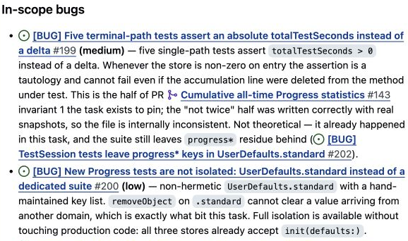
Accumulated time or this call’s contribution?
Two related findings: the assertion and the initial state
Illustrative example
Before 500 seconds
After 500 seconds
after > 0 PASS
after > before FAIL
The call added nothing.
Paired fix: compare with the prior value and give each test its own isolated store.
06
Notes:
TIMING: 7:30–10:00. Planned pace, including pauses and discussion of the evidence. Keep 18:00–20:00 free as a buffer. Audience questions follow the talk.
The requirement concerned the contribution of a particular terminal call: that path must add session time. Five tests instead checked that the accumulated total was greater than zero.
Imagine a store with 500 seconds before the call and the same 500 seconds afterward. The method has added nothing, but a greater-than-zero assertion still passes. Comparing the result with a snapshot from before the call exposes the missing contribution. The number 500 on this slide is an illustrative example, not a measured value from the QA run.
The mechanism connects directly to isolation. These tests used shared UserDefaults.standard storage and manually cleared a list of keys. Old progress could come from other tests or survive from another run. A positive total therefore did not necessarily come from the action being tested.
The fix addressed both parts: snapshot the prior value and assert an increase, and give each test a separate temporary suite through the stores' existing injection parameters. No production-code changes were necessary. This controls the starting state and expresses the behavioral requirement.
QA found three issues overall. The third concerned distinguishing the two exit branches. We can discuss it after the talk. The main point here is the connection between a weak assertion and shared state. The other tests retained their value.
SOURCES
https://github.com/TeleginS/TrafficRulesApp/pull/198#issuecomment-5500803440
https://github.com/TeleginS/TrafficRulesApp/pull/198#issuecomment-5500799535
https://github.com/TeleginS/TrafficRulesApp/issues/199
https://github.com/TeleginS/TrafficRulesApp/issues/200
https://github.com/TeleginS/TrafficRulesApp/commit/114cb54a883fcfed25f98e08c97d9d3ff9407e20
GitHub screenshots captured on 6 September 2026. Saved agent reports, not an independent rerun. Original private sources require access. Speaker notes and slide wording are in English.

Slide 8
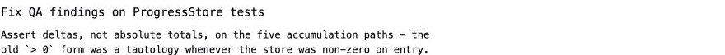
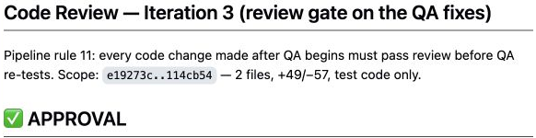
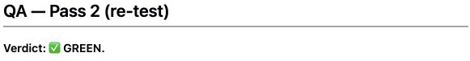
The fix gets its own review
The same change passes review before QA runs again
Fix: delta assertions and isolated test storage
Review 3
QA retest
After isolation, before = 0.
The two fixes work together.
157 passed in all four full runs
07
Notes:
TIMING: 10:00–12:00. Planned pace, including pauses and discussion of the evidence. Keep 18:00–20:00 free as a buffer. Audience questions follow the talk.
This is the new route in a concrete run. The developer addressed the QA findings in the fix commit. Review iteration 3 explicitly invokes rule 11 and evaluates the QA fixes. Only after its approval does the work return to QA.
The review does more than confirm that the code changed. It qualifies the explanation of the fix. With the isolated suite, the initial value is zero in these five tests. In that state, greater than zero and greater than before are numerically equivalent. We therefore cannot credit the entire effect to replacing the assertion alone.
The delta assertion expresses the intended contribution. The isolated suite controls the starting state. Those changes work together. The reviewer also verified the injection and checked whether shared application data could leak into the new suite.
QA then repeated the checks and returned GREEN. Its report records four full runs, each with 157 passing tests, including a deliberately polluted shared store. The screenshots show the first row as a readable excerpt of the larger table.
The outcome was reviewed changes and green QA in an open pull request. The decision to merge remains separate. Now we can discuss what these extra passes cost.
SOURCES
https://github.com/TeleginS/TrafficRulesApp/commit/114cb54a883fcfed25f98e08c97d9d3ff9407e20
https://github.com/TeleginS/TrafficRulesApp/pull/198#issuecomment-5500807469
https://github.com/TeleginS/TrafficRulesApp/pull/198#issuecomment-5500811713
GitHub screenshots captured on 6 September 2026. Saved agent reports, not an independent rerun. Original private sources require access. Speaker notes and slide wording are in English.

Slide 9
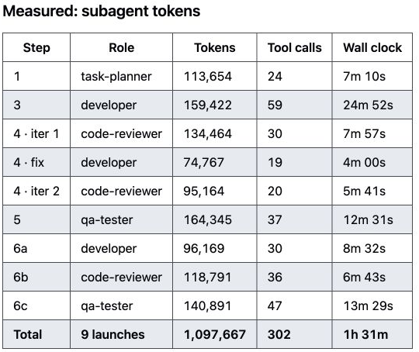
The cost of this run
32 new tests and a project profile in the same pull request
Measure | Recorded result
Subagent launches | 9
Elapsed time | About 1 h 31 min
Subagent tokens | 1,097,667
3 developer, 3 reviewer,
2 QA, 1 planner
Orchestrator tokens excluded. No comparable single-agent control run.
08
Notes:
TIMING: 12:00–14:00. Planned pace, including pauses and discussion of the evidence. Keep 18:00–20:00 free as a buffer. Audience questions follow the talk.
These numbers come from the saved cost report for the same ProgressStore test task. There were nine subagent launches, about an hour and a half of elapsed work and roughly 1.10 million subagent tokens. The exact recorded token count is 1,097,667.
The role breakdown is three developer passes, three review passes, two QA passes and one planning pass. Each return to a role requires context, investigation, checks and another report. The extra passes produced findings, but they were not free.
The token figure excludes the orchestrator. Its tokens were mixed with the main session and only estimated in the source report. Elapsed time comes from that report, not from the timestamps of GitHub comments. Comments can appear after the underlying work.
I am also not presenting an estimated dollar range as a provider invoice. Model choice, input and output tokens, and caching affect such an estimate.
For 32 new tests, this is substantial overhead. I have no matched single-agent control, so this run does not establish a price or quality advantage for multiple agents. It does show the checks we paid for and the findings they produced. For future runs, I also want to record the time I spend intervening and reading reports.
SOURCES
https://github.com/TeleginS/agent-orchestration/blob/693c5cd291e35d773c9f68f99888ca420dbbf30a/examples/run-progress-store-tests/README.md
https://github.com/TeleginS/TrafficRulesApp/pull/198
GitHub screenshots captured on 6 September 2026. Saved agent reports, not an independent rerun. Original private sources require access. Speaker notes and slide wording are in English.

Slide 10
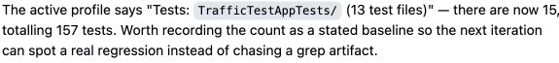
What I changed and what comes next
Observations from the run feed back into the process
Observation | Response
QA fixes change reviewed code | Another review before QA
Project facts drift | A shared profile, corrected from evidence
Text rules can be skipped | Next: enforce transitions in the runtime
Coordination consumes resources | Next: measure human intervention too
Profile correction:
13 to 15 test files
Current routing relies mainly on prompts. Runtime enforcement is a proposed improvement.
09
Notes:
TIMING: 14:00–17:00. Planned pace, including pauses and discussion of the evidence. Keep 18:00–20:00 free as a buffer. Audience questions follow the talk.
The first change is the review of QA fixes that we just saw. Another is separating general role instructions from project facts. A shared profile holds the build and test commands, architecture and project constraints. This run added a profile and corrected drift reported by the agents.
The evidence included the question count, the number of test files and the way test results were counted. A particularly useful example was 156 versus 157. Parallel console output lost part of a line, so counting passed messages with grep undercounted tests. The agents used the structured xcresult summary to establish that 157 tests ran. The process needs a better source for the next report, rather than just a corrected number in the current report.
Profiles can themselves become stale. Reviewers can misread evidence. Reports should record the scenario, the version and the way the result was obtained.
Today, much of this route lives in prompts. A possible next step is runtime enforcement of transitions, retry limits and review for the current code version. A runtime can enforce the existence of an approval without proving that the review is correct. Checkpoints and automatic recovery also require more than this prompt repository provides.
Finally, the right amount of decomposition depends on the task. An extra role may repeat an investigation the previous agent already performed. For a small change, one agent and suitable tests may be enough. To compare pipeline versions fairly, I need comparable tasks, recorded conditions and the amount of human intervention.
SOURCES
https://github.com/TeleginS/TrafficRulesApp/commit/9a26da875489315c3164ebeb14e1b8af7c57b177
https://github.com/TeleginS/TrafficRulesApp/pull/198
https://github.com/TeleginS/TrafficRulesApp/pull/198#issuecomment-5500807469
https://github.com/TeleginS/agent-orchestration/blob/693c5cd291e35d773c9f68f99888ca420dbbf30a/PIPELINE.md
https://github.com/TeleginS/agent-orchestration/blob/693c5cd291e35d773c9f68f99888ca420dbbf30a/examples/run-progress-store-tests/README.md
GitHub screenshots captured on 6 September 2026. Saved agent reports, not an independent rerun. Original private sources require access. Speaker notes and slide wording are in English.

Slide 11
Tuning the process from real runs
One task type
A checkable result for every stage
A saved record of each run
Findings, instruction version, costs and human intervention
Roles, project profiles and run reports
github.com/TeleginS/agent-orchestration
10
Notes:
TIMING: 17:00–18:00. Planned pace, including pauses and discussion of the evidence. Keep 18:00–20:00 free as a buffer. Audience questions follow the talk.
If you want to try this approach, begin with one type of task and a clear result for every stage. Save the reports and examine which checks brought useful findings and which only added cost.
In the earlier case, QA found a bug after approval. Later, versioned instructions explicitly added review of QA fixes. In the September run, the reports show that step checking both the code and the explanation of the result. The history supports a concrete change in the process, while leaving the full historical session state unknown.
That is how I want to tune the pipeline: use observed gaps, change a rule or a source of context, and inspect what happens in the next run. The checks themselves need evidence too.
The repository contains the roles, profiles and run examples. Thank you. Questions follow the talk. Keep the remaining two minutes as a buffer rather than adding another topic.
SOURCES
https://github.com/TeleginS/agent-orchestration
GitHub screenshots captured on 6 September 2026. Saved agent reports, not an independent rerun. Original private sources require access. Speaker notes and slide wording are in English.

