Slide 1
Agent Orchestration
Sergei Telegin
github.com/TeleginS/agent-orchestration
Notes:
TIMING: 0:00–0:15. Main talk ends at 18:00, with a two-minute buffer. Questions follow the talk.
Hi, I’m Sergei Telegin. I’ll show you the agent pipeline I use in my own project, and follow one real task through its reviews, fixes and final checks.
SOURCES
https://github.com/TeleginS/agent-orchestration
Screenshots captured on 6 September 2026. Agent reports, not an independent rerun. The PR was open at capture. Private GitHub sources require repository access.

Slide 2
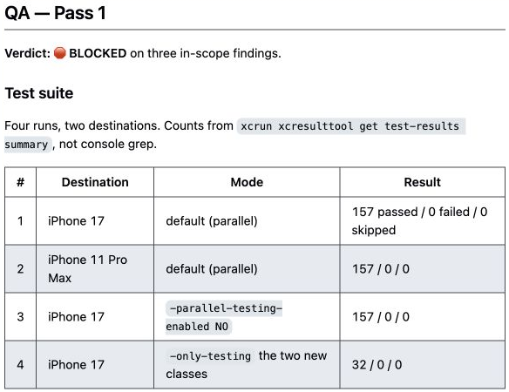
157 tests passed. QA blocked the PR
TrafficRulesApp: my iOS app for the Spanish driving theory exam
32 new tests
Review approved
the change
QA found weaknesses
in the tests themselves
01
Notes:
TIMING: 0:15–1:00. Main talk ends at 18:00, with a two-minute buffer. Questions follow the talk.
TrafficRulesApp is my personal iOS app for preparing for the Spanish driving theory exam. I use a team of AI agents for some development tasks.
In this task, the agents added tests. The reviewer approved the change, and all 157 tests passed. Then QA blocked the pull request because it found weaknesses in the tests themselves.
We’ll follow that task through the actual process: where it moved forward, where it returned for repairs, and what the next review contributed. I’ll also show the cost of those extra passes.
SOURCES
https://github.com/TeleginS/TrafficRulesApp/pull/198
https://github.com/TeleginS/TrafficRulesApp/pull/198#issuecomment-5500803440
Screenshots captured on 6 September 2026. Agent reports, not an independent rerun. The PR was open at capture. Private GitHub sources require repository access.

Slide 3
Model, tools and execution environment
Stage result goes to the next role
Context
Model
Tool call
Tool result
Harness
Runs tools, returns results and manages the execution loop
02
Notes:
TIMING: 1:00–2:30. Main talk ends at 18:00, with a two-minute buffer. Questions follow the talk.
First, a quick definition. The model receives context and chooses an action. A tool reads a file, runs a command, or interacts with another system. The execution environment, often called a harness, runs that action and returns its result to the model.
That cycle can continue through many steps. A developer agent might inspect the project, edit code, run tests, read an error and try again. We can give it freedom to investigate while defining what it must deliver at the end.
With several agents, someone must also decide which role works next and what context it receives. In my setup, an orchestrator agent does that. It passes the task, requirements and previous results between roles.
A role name alone gives us very little. The reviewer needs the actual diff and the requirements. QA needs acceptance criteria and a way to test them. Their reports determine the next step.
Most of those routing rules currently live in prompts. The graph I’m about to show describes the intended workflow. It does not execute or enforce that workflow by itself.
SOURCES
https://github.com/TeleginS/agent-orchestration/blob/db77602/PIPELINE.md
https://www.anthropic.com/engineering/building-effective-agents
Screenshots captured on 6 September 2026. Agent reports, not an independent rerun. The PR was open at capture. Private GitHub sources require repository access.

Slide 4
The complete delivery workflow
Current documented workflow
Preparation
Implementation
Verification
Completion
Green
0 Design check
Pause for
design decisions
4 Review loop
7 Artifact check
Resume after clarification
Approval
1 Plan and issues
5 QA
8 Issue cleanup
Bugs to fix
2 Branch setup
3 Develop
and open PR
6 Fix, review
and retest
9 Settings
(optional)
Fixed
Orchestrator: routing and handoffs
Both loops stop after
3 unsuccessful iterations
10 Final report
Project profile: shared context
03
Notes:
TIMING: 2:30–4:30. Main talk ends at 18:00, with a two-minute buffer. Questions follow the talk.
Here is the complete route, including the work around writing and checking code.
Preparation starts with the design check. If the task needs a product decision that has not been made, the process stops for clarification. A small operational task can proceed without a separate design document. The planner then creates checkable requirements and issues. Branch setup checks the working tree so unrelated changes do not travel into the task.
The developer implements the change and opens a pull request. That takes us into verification: review, QA, and the repair loop we’ll examine next.
Completion still involves work. The orchestrator checks accumulated files, updates the task’s issues, optionally cleans up local settings, and produces a final report. A green QA result does not mean that the pull request has merged. Issues for unmerged work keep their PR references and remain open.
The orchestrator coordinates this whole route. The project profile supplies shared facts such as build commands and architecture constraints. Those facts are separate from the general role instructions.
The numbering gives us a stable map. When an agent returns for repairs, we can identify which stage it is revisiting and what result allows it to leave. Now let’s enlarge the verification area without changing the route.
SOURCES
https://github.com/TeleginS/agent-orchestration/blob/db77602/PIPELINE.md
https://github.com/TeleginS/agent-orchestration/blob/db77602/PIPELINE-GRAPH.md
Screenshots captured on 6 September 2026. Agent reports, not an independent rerun. The PR was open at capture. Private GitHub sources require repository access.

Slide 5
Review and QA loops
Current documented workflow
From step 3: PR and check results
Re-review
Rule 11
4 Reviewer
4 Developer fix
Review QA fixes
before retesting
Findings
Approval
5 QA
6 Developer fix
Limit: 3 iterations
In-scope bugs
QA green continues
at step 7
6 QA retest
6 Review fixes
Approval
New bugs
Verified pre-existing bugs stay open. Unconfirmed origin remains blocking.
04
Notes:
TIMING: 4:30–6:00. Main talk ends at 18:00, with a two-minute buffer. Questions follow the talk.
There are two repair loops here. In the first, the reviewer checks the change and returns findings or approval. Findings can send the work back to the developer on the same branch. Approval allows QA to begin.
QA runs the project’s test suite and checks the acceptance criteria and behavioral scenarios. Bugs related to the task enter the second loop. The developer fixes them, the reviewer checks those fixes, and only then does QA retest.
That middle review matters because a fix changes the code. An approval of the previous version cannot establish that the new version is correct.
Both loops have a limit of three iterations. If blockers remain, the instructions require a stop and escalation. Existing bugs can remain separate work, but calling a bug pre-existing requires evidence from the base version. Uncertain origin does not justify a green verdict.
These are instructions for the orchestrator today. A future controller could enforce transitions and retry limits. It would still need good reviews and trustworthy test evidence inside those stages.
SOURCES
https://github.com/TeleginS/agent-orchestration/blob/db77602/PIPELINE.md
https://github.com/TeleginS/agent-orchestration/blob/db77602/PIPELINE-GRAPH.md
Screenshots captured on 6 September 2026. Agent reports, not an independent rerun. The PR was open at capture. Private GitHub sources require repository access.

Slide 6
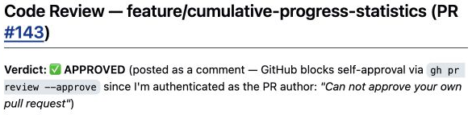
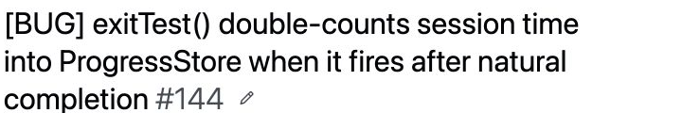
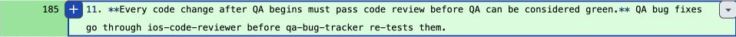
A versioned change to the review route
July and August 2026
July: PR #143
26 August: rule 11
QA fix
Code review
QA retest
Versioned instructions establish the change. Full historical session state is unknown.
05
Notes:
TIMING: 6:00–7:30. Main talk ends at 18:00, with a two-minute buffer. Questions follow the talk.
The process has changed over time. In July, PR 143 added cumulative progress statistics. The reviewer approved the change. QA then found a scenario that could count session time twice.
The timer could complete the test while an exit confirmation dialog remained open. Confirming the exit afterward could add the time again. That is a concrete example of a behavioral scenario reaching QA after approval.
On August 26, the instruction history records an explicit rule: changes made after QA begins must pass code review before QA can become green. The diff also adds the reviewer between the developer’s QA fixes and the retest.
I cannot reconstruct the complete state of the earlier agent sessions. We have versioned instructions and saved reports, but not every piece of context or every setting. I’m therefore showing a documented change in the process, without claiming that the July bug alone caused it.
The later PR gives us a recorded example of that review step in use. Let’s follow it through the map.
SOURCES
https://github.com/TeleginS/TrafficRulesApp/pull/143
https://github.com/TeleginS/TrafficRulesApp/issues/144
https://github.com/TeleginS/TrafficRulesApp/commit/47fe4917052c82e7181e9de5321511ed8194c11c
Screenshots captured on 6 September 2026. Agent reports, not an independent rerun. The PR was open at capture. Private GitHub sources require repository access.

Slide 7
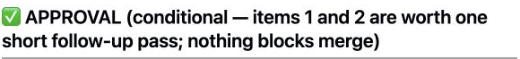
PR #198: the route to QA
Recorded review and QA sequence
From step 3: PR and check results
Re-review
Review 1: conditional approval
4 Reviewer
4 Developer fix
Findings
Approval
5 QA
6 Developer fix
In-scope bugs
Quality findings prompt
a developer follow-up
6 QA retest
6 Review fixes
32 new tests
Application code unchanged
Approval
New bugs
6a
Notes:
TIMING: 7:30–8:15. Main talk ends at 18:00, with a two-minute buffer. Questions follow the talk.
PR 198 added unit tests for ProgressStore and for recording progress when a test session ends. The work also covered the protection against counting time again after completion, connecting it to the earlier bug.
The pull request added 32 tests, taking the suite from 125 to 157. It also included a project profile. Application code did not change.
Here is the first visit to the reviewer. The verdict was conditional approval with quality findings worth a follow-up pass. It was not a report of critical blockers. The developer addressed the findings, and the work returned to the same review stage.
SOURCES
https://github.com/TeleginS/TrafficRulesApp/pull/198
https://github.com/TeleginS/TrafficRulesApp/pull/198#issuecomment-5500796064
https://github.com/TeleginS/TrafficRulesApp/pull/198#issuecomment-5500799535
https://github.com/TeleginS/TrafficRulesApp/pull/198#issuecomment-5500803440
Screenshots captured on 6 September 2026. Agent reports, not an independent rerun. The PR was open at capture. Private GitHub sources require repository access.

Slide 8
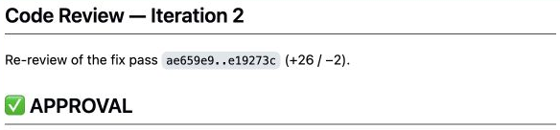
PR #198: the route to QA
Recorded review and QA sequence
From step 3: PR and check results
Re-review
Review 2: approval
4 Reviewer
4 Developer fix
Findings
Approval
5 QA
6 Developer fix
In-scope bugs
The same review stage
checks the revised work
6 QA retest
6 Review fixes
Approval
New bugs
6b
Notes:
TIMING: 8:15–8:45. Main talk ends at 18:00, with a two-minute buffer. Questions follow the talk.
On the second visit, the reviewer approved the result. The task then reached QA. Notice that the map has not gained another reviewer box. The same role is checking a later state of the work.
SOURCES
https://github.com/TeleginS/TrafficRulesApp/pull/198
https://github.com/TeleginS/TrafficRulesApp/pull/198#issuecomment-5500796064
https://github.com/TeleginS/TrafficRulesApp/pull/198#issuecomment-5500799535
https://github.com/TeleginS/TrafficRulesApp/pull/198#issuecomment-5500803440
Screenshots captured on 6 September 2026. Agent reports, not an independent rerun. The PR was open at capture. Private GitHub sources require repository access.

Slide 9
PR #198: the route to QA
Recorded review and QA sequence
From step 3: PR and check results
Re-review
QA Pass 1: blocked
157 tests passed
4 Reviewer
4 Developer fix
Findings
Approval
5 QA
6 Developer fix
In-scope bugs
6 QA retest
6 Review fixes
Approval
New bugs
6c
Notes:
TIMING: 8:45–9:30. Main talk ends at 18:00, with a two-minute buffer. Questions follow the talk.
The QA report records successful test runs. It also returns BLOCKED and identifies three problems in the tests. Passing the suite established that these checks executed successfully. QA questioned whether particular assertions established the behavior the task required.
That finding activates the second repair loop. Before following the fix around it, we need to understand why the tests could pass and still need changes. Two of the findings describe connected parts of the same problem: the assertion and the starting state.
SOURCES
https://github.com/TeleginS/TrafficRulesApp/pull/198
https://github.com/TeleginS/TrafficRulesApp/pull/198#issuecomment-5500796064
https://github.com/TeleginS/TrafficRulesApp/pull/198#issuecomment-5500799535
https://github.com/TeleginS/TrafficRulesApp/pull/198#issuecomment-5500803440
Screenshots captured on 6 September 2026. Agent reports, not an independent rerun. The PR was open at capture. Private GitHub sources require repository access.

Slide 10
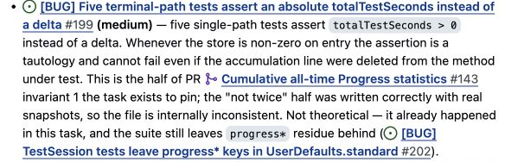
The assertion and the starting state
QA findings in PR #198
Illustrative example
Before 500 seconds
After 500 seconds
after > 0 PASS
Paired fix
after > before FAIL
Compare with the prior value
Give each test its own store
The 500-second example illustrates a mechanism. It is not a measured result.
07
Notes:
TIMING: 9:30–12:00. Main talk ends at 18:00, with a two-minute buffer. Questions follow the talk.
Five tests checked that the accumulated time was greater than zero after a terminal call. But the requirement concerned the contribution of that particular call: did this path actually add session time?
Imagine the store already contains 500 seconds. We call the method, it adds nothing, and the store still contains 500 seconds. The assertion that the total is greater than zero passes. The assertion that the total increased fails.
Those numbers are an illustration of the failure mechanism. They are not a measured result from the QA run.
Why could old time exist in the first place? The tests used shared UserDefaults.standard storage and manually cleared a list of keys. Other tests or previous runs could leave state that made the total positive before the action under test.
The repair addressed both parts. Each test received its own temporary store through existing injection parameters. The assertions took a snapshot before the action and checked for an increase afterward. Application code did not need to change.
These changes serve related purposes. Isolation controls where the starting value comes from. The comparison expresses the contribution the test intends to check. Reading the assertion without looking at the fixture would miss part of the explanation.
QA found a third issue about distinguishing the two exit branches. I’ll leave that detail for questions so we can follow the main repair through the process.
The next stage is particularly useful here. The reviewer will examine both the code changes and the explanation of what they prove. That explanation needs a qualification once the new isolated store starts at zero.
SOURCES
https://github.com/TeleginS/TrafficRulesApp/pull/198#issuecomment-5500803440
https://github.com/TeleginS/TrafficRulesApp/issues/199
https://github.com/TeleginS/TrafficRulesApp/issues/200
https://github.com/TeleginS/TrafficRulesApp/commit/114cb54a883fcfed25f98e08c97d9d3ff9407e20
Screenshots captured on 6 September 2026. Agent reports, not an independent rerun. The PR was open at capture. Private GitHub sources require repository access.

Slide 11
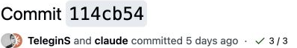
PR #198: fix, review and retest
Recorded review and QA sequence
From step 3: PR and check results
Re-review
Developer: QA fixes
4 Reviewer
4 Developer fix
Findings
Approval
5 QA
6 Developer fix
Delta assertions
Isolated test storage
In-scope bugs
6 QA retest
6 Review fixes
Approval
Same PR and branch
New bugs
PR open at capture, 6 September 2026. QA green permits the completion steps.
8a
Notes:
TIMING: 12:00–12:20. Main talk ends at 18:00, with a two-minute buffer. Questions follow the talk.
The developer pushes the QA fixes to the same pull request. The work then visits the reviewer before returning to QA. Review iteration three explicitly refers to rule 11.
SOURCES
https://github.com/TeleginS/TrafficRulesApp/commit/114cb54a883fcfed25f98e08c97d9d3ff9407e20
https://github.com/TeleginS/TrafficRulesApp/pull/198#issuecomment-5500807469
https://github.com/TeleginS/TrafficRulesApp/pull/198#issuecomment-5500811713
Screenshots captured on 6 September 2026. Agent reports, not an independent rerun. The PR was open at capture. Private GitHub sources require repository access.

Slide 12
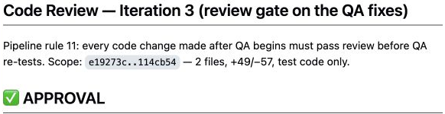
PR #198: fix, review and retest
Recorded review and QA sequence
From step 3: PR and check results
Re-review
Review 3: approval
4 Reviewer
4 Developer fix
Findings
Approval
5 QA
6 Developer fix
In-scope bugs
After isolation, before = 0
6 QA retest
6 Review fixes
Both changes matter
Approval
New bugs
PR open at capture, 6 September 2026. QA green permits the completion steps.
8b
Notes:
TIMING: 12:20–13:15. Main talk ends at 18:00, with a two-minute buffer. Questions follow the talk.
The review approves the fixes, but also qualifies the proof. With an isolated store, the starting value is zero in these five tests. In that state, comparing the result with zero and comparing it with the prior value are numerically equivalent.
So we should not attribute the entire improvement to the new assertion alone. The delta form states the intended contribution and remains useful if a future fixture seeds state. Isolation removes the old shared-state condition. The explanation has to account for both changes.
That is an example of what the extra review contributed: it checked the fix and corrected an overly broad interpretation of the result.
SOURCES
https://github.com/TeleginS/TrafficRulesApp/commit/114cb54a883fcfed25f98e08c97d9d3ff9407e20
https://github.com/TeleginS/TrafficRulesApp/pull/198#issuecomment-5500807469
https://github.com/TeleginS/TrafficRulesApp/pull/198#issuecomment-5500811713
Screenshots captured on 6 September 2026. Agent reports, not an independent rerun. The PR was open at capture. Private GitHub sources require repository access.

Slide 13
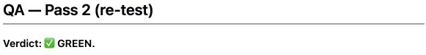
PR #198: fix, review and retest
Recorded review and QA sequence
From step 3: PR and check results
Re-review
QA Pass 2: green
4 Reviewer
4 Developer fix
Findings
Approval
5 QA
6 Developer fix
In-scope bugs
Four full runs
157 passed in each
6 QA retest
6 Review fixes
Approval
New bugs
PR open at capture, 6 September 2026. QA green permits the completion steps.
8c
Notes:
TIMING: 13:15–14:00. Main talk ends at 18:00, with a two-minute buffer. Questions follow the talk.
Only after approval did the task return to QA. The second QA report records four full runs, each with 157 passing tests. One run deliberately polluted the shared standard store to check that it could not affect the isolated tests. The final QA verdict was GREEN.
At the time these screenshots were captured, the pull request was still open. Green QA permits the completion steps in the workflow. It does not establish that the change has merged. With that distinction clear, we can put a cost against the route we just followed.
SOURCES
https://github.com/TeleginS/TrafficRulesApp/commit/114cb54a883fcfed25f98e08c97d9d3ff9407e20
https://github.com/TeleginS/TrafficRulesApp/pull/198#issuecomment-5500807469
https://github.com/TeleginS/TrafficRulesApp/pull/198#issuecomment-5500811713
Screenshots captured on 6 September 2026. Agent reports, not an independent rerun. The PR was open at capture. Private GitHub sources require repository access.

Slide 14
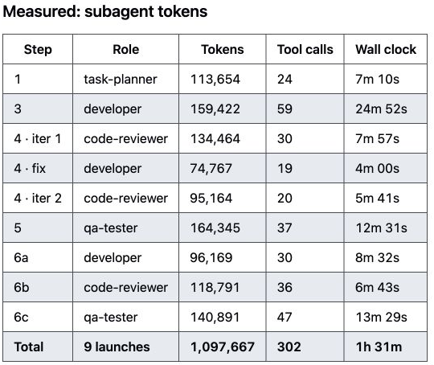
The cost of this run
The same ProgressStore coverage task
Measure | Recorded result
Subagent launches | 9
Elapsed time | About 1 h 31 min
Subagent tokens | 1,097,667
Planner 1 Developer 3
Reviewer 3 QA 2
Orchestrator tokens excluded. No matched single-agent baseline.
09
Notes:
TIMING: 14:00–16:00. Main talk ends at 18:00, with a two-minute buffer. Questions follow the talk.
This is the cost report for the same task. It records nine subagent launches, about one hour and thirty-one minutes of elapsed work, and just under 1.1 million subagent tokens.
The launch count now has a concrete explanation. There was one planner pass, three developer passes, three reviewer passes and two QA passes. Several boxes on our map were visited more than once.
Each visit means assembling context, investigating the current state, running checks and writing a report. The review passes used slightly more tokens in total than the developer passes in this run. Review was a substantial part of the work.
The token figure excludes the orchestrator because its usage was mixed into the main session. The source estimates that separately. I am keeping the measured figure separate here, and I am not presenting a dollar estimate as a provider invoice.
We saw useful findings, but this single run cannot establish that multiple agents were cheaper or more effective than one agent with suitable tests. I do not have a matched control run.
The practical question is which checks justify their cost on a given type of task. To answer that, future records should include confirmed findings, missed defects and the time I spend intervening. The diagram tells us where to measure those things.
SOURCES
https://github.com/TeleginS/agent-orchestration/blob/693c5cd291e35d773c9f68f99888ca420dbbf30a/examples/run-progress-store-tests/README.md
https://github.com/TeleginS/TrafficRulesApp/pull/198
Screenshots captured on 6 September 2026. Agent reports, not an independent rerun. The PR was open at capture. Private GitHub sources require repository access.

Slide 15
What I would measure next
7 Artifacts
A checkable result
for each stage
0 Design
4 Review
8 Issues
1 Plan
5 QA
A versioned record
of each run
9 Settings
2 Branch
3 Develop
6 Fix loop
10 Report
Next: validate approval and QA
against the code version
github.com/TeleginS/agent-orchestration
10
Notes:
TIMING: 16:00–18:00. Main talk ends at 18:00, with a two-minute buffer. Questions follow the talk.
The map gives me a way to discuss the process beyond the number of agents. At each transition, I can ask what result the previous stage produced and what evidence allows the next stage to begin.
In this example, review approval led to QA. QA findings led to a fix. The fix required another review, and that review improved the explanation before the final retest. We can point to the reports for those visits and see what each contributed.
My next step would be to save a versioned record of every run: the instructions, project profile, code version, stage results and measured costs. That would make comparisons easier than reconstructing old sessions from Git history.
I would then validate the handoffs programmatically, starting with whether review and QA refer to the code version being delivered. Such a check could reject stale approval. It would not prove that the reviewer found every bug.
For someone trying this in their own project, I would start with one task type and define the result each stage must provide. Then inspect real runs to see which checks add useful evidence and which mainly repeat work.
The repository contains the role instructions, project profiles, the full graph and saved run reports. You can use those to examine the process and adapt it. Thank you. I’m happy to discuss the details in questions.
SOURCES
https://github.com/TeleginS/agent-orchestration
https://github.com/TeleginS/agent-orchestration/blob/db77602/PIPELINE.md
https://github.com/TeleginS/agent-orchestration/blob/db77602/PIPELINE-GRAPH.md
Screenshots captured on 6 September 2026. Agent reports, not an independent rerun. The PR was open at capture. Private GitHub sources require repository access.

Slide 16
Full workflow and transition conditions
Reference for questions. Each repair loop stops after 3 unsuccessful iterations.
Approval
0 Design
1 Plan
2 Branch
3 Dev / PR
4 Review
5 QA
Findings
Bugs
Pause:
design
Stop:
QA limit
Stop:
review limit
4 Dev fix
6 Dev fix
Approval
10 Report
9 Settings*
8 Issues
7 Artifacts
6 QA retest
6 Review
Green
New bugs
QA green
* Settings are optional. Verified pre-existing findings stay open. Unknown origin remains blocking.
Completion includes artifact and issue checks. A green QA verdict does not establish merge.
A
Notes:
This reference expands the two loops. Review findings return to the developer. QA fixes require reviewer approval before retesting. Both loops cap at three iterations. Unresolved design returns for clarification. Verified pre-existing findings remain open and do not skip completion steps. Unknown origin stays blocking until evidence resolves its classification. The graph describes instructions, not a runtime enforcement engine.
SOURCES
https://github.com/TeleginS/agent-orchestration/blob/db77602/PIPELINE-GRAPH.md
https://github.com/TeleginS/agent-orchestration/blob/db77602/PIPELINE.md

Slide 17
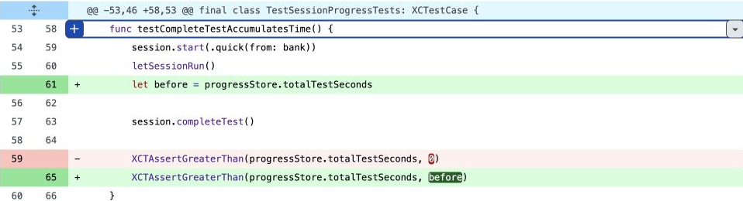
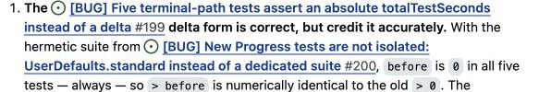
The test fix in the actual diff
Assertions and isolated storage address connected concerns
In the repaired fixture:
before = 0
after > 0
after > before
Numerically equivalent
for these five tests
The dirty-store example describes the original risk, not the repaired fixture.
B
Notes:
In the committed isolated fixture, the two comparisons are numerically equivalent. The delta assertion expresses the contribution we want to check. Isolation controls the starting state. The dirty-store example explains the original risk, and should not be presented as the state of the repaired fixture.
A separate finding, issue 201, concerned assertions distinguishing the two exit branches. The 156 versus 157 discrepancy came from counting parallel console output. Review 3 used the structured xcresult summary to confirm 157.
SOURCES
https://github.com/TeleginS/TrafficRulesApp/commit/114cb54a883fcfed25f98e08c97d9d3ff9407e20
https://github.com/TeleginS/TrafficRulesApp/pull/198#issuecomment-5500807469
https://github.com/TeleginS/TrafficRulesApp/issues/201

