Slide 1
Lost Password Scheme
Scott Coleman
12/1/2014

Slide 2
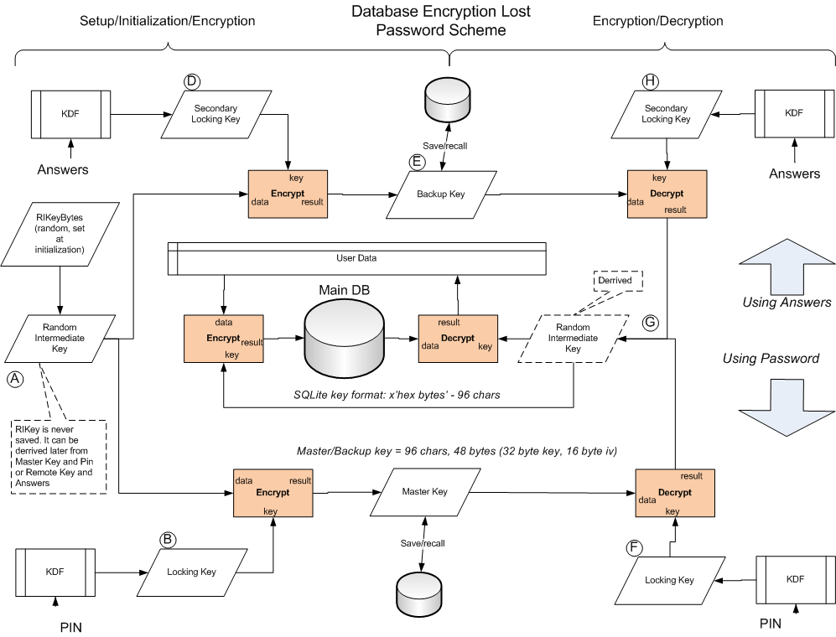
Overview

Slide 3
Initialization
(A) Random Intermediate Key (RIKey) is created and database is initialized to use this key.
(B) Locking Key is derived from the PIN using KDF algorithm. Master Key is created by encrypting the RIKey with the Locking Key. Master Key is saved to device storage.
(D) Secondary Locking key is derived from the Security question answers using KDF algorithm. Backup Key is created by encrypting the RIKey with the Locking Key. Backup Key is saved to device storage.

Slide 4
Login/Data Access with PIN
(F) Locking Key is derived from the PIN.
(G) RIKey is re-constructed by decrypting the Master Key using the Locking Key.
If the RIKey matches the key that the database was initialized with then Login/Data access is successful.

Slide 5
Login/Data Access with Security Answers
(H) Secondary Locking Key is derived from the Security Question Answers.
(G) RIKey is re-constructed by decrypting the Backup Key using the Secondary Locking Key.
If the RIKey matches the key that the database was initialized with then Login/Data access is successful.

Slide 6
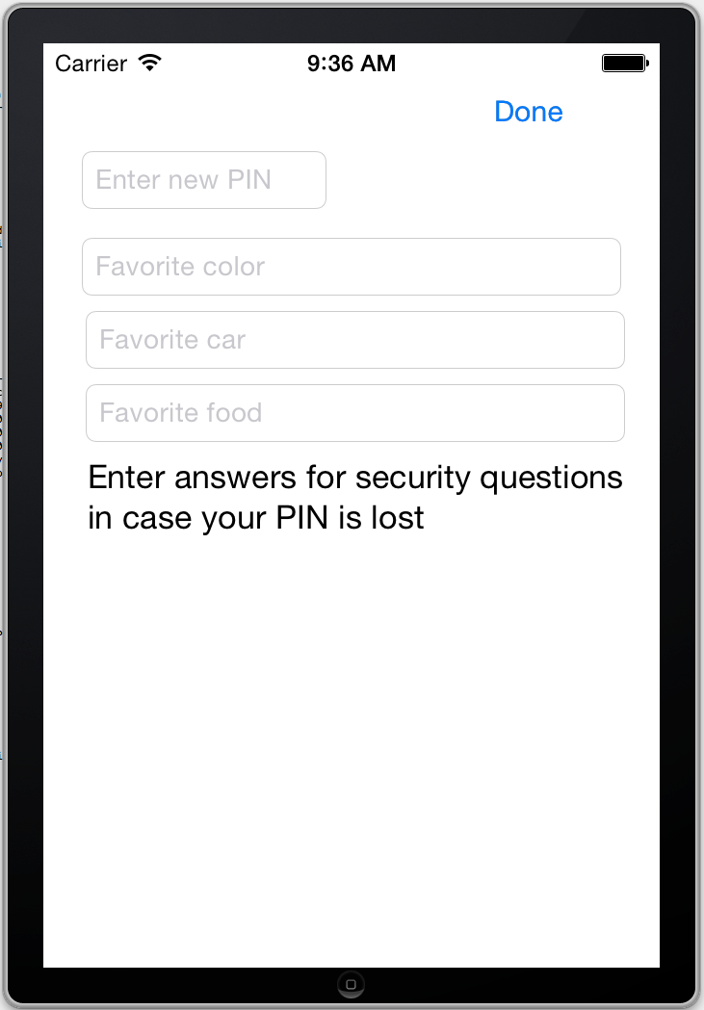
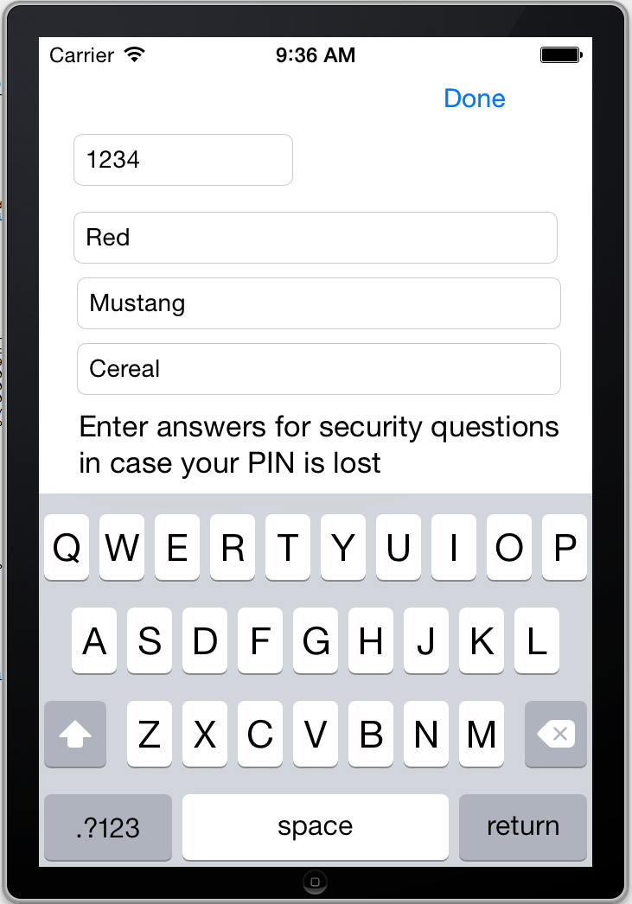
Demo App Example
App Initialization: User is prompted for password and answers to security questions

Slide 7
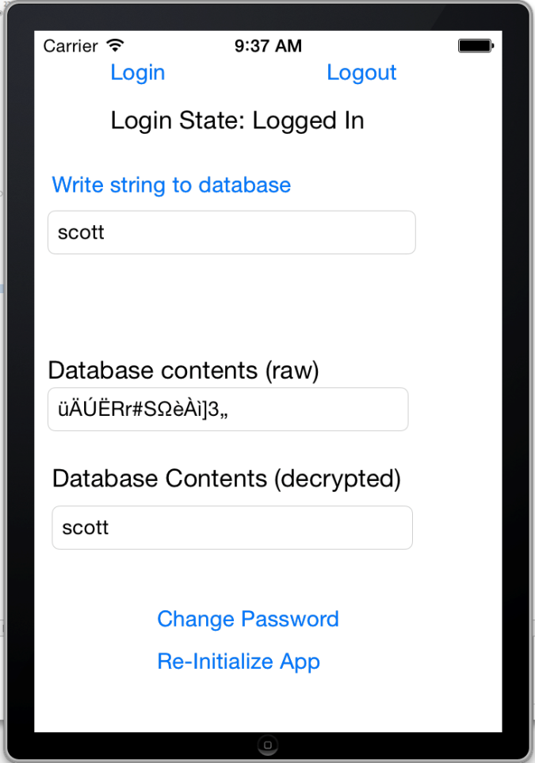
Demo App Example
Logged in: User can write to/read from database

Slide 8
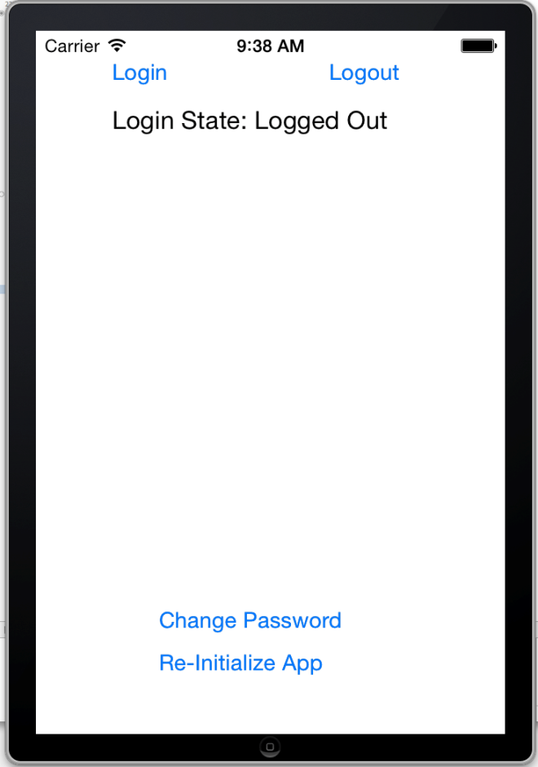
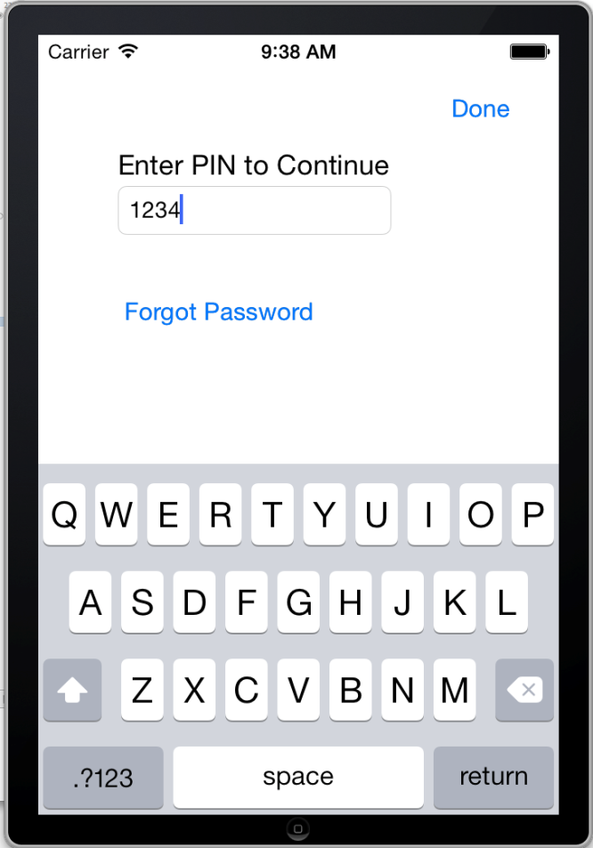
Demo App Example
User Login via PIN

Slide 9
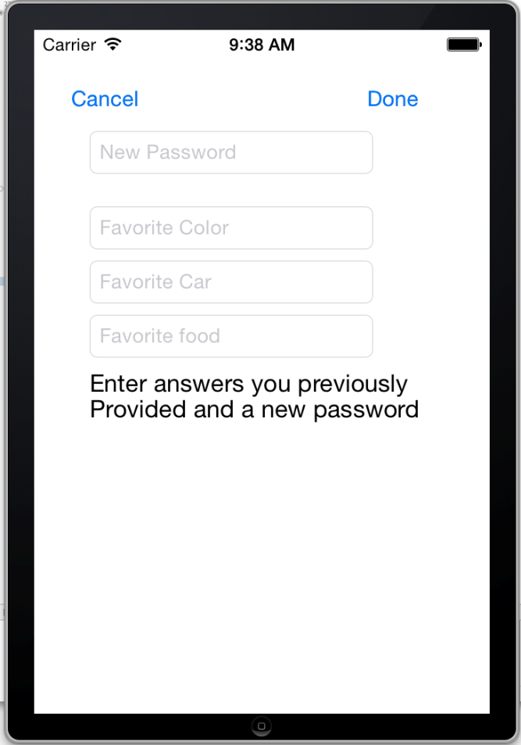
Demo App Example
????
User Login via Security Questions

Slide 10
Notes
RIKey is never saved anywhere. It is generated at initialization and used. When it is needed again it is derived from either the Master Key and PIN, or the Backup Key and Sequrity Question Answers.
Security Questions stored statically unencrypted (Answers are not stored direcly but via encrypted Backup Key.

