Slide 1
System Analysis
Section 2

Slide 2
From Previous Section
System Request
Feasibility Study
Project Plan
Methodology
Time Estimation
Task Identification
Pert Chart
Gantt Chart
Scope Management
Planning
Interview
JAD Session
Questionnaire
Use Case
Data Flow Diagram
Entity Relationship
Normalization
Analysis
Design
Implementation

Slide 3
Project Methodology
Project methodology is an approach that describes how to implement SDLC.
Examples of Methodology:
Waterfall Method.
Parallel Method.
Rapid Application Development (RAD)
Iterative Method.
System Prototyping.
Agile Development.

Slide 4
Waterfall Method
Planning
Analysts and users proceed sequentially from one phase to the next.
Analysis
Design
Implementation
System

Slide 5
Parallel Method
Planning
The project is divided into a series of subprojects that can be designed and implemented in parallel
Analysis
Design
Implementation
Design
Design
Implementation
Implementation
Design
Implementation
System

Slide 6
Iterative Method (RAD)
Planning
Breaks the overall projects into a series of versions that are developed sequentially.
Analysis
System Version 1
Analysis
Design
Implementation
System Version 2
Analysis
Design
Implementation
System Version 3
Analysis
Design
Implementation

Slide 7
System Prototyping (RAD)
Planning
Performs analysis, design and implementation concurrently in order to quickly develop a simplified version of the proposed system and give it to users for evaluation and feedback.
Analysis
Design
System Prototype
Implementation
Implementation
System

Slide 8
Agile Development
Planning
Face-to-Face communication in each phase.
Analysis
Design
System
Implementation

Slide 9
Time Estimation
To know total project time, use planning time to predict the time required for the entire project.
The percentage of phases time are:
Planning → 15%
Analysis → 20%
Design → 35%
Implementation → 30%

Slide 10
Task Identification
Its divide project into subtasks and each subtask into subtasks and so on.
Example | Task Information
Economic Feasibility | Name of Task
16-2-2015 | Start Date
20-2-2015 | End Date
Mohamed Gaber | Person assigned to task
High | Priority
Microsoft Word | Resources Needed
10 Hours | Estimated Time
8 Hours | Actual Time

Slide 11
Pert Diagram (Example 1)
Consider the list of four activities for planning phase:-
Draw the Pert Diagram?
Activity | Description | Predecessors | Duration
A | System Request | - | 2
B | Feasibility Study | - | 4
C | Methodology | B | 5
D | Time Estimation | A,C | 3

Slide 12
Pert Diagram Example 1 Solution
Activity | Description | Predecessors | Duration
A | System Request | - | 2
B | Feasibility Study | - | 4
C | Methodology | B | 5
D | Time Estimation | A,C | 3
1
A, 2
3
D, 3
4
B, 4
C, 5
2

Slide 13
Pert Diagram (Example 2)
Consider the list of following activities for planning phase:-
Activity | Description | Predecessors | Duration
A | System Request | - | 2
B | Feasibility Study | - | 4
C | Methodology | B | 2
D | Time Estimation | A, C | 3
E | Task Identification | C | 2
F | Pert Chart | C | 5
G | Gantt Chart | D, E, F | 2

Slide 14
Pert Diagram Example 2 Solution
Activity | Predecessors
A | -
B | -
C | B
D | A, C
E | C
F | C
G | D, E, F
1
A
3
D
4
G
E
Dummy
7
B
Dummy
5
C
F
2
6

Slide 15
Gant Chart (Example 1)
Consider the list of four activities for planning phase:-
Draw the Gant Chart?
Activity | Description | Predecessors | Duration
A | System Request | - | 2
B | Feasibility Study | - | 4
C | Methodology | B | 5
D | Time Estimation | A,C | 3

Slide 16
Gant Chart Example 1 Solution
Activity | Description | Predecessors | Duration
A | System Request | - | 2
B | Feasibility Study | - | 4
C | Methodology | B | 5
D | Time Estimation | A,C | 3
A
B
C
D
2
4
9
12

Slide 17
Gant Chart Example 1 Solution
Minimum Duration Time = 12
Activity | Description | Predecessors | Duration
A | System Request | - | 2
B | Feasibility Study | - | 4
C | Methodology | B | 5
D | Time Estimation | A,C | 3
Critical Path
B → C → D
A
B
C
D
2
4
9
12

Slide 18
Gant Chart (Example 2)
Consider the list of following activities for planning phase:-
Activity | Description | Predecessors | Duration
A | System Request | - | 2
B | Feasibility Study | - | 4
C | Methodology | B | 2
D | Time Estimation | A, C | 3
E | Task Identification | C | 2
F | Pert Chart | C | 5
G | Gantt Chart | D, E, F | 2

Slide 19
Gant Chart Example 2 Solution
Activity | Predecessors | Duration
A | - | 2
B | - | 4
C | B | 2
D | A, C | 3
E | C | 2
F | C | 5
G | D, E, F | 2
A
B
C
D
E
F
G
2
4
6
8
9
11
13

Slide 20
Gant Chart Example 2 Solution
Minimum Duration Time = 13
Activity | Predecessors | Duration
A | - | 2
B | - | 4
C | B | 2
D | A, C | 3
E | C | 2
F | C | 5
G | D, E, F | 2
Critical Path
B → C → F → G
A
B
C
D
E
F
G
2
4
6
8
9
11
13

Slide 21
Scope Management
Who will responsible for who?
Project Manager
Junior Analyst
Senior Analyst
Junior Designer
Junior Analyst
Senior Designer
Junior Designer
Junior Developer
Senior Developer
Junior Developer

Slide 22
SDLC
System Request
Feasibility Study
Project Plan
Methodology
Time Estimation
Task Identification
Pert Chart
Gantt Chart
Scope Management
Planning
Interview
JAD Session
Questionnaire
Use Case
Data Flow Diagram
Entity Relationship
Normalization
Analysis
Design
Implementation

Slide 23
Task 1 (Solved)
Draw Pert diagram for the following activities:-
Activity | Predecessor
A | -
B | A
C | A
D | -
E | D
F | B, C, E
G | F
H | D
I | G, H

Slide 24
Task 2
Draw Pert diagram for the following activities:-
Activity | Predecessor
A | -
B | -
C | -
D | A
E | C
F | B, D
G | B, D
H | E, F
I | A
J | G, H
K | E, F

Slide 25
Task 3
Draw Pert diagram and gant chart for the following activities and find minimum duration for execution:-
Activity | Duration (Days) | Predecessor
T1 | 8 | -
T2 | 15 | -
T3 | 15 | T1
T4 | 10 | -
T5 | 10 | T2 , T4
T6 | 5 | T1 , T2
T7 | 20 | T1
T8 | 25 | T4
T9 | 15 | T3, T6
T10 | 15 | T5 , T7
T11 | 7 | T9
T12 | 10 | T11

Slide 26
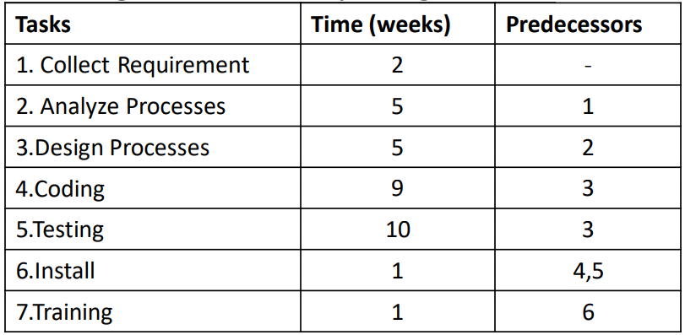
Taske4
A project has been defined to contain the following list of tasks along with their completing duration.
Draw a Pert chart ii. Show the critical path.

Slide 27
Task 5
Complete Your Project.

Slide 28
Thank You

