Slide 1
System Analysis & Design
Section 3

Slide 2
SDLC
Planning
Project Plan
Deadline: next week
Interview
JAD Session
Questionnaire
Data Flow Diagram
Data Dictionary
Process Specification
Entity Relationship
Normalization
Analysis
Design
Implementation
Notes:
The analysis phase
answers the questions
of who will use the system,
what the system will do,
and
where and when it will be used.

Slide 3
THE ANALYSIS PHASE
Purpose:
Understand the existing system (as-is system)
Identify improvements
Define the requirement for the new system (the to-be system)
Notes:
Analysis refers to breaking a whole into its parts with the intent of understanding the parts’ nature, functions, and interrelationships.

Slide 4
Information Gathering
Information gathering or requirements determination
Purpose:
Collecting information about the existing system
Determining the new system requirements
Three techniques requirements determination:
Interview
Joint Application Design (JAD)
Questionnaire
Notes:
Analysis refers to breaking a whole into its parts with the intent of understanding the parts’ nature, functions, and interrelationships.

Slide 5

Interview
1
Interview
is an important method for collecting data about system requirements
Is the most commonly used requirements elicitation technique
Interviews collect information about:
Current state of the system.
System goals.
Interviewee opinions.
Interviewee feelings.

Slide 6
Planning the Interview
1. Reading background material
2. Determine interview objectives
3. Deciding whom to interview
4. Preparing the interviewee
5. Designing interview questions
6. Closing interview
7. Write interview report

Slide 7
5. Designing interview questions
In designing the interview questions, you should determine:
Questions types:
There are four types of interview questions:
Closed-Ended Questions.
Open-Ended Questions
Bipolar Questions.
Probing Questions.
Questions structuring
There are three structures
Pyramid
Funnel
Diamond
basic types

Slide 8
Question Types: 1.Open-Ended
Open-Ended Questions:
similar to essay questions that you might find on an exam.
allow interviewees to respond how they wish.
It is appropriate when the analyst is interested in breadth and depth of reply.
Examples
What do you think about the way invoices are currently processed?
What are some of the problems you face on a daily basis?
What are some of the improvements you would like to see in the way invoices are processed?

Slide 9
Question Types: 1.Open-Ended
Advantage
Provides richness of detail.
Puts the interviewee at ease.
Provides further questioning that may have not prepared.
Provides more interest for the interviewee.
Useful if the interviewer is unprepared.
Disadvantage
May result in too much irrelevant detail.
Possibly losing control of the interview.
May take too much time for the amount of useful information gained.
It is seeming that the interviewer is unprepared.
Fishing expedition.

Slide 10
Question Types: 2.Closed-Ended
Closed-Ended Questions:
limit the number of possible responses
It is appropriate for generating precise, reliable data that is easy to analyze.
Examples:
How many telephone orders are received per day?
How do customers place orders?
What information is missing from the monthly sales report?

Slide 11
Question Types: 2.Closed-Ended
Advantage
Saving interview time.
Keeping control of the interview.
Covering a large area quickly.
Getting to relevant data.
Disadvantage
Boring for the interviewee.
Failure to obtain rich details.
Missing main ideas
Failing to build rapport between interviewer and interviewee.
Notes:
rapport

Slide 12
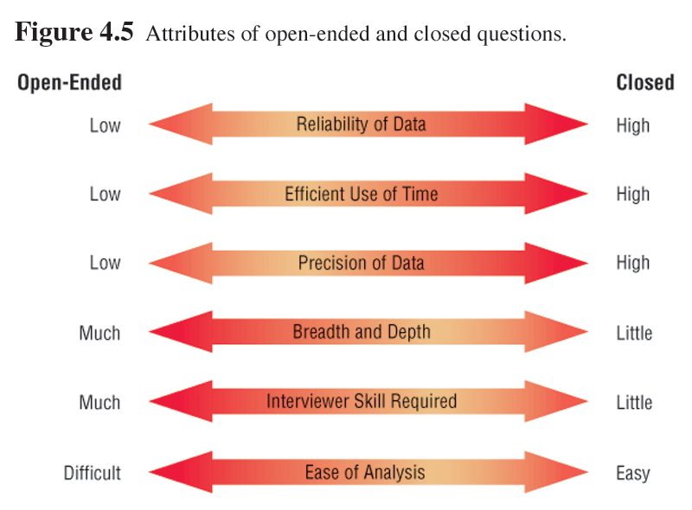
Attributes of open-ended and closed Questions

Slide 13
Question Types: 3.Bipolar
Bipolar questions:
are those that may be answered with a ‘yes’ or ‘no’ or ‘agree’ or ‘disagree’.
should be used sparingly.

Slide 14
Question Types: 4.Probing
Probing questions often are used :
when the interviewer is unclear about an interviewee’s answer.
to get more details or clarify about previous asked questions.
Examples:
Why?
Can you give me an example?
Can you explain that in a bit more detail?

Slide 15
2. Questions structuring
There are three basic ways of structuring interviews:
Pyramid: starting with very detailed closed questions and working toward open-ended questions and more generalized responses
Is useful when the interviewees seem not ready to address the topic and need need to be warmed up to the topic
Funnel: starting with open-ended questions and working toward closed questions
Is useful when the interviewee feels emotionally about the topic
Diamond: starting with closed, moving toward open-ended, and ending with closed questions
Is useful in keeping the interviewee's interest and attention through a variety of questions
Notes:
Top-down:
Is useful if interviewees need to be warmed up to the topic or seem reluctant to address the topic
Bottom-up:
Is useful when the interviewee feels emotionally about the topic

Slide 16

6. Closing the Interview
Always ask “Is there anything else that you would like to add?”
Provide feedback on your impressions.
Ask whom you should talk with next.
Set up any future appointments.
Thank them for their time and shake hands.

Slide 17
7. Interview Report
Interview Report
Person Interviewed: Adel Ahmed, Director, Human Resources Interviewer: Nesma Mahmoud Purpose of Interview: • Understand reports produced for Human Resources by the current system. • Determine information requirements for future system. Summary of Interview: • Sample reports of all current HR reports are attached to this report. The information that is not used and missing information are noted on the reports. • Two biggest problems with the current system are: 1. The data are too old. (The HR Department needs information within 2 days of month end; currently information is provided to them after a 3-week delay.) 2. The data are of poor quality. (Often, reports must be reconciled with the HR departmental database.) • The most common data errors found in the current system include incorrect job-level information and missing salary information. Open Items: • Get current employee roster report from Engy Mohamed. • Verify calculations used to determine vacation time with Engy Mohamed. • Schedule interview with Lamyaa Saad regarding the reasons for data quality problems. Detailed Notes: See attached transcript.
An interview report:
describes the information from the interview.
contains interview notes and is summarized in a useful format.
Example:
Notes:
Roster قائمة الاسماء

Slide 18

Joint Application Design (JAD)
2
JAD
is an information gathering technique that replaces a interviews with the user community.
allows the analyst to accomplish requirements analysis and design the user interface with the users in a group setting
Used when the organizational culture supports joint problem-solving behaviors.
Notes:
The facilitator is a person who sets the meeting agenda and guides the discussion, but does not join in the discussion as a participant.

Slide 19
JAD Personnel
JAD involves
Analysts
Users
Executives
Observers
A scribe
A session leader
Notes:
Personnel الطاقم
Executives المدراء التنفيذيون
Observer المراقبون
Scribe كاتب

Slide 20
JAD
Advantages
Time is saved, compared with traditional interviewing.
Rapid development of systems.
Improved user ownership of the system.
Creative idea production is improved
Disadvantages
JAD requires a large block of time.
If preparation is incomplete, the session may not go very well.
If the follow-up report is incomplete, the session may not be successful.
The organizational skills and culture may not be conducive to a JAD session.

Slide 21
Questionnaires
3
Questionnaires
is a set of written questions for obtaining information from individuals.
are valuable if:
Organization members are widely dispersed.
Many members are involved with the project.
are useful in gathering information from organization members about:
Attitudes.
Beliefs.
Behaviors.
Characteristics.

Slide 22
Questionnaires: Question Types
Questions are designed as either:
Open-ended
Try to anticipate the response you will get.
Well suited for getting opinions.
Closed
Use when all the options may be listed.

Slide 23
Questionnaire: Language
Questionnaire language should be:
Simple
Specific
Free of bias
Technically accurate
Addressed to those who are knowledgeable
Appropriate for the reading level of the respondent

Slide 24
Questionnaire: Measurement scales
Scales make respondents act as judges for the subject of the questionnaire
1. Nominal Scales
Nominal scales are used to
classify things into categories.
What type of software do you use the most?
1 = Word Processor
2 = Spreadsheet
3 = Database
4 = An Email Program
2. Ordinal Scales
Allow classification & also imply rank ordering
The support staff of the Technical Support Group is:
1. Extremely Helpful 4. Not Very Helpful
2. Very Helpful 5. Not Helpful At All
3. Moderately Helpful

Slide 25
Questionnaire: Measurement scales
3. Interval Scales
is used when the intervals are equal.
There is no absolute zero.
How useful is the support given by the Technical Support Group?
NOT USEFUL EXTREMELY USEFUL
1 2 3 4 5
4. Ratio Scales
The intervals between numbers are equal
have an absolute zero
Approximately how many hours do you spend on the Internet daily?
0 2 4 6 8

Slide 26
Questionnaire: Order of Questions
Place most important questions first
Cluster items of similar content together
Introduce less controversial questions first
Notes:
Controversial مثير للخلاف

Slide 27
Questionnaire: Web Form
Web forms questionnaires control:
Single line text box
Scrolling text box, used for one or more paragraphs of text.
Checkbox for yes-no or true-false answers.
Radio button for mutually exclusive yes-no or true-false answers.
Drop-down menu for selection from a list.
Submit or Clear buttons.

Slide 28
Task
Complete Your Project.
Interviews
Questionnaires (use Google Forms)

