Slide 1
Artificial Intelligence
Genetic Algorithms

Slide 2
Genetic Algorithm
Genetic Algorithms have been applied successfully to a variety of AI applications
For example, they have been used to learn collections of rules for robot control.
Genetic Algorithms and genetic programming are called Evolutionary Computation

Slide 3
Theory of Evolution
Every organism has unique attributes that can be transmitted to its offspring
Selective breeding can be used to manage changes from one generation to the next
Nature applies certain pressures that cause individuals to evolve over time

Slide 4
Genetic Algorithms (GAs) and
Genetic Programming (GP)
Genetic Algorithms
  Optimising parameters for problem solving
  Represent the parameters in the solution(s)
    As a “bit” string normally, but often something else
  Evolve answers in this representation
Genetic Programming
  Representation of solutions is richer in general
  Solutions can be interpreted as programs
  Evolutionary process is very similar

Slide 5
GA
Genetic algorithms provide an AI method by an analogy of biological evolution
It constructs a population of evolving solutions to solve the problem

Slide 6
Genetic Algorithms
What are they?
  Evolutionary algorithms that make use of operations like mutation, recombination, and selection
Uses?
  Difficult search problems
  Optimization problems
  Machine learning
  Adaptive rule-bases

Slide 7
Classical GAs
Representation of parameters is a bit string
  Solutions to a problem represented in binary
  101010010011101010101
Start with a population (fairly large set)
  Of possible solutions known as individuals
Combine possible solutions by swapping material
  Choose the “best” solutions to swap material between and kill off the worse solutions
  This generates a new set of possible solutions
Requires a notion of “fitness” of the individual
  Base on an evaluation function with respect to the problem

Slide 8
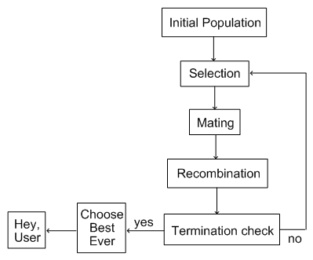
Genetic Algorithm

Slide 9
Representation
Phenotype space
Genotype space = {0,1}^{L}
Encoding
(representation)
10010001
10010010
010001001
011101001
Decoding
(inverse representation)

Slide 10
GA Representation
Genetic algorithms are represented as gene
Each population consists of a whole set of genes
Using biological reproduction, new population is created from old one.

Slide 11
The Initial Population
Represent solutions to problems
  As a bit string of length L
Choose an initial population size
  Generate length L strings of 1s & 0s randomly
Strings are sometimes called chromosomes
  Letters in the string are called “genes”
  We call the bit-string “individuals”

Slide 12
Initialization
Initial population must be a representative sample of the search space
Random initialization can be a good idea (if the sample is large enough)

Slide 13
The gene
Each gene in the population is represented by bit strings.
001 10 10
Outlook Wind play tennis
0011010

Slide 14
Gene Example
The idea is to use a bit string to describe the value of attribute
The attribute Outlook has 3 values (sunny, overcast, raining)
So we use 3 bit length to represent attribute outlook
010 represent the outlook = overcast

Slide 15
GA
The fitness function evaluates each solution and decide it will be in next generation of solutions

Slide 16
Selection
Want to to give preference to “better” individuals to add to mating pool
If entire population ends up being selected it may be desirable to conduct a tournament to order individuals in population
Would like to keep the best in the mating pool and drop the worst

Slide 17
Selection methods
Common selection methods used in GAs are
Fitness Proportionate Selection
Rank Selection
Tournament Selection

Slide 18

Rank Selection
All individuals are sorted according to their fitness.
Each individual is then assigned a probability of being selected from some prior probability density.

Slide 19
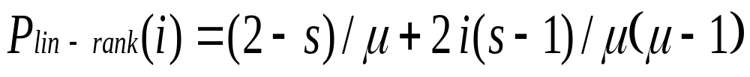
Linear Ranking
Parameterised by factor s: 1.0 < s ≤ 2.0
  measures advantage of best individual
  in GGA this is the expected number of children allotted to it

Slide 20
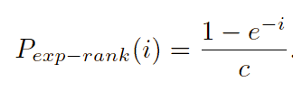
Exponential Ranking
Linear Ranking is limited to selection pressure
Exponential Ranking can allocate more than 2 copies to fittest individual
Normalize constant factor c according to population size

Slide 21
Selection
Main idea: better individuals get higher chance
  Chances proportional to fitness
  Implementation: roulette wheel technique
        Assign to each individual a part of the roulette wheel
        Spin the wheel n times to select n individuals
1/6 = 17%
B
fitness(A) = 3
A
C
fitness(B) = 1
3/6 = 50%
2/6 = 33%
fitness(C) = 2

Slide 22
Roulette Wheel Selection
1
2
3
4
5
6
7
8
1
2
3
1
3
5
1
2
0
Rnd[0..18] = 7
Chromosome4
Parent1
Rnd[0..18] = 12
Chromosome6
Parent2
18

Slide 23
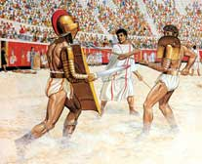
Tournament
Selection
Select a group of N
(N>1) members.
Select the fittest member of this group and discard the rest.

Slide 24
Survivor Selection
Survivor selection can be divided into two approaches:
  Age-Based Selection
    In SSGA can implement as “delete-random” (not recommended) or as first-in-first-out (a.k.a. delete-oldest)
  Fitness-Based Selection
    Using one of the methods above or

Slide 25
New Population
To build new population from old one we use genetic operators to evolve the population of solutions
Genetic operators are
  Crossover operator
  Mutation operator
  Production operator

Slide 26
Crossover operator
It produces two new offspring from two parent strings by copying selected bits from each parent.
00001010101
11101001000
11101010101
00001001000

Slide 27
Crossover
In sexual reproduction the genetic codes of both parents are combined to create offspring
Would like to keep 60/40 split between parent contributions
95/5 splits negate the benefits of crossover (too much like asexual reproduction)

Slide 28
Cycle crossover
Basic idea:
Each allele comes from one parent together with its position.
Informal procedure:
1. Make a cycle of alleles from P1 in the following way.
  (a) Start with the first allele of P1.
  (b) Look at the allele at the same position in P2.
  (c) Go to the position with the same allele in P1.
  (d) Add this allele to the cycle.
  (e) Repeat step b through d until you arrive at the first allele of P1.
2. Put the alleles of the cycle in the first child on the positions they have in the first parent.
3. Take next cycle from second parent

Slide 29
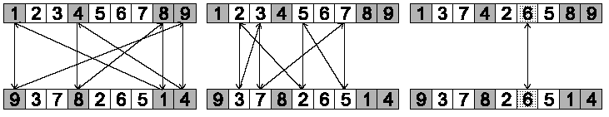
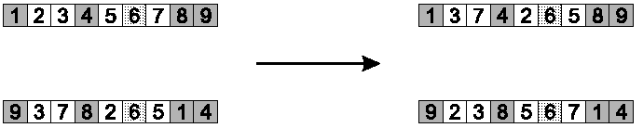
Cycle crossover example
Step 1: identify cycles
Step 2: copy alternate cycles into offspring

Slide 30
Multi-parent recombination
Recall that we are not constricted by the practicalities of nature
Noting that mutation uses 1 parent, and “traditional” crossover 2, the extension to a>2 is natural to examine
Been around since 1960s, still rare but studies indicate useful
Three main types:
  Based on allele frequencies, e.g., p-sexual voting generalising uniform crossover
  Based on segmentation and recombination of the parents, e.g., diagonal crossover generalising n-point crossover
  Based on numerical operations on real-valued alleles, e.g., center of mass crossover, generalising arithmetic recombination operators

Slide 31
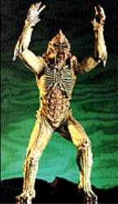
Mutation operator
It produces offspring from single parent by small random change in bit string.
11101001000
11100001000

Slide 32
Mutation
Mutation is important for maintaining diversity in the genetic code
In humans, mutation was responsible for the evolution of intelleigence
Example: The occasional (low probably) alteration of a bit position in a string

Slide 33
Insert Mutation for permutations
Pick two allele values at random
Move the second to follow the first, shifting the rest along to accommodate
Note that this preserves most of the order and the adjacency information

Slide 34
Swap mutation for permutations
Pick two alleles at random and swap their positions
Preserves most of adjacency information (4 links broken), disrupts order more

Slide 35
Inversion mutation for permutations
Pick two alleles at random and then invert the sub-string between them.
Preserves most adjacency information (only breaks two links) but disruptive of order information

Slide 36
Replacement
Determine when to insert new offspring into the population and which individuals to drop out based on fitness
Steady state evolution calls for the same number of individuals in the population, so each new offspring processed one at a time so fit individuals can remain a long time

Slide 37
Fitness Based Competition
Selection can occur in two places:
  Selection from current generation to take part in mating (parent selection)
  Selection from parents + offspring to go into next generation (survivor selection)
Selection operators work on whole individual
  i.e. they are representation-independent
Distinction between selection
  operators: define selection probabilities
  algorithms: define how probabilities are implemented

Slide 38
The Termination Check
Termination may involve testing whether an individual solves the problem to a good enough standard
  Not necessarily having found a definitive answer
Alternatively, termination may occur after a fixed time
  Or after a fixed number of generations
Note that the best individual in a population
So, your GA should:
  Record the best from each generation
  Output the best from all populations as the answer

Slide 39
Why use genetic algorithms?
They can solve hard problems
Easy to interface genetic algorithms to existing simulations and models
GA’s are extensible
GA’s are easy to hybridize
GA’s work by sampling, so populations can be sized to detect differences with specified error rates
Use little problem specific code

Slide 40
Example
No. | A1 | A2 | Classification
1 | T | T | +
2 | T | T | +
3 | T | F | -
4 | F | F | +
5 | F | T | -
6 | F | T | -

Slide 41
Representation
A1 ={T, F} → 10 = T && 01 = F
A2={T, F} → 10 = T && 01 = F
Classification = {+, -} → 1 = + && 0 = -
The gene is A1 (2) + A2 (2) +Classification (1) = 5 bits
[1 0 1 0 1]
A1= T & A2=T & Classification = +

Slide 42
Initial Population
Let we construct 10 genes randomly as
[11101] fitness = 4 cases { 2 true and 2 false}=0.5
[10001] fitness = 0.66
[01011] fitness = 0.0
[01011]
[01111]
[11111]
[01000]
[00001]
[11110]
[01100]

Slide 43
Crossover operation
[11101] X [01100]→[11100] + [01101]
[01011] X [10001] → [11001] + [01010]

Slide 44
Mutation Operation
[01011] → [01010]
[11111] → [11011]

Slide 45
New Population
[11100]
[01010]
[11001]
[01111]
[11011]
[01000]
[00001]
[11110]
[01101]

Slide 46
GA Application
Searching maximum of function
Search for value of x to y=f(x) be maximum.
X play the role of genes, binary code of x value in 8 bits gene (chromosome)
Y the role of fitness

Slide 47
GA Application
Given the digits 0 through 9 and operators +, -, *, and /.
Find sequence that represent given target number.
E.g. Given number 23, the sequence +6+5*4/2+1
If number is 75.5, then 5/2+9*7-5

Slide 48
GA Application
Four bits are required to represent char
0:0000, …….9:1001, +:1010, -:1011, *:1100, /:1101
Gene:011010100101110001001101001010100001 is 6+5*4/2+1 = 23

Slide 49
TSP Application
Use a genetic algorithm to solve the traveling salesman problem we could begin by creating a population of candidate solutions
We need to define mutation, crossover, and selection methods to aid in evolving a solution from this population

Slide 50
Related Technologies
Genetic Programming
  Existing programs are combined to breed new programs
Artificial Life
  Using cellular automata to simulate population growth

Slide 51
Automatic Programming
Getting software to write software
  Brilliant idea, but turned out to be very difficult
  Intuitively, should be easier than other tasks
The automatic programming community
  Didn’t deliver on early promises
  So people began to avoid this area
    And “Automated Programming” became words of warning

Slide 52
Questions to be Answered
How is the programming task specified?
How are the ingredients chosen/specified/
How do we represent programs?
  Which enables reproduction, evaluation, etc.
How are individuals chosen for reproduction?
How are offspring produced?
How are termination conditions specified?
We will start by looking at the representation of programs, as this is required to answer many questions

Slide 53
Genetic Programming
It same as GA but the gene is tree
Each tree = computer program
It contain a population of computer programs to solve the problem specifically

Slide 54
A Tree Representation
Idea: represent programs as trees
  Each node is either a function or a terminal
Functions
  Examples: add, multiply, square root, sine, cosine
  Problem specific ones: getPixel(), goLeft()
Terminals
  Constants and variables, e.g., 10, 17, X, Y
The nodes below a function node
  Are the inputs to that function
The node itself represents the output from the function
  As input to the parent node
The nodes at the ends of branches are terminals only

Slide 55
Computer Programs as Trees
Infix/Postfix
(2 + a)*(4 - num)
*
+
-
2
a
4
num

Slide 56
“Breeding” Computer Programs
Start off with a large “pool” of random computer programs.
Need a way of coming up with the best solution to the problem using the programs in the “pool”
Based on the definition of the problem and criteria specified in the fitness test, mutations and crossovers are used to come up with new programs which will solve the problem.

Slide 57
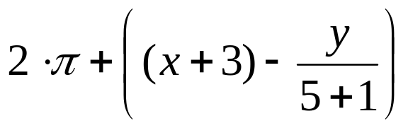
Tree based representation
Trees are a universal form, e.g. consider
Arithmetic formula
Logical formula
Program
(x ∧ true) → (( x ∨ y ) ∨ (z ↔ (x ∧ y)))
i =1;
while (i < 20)
{
i = i +1
}

Slide 58
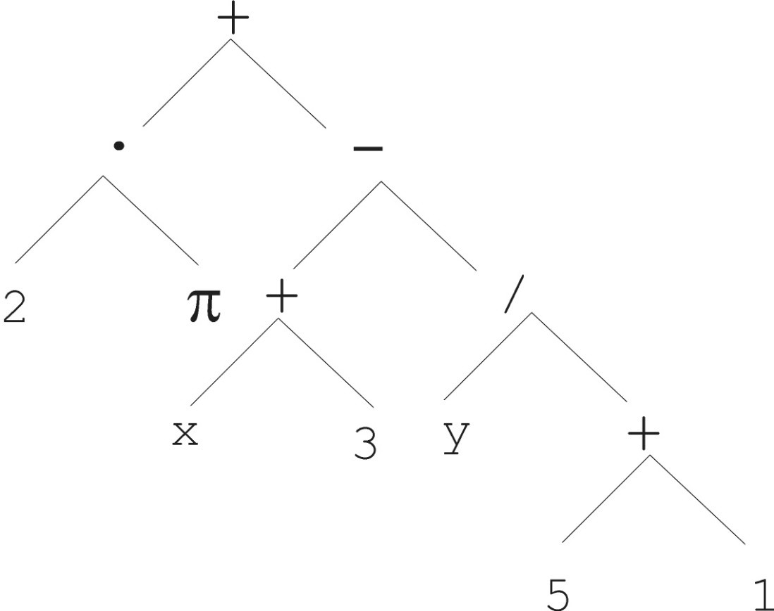
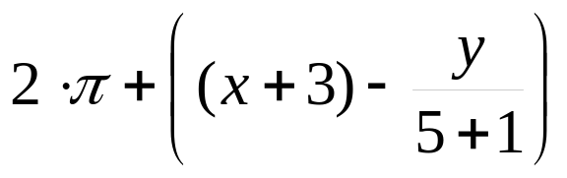
Tree based representation

Slide 59
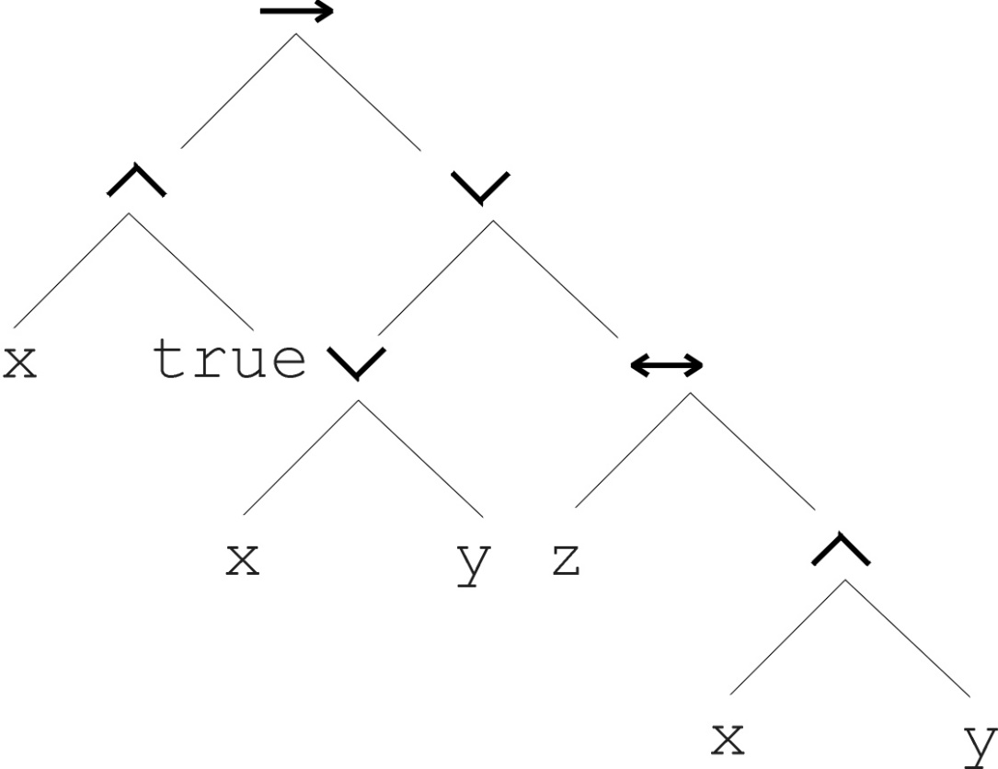
Tree based representation
(x ∧ true) → (( x ∨ y ) ∨ (z ↔ (x ∧ y)))

Slide 60
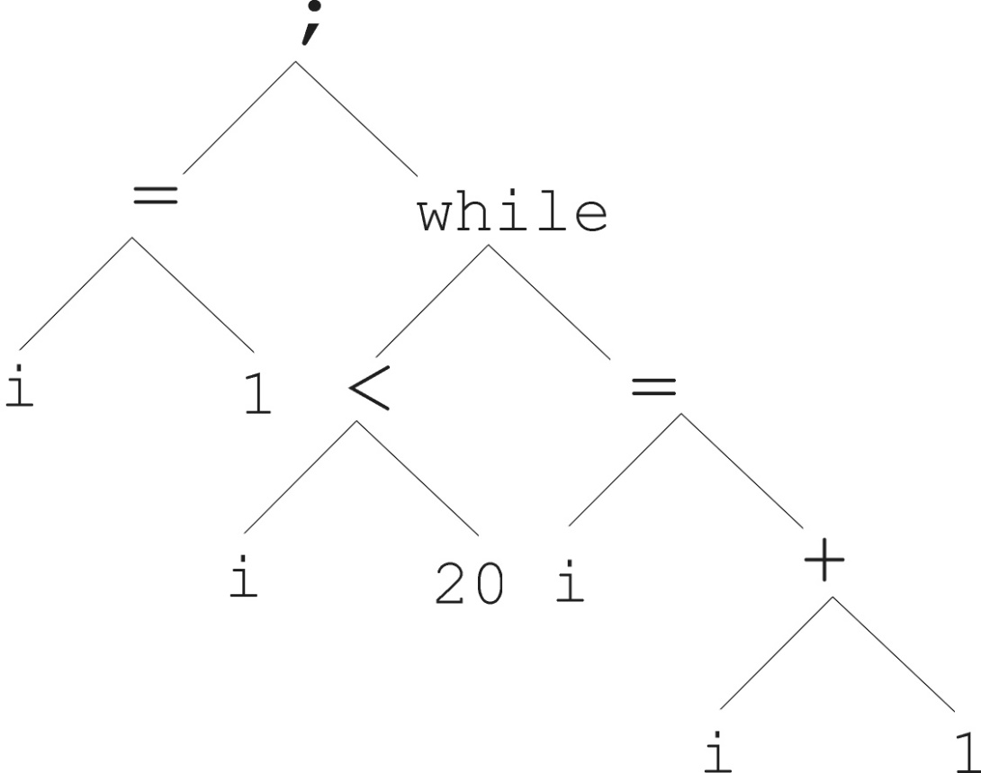
Tree based representation
i =1;
while (i < 20)
{
i = i +1
}

Slide 61
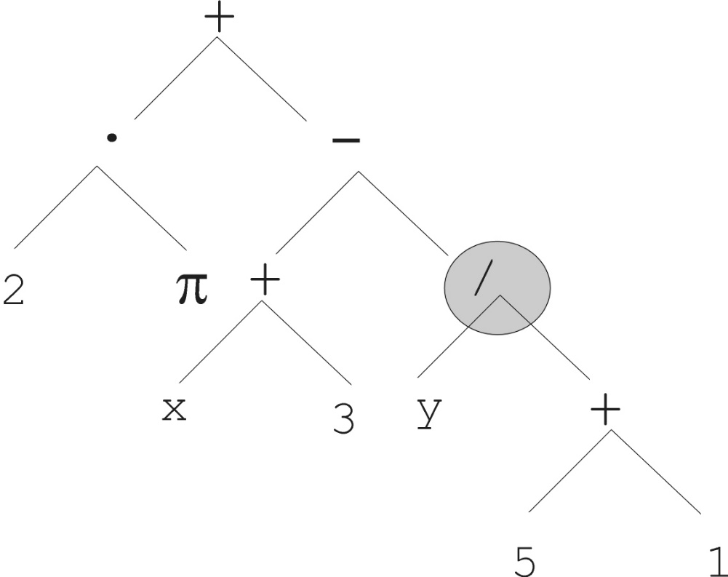
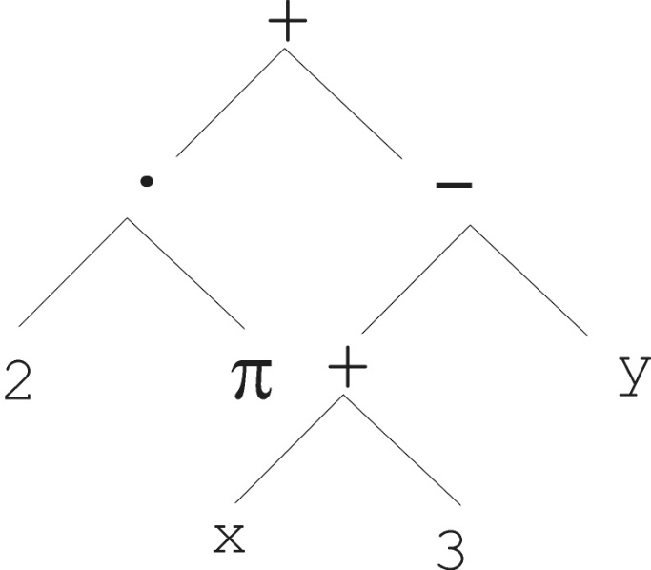
Mutation
Most common mutation: replace randomly chosen subtree by randomly generated tree

Slide 62
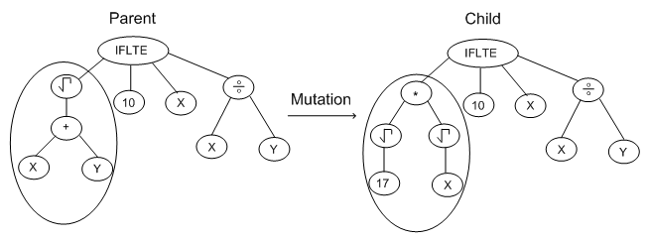
Example of Mutation

Slide 63
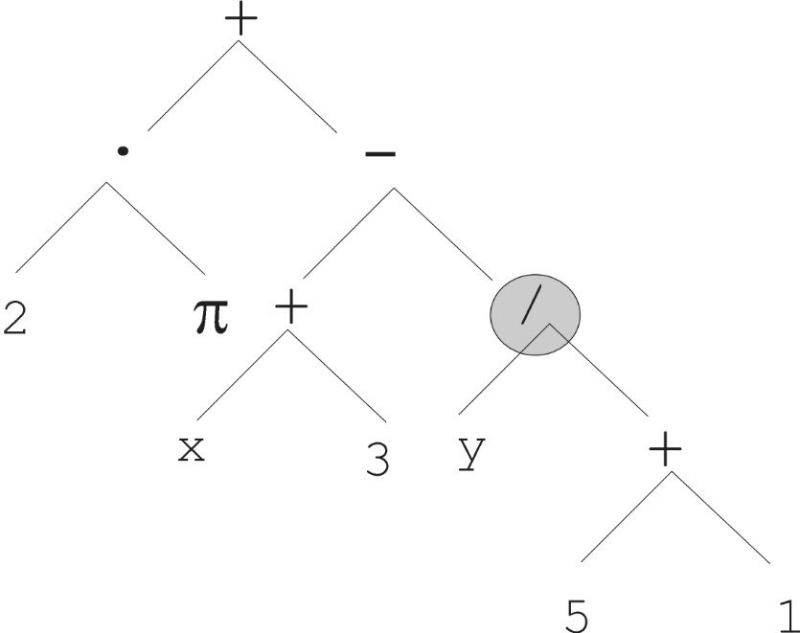
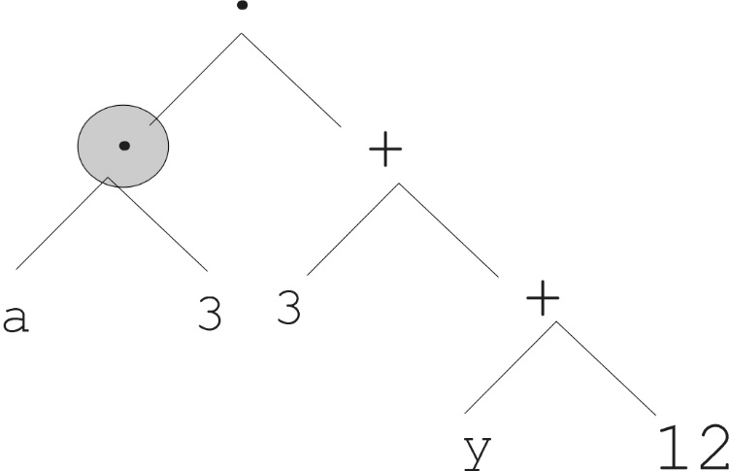
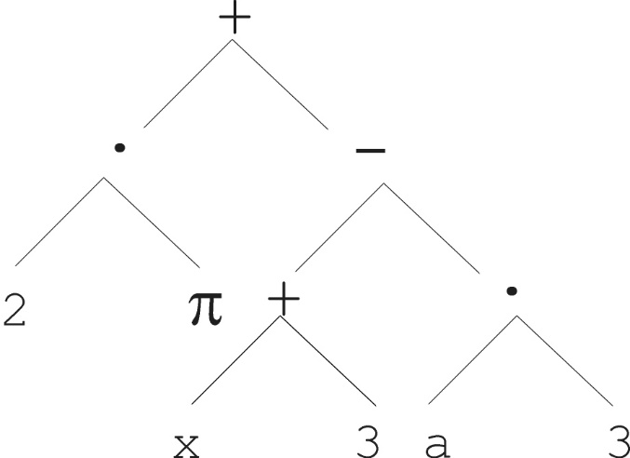
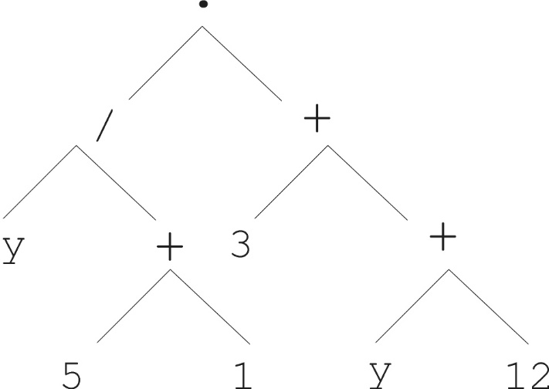
Crossover operation
Parent 1
Parent 2
Child 1
Child 2

Slide 64
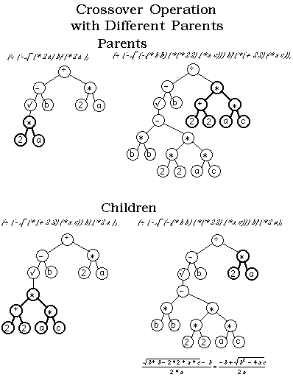

Slide 65
Application Domain #1
Evolving Electronic Circuits
John Koza
  Stanford Professor and CEO of “Genetic Programming Inc.”
  Guru of Genetic Programming, very successful
  Made GP more mainstream by his success
Particularly fruitful area:
  Producing designs for circuit diagrams
    E.g., antennas, amplifiers, etc.
  Functions mimic how transistors, resistors, etc. work

Slide 66
GP Application 1
Given the digits 0 through 9 and operators +, -, *, and /. Find sequence that represent given target number.
Given number 23, the sequence +6+5*4/2+1
If number is 75.5, then 5/2+9*7-5

Slide 67
Generate Random Programs
Generate well-formed formulas using prefix notation from variable A and a set of function symbols, for example { +, -, *, %, sqrt }
Examples:
  ( + A ( * ( sqrt A ) A ) )
  (* A (- (* A A) (sqrt A) ) )

Slide 68
Examples of Genetic Programs
Symbolic Regression - the process of discovering both the functional form of a target function and all of its necessary coefficients, or at least an approximation to these.
Analog circuit design - Embryo circuit - Initial circuit which is modified to create a new circuit according to functionality criteria.

Slide 69
Nim is a two-player game The rules are as follows. The game starts with a single stack of 9 tokens. At each move a player selects one stack and divides it into two non-empty, non-equal stacks. A player who is unable to move loses the game.
Draw the complete search tree for Nim.
Assume two players, min and max, play Nim. Min plays first.
If a terminal state in the search tree developed above is a win for min, a utility function of zero is assigned to that state. A utility function of 1 is assigned to a state if max wins the game. Apply the minimax algorithm to the search tree to assign utility functions to all states in the search tree.
If both min and max play a perfect game, who will win? Explain your answer.

Slide 70
The numbers on the arcs are the incremental costs. The San Diego cities have a heuristic cost-to-go of $0, the two cities Miami and New York have a heuristic cost-to-go of $90, Chicago has one of $60, Denver is $50 and the remaining two cities $30.
Compute the order in which nodes would be expanded by each type of search from New York to the goal of San Diego using the generic forward search algorithm, and then record the resulting path cost.
Breadth-first, Depth-first,Greedy best-first

Slide 71
