Slide 1

UNIVERSITY OF NORTHAMPTON
COMPUTER NETWORKS MODULE
SDN ASSIGNMENT
Topic 4: understanding how to build a cluster of controllers

Slide 2
Content
Teaching how to build a cluster of controllers
Three different methods:
) Python script with middle-level API
) Python script with high-level API
) ovs-vsctl

Slide 3
Teaching format
One lab activity for each method + final challenge for testing the knowledge aquired
In each activity one different topology to implement
step-by-step guide for implementing it
testing
reflection questions
Solutions provided as appendix

Slide 4
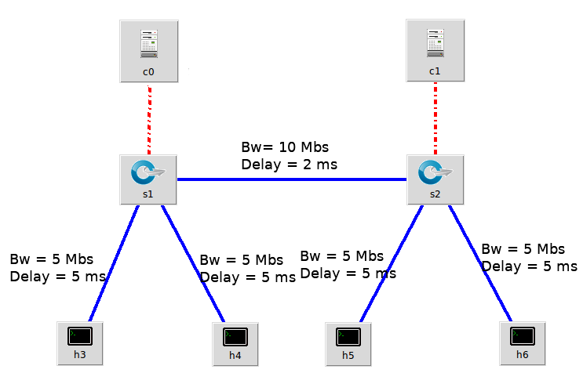
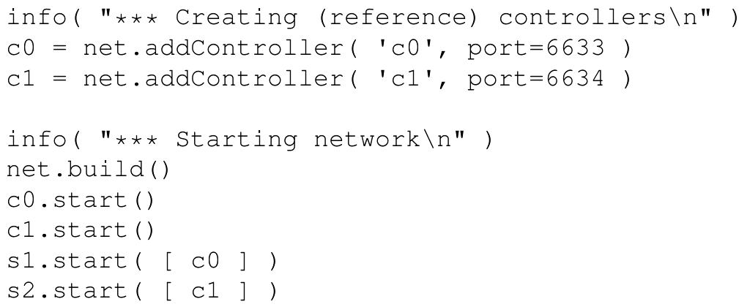
Activity 1

Slide 5
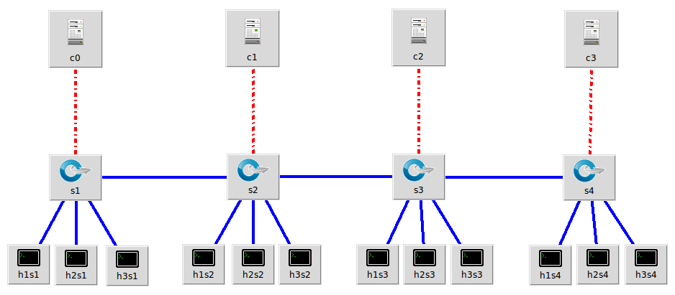
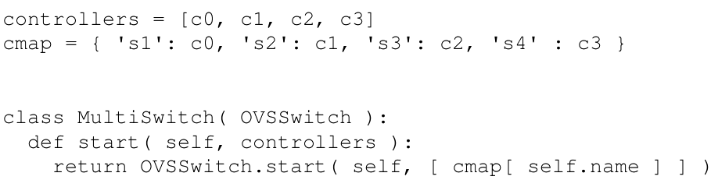
Activity 2

Slide 6
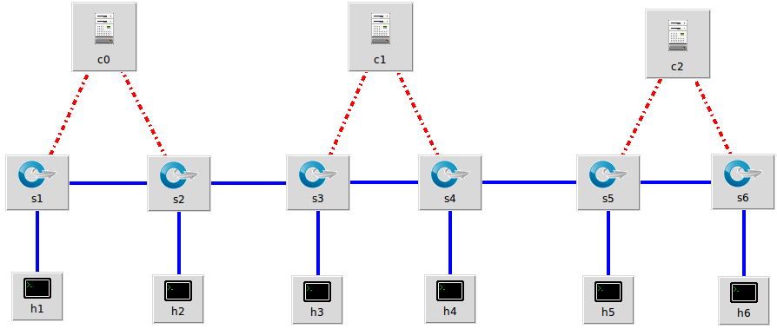
Activity 3

Slide 7
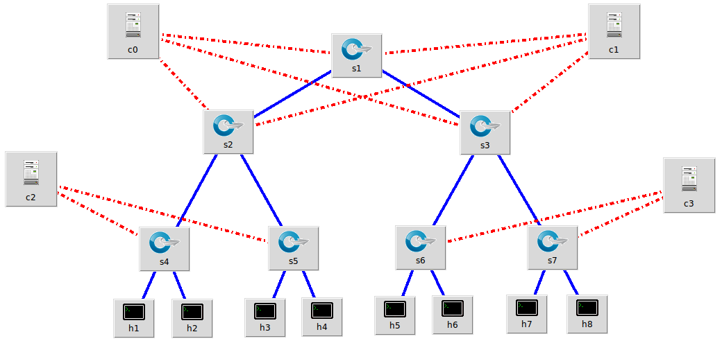
Final challenge

Slide 8

“Understanding how to build a cluster of controllers”
Thank you for your time

