Slide 1


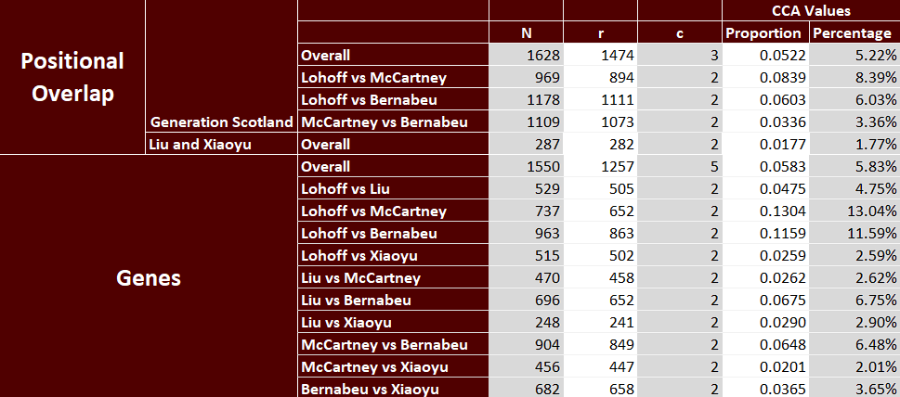
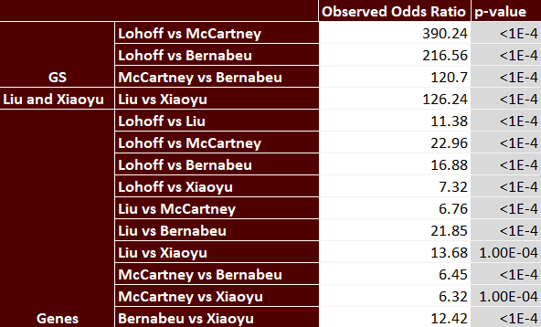
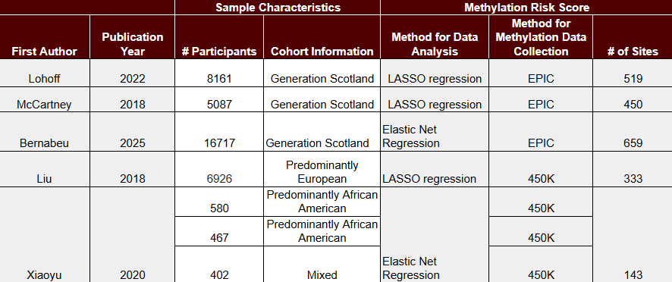
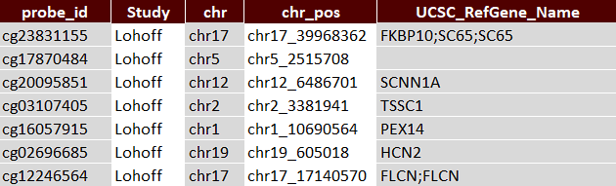
A Comparison Between Methylation Risk Scores
Used to Predict Alcohol Use
Dennis Gao¹, Shaunna L. Clark²
¹The University of Texas at Austin ²Department of Psychiatry and Behavioral Sciences, Texas A&M University
Background
Earlier studies have linked specific DNA methylation (DNAm) sites to alcohol use disorder and alcohol consumption.
Methylation Risk Score (MRS) models have been built to predict alcohol consumption from methylation data
Many MRSs are built using Least Absolute Shrinkage and Selection Operator (LASSO) and Elastic Net Regression (ENR)
This may be problematic as, when dealing with areas with many highly correlated methylation sites, they choose one site at random
Goal: Compare different MRSs to analyze if they are picking up on the same signal
Sample & Measures
Corrected Cover Area
MRSs Used
Lohoff (2022), McCartney (2018), Liu (2018), Xiaoyu (2020), Bernabeu (2025)
Phenotype: Alcohol Consumption
DNAm: Illumina EPIC array and Illumina 450K array
Analyses
Literature Review
Gathered information about previously built MRSs
Annotation
Chromosome and base pair location for each probe and if within gene boundary
Corrected Cover Area
Quantifies similarities between comparable MRSs
Permuted Fisher’s Exact Test
Analyzed independence between different MRSs
Permuted Fisher’s Exact Test
Literature Review
Conclusion
Annotation
All tests were significant with p-value ≤ 1x10⁻⁴
MRS picking up on same signal
The empirical p-value in many cases was 0 most likely due to the low number of permutations (k=1,000)
The Generation Scotland cohort was used in 3 MRSs
Although we are picking up on similarities between MRSs, we are not sure if this similarity is due to predicting the same outcome or using the same cohort

