Slide 1


Slide 2
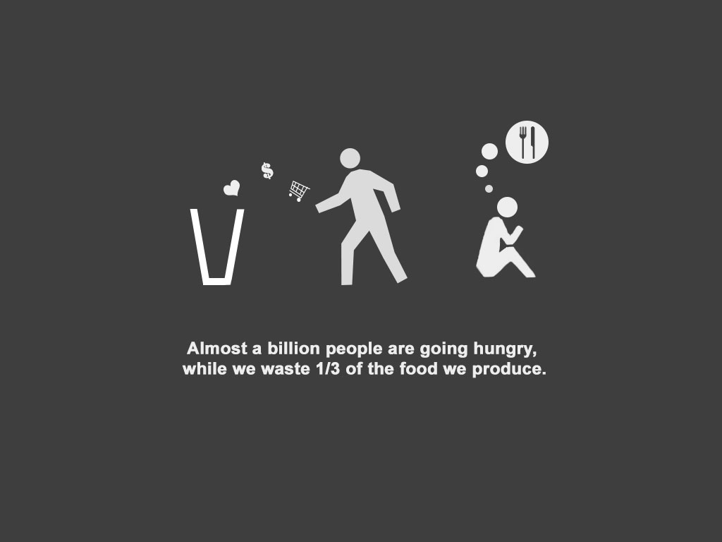

Slide 3
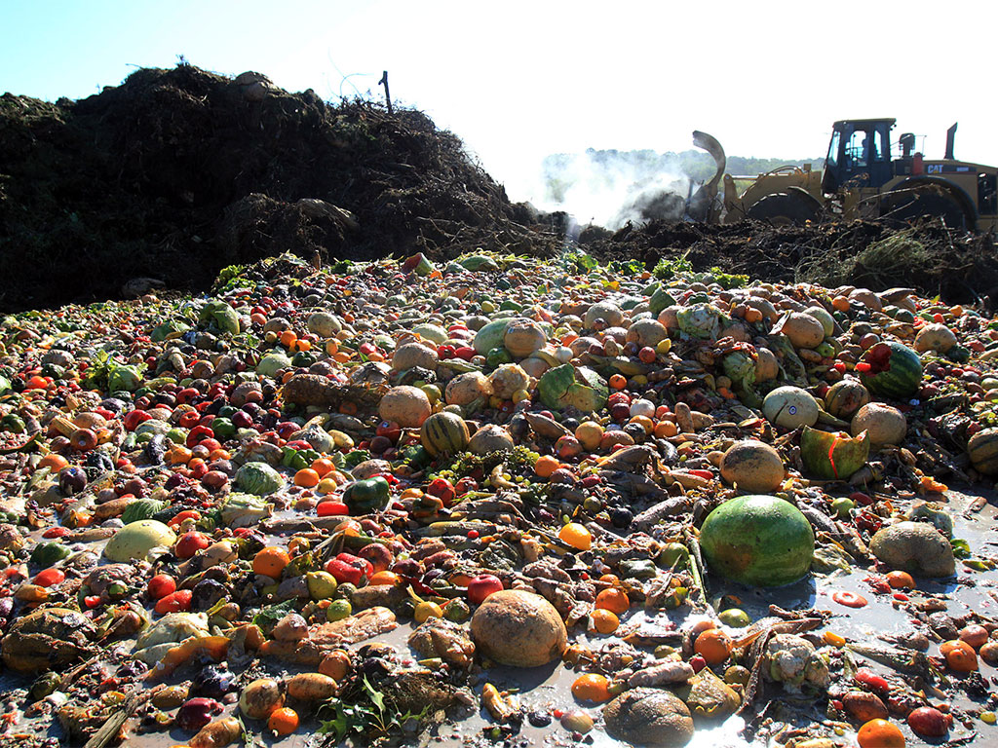

Slide 4

Food waste also contributes to squandering of resources:
Water
Land
Energy
Labor
Capital
…and also climate change.

Slide 5
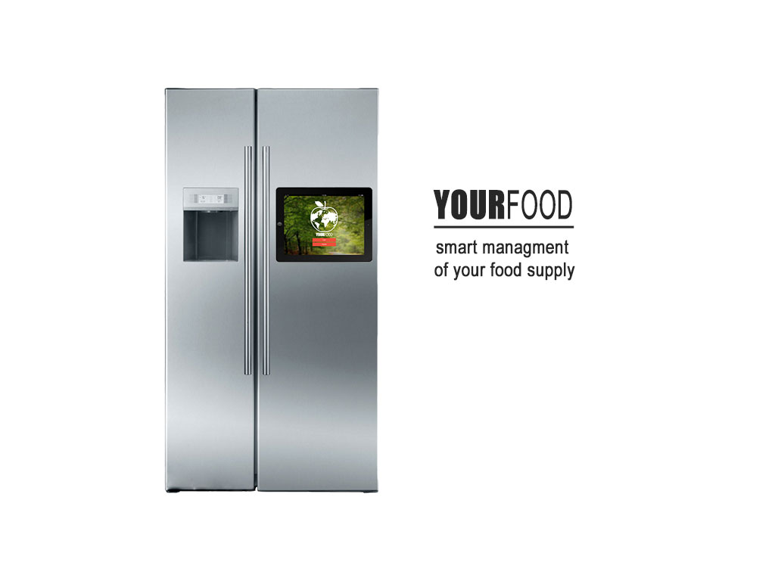

Slide 6
Keeps track of your food
Helps you with cooking and shopping
Gives nutritional advice
Saves you money
Saves the world

Slide 7

What’s out there?
LG Smart fridge
Expensive
Unpopular
User unfriendly

Slide 8
THANKS FOR LISTENING
Stefan Dimov
Yasen Mihaylov
Zdravko Georgiev
Martin Nikolov
Nikolay Radkov

