Slide 1

Workshop in React, JavaScript and ES6

Slide 2

Who are we?

Slide 3

Seems Interesting? We are hiring!

Slide 4
JavaScript

Slide 5
JavaScript
## Language Invented for the web
Adds functionality and interactivity to a website
## Easy to use, prototype and do rapid development
## Code often parsed in browser, often referred to as on the “client”
## Code lives in browsers (chrome, edge, firefox, safari)
Code that is parsed in the browser and not sent via network, often denoted as “Client Side”
Code evaluated on a server and sending JavaScript to browser, often denoted as “Server Side”
## Fairly easy syntax, but a lot of learning material and knowledge needed to master
## JavaScript !== Java

Slide 6
Demo Time

Slide 7
Demo Time

Slide 8
React

Slide 9
The problem we are trying to solve with React
Complex functionality, separation of concern is was hard in JavaScript

Slide 10
React
## Framework made to make web development easier
## Easier to use compared to other frameworks due the architecture of the framework
## Logic for code and separation of concern is made through “Components”
## Components encapsulates state and logic, which has a relationship like a Binary Search Tree
## Parent nodes can send data down to child nodes and child nodes can invoke actions to parent nodes
## Functionality split into cycles that a component lives through

Slide 11
JSX
## HTML-alike syntax

Slide 12
Simple Hello World

Slide 13
React Concepts
## Virtual DOM
## Component and Component Architecture
## props and state (read-only, r/w data)
## event handling and responding to events (click, drag, etc)
## Component life cycle
## Ajax requests and fetching data

Slide 14
Virtual DOM
Isomorphic Data Structure
https://reactjs.org/docs/faq-internals.html#what-is-the-virtual-dom

Slide 15
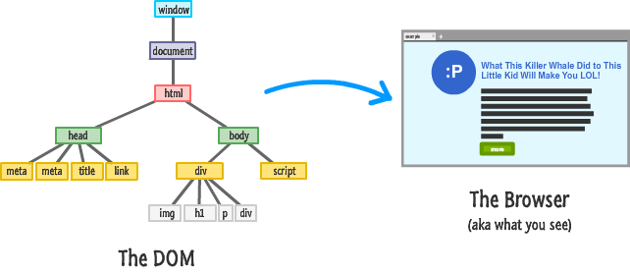

Slide 16
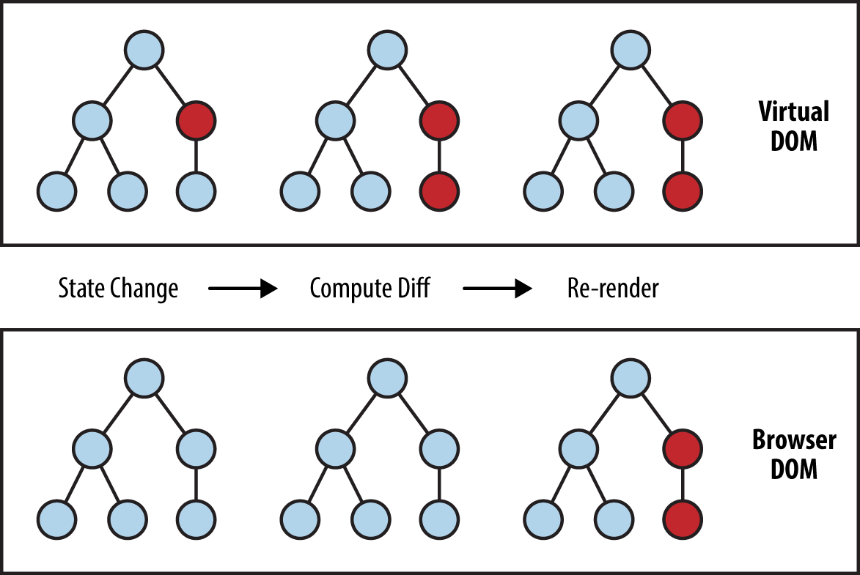

Slide 17
Component and Component Architecture
Abstractions

Slide 18
<MyElem />

Slide 19
<div> <ChuckNorris /> </div>

Slide 20
Dealing with data
State
Props
Abstractions
https://reactjs.org/docs/components-and-props.html

Slide 21
Event Handling
onClick
Bind to function
methods
https://reactjs.org/docs/handling-events.html

Slide 22
Component life cycle

Slide 23
componentDidMount
invoked immediately after a component is mounted

Slide 24
componentDidUpdate
invoked immediately after updating occurs

Slide 25
componentWillUnmount
invoked immediately before a component is unmounted and destroyed

Slide 26
getDerivedStateFromProps
invoked right before calling the render method, both on the initial mount and on subsequent updates

Slide 27
getSnapshotBeforeUpdate
invoked right before the most recently rendered output is committed to e.g. the DOM

Slide 28
getDerivedStateFromError
invoked after an error has been thrown by a descendant component

Slide 29
componentDidCatch
invoked after an error has been thrown by a descendant component

Slide 30
Fetching data
ComponentDidMount
State
API

Slide 31
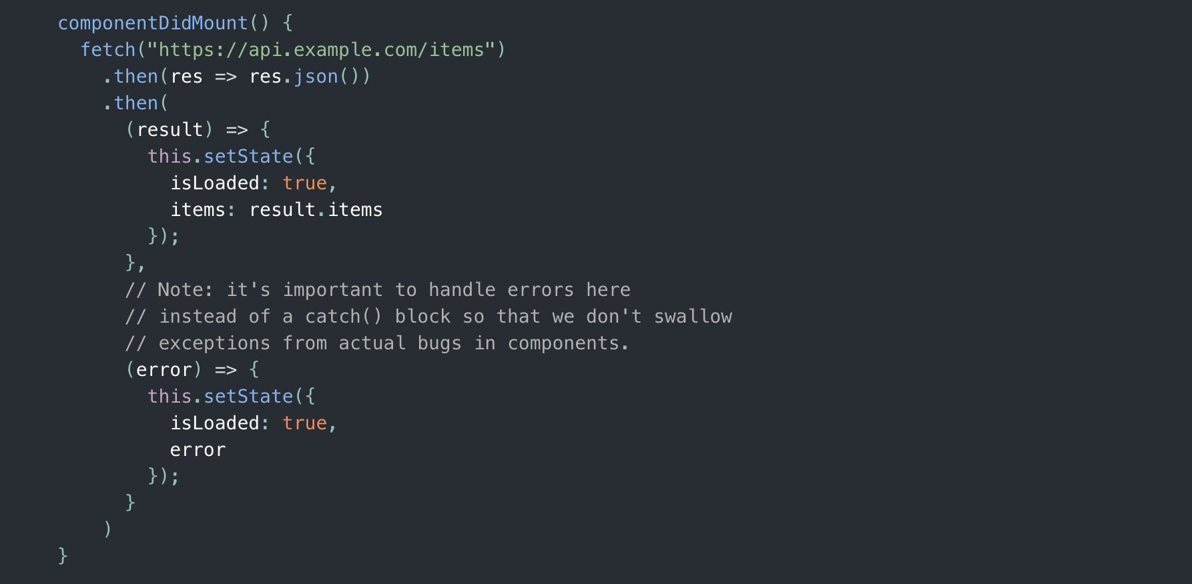

Slide 32
Single Page Application and Deployment

Slide 33
Summary
React is used to simplify complex Applications
JavaScript syntax is compiled down to a syntax browser
can understand
Easy to prototype, dynamic non-strict language
TypeScript enforces strictness

