Slide 1

Workshop in React, JavaScript and ES6

Slide 2

Who are we?

Slide 3

Seems Interesting? We are hiring!

Slide 4
JavaScript

Slide 5
JavaScript
## Language Invented for the web
Adds functionality and interactivity to a website
## Easy to use, prototype and do rapid development
## Code often parsed in browser, often referred to as on the “client”
## Code lives in browsers (chrome, edge, firefox, safari)
Code that is parsed in the browser and not sent via network, often denoted as “Client Side”
Code evaluated on a server and sending JavaScript to browser, often denoted as “Server Side”
## Fairly easy syntax, but a lot of learning material and knowledge needed to master
## JavaScript !== Java

Slide 6
Demo Time
https://codesandbox.io/s/4z6mwy7oj4

Slide 7
React

Slide 8
What is react, and why do I need it?

Slide 9
Web: HTML, CSS, JS

Slide 10
React

Slide 11
Simple Hello World
https://codesandbox.io/s/4056qq13z4

Slide 12
React Concepts
## Virtual DOM
## Component and Component Architecture
## props and state (read-only, r/w data)
## event handling and responding to events (click, drag, etc)
## Component life cycle
## Ajax requests and fetching data

Slide 13
Virtual DOM
Isomorphic Data Structure
https://reactjs.org/docs/faq-internals.html#what-is-the-virtual-dom

Slide 14
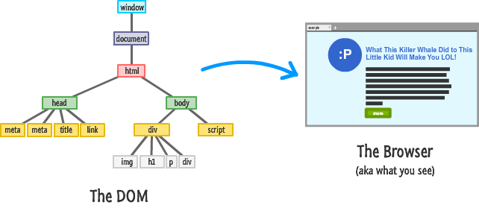

Slide 15
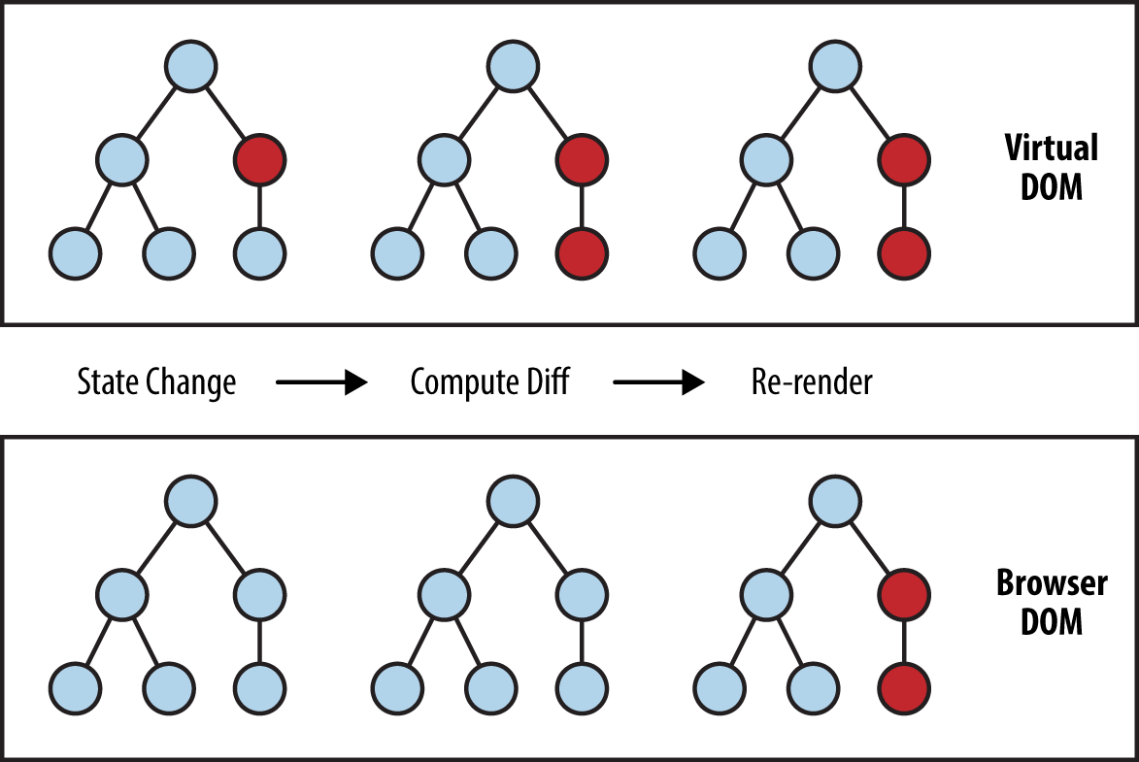

Slide 16
Component and Component Architecture
Abstractions

Slide 17
<MyElem />

Slide 18
<div> <ChuckNorris /> </div>

Slide 19
Dealing with data
State
Props
Abstractions
https://reactjs.org/docs/components-and-props.html

Slide 20
Event Handling
onClick
Bind to function
methods
https://reactjs.org/docs/handling-events.html

Slide 21
Component life cycle

Slide 22
componentDidMount
invoked immediately after a component is mounted

Slide 23
componentDidUpdate
invoked immediately after updating occurs

Slide 24
componentWillUnmount
invoked immediately before a component is unmounted and destroyed

Slide 25
getDerivedStateFromProps
invoked right before calling the render method, both on the initial mount and on subsequent updates

Slide 26
getSnapshotBeforeUpdate
invoked right before the most recently rendered output is committed to e.g. the DOM

Slide 27
getDerivedStateFromError
invoked after an error has been thrown by a descendant component

Slide 28
componentDidCatch
invoked after an error has been thrown by a descendant component

Slide 29
Fetching data
ComponentDidMount
State
API

Slide 30
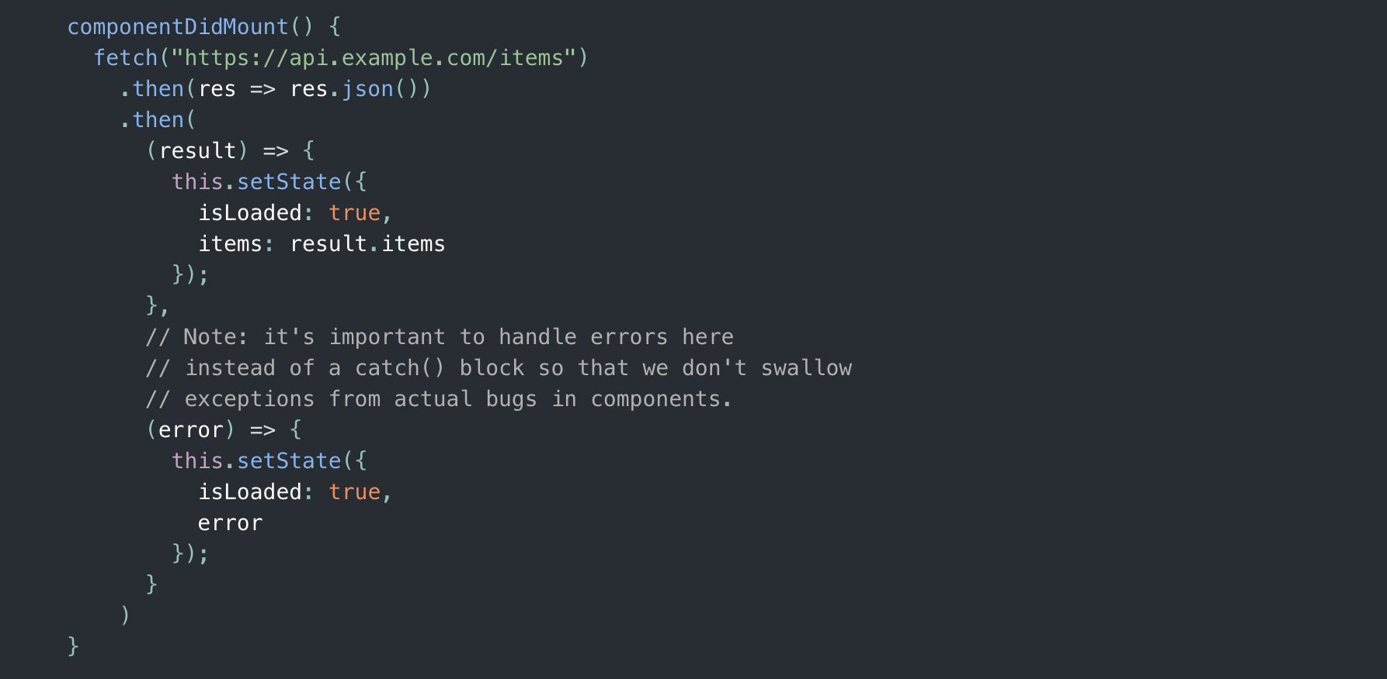

Slide 31
Single Page Application and Deployment

Slide 32
Summary
React is used to simplify complex Applications
JavaScript syntax is compiled down to a syntax browser
can understand
Easy to prototype, dynamic non-strict language
TypeScript enforces strictness

