Slide 1
Module Name: BLOCKCHAIN FUNDAMENTALS Module Code: SWDBF501 Credits:10 Sector: ICT AND MULTIMEDIA Trade: SOFTWARE DEVELOPMENT

Slide 2
L.O.1:1: Design blockchain system architecture
A blockchain is a decentralized, distributed digital ledger that records transactions in a secure, transparent, and immutable manner.
It is the underlying technology that powers cryptocurrencies and various decentralized applications (DApps).

Slide 3
Why is distributed and decentralized?
Distributed A distributed system means that the data or operations are spread across multiple computers (often referred to as nodes) instead of being stored or controlled by a single entity.

Slide 4
Why Decentralized
Decentralization means that there is no central authority or a single entity that controls the entire network.
Instead, control and decision-making are distributed across all the nodes in the network.

Slide 5
Trustless Environment
In a decentralized system, you don't need to trust a single entity (like a bank or government) to manage or control the system.

Slide 6
Key Components of a Blockchain
Cryptography is the science and practice of securing information and communication through the use of mathematical techniques.

Slide 7
Cryptography in Blockchain

Slide 8
What is Cryptography
Cryptography is a method of securing data from unauthorized access.

Slide 9
In the blockchain, cryptography is used to secure transactions taking place between two nodes in a blockchain network.

Slide 10
Some terminologies related to Cryptography
Encryption: Conversion of normal text to a random sequence of bits.
Key: Some amount of information is required to get the information of the cryptographic algorithm.
Decryption: The inverse process of encryption, conversion of a Random sequence of bits to plaintext.
Cipher: The mathematical function, i.e. a cryptographic algorithm which is used to convert plaintext to ciphertext(Random sequence of bits).

Slide 11
Types of Cryptography
The two types of cryptography are:
Symmetric-key cryptography.
Asymmetric-key cryptography.

Slide 12
Symmetric-Key Cryptography (Secret Key Cryptography)
Uses the same key for both encryption and decryption.
Faster and more efficient but requires secure key exchange.
Common algorithms: AES, DES, 3DES, RC4.
Used in applications like secure file storage and VPN encryption.

Slide 13
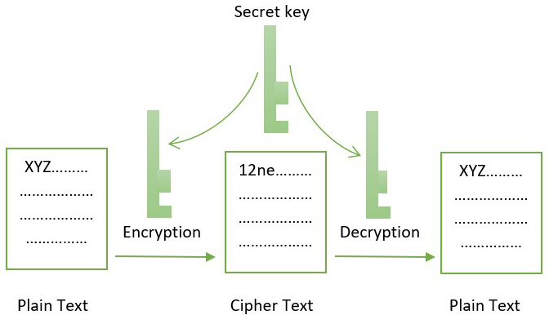
Symmetric-Key Cryptography (Secret Key Cryptography)

Slide 14
Asymmetric-Key Cryptography (Public Key Cryptography)
Uses two keys: a public key for encryption and a private key for decryption.
More secure but slower than symmetric encryption.
Common algorithms: RSA, ECC, DSA.
Used in digital signatures, SSL/TLS, and blockchain transactions.

Slide 15
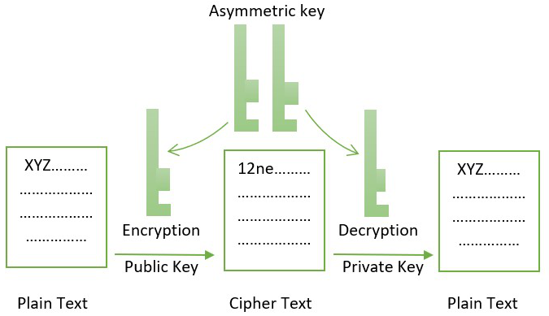
Symmetric-Key Cryptography (Secret Key Cryptography)

Slide 16
DIGITAL SIGNATURE
A digital signature is a cryptographic technique used to verify the authenticity and integrity of a message, document, or transaction.

Slide 17
How Digital Signatures Work:
Signing: The sender uses their private key to generate a unique signature for the message or document.
Verification: The recipient uses the sender’s public key to decrypt the digital signature.

Slide 18
Cryptocurrency
is a type of digital or virtual currency that uses cryptography for security.
Unlike traditional currencies issued by governments (like the US dollar or the Euro), cryptocurrencies operate on decentralized networks based on blockchain technology.

Slide 19
Block in Blockchain
a block is a fundamental component of the blockchain structure.

Slide 20
a block is a fundamental component of the blockchain structure.
Each block is a digital record that contains a list of transactions or data.
These blocks are linked together in a chronological sequence to form the blockchain.

Slide 21
SMART CONTRACT
A smart contract is a self-executing contract with the terms of the agreement directly written into code.

Slide 22
These contracts automatically enforce and execute the terms of a contract when predefined conditions are met, without the need for intermediaries like lawyers or notaries.
Smart contracts run on blockchain networks, which ensures that they are secure, transparent, and immutable.

Slide 23
Immutability
Immutability refers to the characteristic of something that cannot be changed or altered after it has been created.
In the context of blockchain technology, immutability means that once data is written to a blockchain, it cannot be modified or deleted.
This feature is a fundamental aspect of blockchain's security and reliability.

Slide 24
Consensus mechanisms
Consensus mechanisms are protocols used in blockchain networks to achieve agreement among distributed nodes on the state of the blockchain.
They ensure that all participants in the network agree on which transactions are valid and which blocks should be added to the blockchain.
Consensus mechanisms are crucial for maintaining the integrity and consistency of the blockchain without the need for a central authority.

Slide 25
Types of Blockchain
Public Blockchains are open to anyone who wants to participate.
They are decentralized and maintained by a network of nodes that validate transactions and maintain the ledger.
Example: Bitcoin, Ethereum

Slide 26
Characteristics Public Blockchains
Open Access: Anyone can join the network, view the blockchain, and participate in the consensus process.
Decentralization: No central authority controls the network; instead, it is maintained by a distributed network of nodes.
Transparency: Transactions are visible to all participants, and the ledger is accessible to the public.
Security: Security is ensured through consensus mechanisms like Proof of Work (PoW) or Proof of Stake (PoS)

Slide 27
2. Private Blockchains
Private Blockchains are restricted to a specific group of participants.
They are often used within organizations or consortia where access and permissions are controlled

Slide 28
Characteristics Private Blockchains
Restricted Access: Only authorized participants can join the network and access the blockchain.
Centralization: Often controlled by a single organization or a consortium of organizations.
Privacy: Transactions and data are visible only to authorized participants, providing greater privacy and Control.

Slide 29
Examples of Private Blockchains
Hyperledger Fabric: An open-source framework for creating private blockchains, often used in enterprise settings.
R3 Corda: A distributed ledger technology platform designed for business transactions and privacy

Slide 30
3. Consortium Blockchains
Consortium blockchains are semi-private and are managed by a group of organizations rather than a single entity.
They are used when multiple parties need to collaborate and share information in a controlled manner.

Slide 31
Characteristics of Consortium Blockchains
Controlled Access: Only a predefined set of organizations or entities can participate in the network.
Shared Control: Governance and decision-making are shared among the participating organizations.
Balance: They offer a balance between decentralization and control, providing a level of transparency while maintaining privacy

Slide 32
Examples of Consortium Blockchains
Enterprise Ethereum Alliance: A consortium of companies working together to develop and promote Ethereum-based technologies for business use.
B3i: A consortium of insurance companies working on blockchain solutions for the insurance industry.

Slide 33
4. Hybrid Blockchains
Hybrid Blockchains Combine elements of public and private blockchains, offering customizable access and transparency.
Examples: IBM Food Trust, Dragonchain

Slide 34
Characteristics of Hybrid Blockchains
Selective Transparency: Some data and transactions may be public, while others are kept private or restricted.
Customizable Access: Organizations can define which parts of the blockchain are open to the public and which are private.
Flexibility: Offers the ability to adapt to various use cases and regulatory requirements

Slide 35
Blockchain Principles
Decentralization: Decentralization means that control is distributed across a network of participants rather than being centralized in a single entity.
Distributed Ledger: A distributed ledger is a database that is replicated and synchronized across multiple nodes in a network. Ensures data consistency across multiple nodes.
Consensus Mechanisms: are protocols used to agree on the validity of transactions and the state of the blockchain. i.e Agree on the validity of transactions

Slide 36
Common Types Consensus Mechanisms
Proof of Work (PoW): Requires nodes to solve complex mathematical problems to validate transactions (e.g., Bitcoin).
Proof of Stake (PoS): Validators are chosen based on the number of tokens they hold and are willing to "stake" as collateral (e.g., Ethereum2.0).
Delegated Proof of Stake (DPoS): Stakeholders elect delegates to validate transactions on their behalf (e.g., core).

Slide 37
Wallet
A blockchain wallet is a tool that allows users to interact with a blockchain and perform transactions with cryptocurrencies.
It stores a user's public and private keys, which are used to secure the wallet and enable transactions.

Slide 38
Types of Wallets
1. Software Wallets : is a program that allows users to manage their cryptocurrency on the blockchain through a device like a computer or mobile device.
Mobile Wallets: Apps installed on smartphones, offering convenience and access on the go. Examples include Trust Wallet and Mycelium.

Slide 39
Mobile Wallets: Apps installed on smartphones, offering convenience and access on the go. Examples include Trust Wallet and Metamask.
Web Wallets: Accessed through a web browser. They are convenient but can be less secure than other types.
Examples include Coinbase and Blockchain.info.

Slide 40
Types of Wallets
2. Hardware Wallets: Physical devices that store your private keys offline, providing a high level of security against online threats.
Examples: Ledger Nano S/X, Trezor One/Trezor Model T.

Slide 41
Types of Wallets
3. Paper Wallets : Physical printouts or handwritten records of your public and private keys. Used for offline storage.
Usage: Often used for long-term storage or cold storage, but can be easily damaged or lost.

Slide 42
Types of Wallets
4. Custodial Wallets: Wallets where a third party manages the private keys on your behalf.
Examples: Wallets provided by exchanges like Binance or Coinbase

Slide 43
Key Components of a Wallet
1. Private Key: A secret key used to sign transactions and prove ownership of your assets.
It must be kept secure.
Usage: Grants control over the assets stored in the wallet

Slide 44
Key Components of a Wallet
2. Public Key: These are derived from the private key and serve as an address that others can use to send cryptocurrencies to the wallet.
Public keys are shared openly.
Usage: Allows others to send you funds and verify your transactions.

Slide 45
Key Components of a Wallet
3.Wallet Address:A unique identifier derived from the public key. It is used
to receive digital assets.
Usage: Shared with others to receive cryptocurrency

Slide 46
Key Components of a Wallet
4. Passphrase (or Seed Phrase) A series of words used to recover your wallet if you lose access to it.
Usage: Provides an additional layer of security and backup

Slide 47
Description of blockchain key concepts
dApps(Decentralized Applications): Applications running on a blockchain network.
Hash Functions: Functions that create unique identifiers for data.

Slide 48
Transactions: Transactions are the fundamental operations that involve transferring digital assets (e.g., cryptocurrency) from one address to another.

Slide 49
Merkle Trees: A Merkle Tree is a data structure that organizes transactions in a way that allows for efficient and secure
verification of data integrity.

Slide 50
QUIZ /6marks
What is Blockchain /1marks
Explain 4 type of Blockchain /2marks
What is Dapp /1marks
Explain Immutability /1marks
What is Wallet /1marks

Slide 51
How They Work
Each transaction is hashed (a process that converts data into a fixed-size string of characters).
These hashes are paired and hashed together to form a parent node.
This process continues until a single hash, called the Merkle Root, is created at the top of the tree.

Slide 52
The Merkle Root represents all the transactions in that block, allowing anyone to verify whether a transaction is included without needing to check every single transaction.

Slide 53
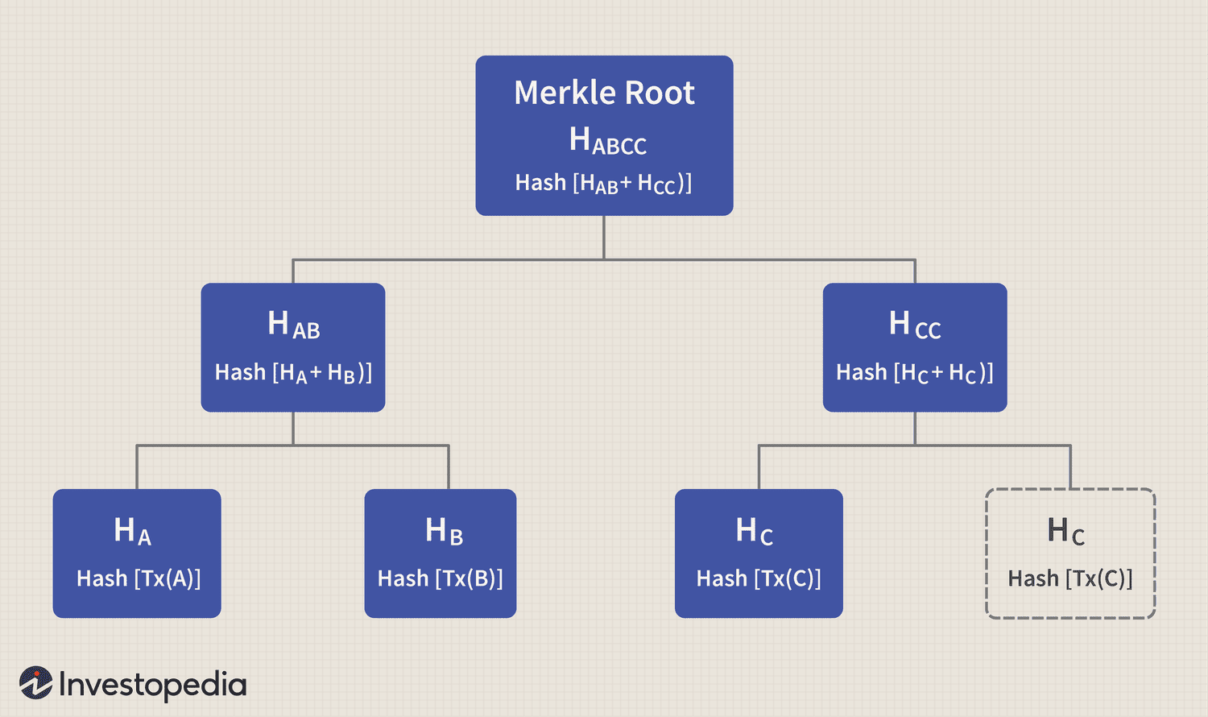

Slide 54
Block
A block in a blockchain is a data structure that stores a list of transactions or other relevant information.
Each block is linked to the previous one, forming a chain, hence the term "blockchain."

Slide 55
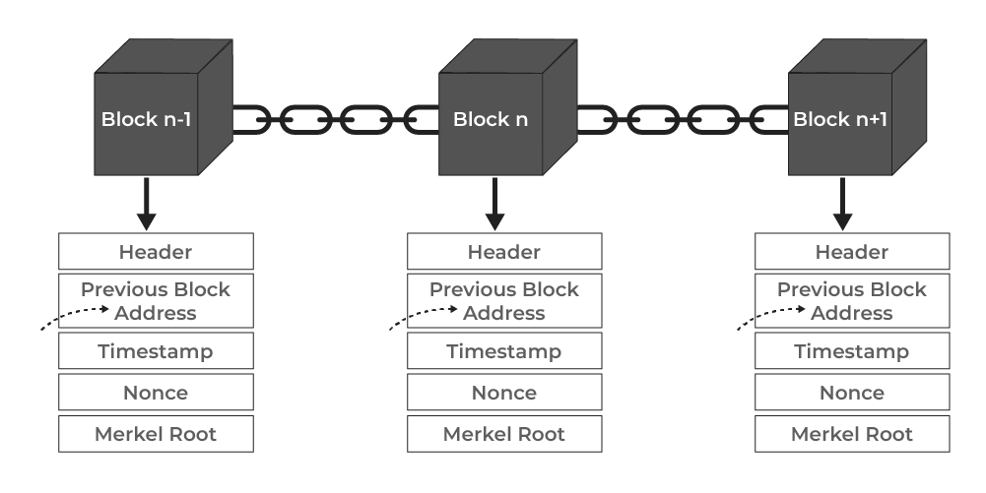
Components of a block

Slide 56
Components of a block
Header: This contains metadata about the block, including:
Hash of the previous block: This ensures the immutability of the blockchain, linking each block to its predecessor.
Metadata is data that provides information about other data. Example: For a document: file size, creation date, author, and file type.

Slide 57
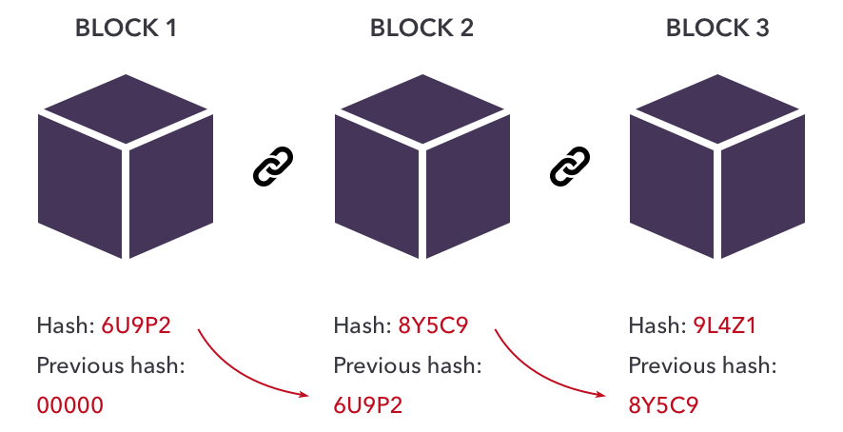
Hash of the previous block

Slide 58
Components of a block Cont…
Timestamp: The time when the block was created.
Nonce: In blockchain terms, a nonce is a (number used once). A random number generated by miners when they create a new block in the blockchain.
Merkle Root: A hash that represents all the transactions within the block, enabling efficient verification of the transactions.
A miner in a blockchain is a person or entity that performs computational work to validate transactions and secure the blockchain.
Miners are rewarded for their work with newly minted coins and transaction fees.

Slide 59
How a blockchain transaction works
Steps in a blockchain transaction
Transaction Creation Alice creates a transaction with the amount, Bob’s wallet address, and signs it using her private key.
Broadcasting: The transaction is broadcasted to the blockchain network for nodes to receive.
Validation by Nodes: Nodes verify Alice's balance and digital signature. If valid, the transaction goes to the mempool.
Inclusion in a Block: Miners pick transactions from the mempool to include in the next block.
A mempool, short for "memory pool", is a temporary storage area for unconfirmed transactions on a blockchain network.

Slide 60
How a blockchain transaction works
5. Mining/Validation: Miners solve a cryptographic puzzle to create a new block, which is broadcasted for validation.
6. Consensus: Other nodes validate the new block. If valid, it is added to the blockchain.
7. Confirmation: The transaction is confirmed and becomes harder to reverse with more blocks added after it.
8. Completion: Bob sees the confirmed funds in his wallet.

Slide 61
Blockchain use cases
Blockchain technology has a wide range of use cases across different industries due to its transparency, security, and decentralized nature.
Here are some key blockchain use cases:
Cryptocurrencies
Supply Chain Management
Smart Contracts
Healthcare
Voting Systems
Identity Management
Asset Tokenization
Financial Services

Slide 62
Test 2
Write at least 3 use case of blockchain/1.5marks
Define Mempool /1marks
Define a Miner /1marks
State components of a block /1.5marks

Slide 63
Learning outcome 2: Apply Solidity Basics
Solidity is a programming language used to develop smart contracts for the Ethereum blockchain.

Slide 64
What it is
Solidity is a high-level, object-oriented programming language that uses curly brackets.
It's designed to run on the Ethereum Virtual Machine (EVM) and is inspired by C++, Python, and JavaScript.

Slide 65
What it's used for
Solidity is used to create decentralized applications(dApps), write smart contracts, and build DeFi apps (Decentralized Finance applications).

Slide 66
How it works
Solidity smart contracts are immutable, meaning they can't be changed once deployed.
The file extension for Solidity files is .sol. For example, a Solidity contract file might be named SampleContract.sol.

Slide 67
Features
Solidity supports complex member variables, inheritance, libraries, and user-defined types.
It also includes an application binary interface (ABI) that allows for multiple type-safe functions within a single smart contract.

Slide 68
Basic Syntax of Solidity
// SPDX-License-Identifier: MIT
pragma solidity ^0.8.0;
contract HelloGeeks {
uint a;
function set(uint x) public {
a = x;
}
function get() public view returns (uint) {
return a;
}
}

Slide 69
SPDX License Identifier
Syntax Explanation
// SPDX-License-Identifier: MIT
This is a comment line that specifies the software license for the code. In this case, it's the MIT license.

Slide 70
Pragma Directive
pragma solidity ^0.8.0;
This line specifies the version of the Solidity compiler that is compatible with the contract.
^0.8.0 means that this contract can be compiled with Solidity version 0.8.0 or any newer patch version (like 0.8.1, 0.8.2), but not with major version 0.9.x or higher.

Slide 71
Contract Definition
contract HelloGeeks {
contract defines a new smart contract named HelloGeeks.
A contract is similar to a class in object-oriented programming; it contains variables and functions that define its behavior.

Slide 72
State Variable
uint a;
uint a; declares a state variable a of type uint (unsigned integer) which will hold a positive number.
This variable is stored on the blockchain and its value persists between function calls.

Slide 73
set() Function
function set(uint x) public { a = x; }
function set(uint x) public defines a public function named set that accepts one argument of type uint (unsigned integer).
public means this function can be called by anyone, both inside and outside the contract.

Slide 74
get() Function
function get() public view returns (uint) {
return a;
}
The view keyword indicates that the function does not modify the state of the contract (it only reads the state variable a).
The function returns the value of the state variable a

Slide 75
Solidity Data Types
Two types of Solidity data type
Value Types in Solidity
Reference Types
Value Types in Solidity
Value types store data directly in memory and allow duplication across functions or assignments without altering the original value.
Key characteristics include independent copies of data after duplication.

Slide 76
Here are the main value types:
Addresses: Designed to hold Ethereum addresses (20 bytes).
There are two types:
address (for storage)
address payable (for sending and receiving Ether).
Ex: 0xe4537760C761Dd18eb7a3319be213421D0e15081

Slide 77
Remix IDE
Remix IDE is a free, open-source, browser-based toolset for developing smart contracts for the Ethereum network
Visit: https://remix.ethereum.org/

Slide 78
Enums: Used for defining constant values, improving readability and maintenance in smart contracts. Options of enums can be represented by unsigned integer values starting from 0.
Ex: enum FreshJuiceSize{ SMALL, MEDIUM, LARGE }

Slide 79
Booleans: Represent binary outcomes (True/False) with a default value of false.
Common Boolean logic is supported, but no conversion between Booleans and integers is allowed.
Ex: bool public myBool;

Slide 80
Bytes: Although bytes are similar to strings, they have some differences.
bytes used to store a fixed-sized character set while the string is used to store the character set equal to or more than a byte.
The length of bytes is from 1 to 32, while the string has a dynamic length.
Ex: bytes1 public b = "a";

Slide 81
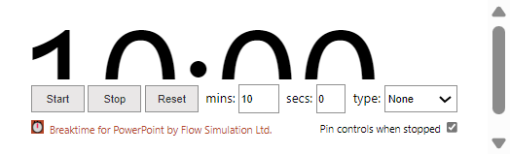
Test
What is solidity
Give two types of solidity datatype
Provide full word of uint and explain it.
What is enum datatype and How does it work?
Give two types of solidity Addresses datatype.

Slide 82
Integer: This data type is used to store integer values: int and uint are used to declare signed and unsigned integers respectively.
Ex: int32 public int_var = -60313;
String: A string in Solidity is a data type used to store text.
Ex: string public myVariable = 'Hello World';

Slide 83
2) Reference Types
Reference type variables store the location of the data.
They don’t share the data directly.
With the help of reference type, two different variables can refer to the same location where any change in one variable can affect the other one.

Slide 84
Arrays:
An array is a group of variables of the same data type in which the variable has a particular location known as an index.
By using the index location, the desired variable can be accessed.
The array size can be fixed or dynamic.
Ex: uint[5] public array = [uint(1), 2, 3, 4, 5] ;

Slide 85
Struct
Solidity allows users to create and define their own type in the form of structures.
The structure is a group of different types even though it’s not possible to contain a member of its own type.
The structure is a reference type variable that can contain both value type and reference type

Slide 86
Example of Struct
struct student {
string name;
string subject;
uint8 marks;
}

Slide 87
Mapping
Mapping is the most used reference type, that stores the data in a key-value pair where a key can be any value type.
It is like a hash table or dictionary as in any other programming language, where data can be retrieved by key.

Slide 88
Mapping
Mapping is the most used reference type, that stores the data in a key-value pair where a key can be any value type.
It is like a hash table or dictionary as in any other programming language, where data can be retrieved by key.
Ex: mapping (address => student) result;

Slide 89
Solidity - Variables
Solidity supports three types of variables.
State Variables: Variables whose values are permanently stored in a contract storage.
Local Variables: Variables whose values are present till function is executing.
Global Variables: Special variables exists in the global namespace used to get information about the blockchain.

Slide 90
State Variable
pragma solidity ^0.5.0;
contract SolidityTest {
uint storedData; // State variable
constructor() public {
storedData = 10; // Using State variable
}
}

Slide 91
Local Variable
pragma solidity ^0.5.0;
contract SolidityTest {
uint storedData; // State variable
constructor() public {
storedData = 10;
}
function getResult() public view returns(uint){
uint a = 1; // local variable
uint b = 2;
uint result = a + b;
return result; //access the local variable
}
}

Slide 92
Blockchain QUIZ
Compare Proof of Work (PoW) and Proof of Stake (PoS) consensus mechanisms.
Define a smart contract. How does it differ from a traditional contract?

Slide 93
Group Activity
Open https://remix.ethereum.org/
Then
Write a basic Solidity contract named GroupActivity that:
Has a bytes variable named user
Allows users to enter name of user and retrieve that name

Slide 94
Group Activity
Open https://remix.ethereum.org/
Then
Q. Write a solidity contract which add two numbers and then returns the sum.

Slide 95

Ganache
Ganache is a local blockchain environment that allows Ethereum developers to simulate the Ethereum network and test smart contracts
Installation
To use Ganache, you must first install:
Node.js >= v16.0.0
npm >= 7.10.0

Slide 96

Truffle
What is Truffle?
A world class development environment, testing framework and asset pipeline for blockchains using the Ethereum Virtual Machine (EVM), aiming to make life as a developer easier.

Slide 97
With Truffle, you get:
Built-in smart contract compilation, linking, deployment and binary management.
Advanced debugging with breakpoints, variable analysis, and step functionality.
Use console.log in your smart contracts
Deployments and transactions through MetaMask with Truffle Dashboard to protect your mnemonic.

Slide 98
Install Truffle
In a terminal, use NPM to install Truffle:
npm install -g truffle
You may receive a list of warnings during installation.
To confirm that Truffle was installed correctly, run:
truffle version

Slide 99
Create a project
Most Truffle commands require that you run them against an existing Truffle project.
So the first step is to create a Truffle project.
Run truffle init

Slide 100
Create a project
Once this operation is completed, you'll now have a project structure with the following items:
contracts/: Directory for Solidity contracts
migrations/: Directory for scriptable deployment files
test/: Directory for test files for testing your application and contracts
truffle-config.js: Truffle configuration file

Slide 101

MetaMask
MetaMask is a software cryptocurrency wallet used to interact with the Ethereum blockchain.
It allows users to access their Ethereum wallet through a browser extension or mobile app, which can then be used to interact with decentralized applications.

Slide 102

Configure MetaMask
Visit : https://metamask.io/
Click Get MetaMask
Then Add to Chrome
Popup will come the click Add extension
After added Pin it on your browser

Slide 103
Connect MetaMask & Frontend
import Web3 from "web3";
In App.j function
const [web3, setWeb3] = useState(null);
const [contract, setContract] = useState(null);
const [account, setAccount] = useState("");

Slide 104
Connect MetaMask & Frontend
const loadBlockchainData = async () => {
if (window.ethereum) {
const web3Instance = new Web3(window.ethereum);
await window.ethereum.request({ method: "eth_requestAccounts" });
const accounts = await web3Instance.eth.getAccounts();
const networkId = await web3Instance.eth.net.getId();
const deployedNetwork = EvenOddCheckerContract.networks[networkId];

Slide 105
if (deployedNetwork) {
const contractInstance = new web3Instance.eth.Contract(
EvenOddCheckerContract.abi,
deployedNetwork.address
);
setWeb3(web3Instance);
setContract(contractInstance);
setAccount(accounts[0]);
} else {
alert("Contract not deployed on the current network!");
}
} else {
alert("Please install MetaMask to use this DApp.");
}};

Slide 106
State Variables
State variables store data on the blockchain and are permanently written to the Ethereum blockchain.
- Stored on-chain
- Part of the contract state
- Accessible globally or limited by visibility specifiers

Slide 107
State Variables Example
uint256 public totalSupply;
string public tokenName;

Slide 108
Modifiers (Conditions)
Modifiers are special Solidity functions that change other functions' behaviour.
They are often used for validating conditions or access control.
- Apply conditions to functions
- Improve code reusability and readability

Slide 109
Modifiers Example:
modifier onlyOwner() {
require(msg.sender == owner, "Not the owner");
_;
}

Slide 110
Practical Activity
Write a Solidity contract with a function to check if a number is even. The function should return “Number is Even” if it is, and “Number is Odd” otherwise.

Slide 111
truffle-config.js
module.exports = {
networks: {
development: {
host: "127.0.0.1
port: 7545,
network_id: 5777,
gas: 6721975,
gasPrice: 20000000000,
from: "0xC85e07c942E125Cdd1f2cABbC2Fe43a4852Ca0fC",
},
},

Slide 112
truffle-config.js
compilers: {
solc: {
version: "0.8.0",
settings: {
optimizer: {
enabled: true,
runs: 200
},
}
}
},

Slide 113
1_migrate_contracts.js
const EvenOddChecker = artifacts.require("EvenOddChecker");
module.exports = function (deployer) {
deployer.deploy(EvenOddChecker);
};

Slide 114
CheckEvenOdd Button
const checkEvenOdd = async () => {
if (contract && number) {
try {
const response = await contract.methods.checkEvenOdd(number).call();
setResult(response);
} catch (error) {
console.error("Error checking number:", error);
setResult("Error occurred");
}}};

Slide 115
Smart Contract
A smart contract is a self-executing contract with the terms of the agreement directly written into code.
Key Features:
- Immutable
- Transparent
- Automates transactions

Slide 116
Smart Contract Real-World Example
- Decentralized Finance (DeFi) platforms
- Supply chain tracking

Slide 117
Visibility and Access Control
Specifies who can access specific functions and variables within a contract.
Types of specifiers:
- Public: Accessible by anyone
- Private: Accessible only within the contract
- Internal: Accessible within the contract and derived contracts
- External: Accessible only externally

Slide 118
Visibility and Access Control Example
function getBalance() public view returns (uint) {
return address(this).balance;
}

Slide 119

Ethereum
Ethereum is an open-source, decentralized blockchain platform that enables smart contract execution.

Slide 120
Ethereum
- Launched in 2015 by Vitalik Buterin
- Uses Ether (ETH) as its native cryptocurrency
- Supports DApps and DeFi
Importance of Ethereum:
- Facilitates decentralized applications
- Promotes trustless transactions

Slide 121
Ethereum Virtual Machine (EVM)
The EVM is a runtime environment that executes smart contracts on the Ethereum blockchain.
Key Functions:
- Translates smart contract code into machine-readable instructions
- Ensures consensus across nodes

Slide 122
Data Types and Variables
Understand the various data types and how to declare variables in Solidity.
Types of Data types
1. Value Types:
- Integers (uint, int)
- Booleans (bool)
- Addresses (address)
- Strings and bytes

Slide 123
Data Types and Variables
2. Reference Types:
- Arrays
- Structs
- Mappings

Slide 124
Example
uint256 count = 10;
bool isActive = true;
address owner = msg.sender;

Slide 125
Use of Functions
Functions are blocks of code that execute when called.
Types of Functions
- Pure: No state modification
- View: Reads but does not modify state
- Payable: Handles Ether transfers

Slide 126
Function Syntax
function add(uint x, uint y) public pure returns (uint) {
return x + y;
}

Slide 127
Control Structures
Control structures direct the flow of execution based on conditions.
- Loops: For, while, do-while loops
- Require and Assert: Validate conditions, error handling

Slide 128
If-Else Statements
if (balance > 0) {
withdraw();
} else {
deposit();
}

Slide 129
Arrays and Structs
Arrays store collections of similar data types, while structs define custom data structures.
Array Example:
uint[] public numbers;
numbers.push(5);

Slide 130
Struct Example
struct TeaQuality {
string origin;
uint256 moistureContent;
}
TeaQuality public sample = TeaQuality("Rwanda", 15);

Slide 131
Events and Logging
Event is an inheritable member of a contract. An event is emitted, it stores the arguments passed in transaction logs.
These logs are stored on blockchain and are accessible using address of the contract till the contract is present on the blockchain.

Slide 132
Events and Logging
Events log activity is useful for off-chain applications to track contract actions.
Event Declaration:
event Transfer(address indexed from, address indexed to, uint256 value);
Emit an Event:
emit Transfer(msg.sender, recipient, amount);

Slide 133
Error Handling
Techniques:
- Require: Validate inputs
- Revert: Stop execution, revert state changes
- Assert: Check for critical conditions
Example:
require(msg.sender == owner, "You are not the owner.");

Slide 134
2.4. Optimizing Gas Costs
In blockchain development, especially on Ethereum, every operation you perform costs gas (a unit that measures the amount of computational effort required to execute operations).
Understanding and optimizing gas costs is crucial for building cost-efficient smart contracts and DApps.

Slide 135
Proper Analysis of Gas Cost
Proper gas analysis involves evaluating how much gas each operation or transaction consumes and finding ways to minimize unnecessary gas usage.
This process includes:
Estimating gas before deployment using tools like Remix, Truffle, or Hardhat.
Reviewing the Solidity code for expensive operations such as loops, storage writes, and unnecessary data structures.
Using gas-efficient data types, such as uint256 instead of uint, or choosing smaller data types when possible.
Optimizing function visibility (e.g., using external instead of public when appropriate).
Avoiding expensive operations inside frequently called functions.

Slide 136
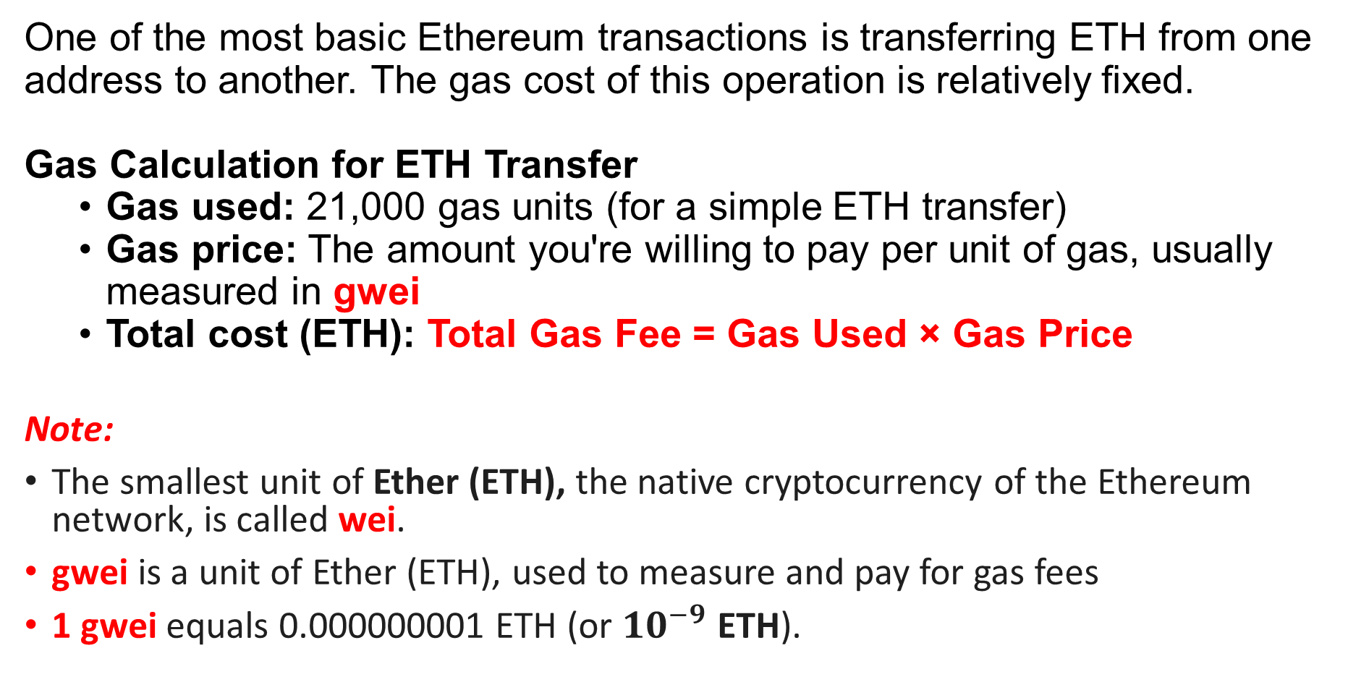
Calculating the Cost of Ethereum Transfer
One of the most basic Ethereum transactions is transferring ETH from one address to another. The gas cost of this operation is relatively fixed.
Gas Calculation for ETH Transfer
Gas used: 21,000 gas units (for a simple ETH transfer)
Gas price: The amount you're willing to pay per unit of gas, usually measured in gwei
Total cost (ETH): Total Gas Fee = Gas Used × Gas Price
Note:
The smallest unit of Ether (ETH), the native cryptocurrency of the Ethereum network, is called wei.
gwei is a unit of Ether (ETH), used to measure and pay for gas fees
1 gwei equals 0.000000001 ETH (or ${10}^{−9}$ ETH).

Slide 137
Example:
Let’s assume:
Gas used = 21,000
Gas price = 20 gwei
1 gwei = 10⁻⁹ ETH
Total cost = 21,000 × 20 gwei = 420,000 gwei = 0.00042 ETH
So, transferring ETH from one wallet to another at a gas price of 20 gwei will cost approximately 0.00042 ETH in gas fees.

Slide 138
Heavy and Light Functions
In Solidity, functions are the core of smart contracts. But not all functions are equal in terms of gas usage.
Some are "heavy" they consume a lot of gas while others are "light" and cost very little or even nothing to execute.

Slide 139
Light Functions
Light functions are those that:
Do not change the state of the blockchain
Are marked with a view or pure keywords
Do not require gas when called externally (off-chain)
Examples:
function getBalance() public view returns (uint) {
return address(this).balance;
}
function multiply(uint a, uint b) public pure returns (uint) {
return a * b;
}

Slide 140
Heavy Functions
Heavy functions are those that:
Modify the blockchain state (e.g., writing to storage, sending ETH, emitting events)
Do not use view or pure
Consume gas, even when called from other contracts or externally
Examples:
function deposit() public payable {
balances[msg.sender] += msg.value;
}
function setOwner(address _newOwner) public {
owner = _newOwner;
}

Slide 141
Block Limit
In Ethereum, every block has a maximum gas limit a cap on the total amount of gas that can be consumed by all transactions included in a single block.
This concept ensures that blocks are not too large, which helps keep the blockchain decentralized and fast to propagate across the network.

Slide 142
What is the Block Gas Limit?
The block gas limit determines how much total computational work can be included in one block.
As of recent Ethereum network conditions, the block gas limit is approximately 35.95 million gas units (subject to change over time).
This is not the gas limit per transaction, but the total for all transactions within one block.

Slide 143
Why is Block Limit Important?
It directly affects how many transactions can fit into a block.
If your transaction is too gas-heavy, it might:
Not get included in the next block
Be rejected if it exceeds the block gas limit
Developers must ensure their smart contract functions are efficient and can execute within gas limits.

Slide 144
Opcode Gas Cost
In the Ethereum Virtual Machine (EVM), every instruction executed by a smart contract is broken down into opcodes (operation codes).
These are low-level instructions like ADD, SSTORE, CALL, etc.
Each opcode has a predefined gas cost, which reflects the computational and storage resources it consumes.

Slide 145
What are Opcodes?
Opcodes are the building blocks of smart contract bytecode.
When you compile Solidity code, it is transformed into EVM bytecode, composed of opcodes.
Examples: PUSH1, ADD, MUL, SLOAD, SSTORE, CALL

Slide 146
Gas Costs of Common Opcodes
Opcode | Description | Gas Cost
ADD | Addition operation | 3 gas
MUL | Multiplication | 5 gas
SLOAD | Read from storage | 2100 gas
SSTORE | Write to storage | 20,000 gas (new), 5,000 (update)
CALL | Call another contract | 700 gas + other costs
LOG0 | Emit event without topics | 375 gas + data cost
Note: Storage operations (SSTORE, SLOAD) are very expensive, while arithmetic operations (ADD, MUL) are relatively cheap.

Slide 147
Example: Expensive vs. Cheap Operation
uint x = a + b; // Uses ADD → Low gas
storedData = 42; // Uses SSTORE → High gas
Even though both look simple in Solidity, the second line is far more expensive due to how the EVM handles storage.

Slide 148
Non-payable Functions
In Solidity, functions can be defined with different payability types, which control whether or not they can receive Ether.
A non-payable function is a function that does not accept Ether, and will revert (fail) if anyone tries to send ETH to it.

Slide 149
What is a Non-payable Function?
A non-payable function:
Does not have the payable keyword
Rejects ETH transfers
Is used for logic-only operations that don’t require receiving funds

Slide 150
Example
// This is a non-payable function
function updateName(string memory _name) public {
name = _name;
}
// This is a payable function
function deposit() public payable {
balance[msg.sender] += msg.value;
}

Slide 151
Elaboration of Storage
In Ethereum, storage is the most expensive resource in terms of gas cost. Efficient use of storage is critical when writing gas-optimized smart contracts. Solidity stores contract variables in storage slots, and how you organize data affects how much gas your contract consumes.
This section explores how we can optimize gas usage by smartly using:
Smaller Integers
Unchanged Storage Values
Arrays

Slide 152
Smaller Integers, Unchanged Storage Values, Arrays
Smaller Integers (Packing Variables)
Solidity allows you to use smaller integer types like uint8, uint16, instead of the default uint256. This enables storage packing, where multiple variables can fit into a single 32-byte slot reducing gas costs.
Example:
// Gas-efficient
uint8 age;
uint8 status;
// Not efficient
uint256 age;
uint256 status;

Slide 153
Unchanged Storage Values
Updating storage in Solidity is very expensive, especially when you overwrite a value with a different one. But if you're setting a variable to the same value it already has, you're wasting gas unnecessarily.
Example:
if (status != newStatus) {
status = newStatus; // Only write when necessary
}

Slide 154
Arrays and Gas Usage
Arrays can be tricky their gas cost depends on:
Their length
How often you push, pop, or modify elements
Whether you use dynamic or fixed-size arrays
Costly operations:
push() to a dynamic storage array
Iterating through and modifying each element in storage
Optimized usage:
Minimize writes to storage arrays
Use memory arrays when possible (temporary and cheap)

Slide 155
Refunds and Setting to Zero
Storage Refunds in Ethereum
In Ethereum, gas refunds are awarded when a contract frees up storage, specifically by setting storage variables to zero.
This is a mechanism to incentivize smart contract developers to clean up unused storage, which helps reduce the size of the blockchain.
Example: storedValue = 0; // Gas refund!
When a storage slot is non-zero and is set to zero, Ethereum gives a gas refund of up to 15,000 units.
This refund does not exceed 50% of the total gas used in the transaction, to avoid abuse.

Slide 156
ERC-20 Transfers and Gas Usage
ERC-20 Token Transfers
ERC-20 is the most popular standard for fungible tokens on Ethereum.
A simple token transfer involves:
function transfer(address to, uint256 amount) public returns (bool)
This performs:
A read from the sender’s balance
A subtraction
A write (SSTORE) to update the sender’s balance
A read from the recipient’s balance
An addition
Another SSTORE for the recipient
An event emission (LOG)

Slide 157
Storage Cost for Files
What It Means
On Ethereum, storing any kind of data including files, images, or documents on-chain is extremely expensive.
This is because every byte stored in a smart contract’s storage consumes gas, which translates into high transaction fees.

Slide 158
Actual Cost of On-Chain File Storage
Each 32-byte word of storage costs 20,000 gas the first time it’s written.
At current average gas prices and ETH value, storing 1 kilobyte (1,024 bytes) on Ethereum can cost hundreds of USD.
Calculation Example (Rough Estimate):
1 kilobyte = 1024 bytes ≈ 32 slots
Cost = 32 × 20,000 gas = 640,000 gas
If 1 gas = 50 Gwei and 1 ETH = $3,000
→ Total Cost ≈ $96 for 1 KB

Slide 159
Why It's a Problem
Smart contracts are not designed to store large files.
It increases deployment and interaction costs.
It bloats the blockchain, affecting all nodes.
Best Practices To avoid storing full files directly on-chain:
Use IPFS (InterPlanetary File System)
Upload the file to IPFS (a decentralized file system).
Store only the IPFS hash (CID) in your smart contract.
2. Use Off-chain Storage with Oracles
Store files in cloud or local servers.
Use Chainlink or custom oracles to verify/trigger file interactions
Notes:
The blockchain is a ledger, not a file storage system.
Use it to store proofs, pointers, and hashes not files themselves.

Slide 160
Structs and Strings, Variable Packing, Array Length
Smart contracts often use structs, strings, and arrays to organize data. However, improper use of these can lead to unnecessary gas consumption. This section explains how to write efficient Solidity code using:
Structs
Strings
Variable Packing
Array Length

Slide 161
1. Structs and Variable Packing
A struct is a custom data structure that combines multiple variables. These can be gas-efficient, but only if you pack variables correctly.
Solidity stores variables in 32-byte (256-bit) slots. You can pack smaller variables into the same slot to save space and gas.
Good Example:
struct PackedData {
uint128 valueA; // 16 bytes
uint128 valueB; // 16 bytes -> shares same slot with valueA
}
Bad Example:
struct UnpackedData {
uint128 valueA;
uint256 valueB; // Forces a new slot because of misalignment
}
Note: Always order struct variables from smallest to largest to optimize packing.

Slide 162
2. Strings and Storage Cost
Strings are dynamically-sized byte arrays in Solidity. When stored in contract storage, they can be very gas-expensive due to:
Unpredictable size
Separate storage location for long strings
Encoding overhead
Things to Consider:
Short strings (≤ 31 bytes) are stored directly in the storage slot.
Long strings are stored in a separate storage location, increasing gas cost.
Best Practice:
Avoid storing long strings directly on-chain.
Store IPFS hashes or string identifiers instead.

Slide 163
3. Variable Packing Beyond Structs
Even outside of structs, adjacent state variables can share storage slots if:
Their combined size ≤ 32 bytes
They are declared one after the other
uint128 a;
uint128 b; // Can be packed with a
bool c; // Cannot be packed due to alignment issues
Don't mix types randomly. Group and order similar small-sized types together.

Slide 164
4. Array Length and Storage Costs
Solidity arrays store:
The length of the array
The elements in separate storage slots (for dynamic arrays)
Costly Operations:
Appending (push())
Modifying elements in storage
Growing large arrays unnecessarily
Optimized Approach:
Use memory arrays for temporary data (no storage cost)
Avoid frequent resizing or excessive use of .push() in storage

