Slide 1
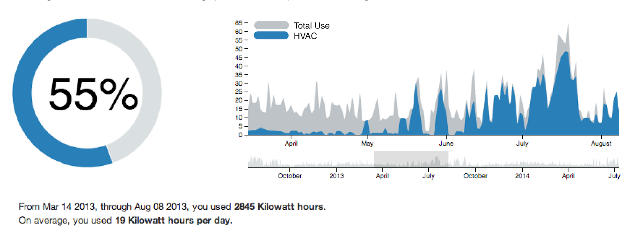
Energy Analytics
Extracting meaning from smart meter data
Summary
Our goal is to offer consumers insights regarding their energy usage patterns using their own accessible smart meter data. Using the residential smart meter data from Oak Park, IL and a rich set of appliance-level data from our partners at the non-profit Pecan Street, we have focused on two tasks: electric vehicle detection and HVAC signal disaggregation. In particular, we have created a set of tools to help individuals make data-informed decision about their energy usage, including estimating the percentage of their bill devoted to heating and air conditioning, evaluating the sensitivity of their energy consumption to temperature change, and comparing their usage relative to their neighbors.
Problem Motivation
Smart meters are two-way communication devices that wirelessly transmit electricity meter readings to utility companies. Smart meters offer a tremendous advantage over traditional meters as they obviate the need for physical meter readings, greatly reducing the collection costs for companies. The companies sample this data at hourly or more frequent intervals and are able to gain a better picture of the flow of power throughout the grid. A higher sampling rate offers a wealth of data not only for the utilities, but also for consumers. This provides opportunities for data scientists to develop tools to help consumers better analyze and understand how they consume energy.
Data
Wikinergy.org is a research database contains datasets with 1- and 15- minute electricity usage in Austin, TX for both whole homes and individual appliances within each home. The data contains over 500 homes and spans from January 2013 through May 2014. A dataset containing hourly temperature data taken from a free API at wunderground.com was used in order to correlate energy usage with temperature. The disaggregation and detection algorithms were ultimately used with our final dataset, smart meter data uploaded from approximately 30 Oak Park residents. This data only contains total home energy use and is sampled at 30-minute intervals.
Methodology(ies)
This is the text describing your algorithms, techniques, equations, etc. The appliance-level data allowed us to generate representative models for devices such as electric vehicles and HVAC systems. After constructing disaggregation and detection algorithms, this dataset was then used to validate our results. THIS IS THE MEAT OF THE POSTER.
Evaluation
Include numbers and figures and graphs. THIS IS ALSO THE MEAT OF THE POSTER
Conclusions
This is a verbal interpretation of the evaluation’s conclusions, what you found/did, why it matters,.
A web interface was constructed to allow residents to continually upload their smart meter data and receive the results from our algorithms, as well as helpful visualizations of the energy consumption.
Future Work
This may just be part of your Conclusions section. (if so rename it to “Conclusions & Future Work”)
End with a bang!
Notes:
Make sure your graphs includes labeled axes, a title, some sort of interpretation (what’s the point?) and no confusing acronyms.
Font suggestions:
Section headings: Bold Lato 54 pt., dark blue (RGB=52, 73, 94, hex=34495E)
Regular text: Georgia 36 pt. black (RGB=0,0,0)
Captions: Georgia 32 pt. black (RGB=0,0,0), dark blue (RGB=52, 73, 94, hex=34495E)
No fonts below 28 pt. or no one can read it! (This holds for graphs too)
Change things if you must but at least be internally consistent within your poster

