Slide 1


Pecan Street and the Village of Oak Park
Making smart meters work for consumers

Slide 2


Smart Meters
DATA
Notes:
More and more towns and cities are turning to smart meters. 2way communication between utilities and the meter, and allow greater data collection. But what is all this data being used for? Previously someone had to read your meter every month, now it can be read however frequently they want, even every second.

Slide 3
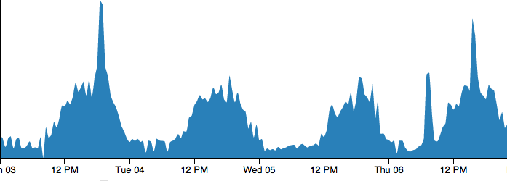



Energy Usage Data
Notes:
Common disaggregation approaches

Slide 4
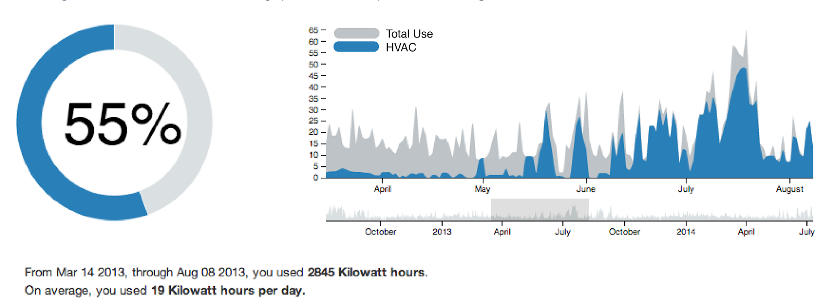
Heating and Cooling Consumption

Slide 5
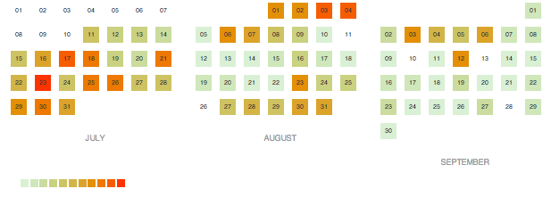
Evaluating consumption

Slide 6
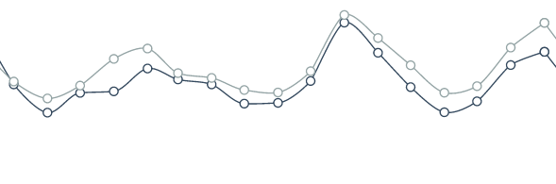
Evaluating consumption
800 –
Energy
(kWh)
0
|
September
2012
|
January
2013
|
May
2013
|
September
2013
|
January
2014

Slide 7
Appliance Signal Decomposition
Notes:
Common disaggregation approaches

Slide 8
smartenergyactions.org
Learn from your data!

