Slide 1
INSTRUCTIONS
Use Font size 22 to 28 and Font Style Times New Roman (body)
Do not change the Template: Heading / Title of the slides
Do not change font style or colours
Do not copy paste paragraphs: use only Bullet Points
Maximum slide Limit is 20 only
As per the number of supervisor allotted adopt slide-2 or slide-3
Please display the required meaningful Content or images or tables
Change the footer accordingly using insert tab then click on header & footer tab and edit it
Save the PPT with Register No, Dept and Review no, example: 23xxxxxxxxx_CSE

Slide 2

Title: xxxxxxxxxxxxxxxxxxxxxxxxxxxxxxxxxxxxxxxxxxxxx
Student Name: xxxxxxxx
Student ID: 23xxxxxx)
Cluster:xxx
Section: xxxxxx
Under the Guidance
of
Supervisor Name: xxxxxxxx
Assistant Professor
Department of CSE

Slide 3
OUTLINE
Abstract
Existing System
Proposed System
System Architecture
Project Modules
Objectives
Co’s Attainments - FWD
Co1
Co2 …….. 5. Co5
Co’s Attainments - DSA
Co1
Co2 …….. 5. Co5
Screen Shots for FWD & DSA
Conclusion
Geo-Tagged Photos

Slide 4
Abstract
Abstract: Smart Student Analytics Dashboard using DSA
The Smart Student Analytics Dashboard is a web-based application developed to manage and analyze students’ academic performance efficiently. The system collects student details such as ID, name, and subject marks, and processes the data using Data Structures and Algorithms (DSA) concepts.
Student records are stored using arrays or lists, while searching and sorting algorithms are used to find students, calculate averages, and generate rankings. The dashboard displays important analytics such as total number of students, class average, highest and lowest scores, and a leaderboard of top-performing students.
The system also allows users to add, delete, search student records, view profiles, and export reports as PDF. By combining DSA concepts with web technologies like HTML, CSS, and JavaScript, the project provides a simple and effective way to analyze academic performance and demonstrate real-world applications of data structures and algorithms.

Slide 5
Existing System
Existing System
In the existing system, student academic records are usually managed using manual methods or basic spreadsheet tools such as Excel. Teachers or administrators enter student details and marks manually, and calculations such as averages, rankings, and performance analysis are done separately.
This system has several limitations. It is time-consuming and prone to human errors, especially when handling large amounts of student data. Searching for a particular student’s record or analyzing overall class performance is also difficult and inefficient. Additionally, the existing system does not provide real-time analytics, automated ranking, or visual dashboards to easily understand students’ performance.
Because of these limitations, the traditional system lacks automation, efficient data management, and advanced analytical features, making it less effective for monitoring and evaluating student academic performance.

Slide 6
Proposed System
Proposed System
The proposed system is a Smart Student Analytics Dashboard that automates the process of managing and analyzing student academic performance. In this system, student details such as ID, name, and subject marks are entered into the application and stored using appropriate data structures.
The system uses Data Structures and Algorithms (DSA) such as arrays for storing records, searching algorithms to quickly find student details, and sorting algorithms to generate student rankings based on average marks. It automatically calculates important statistics like average score, highest and lowest marks, and total number of students.
The dashboard provides an interactive interface where users can add, delete, search, and view student profiles, as well as see a leaderboard of top-performing students. It also allows users to export student reports as PDF, making the system more efficient and organized.
This proposed system reduces manual work, improves accuracy, and provides real-time analytics and better visualization of student performance, making it easier for educators to monitor academic progress.

Slide 7
System Architecture

Slide 8
Project Modules

Slide 9
Objectives
Objectives
To develop a Smart Student Analytics Dashboard for managing and analyzing student academic performance.
To store and organize student data efficiently using appropriate data structures such as arrays or lists.
To apply searching and sorting algorithms to quickly find student records and generate rankings based on average marks.
To automatically calculate academic statistics such as total students, class average, highest score, and lowest score.
To provide an interactive interface that allows users to add, delete, search, and view student details easily.
To generate a leaderboard and export reports in PDF format for better academic analysis and record keeping.

Slide 10
Co’s Attainments - FWD
CO-wise Attainments for DSA Concepts (Only JavaScript Logic)
CO No Course Outcome DSA Concept Used Implementation in Code
CO1 Understand basic data structures Array (Linear Data Structure) Student records are stored in the students[] array as objects containing ID, name, and marks.
CO2 Apply searching techniques Searching Algorithm searchStudent() function searches student names and displays matching records in the table.
CO3 Apply sorting techniques Sorting Algorithm sort((a,b)=>b.avg-a.avg) is used to rank students and generate the leaderboard.

Slide 11
Co’s Attainments - DSA
CO4 Analyze and process data efficiently Array processing methods map() and reduce() functions calculate class average, highest score, and lowest score.
CO5 Perform operations on linear data structures Insert, Delete, Traverse addStudent(), deleteStudent(), and displayStudents() perform insertion, deletion, and traversal operations on the students array.
CO6 Apply DSA concepts in real-world applications Practical DSA implementation The dashboard uses arrays, searching, sorting, and statistical calculations to analyze student academic performance.

Slide 12
Screenshots for FWD & DSA

Slide 13
Conclusion
Conclusion
The Smart Student Analytics Dashboard successfully demonstrates the practical application of Data Structures and Algorithms (DSA) in managing and analyzing student academic performance. The system efficiently stores student data using arrays and applies searching and sorting algorithms to organize records, calculate averages, and generate rankings.
The dashboard provides useful analytics such as total number of students, average score, highest and lowest averages, and leaderboard rankings, which help in understanding student performance more clearly. Features like searching student records, viewing profiles, deleting entries, and exporting reports to PDF make the system more interactive and user-friendly.
Overall, this project shows how DSA concepts can be applied in real-world applications to improve data management, automate calculations, and provide meaningful insights for better academic analysis.

Slide 14
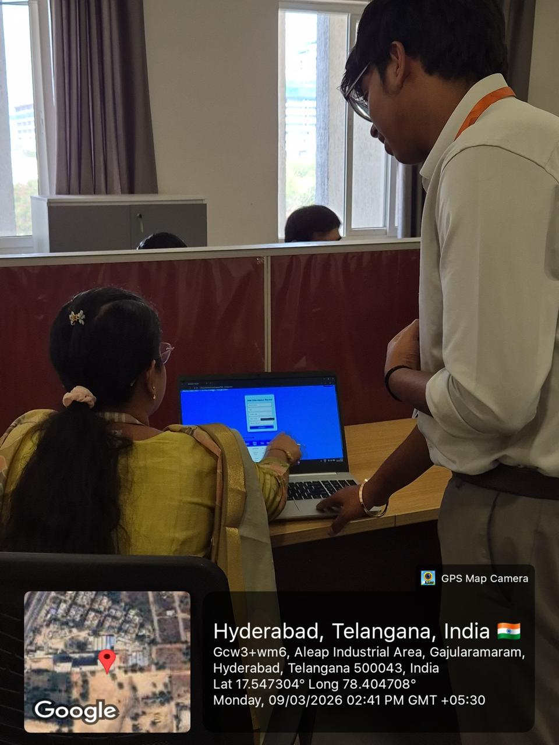
Geo- Tag Photos

Slide 15
THANK YOU

