Slide 1
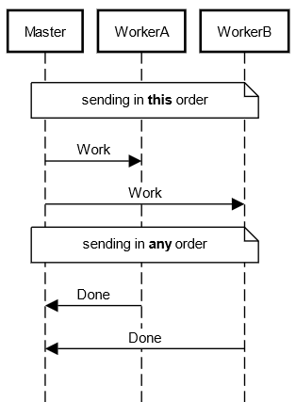


API Generation of Multiparty Session Types Telmo Ribeiro | José Proença & Mário Florido
Faculdade de Ciências da Universidade do Porto
Introduction
Workplan
Multiparty Session Types (MPST) are a typing discipline ensuring that a message-passing process implements a given multiparty session protocol [1].
Session Types ensure the correctness of concurrent programs, where the validity of a protocol can be asserted through the well-typedness of its agents.
Multiparty describes a session with more than two agents in contrast with the parent concept of binary session types.
The MPST framework guarantees [2]:
Communication safety i.e., absence of errors;
Progress, i.e., deadlock-freedom;
Session fidelity, i.e., protocol compliance
 | 10-23 | 11-23 | 12-23 | 01-24 | 02-24 | 03-24 | 04-24 | 05-24
Task 1
Task 2
Task 3
Task 4
Task 5
Task 6
Task 1 – Survey API Generation Engines Task 2 – Categorize Engine Supported Concepts Task 3 – API Implementation for MPST
Task 4 – Explore Other Engine Variations Task 5 – Execute a Concurrent System Task 6 – Write the dissertation
Tool Development
Objectives
Protocol
DSL
Parsing
Achieve a framework capable of generating APIs allowing the implementation of different MPSTs in Scala3 (APIGenMPST);
Allow the choice between multiple semantics;
Allow the choice between multiple constructors;
Parsing
State-of-the-Art (SotA)
Global Type
AST
Projectability
Overview and roadmap of different models of MPST, with different expressivity and guarantees [1].
API generation to enforce session types in different programing languages [3] [4].
Use of Scala 3’s type system to generate compact APIs.
This work proposes APIGenMPST – a framework to generate APIs of different MPST models using Scala 3.
Projectability
Local Type
AST
Operational Semantics
Examples
Master-Workers Workflow
Current Output
Global Type
Master>WorkerA:Work ; Master>WorkerB:Work ; (WorkerA>Master:Done || WorkerB>Master:Done)
Projection
Interpreter
Error
MasterWorkerA!Work
MasterWorkerA!Work
References
Local Types - e.g., WorkerA
MasterWorkerA?Work ; MasterWorkerA!Done
[1] Scalas, A., & Yoshida, N. (2019). Less is more: multiparty session types revisited. POPL, 1-29.
[2] Honda, K., Yoshida, N., & Carbone, M. (2008). Multiparty asynchronous session types. POPL, 273-284.
[3] Hu, R., & Yoshida, N. (2016). Hybrid session verification through endpoint API generation. FASE 2016, 401-418.
[4] Lagaillardie, N., Neykova, R., & Yoshida, N. (2020). Implementing multiparty session types in rust. International Conference on Coordination Languages and Models, 127-136.
[5] Cledou, G., Edixhoven, L. J., Jongmans, S. S., & Proença, J. (2022). API generation for multiparty session types, revisited and revised using scala 3.
Implementation
MasterWorkerA!Work
MasterWorkerA!Work
Processes
M:CC
Notes:
1

