Slide 1

Trip Advisor
Explore New Places

Slide 2
Guide the customers to explore new places
XYZ Company would like to predict the possible ways, by which their customers could make use of the time they are spending for the trip in the most efficient way.
Based on the area a customer would like to explore, with the help of location data of that area and the categories of interest of the customer, a suggestion needs to be provided to the customer.
The customers would be highly satisfied with the service the Company is providing.
Would help to increase the reputation of the company and gain more customers.

Slide 3
Data acquisition and cleaning
One city will be analysed in this project. Based on the city, the latitude and longitude values will be obtained by using geopy module.
The data used in this project is provided by Foursquare location data. The city’s latitude and longitude values will be used to extract the venues data from Foursquare location data using explore endpoint.
From the dataframe we can get the list of unique categories in the data and decide what all categories needs to be considered based on the interest.
After cleaning the data, we would get the list of venues which would be appropriate for the project.
The features of the data should be analysed, and the unnecessary features could be removed. For our project the main feature would be the latitude and longitude values.

Slide 4
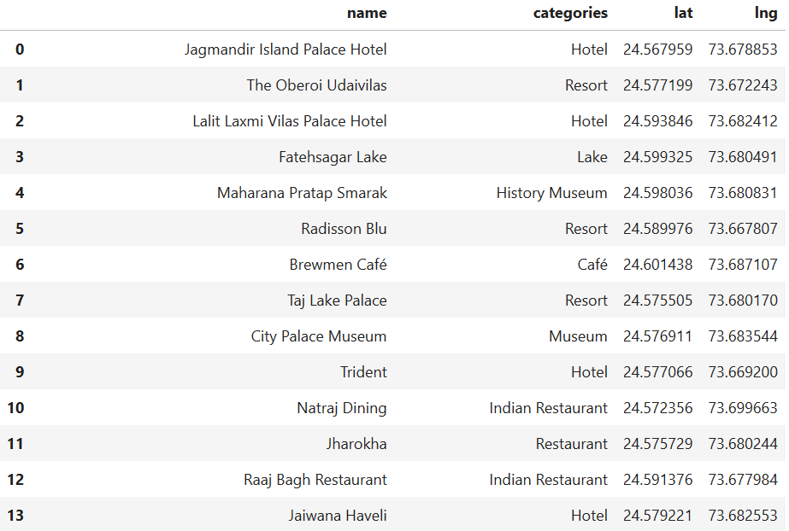
Exploring Udaipur City
For this project we have chosen to explore a city in India. One of the best places to visit in India is Udaipur, which is in the state of Rajasthan in India.
From the obtained clean data of the list of venues in Udaipur City, there are around 54 venues.
Below is the image of the Foursquare API data of Udaipur City, in the form of dataframe after cleaning.

Slide 5
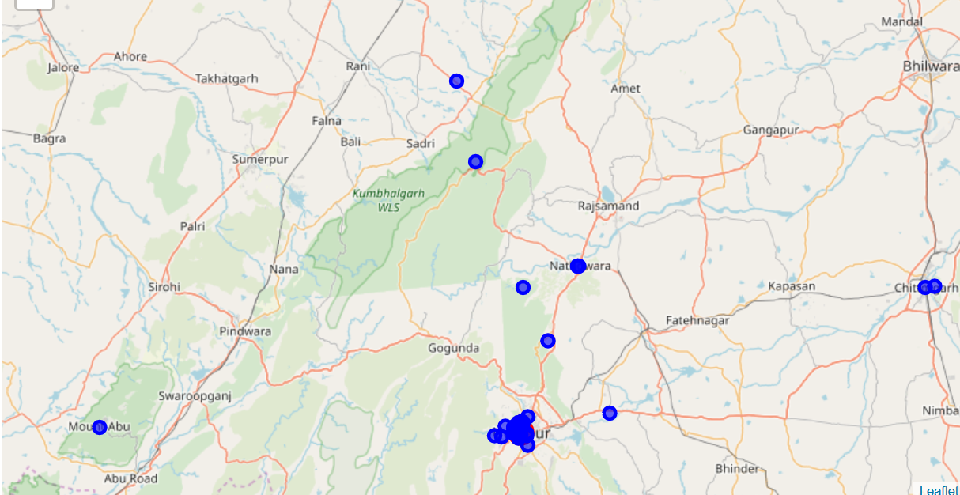
Udaipur City visualization

Slide 6
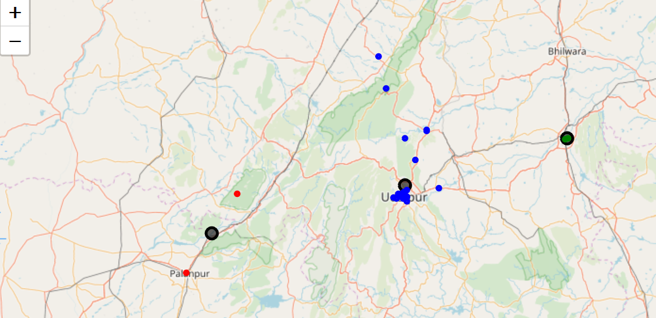
Clustering based on the latitude and longitude values
Apply K-Means Clustering based on the latitude and longitude values. Select 3 clusters for this data.
Udaipur City visualization in clusters:

Slide 7
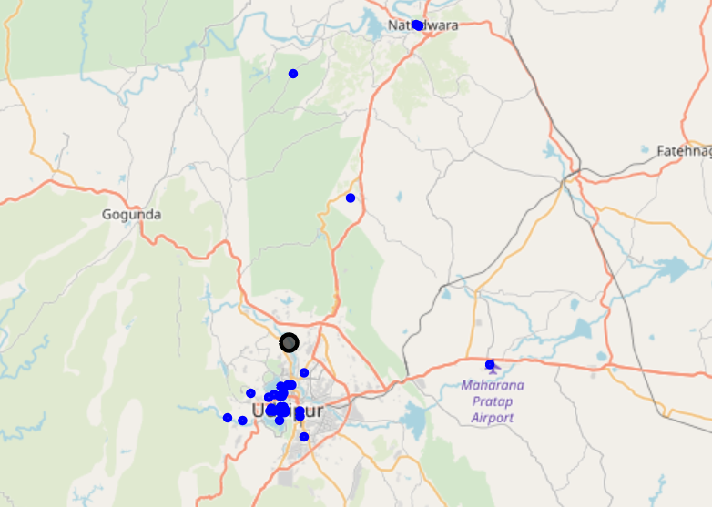
Udaipur City – Cluster0 Categories and Map
Categories: 'Hotel','Resort','Lake','History Museum','Café','Museum','Indian Restaurant','Restaurant','Historic Site','Dessert Shop','Hotel Bar','Mediterranean Restaurant','Rajasthani Restaurant','Roof Deck', 'General Entertainment','Vegetarian / Vegan Restaurant','Hookah Bar','Food','Castle','Monument / Landmark','Bistro','Airport Lounge','Fast Food Restaurant’
Map:

Slide 8
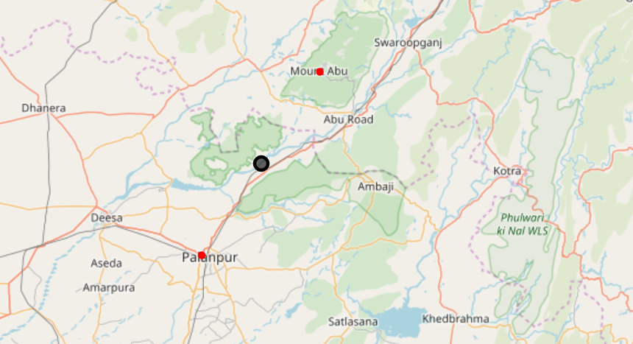
Udaipur City – Cluster1 Categories and Map
Categories: 'Indian Restaurant’, 'Coffee Shop'
Map:

Slide 9
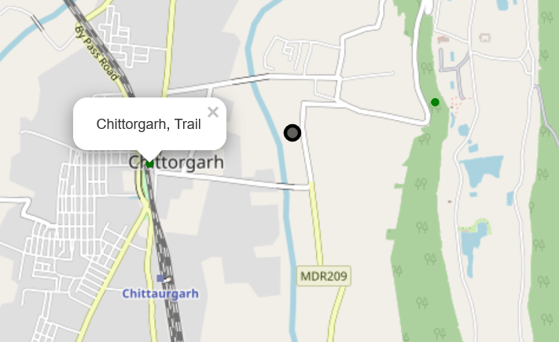
Udaipur City – Cluster2 Categories and Map
Categories: 'Trail', 'Castle'
Map:

Slide 10
Observations
Cluster1 covers around 50 venues, Cluster1 has 2 venues and Cluster2 has 2 venues.
From the map and dataframe we can understand that the maximum number of places can be explored in cluster0.
Cluster1 can be ignored as there are only two venues and they are Restaurant and Coffee Shop.
Cluster2 also has only venues but it is worth exploring the places in Cluster2 as there is a Trail and Castle.

Slide 11
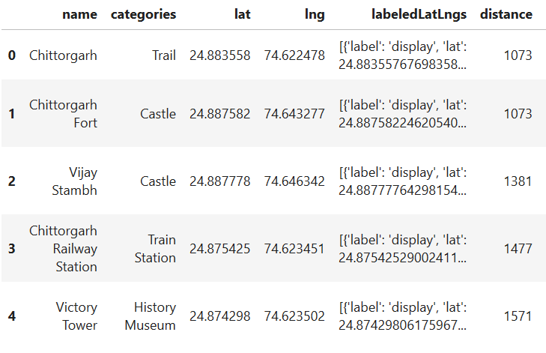
Discussion
We have obtained only two main venues in Cluster2 when the map was centred around Udaipur, let us explore Cluster2 to check if we could get more venues around it since it is worth exploring Cluster2 in detail.
Using the latitude and longitude values of the centroid of Cluster2 explore the area and get the different venues around it.
Below is the image of the Foursquare data venues around Cluster2, we have identified 3 more useful venues:

Slide 12
Conclusion
We analysed that to explore Udaipur it would be better to allocate more time to explore the places in Cluster0 and to prefer stay in one of the Hotels which is closer to the centroid of Cluster0 and then probably to explore the places in Cluster2.
Rail Transport can be preferred to explore Cluster2 and the places in Cluster2 can be covered in a single day as the distance to different venues are within 3km.
The western side of Udaipur can be given the least importance as there are not much interesting places to explore.
This project is performed on limited data. If a good amount of data is available which has the interesting and useful venues, weather condition of the areas etc., the decisions could be made in a much better way.

