Slide 1
Contract Monthly Claim System
PROG6212

Slide 2
Name: Mamaphale Tema
Student Number: ST10443515
Group Number: 02

Slide 3
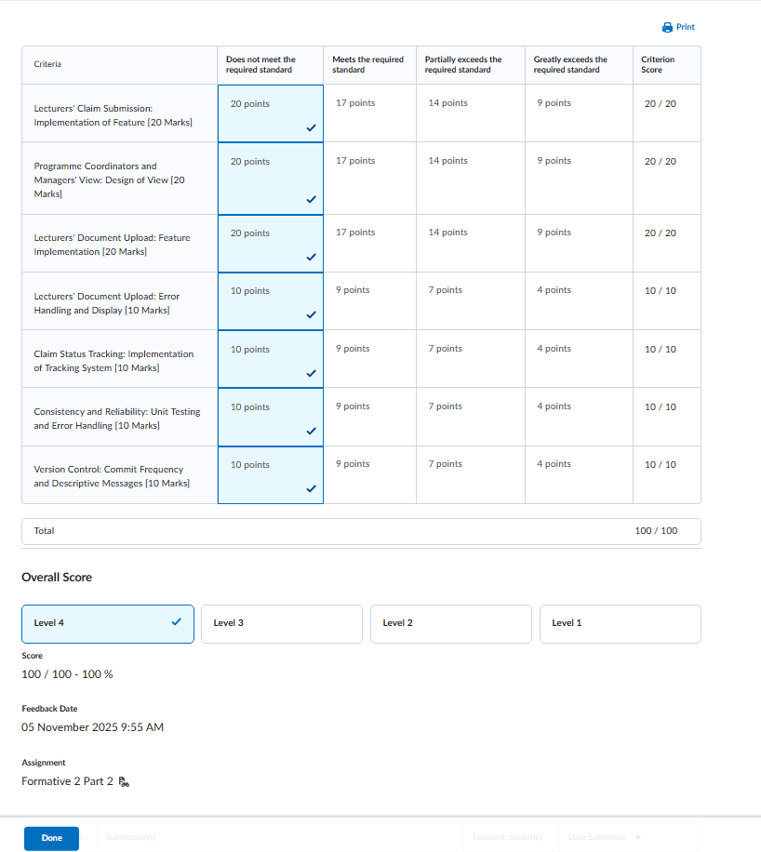
Feedback from Formative 2 (Part 2)
• Achieved 100/100 — full marks across all sections.
• Marker highlighted strong UI layout, clean navigation and visual consistency.
• Excellent validation logic for claims, including duplicate prevention, file upload rules, and data integrity checks.
• Status tracking and workflow navigation were implemented clearly.
• Document upload and error handling were well-designed.
• Git commit frequency and descriptive commit messages were praised.
Areas to strengthen for Part 3:
• Add a fully functional HR role with its own dashboard and access rights.
• Implement lecturer profile management (rate, department, contact details).
• Ensure the full workflow flow is correct (IC → PC → AM → HR).
• Include monthly summaries, totals, and invoice-style reporting.
• Improve presentation of code and UI to clearly show logic.
• Provide demo credentials for each role so markers can test quickly.
• Strengthen explanation of automation, validations, and design decisions.

Slide 4
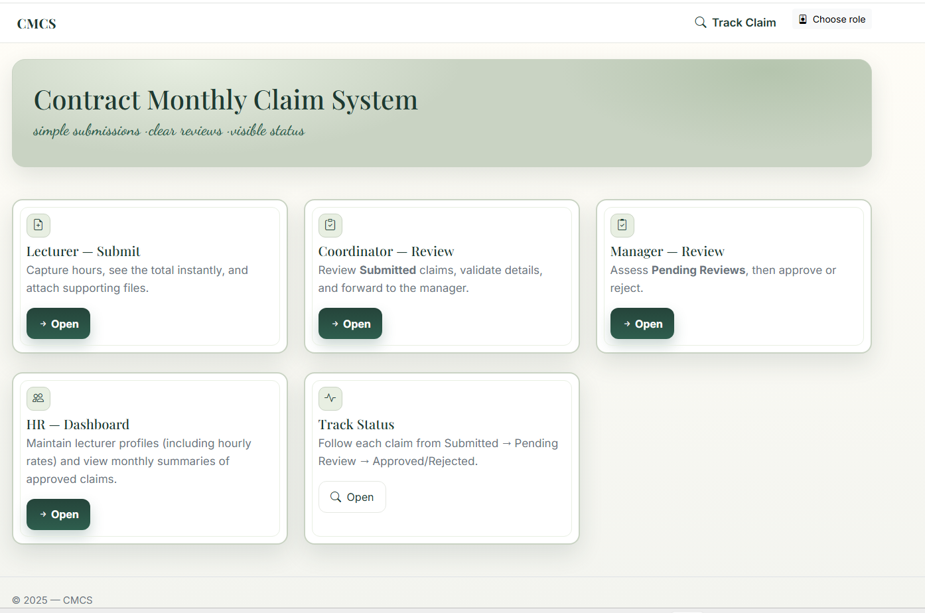
Introduction the System
What the System Is:
A web-based platform used by tertiary institutions to manage monthly timesheet claims submitted by Independent Contractors (Lecturers). The system automates the full claim lifecycle, from submission to approval, reducing manual workload and ensuring clear accountability across roles.
Purpose of the System:
• Replaces spreadsheets, manual emails and inconsistent formats
• Ensures data accuracy through built-in validation rules
• Creates a transparent, auditable 4-stage workflow
• Gives HR reliable month-end summaries without extra admin
• Supports institutional accountability and reduces processing delays
Who Uses the System:
• Lecturer / Independent Contractor → submits monthly claims, hours and supporting documents
• Programme Coordinator → reviews Submitted claims
• Academic Manager → final approver for Pending Review claims
• HR (Super User) → manages lecturer profiles, sets hourly rates, and views monthly financial summaries

Slide 5
System Overview & Architecture
Key Capabilities:
• Digital claim submission form with validation
• Document upload (PDF/DOCX/XLSX) with file-size and type checking
• Automatic claim amount calculation
• Multi-level approval chain
• Role-based access using session-based simulation
• HR summary reports with totals and invoice breakdowns
• Secure lecturer-rate management
Technology Stack:
• ASP.NET Core MVC
• Entity Framework Core + SQL Server
• Bootstrap 5 (UI styling)
• Razor Views
• Session state for role simulation
• CSV export for reporting

Slide 6
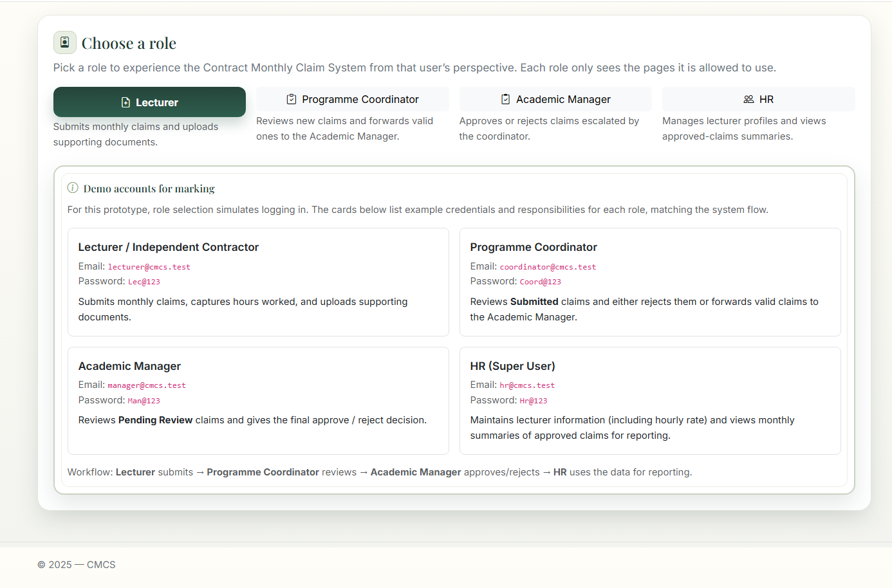
Role Selection & Demo Accounts
This screen simulates logging in by letting the marker choose a role.
Each role sees only the pages aligned to its responsibilities.
This interface demonstrates:
• Clear separation between Lecturer, Programme Coordinator, Academic Manager and HR
• Each role’s responsibilities are summarized for quick understanding
• The workflow (Lecturer → Coordinator → Manager → HR) is visible and easy to follow
• Supports marking by showing example demo credentials for each role

Slide 7
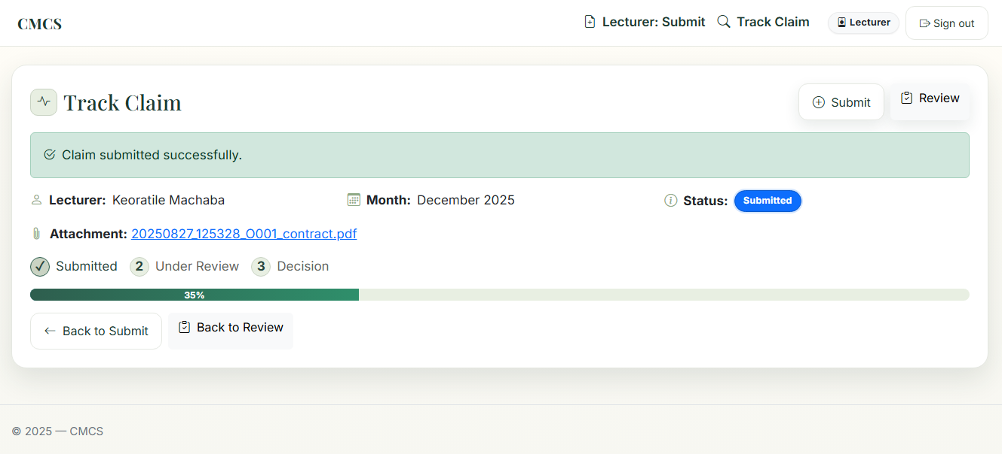
Workflow Overview
Workflow stages:
Lecturer submits a claim with hours, month, and supporting document.
Programme Coordinator reviews new Submitted claims.
Academic Manager reviews Pending Review claims and makes a final decision.
HR cannot approve/reject but can view Approved claims for reporting.
This prevents users from skipping approval levels and mirrors the expected institutional process.

Slide 8
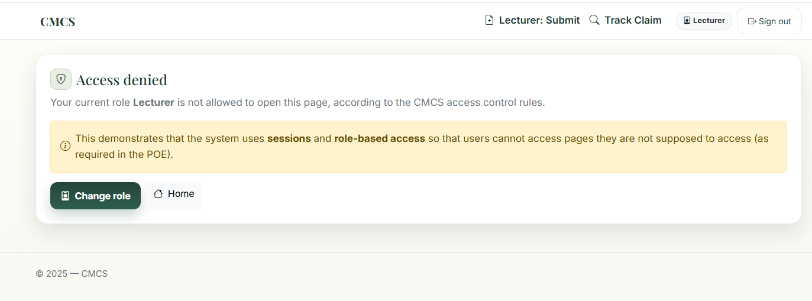
Access Control Enforcement
The system includes built-in access restrictions to ensure users cannot view screens outside their role.
This prevents:
• Lecturers accessing Coordinator/Manager/HR pages
• Coordinators skipping to HR summaries
• Managers viewing Lecturer submissions directly
• Any user bypassing the expected claim-processing flow
How it works:
• Custom [RoleRequired] attribute checks the user’s stored role
• Users are redirected with an “Access denied” message if permissions do not match
• Supports institutional accountability and the POE requirement for role-based access

Slide 9
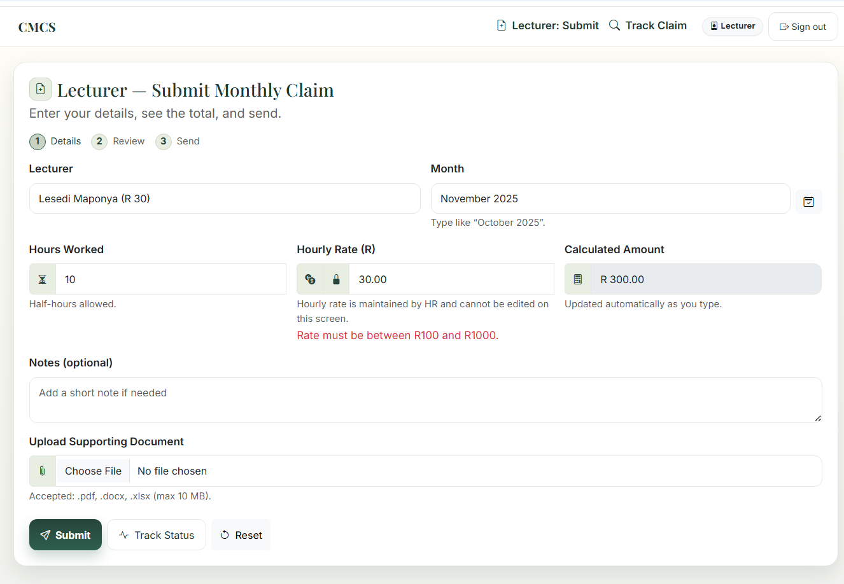
Lecturer Validation Example
This example shows how validation rules prevent incorrect or incomplete claims.
Validation includes:
• Hourly rate limits set by HR (e.g R100–R1000)
• Monthly hour limits (e.g 180 max)
• Required month and lecturer selection
• Document upload checks (file size + file type)
Purpose:
• Prevent invalid data before it enters the workflow
• Reduce administrative corrections for PC/Manager
• Maintain clean, consistent data for HR reporting

Slide 10
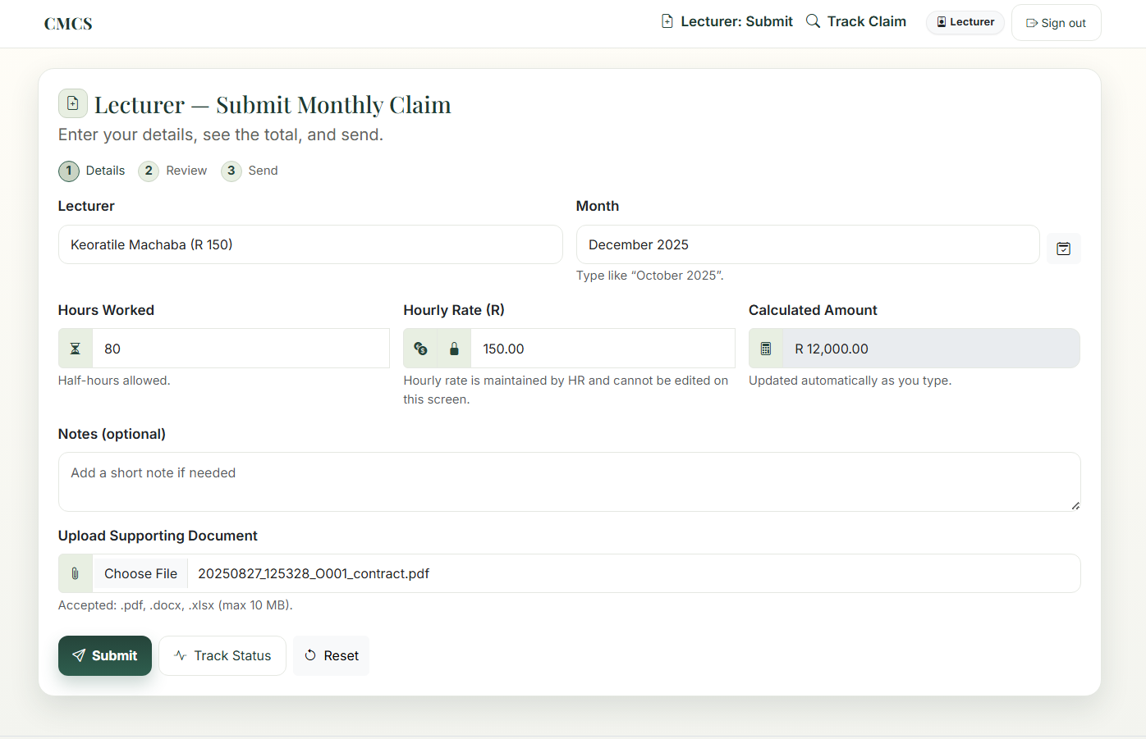
Lecturer Submission
The lecturer can:
Select their profile (pre-captured by HR).
Capture hours worked for a given month.
Automatically see the calculated amount based on the HR defined hourly rate.
Upload a supporting document (PDF, DOCX or XLSX).
Validation rules:
Prevent duplicate claims for the same lecturer and month (unless rejected).
Limit hours per month (e.g. max 180).
Enforce hourly rate ranges and file size/type.

Slide 11
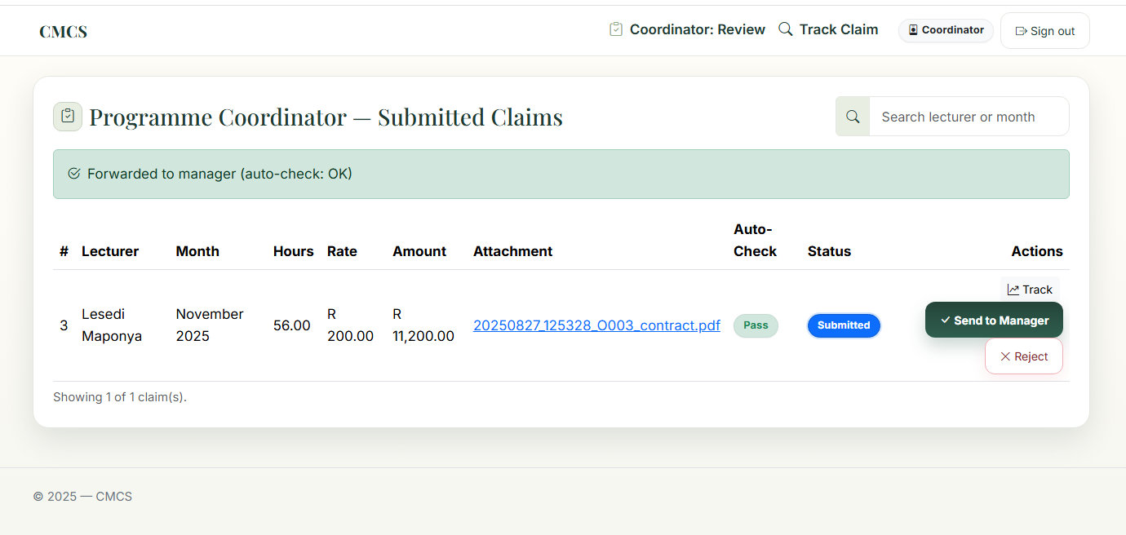
Coordinator Review
Sees only Submitted claims.
Responsibilities:
Check for completeness and obvious issues (hours, amount, attachments).
Reject invalid claims with a reason.
Forward valid claims to the Academic Manager (status changes to PendingReview).
Auto-check logic (e.g. hours and rate limits) supports consistent decision making.

Slide 12
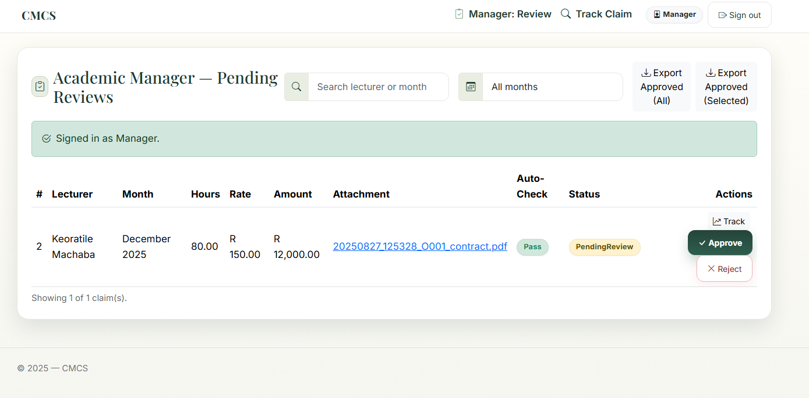
Academic Manager
Sees only PendingReview claims.
Responsibilities:
Perform a final review for accuracy and fairness.
Approve or reject claims.
Once Approved, claims are no longer visible to Lecturer/Coordinator/Manager workflows and they feed into HR reporting.

Slide 13
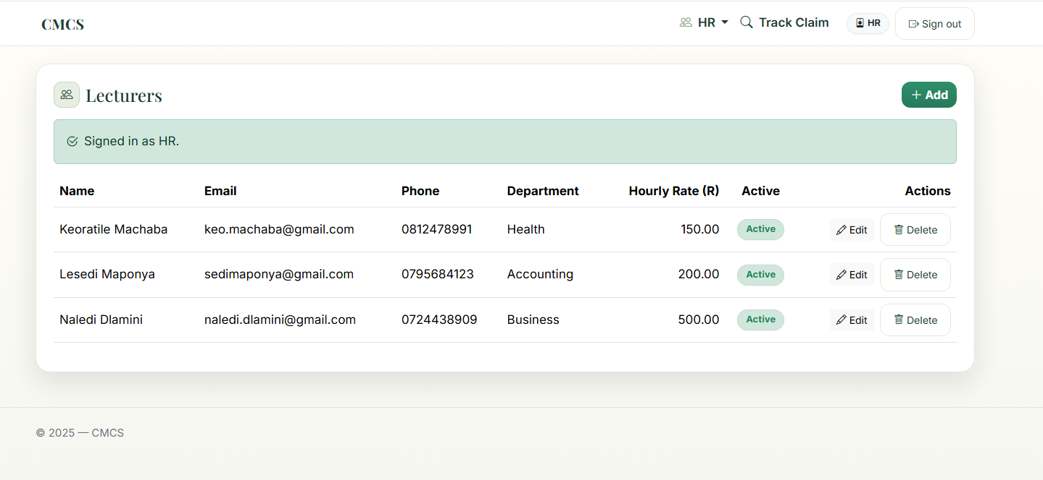
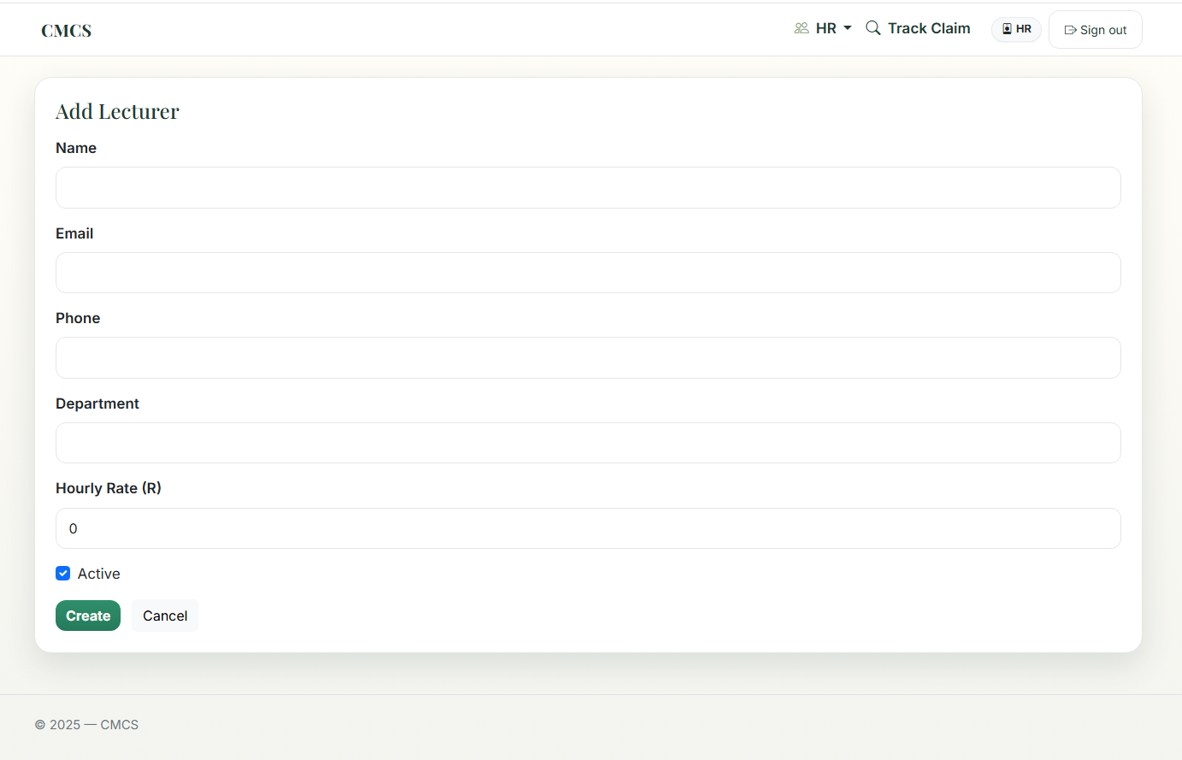
HR Role
This role shows that the system can support real administrative processes beyond simple approval.
HR Responsibilities:
• Maintains lecturer profiles
Hourly rate
Email, phone, department
Active/Inactive status
• Views monthly summaries of approved claims
• Downloads CSV exports
• Opens invoice-style breakdowns per lecturer
• Only sees final, approved data, aligned with institutional structure

Slide 14
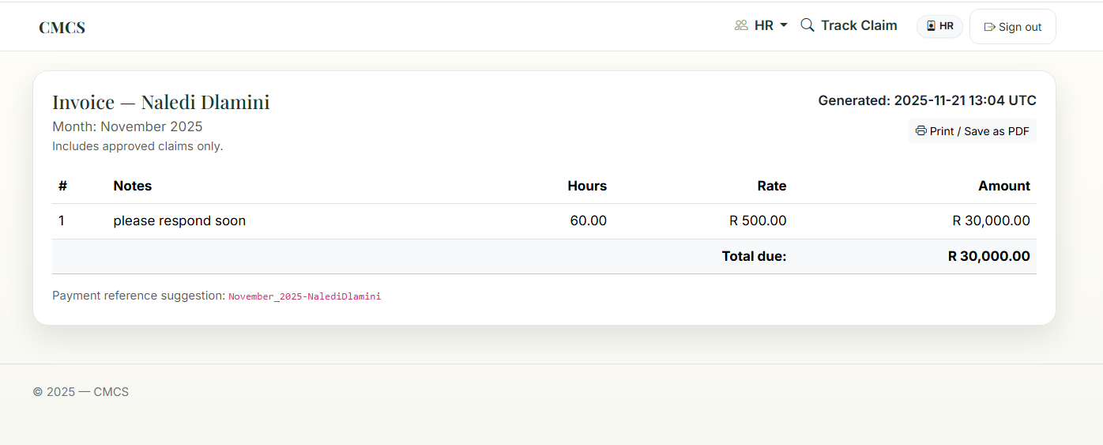
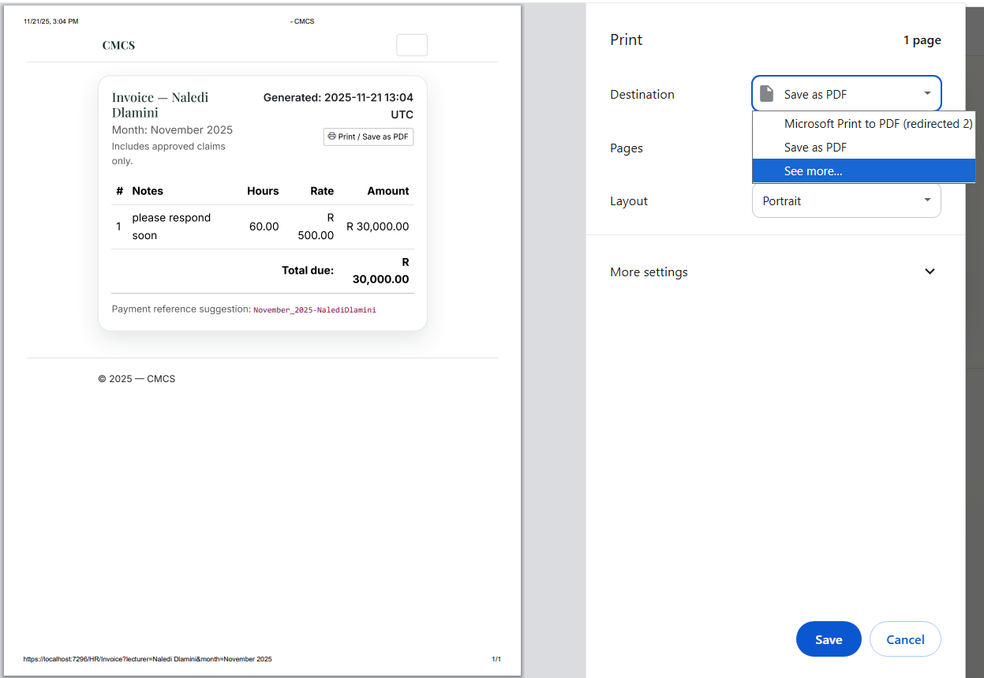
Monthly Summary & Invoice
The HR dashboard includes:
Month selection (from actual approved claim months).
Per-lecturer totals:
  Total hours
  Average rate
  Total amount for the month
Grand totals for the selected month.
An invoice-style page:
Lists each approved claim line for a lecturer and month.
Shows hours, rate and calculated amount.
Includes a print friendly layout so HR can “Print / Save as PDF”.

Slide 15
Benefits of the System
◦ Reduces repetitive, manual admin for Lecturers, Coordinators, Managers and HR.
◦ Ensures a clear, auditable four-stage workflow that cannot be bypassed.
◦ Applies built-in validation to prevent duplicate, invalid or incomplete claims.
◦ Centralizes lecturer profiles, hourly rates and status management under HR.
◦ Produces accurate month end summaries and invoice style reports.
◦ Improves institutional accountability by providing reliable, consistent data.

Slide 16
Conclusion
The Contract Monthly Claim System (CMCS) has progressed from a basic claim form into a fully structured, institution ready application.
◦ Part 3 expanded the system with multi-role workflows, HR functions and several enhancements identified in the Part 2 feedback.
The completed solution now delivers:
◦ A complete four-stage workflow: Lecturer → Programme Coordinator → Academic Manager → HR
◦ HR managed lecturer profiles, rates and active/inactive status
◦ Strong validation rules and enforced workflow transitions
◦ Document upload logic with size or type controls
◦ Monthly summaries, totals and printable invoice pages
◦ A consistent UI that supports role-based access and clear navigation
Together, these components demonstrate how a focused web application can streamline real administrative processes, reduce manual workload and provide accurate, auditable outcomes for institutions.

