Slide 1


The Information Propagation Framework
Temitope Ohiani
Edoardo Patelli

Slide 2

Motivation
Evaluating complex civil infrastructure often requires multiple perspectives of the same system to fully understand its behaviour and performance. In practice:
Each analysis type typically demands its own tool and model definition, so the same network ends up represented and maintained multiple times in parallel
As systems grow in scale and complexity, fragmentation compounds: more analysis types, more scenarios, more parallel models to maintain
When tools are used in isolation, cross-analysis insight is lost. For example: a flow bottleneck and a reliability failure point may be the same edge, but separate models make this invisible

Slide 3
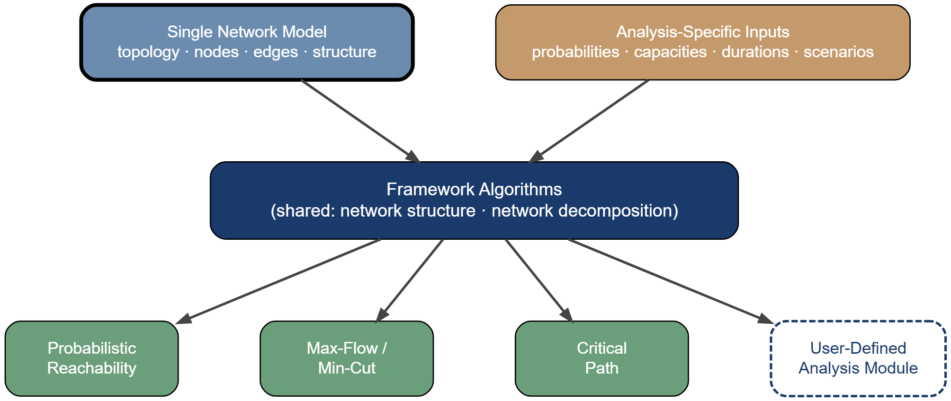
The Information Propagation Framework
An integrated Julia-based framework for analysing how failures, time, cost, and capacity propagate through networks modelled as directed acyclic graphs.
A single network model is defined once and reused across multiple exact propagation-based algorithms, with each analysis supplying only its own specific parameters.
Each algorithm is a vertical slice, so structural preprocessing is performed once and shared across all analyses

Slide 4
Why Directed Acyclic Graphs
Infrastructure systems typically involve goal-oriented processes where resources and information flow from sources toward sink.
Topological sorting provides a fixed, dependency-aware node processing order
Acyclicity ensures all algorithm guaranteed termination with no infinite loops
Nodes in the same topological layer are independent, allowing for parallelization boundaries
Exact solutions can be computed in a single forward pass since no iterative convergence required
Notes:
Why DAGS?
Properties of DAG?
Leads to Propagtion Order

Slide 5
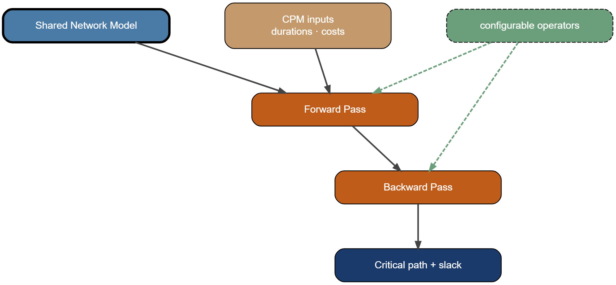
Algorithm family 1: Critical Path
Analysis Perspective: Performance metrics that accumulate along dependency paths in a network such as duration, cost, risk, latency, impact, etc.
Given the shared network model, this module answers:
What is the best or worst achievable outcome from source(s) to sink(s)?
Which sequence of dependencies drives that outcome?
Which components of the network have margin to spare, and which have none?
How does the outcome shift if one input changes?
Notes:
Why DAGS?
Properties of DAG?
Leads to Propagtion Order

Slide 6
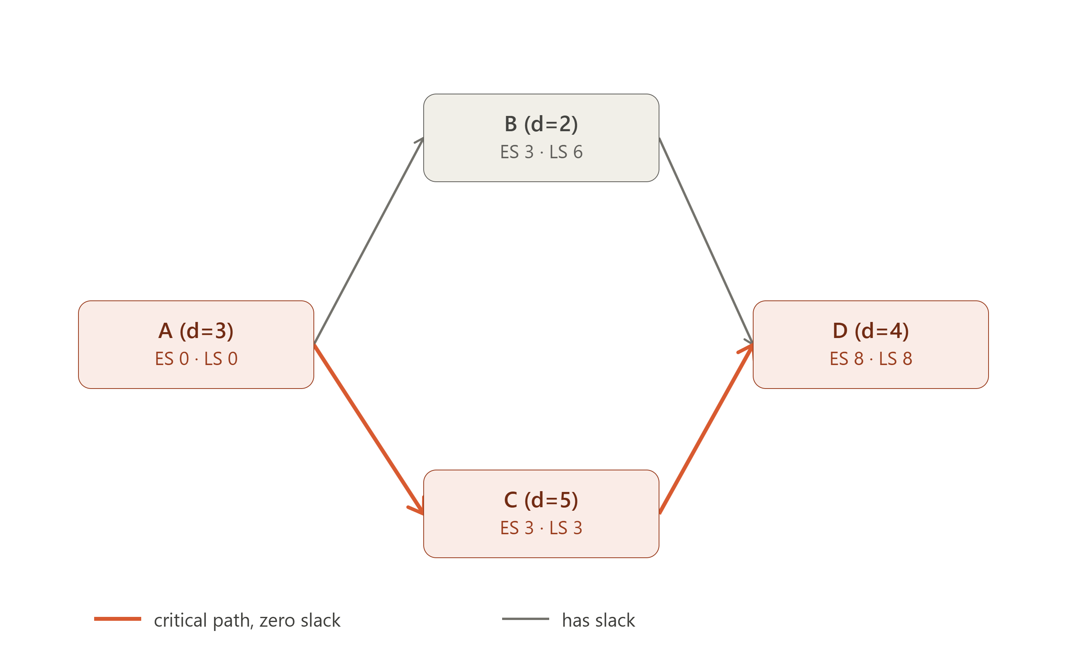

Critical Path
This module's default critical path solver computes the longest path through the DAG via forward and backward propagation:
Forward pass:
$$ES\left(v\right)=\max_{u∈parents\left(v\right)}\left[ES\left(u\right)+d\left(u\right)\right]$$
Backward pass:
$$LS\left(v\right)=\min_{w∈children\left(v\right)}\left[LS\left(w\right)−d\left(v\right)\right]$$
Slack:
$$S\left(v\right)=LS\left(v\right)−ES\left(v\right)$$
Therefore, critical path => nodes where $S\left(v\right)=0$
Notes:
Why DAGS?
Properties of DAG?
Leads to Propagtion Order

Slide 7
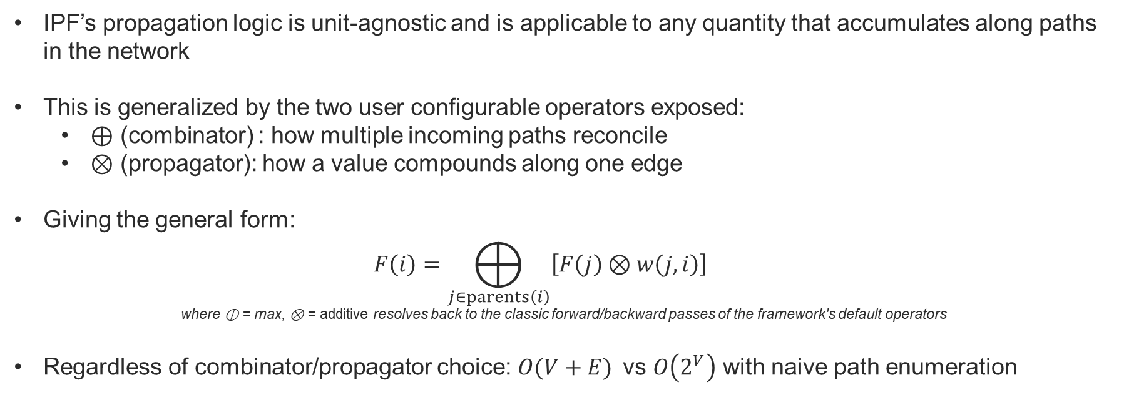
Critical Path
IPF’s propagation logic is unit-agnostic and is applicable to any quantity that accumulates along paths in the network
This is generalized by the two user configurable operators exposed:
⊕ (combinator) : how multiple incoming paths reconcile
⊗ (propagator): how a value compounds along one edge
Giving the general form:
$$F\left(i\right)=⨁_{j∈\operatorname{parents}\left(i\right)}{\left[F\left(j\right)⊗w\left(j,i\right)\right]}$$
where ⊕ = max, ⊗ = additive resolves back to the classic forward/backward passes of the framework's default operators
Regardless of combinator/propagator choice: $O(V+E)$vs $O\left(2^{V}\right)$ with naive path enumeration
Combinator | Propagator | Typical Domain
max | additive | time / latency
sum | additive | cost roll-up
max | multiplicative | risk propagation
min | additive | network routing / optimistic scheduling
Notes:
Why DAGS?
Properties of DAG?
Leads to Propagtion Order

Slide 8
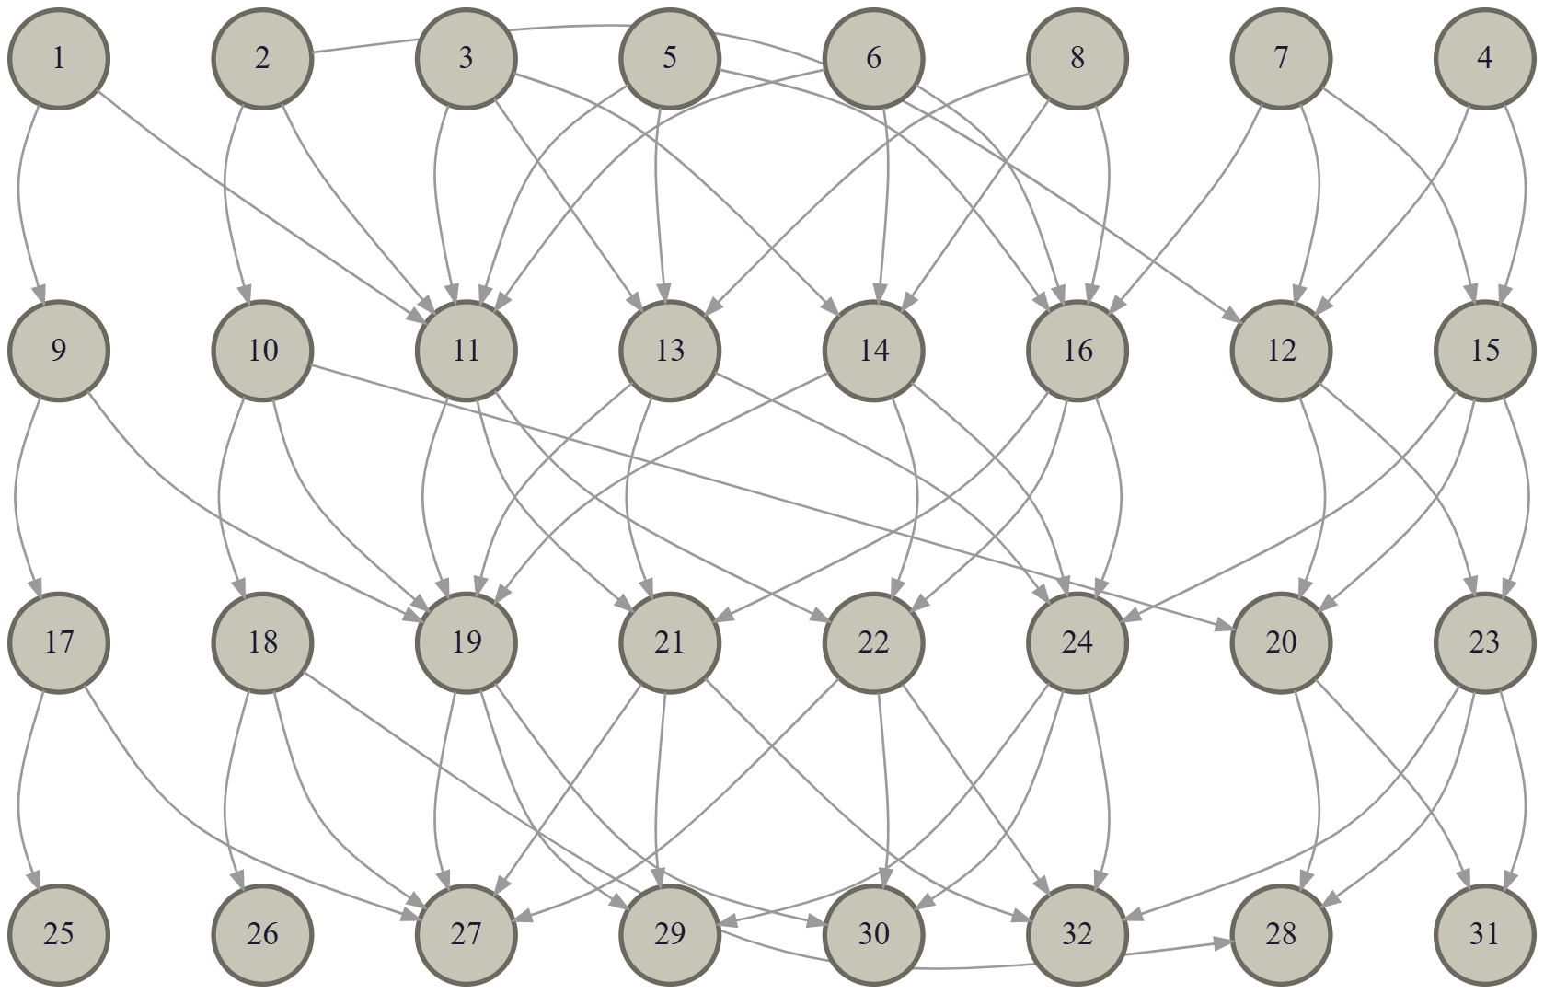
Critical Path: Case Study
Wastewater treatment network¹ ⁽ 32 nodes, 66 edges )
Node durations: 3–9 units by node type*
Edge delays: 1–3 units by connection type*
Given the same network model and same input parameters:
Scenario 1: What is the Longest accumulating path?
Scenario 2: What is the highest point of accumulated load?
[1]Derived from Network Structure in {F. V. Jensen, U. Kjærulff, K. G. Olesen and J. Pedersen. Et Forprojekt Til et Ekspertsystem for Drift af Spildevandsrensning (An Expert System for Control of Waste Water Treatment - A Pilot Project). Technical Report, Judex Datasystemer A/S, Aalborg, 1989. } *
*Values assigned for cpm demonstration - not the network's original concentration data.
Notes:
Why DAGS?
Properties of DAG?
Leads to Propagtion Order

Slide 9
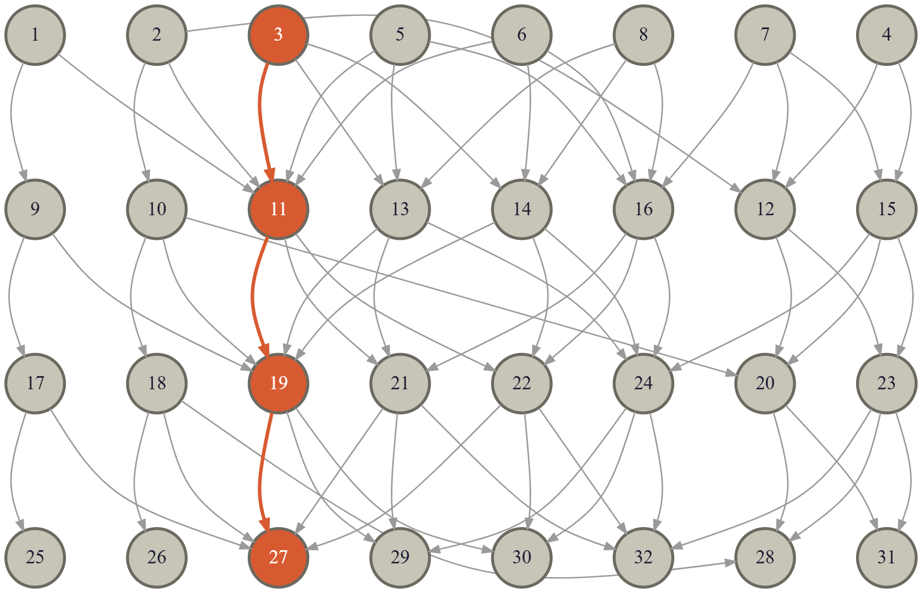
Critical Path: Case Study
Scenario 1: What is the Longest accumulating path?
⊕ Combinator: max,
⊗ Propagator: additive
Node | EF | Slack | Status
27 | 45.0 | 0 | Critical
19 | 33.0 | 0 | Critical
11 | 21.0 | 0 | Critical
3 | 9.0 | 0 | Critical
30 | 43.5 | 1.5 | Near-critical
14 | 19.5 | 1.5 | Near-critical
Notes:
Why DAGS?
Properties of DAG?
Leads to Propagtion Order

Slide 10
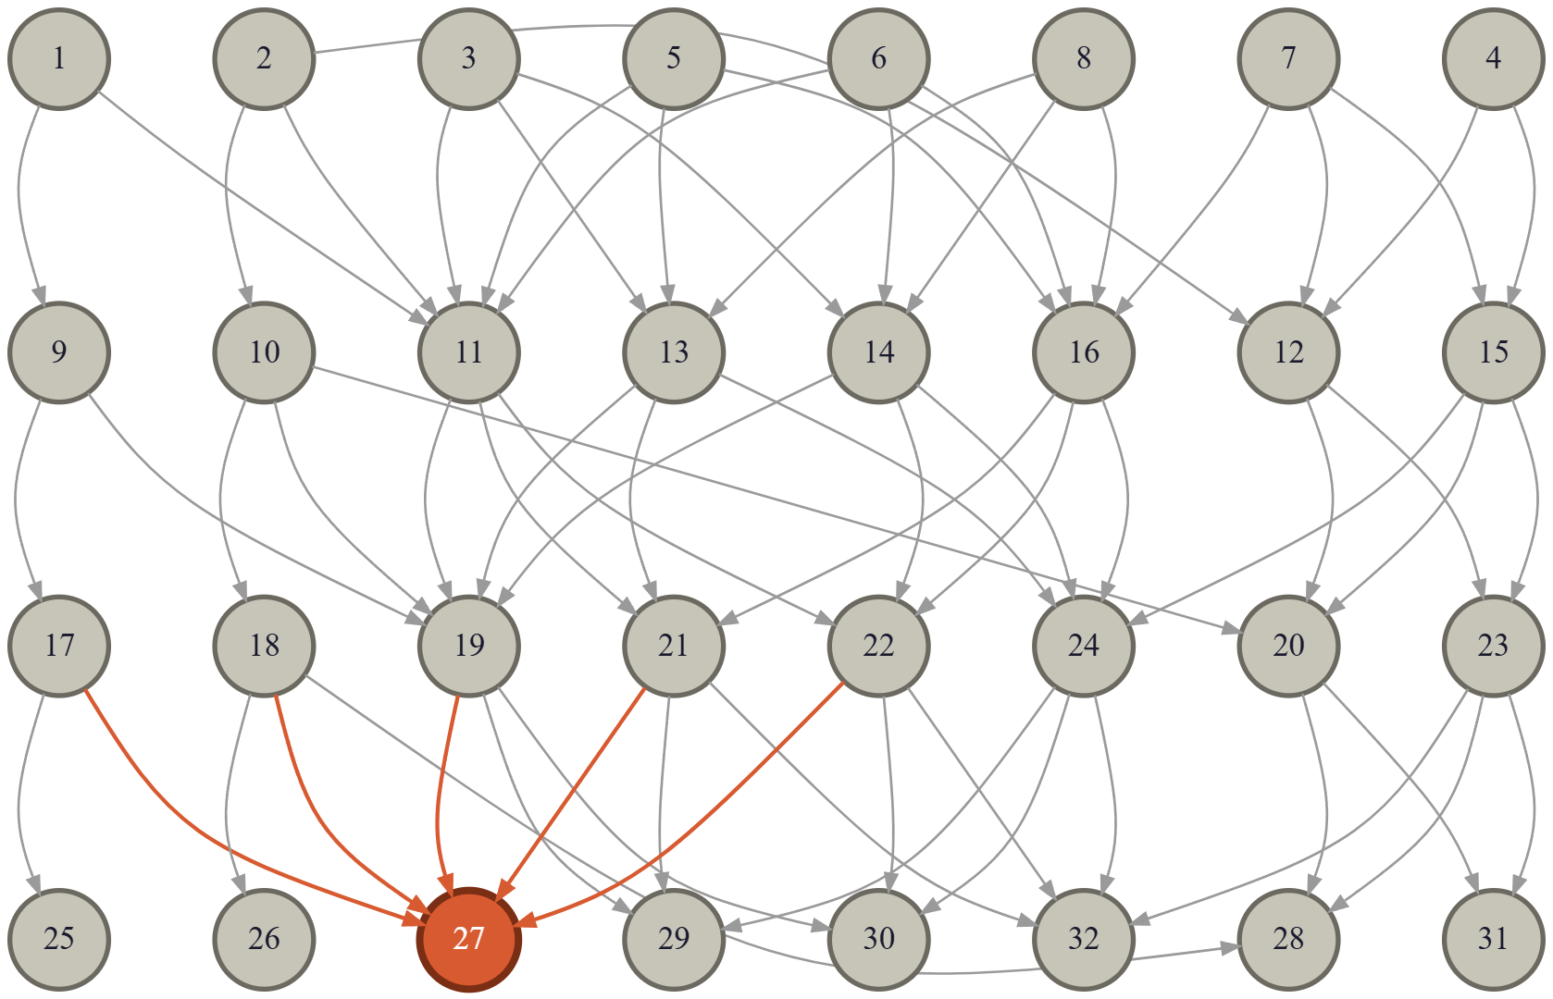
Critical Path: Case Study
Scenario 2: What is the Total accumulated load ?
⊕ Combinator: sum
⊗ Propagator: additive
Node | EF | Slack | Status
27 | 480.0 | 0 | Critical (max load)
30 | 431.5 | 48.5 | High load
32 | 415.0 | 65.0 | High load
29 | 410.5 | 69.5 | High load
19 | 164.0 | 304.0 | Mid-tier convergence
Notes:
Why DAGS?
Properties of DAG?
Leads to Propagtion Order

Slide 11
Critical Path: Case Study
Scenario Comparison:
Node 27 is critical under both configurations, but for different reasons.
Under max-combination it's the endpoint of the single longest chain (3→11→19→27);
Under sum-combination, six independent paths converge at Node 27
Node 19 jumps from 33 to 164 units since sum-combination credits it with every incoming contribution rather than just the single largest one.
Node 30 is structurally important in both scenarios: near-critical under max/additive (slack 1.5), 2nd-highest load under sum/additive (431.5)
Runtime is effectively identical either way (78.3μs vs 78.7μs)
Water Network: Longest accumulating path
Water Network: Highest point of accumulated load
Notes:
Why DAGS?
Properties of DAG?
Leads to Propagtion Order

Slide 12
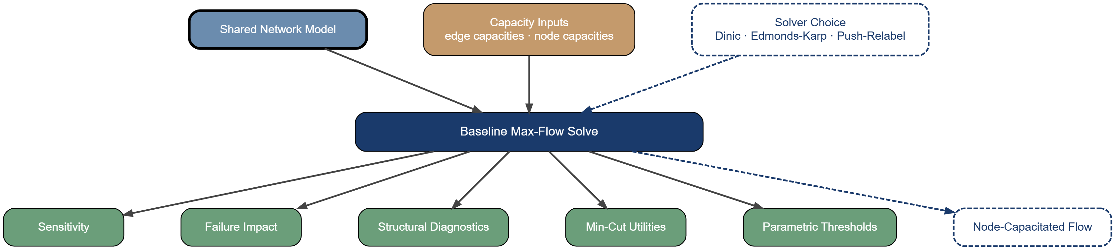
Algorithm family 2: Flow Capacity
Analysis Perspective: Capacity-constrained flow between source and sink nodes and how much throughput can be delivered
Given the shared network model, this module answers:
How much throughput can the network sustain under current capacities?
Where is the bottleneck, and is it tightly localised or distributed across many equivalent cuts?
Which components most constrain delivery, and by how much?
How much capacity margin exists before a target demand level is breached?
Notes:
Why DAGS?
Properties of DAG?
Leads to Propagtion Order

Slide 13
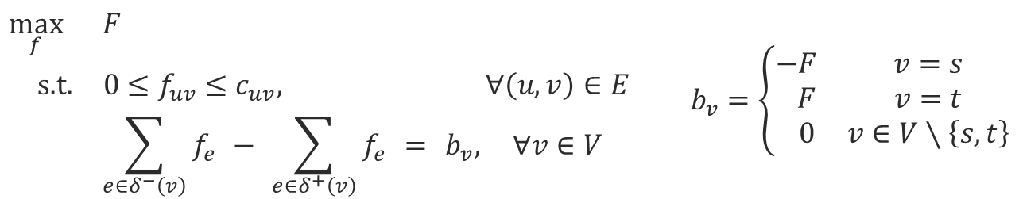
Algorithm family 2: Flow Capacity
Motivating question: How much throughput can flow from s to t under the active edge capacities?
This module computes maximum possible flow delivered from source to sink nodes, without exceeding any edge's capacity or breaking flow balance at intermediate nodes.
$$\begin{aligned}\max_{f}{ }&F \\ \text{s}\text{.}\text{t}\text{. }&0≤f_{uv}≤c_{uv},&∀\left(u,v\right)∈E \\ &\sum_{e∈δ^{−}\left(v\right)}{f_{e}} − \sum_{e∈δ^{+}\left(v\right)}{f_{e}} = b_{v},&∀v∈V\end{aligned} b_{v}=\left\{\begin{matrix}−F & v=s \\ F & v=t \\ 0 & v∈V∖\left\{s,t\right\}\end{matrix}\right.$$
If sink t requires demand level Dt, then Δt = F⋆ − Dt (i.e. Δt ≥ 0 → demand met with margin; Δt < 0 → shortfall)

Slide 14
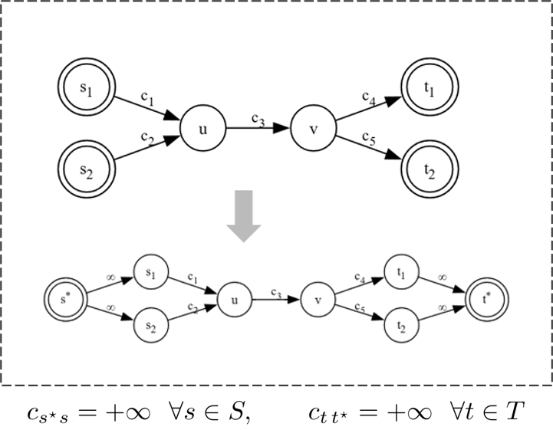
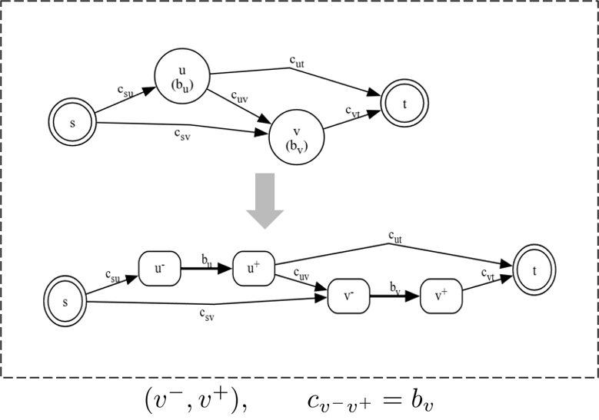
Algorithm family 2: Flow Capacity
Multi-source/sink DAGs resolved to single source/sink via super-terminals s⋆, t⋆ with non-binding (∞) connector capacities; feasible-flow spaces map 1:1
Node capacitated DAGs resolved into edge-only capacity via node splitting: replace v with v⁻/v⁺ joined by an edge of capacity bv; incoming edges redirect to v⁻, outgoing edges originate from v⁺
Both reductions happen internally to the framework: solver outputs are remapped back to the user’s original network

Slide 15
Flow Capacity : Solver Choice
The framework exposes three solver options.
Each solver returns F⋆ along with the solved edge flows, residual capacities, sink allocations, and a representative minimum-cut partition
Edmonds-Karp: BFS to finds the shortest augmenting path. One path per augmentation.
Dinic (default): BFS to build a level graph, layering nodes by distance from source. DFS to find blocking flow per phase.
Push-Relabel: Pre-saturates all outgoing edges from the source node. Each node carries an excess and a height label. Nodes push excess to lower-height neighbours; if no valid push exists, the node is relabelled higher.
Solver | Best for
Edmonds–Karp | small networks
Dinic (default) | layered networks
Push–Relabel | dense / high fan-out networks

Slide 16
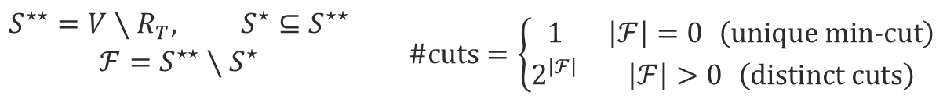
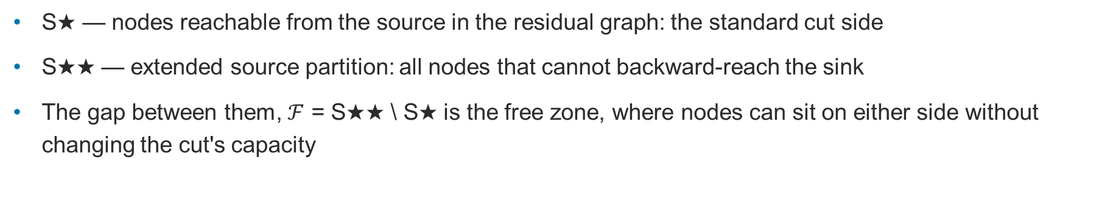
Flow Capacity : Min-Cut
The max-flow result from any solver contains one valid minimum cut, but this is not necessarily the only possible min-cut. The full cut space can be enumerated using the final residual graph's reachability structure.
S★ — nodes reachable from the source in the residual graph: the standard cut side
S★★ — extended source partition: all nodes that cannot backward-reach the sink
The gap between them, $ℱ$ = S★★ \ S★ is the free zone, where nodes can sit on either side without changing the cut's capacity
$$\begin{matrix}S^{⋆⋆}=V∖R_{T}, S^{⋆}⊆S^{⋆⋆} \\ ℱ=S^{⋆⋆}∖S^{⋆} \\ \end{matrix} \#\text{cuts}=\left\{\begin{matrix}1 & \left|ℱ\right|=0 \left(\text{unique} \text{min}\text{−}\text{cut}\right) \\ 2^{\left|ℱ\right|} & \left|ℱ\right|>0 \left(\text{distinct} \text{cuts}\right)\end{matrix}\right.$$
Note: Full enumeration of the $2^|ℱ|$equivalent cuts is bounded by a user-configurable limit to avoid combinatorial blow-up in highly symmetric networks.

Slide 17
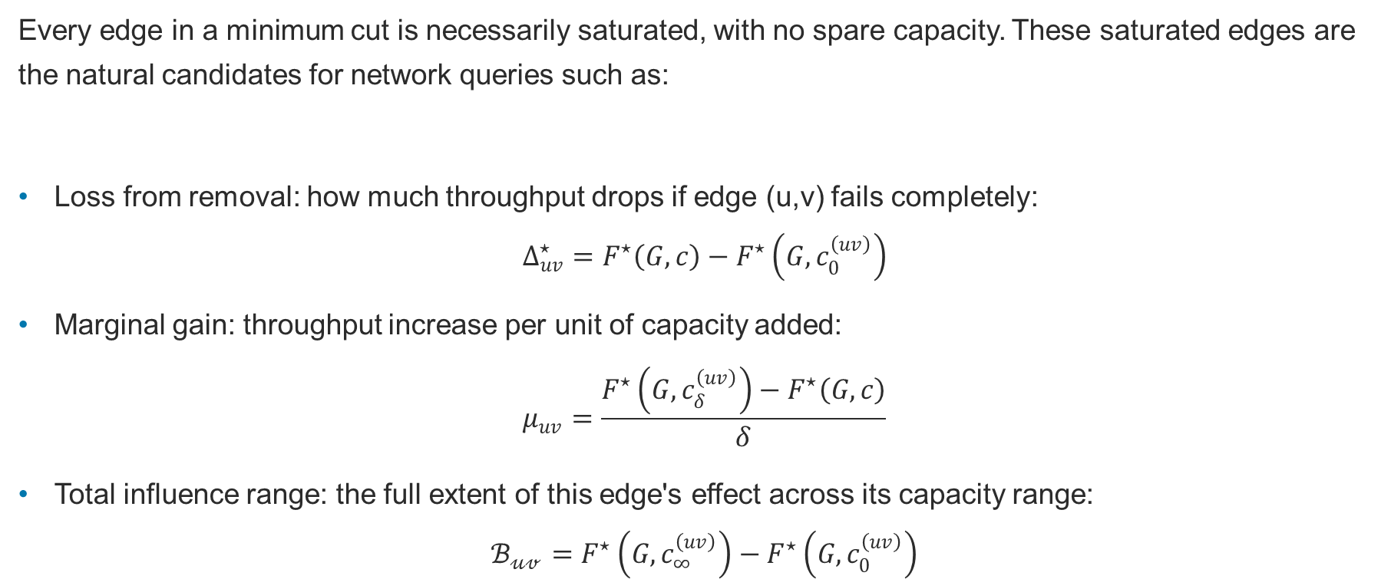
Flow Capacity : Flow Sensitivity
Every edge in a minimum cut is necessarily saturated, with no spare capacity. These saturated edges are the natural candidates for network queries such as:
Loss from removal: how much throughput drops if edge (u,v) fails completely:
$$Δ_{uv}^{⋆}=F^{⋆}\left(G,c\right)−F^{⋆}​\left(G,c_{0}^{\left(uv\right)}\right)$$
Marginal gain: throughput increase per unit of capacity added:
$$μ_{uv}=\frac{F^{⋆}\left(G,c_{δ}^{\left(uv\right)}\right)−F^{⋆}\left(G,c\right)}{δ}$$
Total influence range: the full extent of this edge's effect across its capacity range:
$$ℬ_{𝓊𝓋}=F^{⋆}​\left(G,c_{∞}^{\left(uv\right)}\right)−F^{⋆}​\left(G,c_{0}^{\left(uv\right)}\right)$$

Slide 18
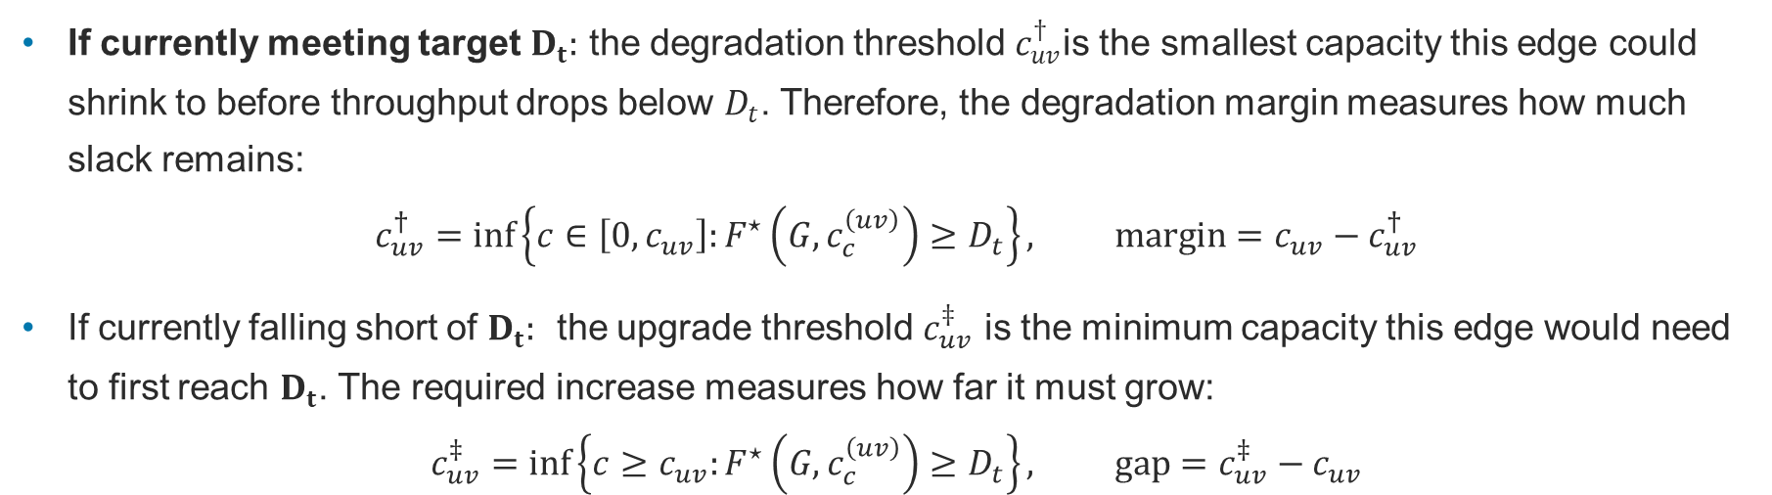
Flow Capacity : Parametric Threshold
While the Sensitivity function evaluates how much extra throughput one more unit of capacity buys, the Parametric Threshold asks how much capacity is needed to hit a target service level $D_{t}$, and how much could be lost before missing it.
If currently meeting target $D_{t}:$ the degradation threshold $c_{uv}^{†}$is the smallest capacity this edge could shrink to before throughput drops below $D_{t}$. Therefore, the degradation margin measures how much slack remains:
$$c_{uv}^{†}=\inf\left\{c∈\left[0,c_{uv}\right]:F^{⋆}​\left(G,c_{c}^{\left(uv\right)}\right)≥D_{t}\right\}, \text{margin}=c_{uv}−c_{uv}^{†}$$
If currently falling short of $D_{t}:$ ​ the upgrade threshold $c_{uv}^{‡}$ is the minimum capacity this edge would need to first reach $D_{t}$. The required increase measures how far it must grow:
$$c_{uv}^{‡}=\inf\left\{c≥c_{uv}:F^{⋆}​\left(G,c_{c}^{\left(uv\right)}\right)≥D_{t}\right\}, \text{gap}=c_{uv}^{‡}−c_{uv}$$

Slide 19
Computational Complexity
Solver / Module | Complexity | Notes
Edmonds–Karp | O(VE²) | small networks
Dinic (default) | O(V²E) | layered/DAG networks
Push–Relabel | O(V²√E) | dense / high fan-out networks
Min-Cut Enumeration | O(V+E) + O(2^|F|) | free zone is a cheap BFS; full enumeration is exponential, bounded by cut_limit
Flow Sensitivity | O(|E_sat| × T_flow)* | one re-solve per saturated edge
Parametric Threshold | O(|E| × max_depth × T_flow)* | per-edge binary search
*T = one baseline max-flow solve.

Slide 20
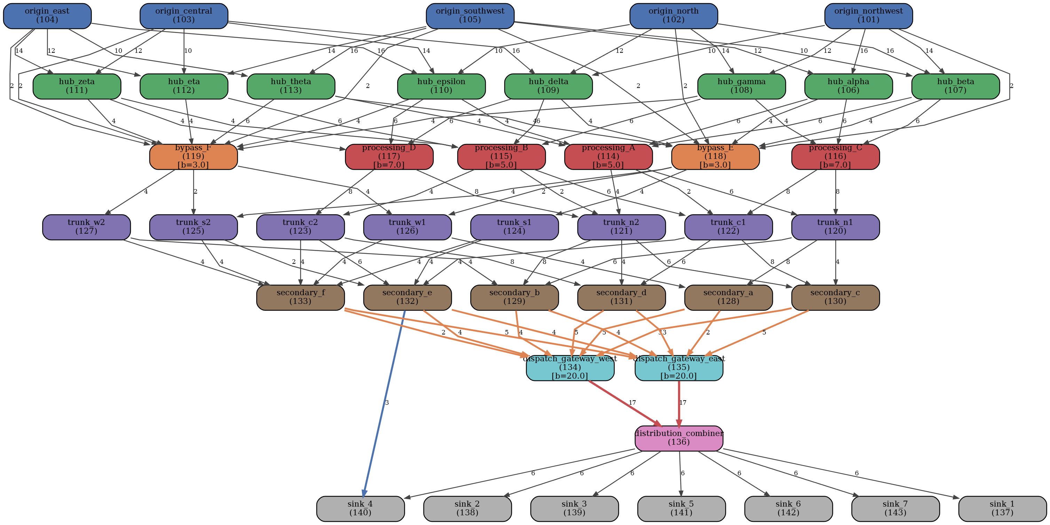
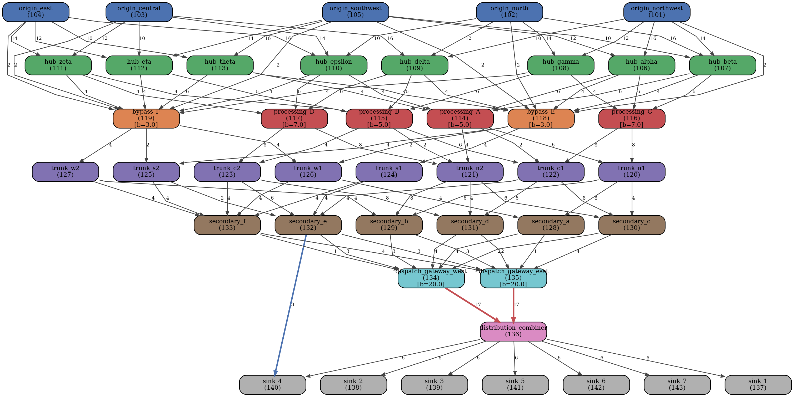
Flow Capacity : Case Study
Two competing designs for a synthetic, multi-source multi-sink DAG network
43 nodes · 107 edges (5 sources → hubs → processing/bypass nodes (node-capacitated) → trunk/secondary layers → 2 gateways → 1 combiner → 7 sinks )
Configuration A: symmetric feeders + limited direct bypass to sink_4
Configuration B: reinforced feeder capacities into the gateway layer

Slide 21
Flow Capacity : Case Study
Despite F⋆ = 37.0 for both configurations and the same degradation curve, configuration 2 has more upgrade recommendations.
Metric | Config A | Config B
Max Flow | 37.0 | 37.0
Saturated edges | 41 | 35
Free-zone size | 2 | 0
Min-cuts | 4 | 1
SPOF nodes | 0 | 0
Gateway upgrade effective | no | yes
Bypass upgrade effective | yes | yes
Edge | Config A upgrade | Config B upgrade
gateway(134 → 136) | ineffective | +1.0
(135 → 136) | ineffective | +1.0
bypass (132 → 140) | +1.0 | +1.0

Slide 22
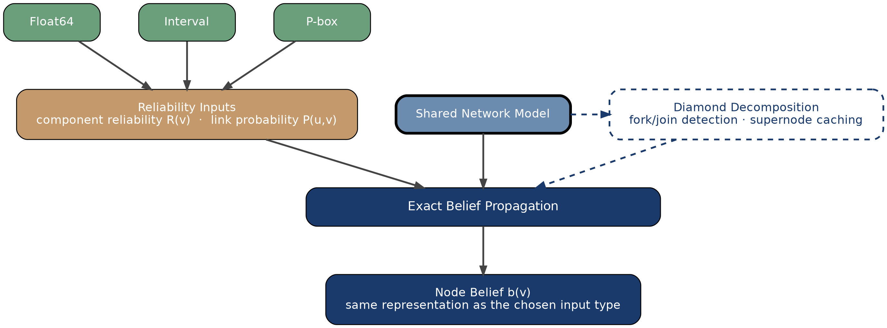
Algorithm family 3: Reachability
Analysis Perspective: The probability that at least one viable path from any source reaches a specific node in the network
Given the shared network model, this module answers:
Does a target node remain reachable under uncertain component and edge failures?
Where does shared ancestry break the naive independence assumption?
How deep can dependency nesting go before exact computation becomes impractical?
Notes:
Why DAGS?
Properties of DAG?
Leads to Propagtion Order

Slide 23
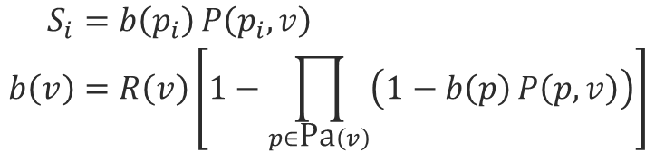
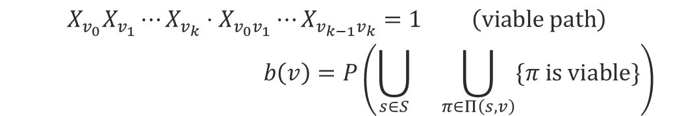
Algorithm family 3: Reachability
Each node and edge carries a reliability value drawn from the same shared network model used elsewhere in the framework:
R(v) = P(Xv=1) — intrinsic reliability of node v
P(u,v) = P(Xuv=1) — transmission probability of edge (u,v)
$$\begin{matrix}X_{v_{0}}X_{v_{1}}⋯X_{v_{k}}⋅X_{v_{0}v_{1}}⋯X_{v_{k−1}v_{k}}=1 \left(\text{viable} \text{path}\right) \\ b\left(v\right)=P\left(\bigcup_{s∈S}{}\bigcup_{π∈Π\left(s,v\right)}{\{π \text{is} \text{viable}\}}\right)\end{matrix}$$
When the node’s parent paths share no common ancestry, incoming signals combine independently:
$$\begin{aligned}S_{i}&=b\left(p_{i}\right) P\left(p_{i},v\right) \\ b\left(v\right)&=R\left(v\right)\left[1−\prod_{p∈\text{Pa}\left(v\right)}{\left(1−b\left(p\right) P\left(p,v\right)\right)}\right]\end{aligned}$$
Note: In this framework, b(v) is computed for every node in the network, not just designated sink nodes

Slide 24
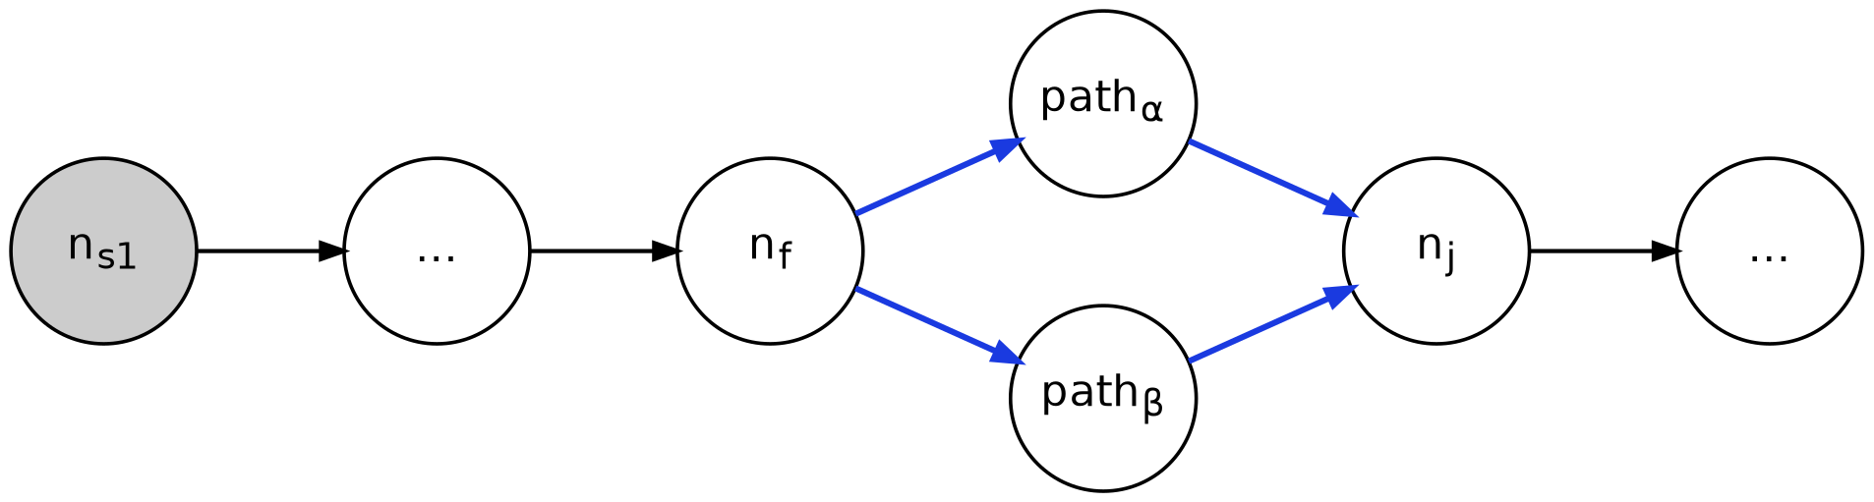
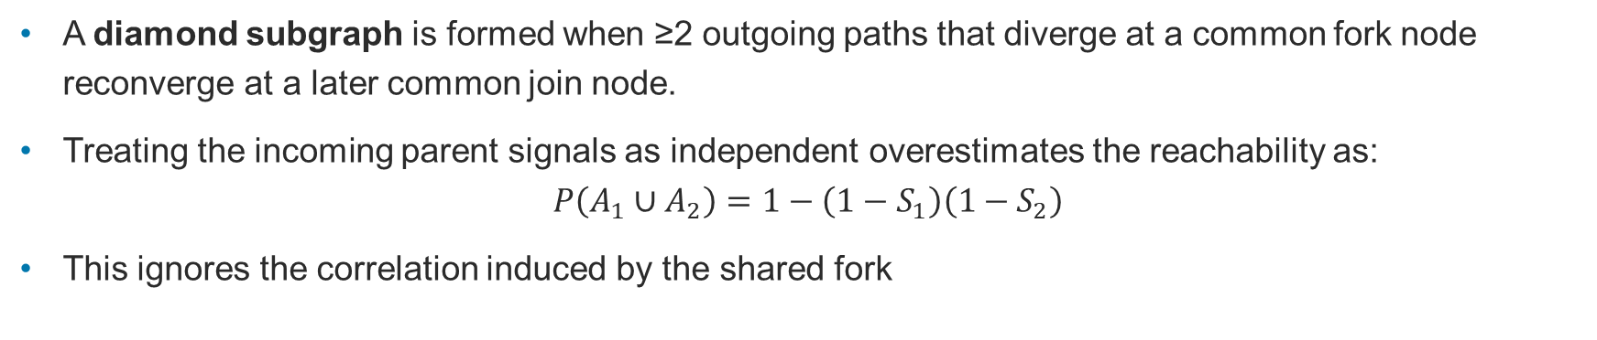
Reachability : The Diamond Problem
A diamond subgraph is formed when ≥2 outgoing paths that diverge at a common fork node reconverge at a later common join node.
Treating the incoming parent signals as independent overestimates the reachability as:
$$P\left(A_{1}∪A_{2}\right)=1−\left(1−S_{1}\right)\left(1−S_{2}\right)$$
This ignores the correlation induced by the shared fork

Slide 25
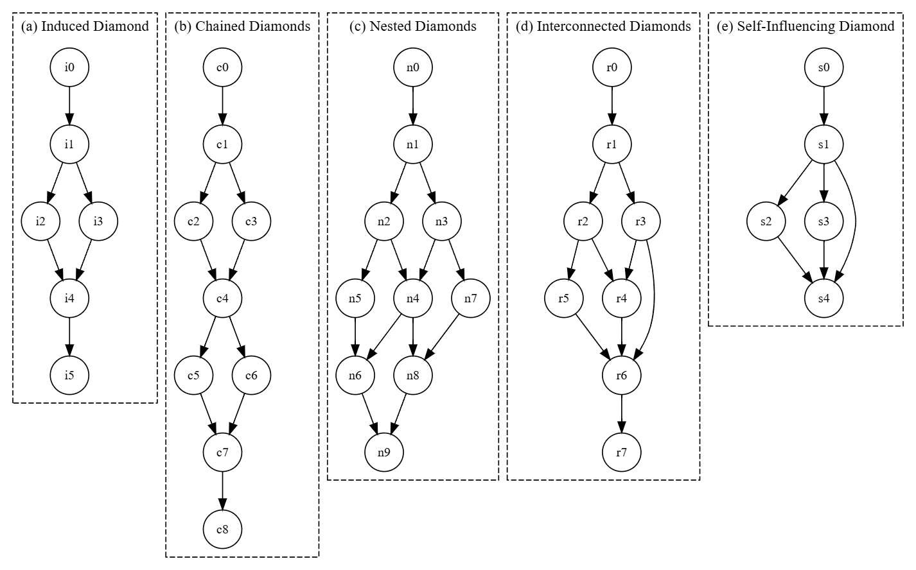
Reachability : Nested Diamonds
Real networks rarely contain only isolated diamonds
The output of one fork-join subgraph often becomes part of a larger, outer reconvergence
Without caching, the inner diamond must be resolved every time the outer diamond is conditioned on a new upstream state
Cost compounds multiplicatively across nesting levels

Slide 26
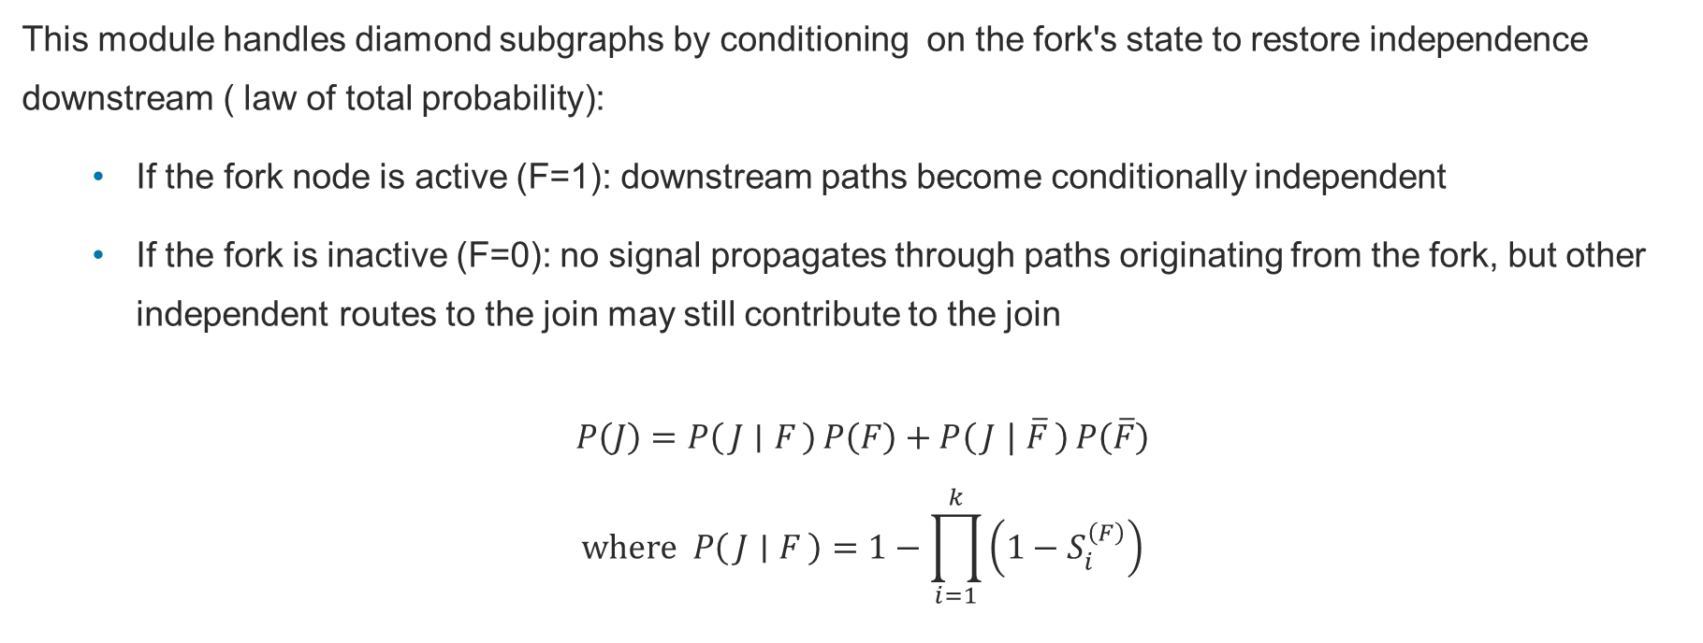
Reachability : The Diamond Problem
This module handles diamond subgraphs by conditioning on the fork's state to restore independence downstream ( law of total probability):
If the fork node is active (F=1): downstream paths become conditionally independent
If the fork is inactive (F=0): no signal propagates through paths originating from the fork, but other independent routes to the join may still contribute to the join
$$P\left(J\right)=P\left(J ∣ F\right) P\left(F\right)+P\left(J ∣ \overline{F}\right) P\left(\overline{F}\right)$$
$$where P\left(J ∣ F\right)=1−\prod_{i=1}^{k}{\left(1−S_{i}^{\left(F\right)}\right)}$$

Slide 27
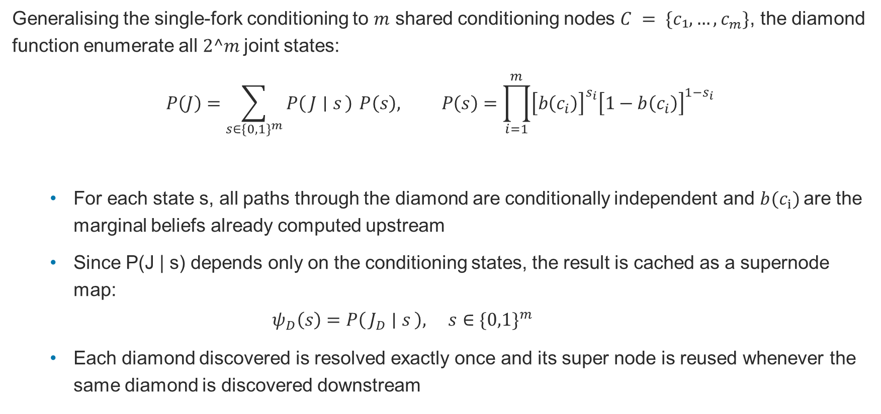
Reachability : Full Formalisation
Generalising the single-fork conditioning to $m$ shared conditioning nodes $C = \{c₁, …,c_{m}\}$, the diamond function enumerate all $2^m$joint states:
$$P\left(J\right)=\sum_{s∈\{0,1\}^{m}}{P\left(J ∣ s\right)} P\left(s\right), P\left(s\right)=\prod_{i=1}^{m}{{\left[b\left(c_{i}\right)\right]}^{s_{i}}{\left[1−b\left(c_{i}\right)\right]}^{1−s_{i}}}$$
For each state s, all paths through the diamond are conditionally independent and $b(c_{i})$are the marginal beliefs already computed upstream
Since P(J | s) depends only on the conditioning states, the result is cached as a supernode map:
$$ψ_{D}\left(s\right)=P\left(J_{D} ∣ s\right), s∈\{0,1\}^{m}$$
Each diamond discovered is resolved exactly once and its super node is reused whenever the same diamond is discovered downstream

Slide 28
Reachability : Handling Uncertainty
The same propagation engine is parametrised to handle three interchangeable probability representations:
Float64: single value, fastest
Interval: [pmin, pmax], guaranteed bounds
p-box: full distribution envelope
The propagation logic is identical; only the arithmetic representation changes

Slide 29
Computational Complexity
Update Type | Complexity | Notes
Preprocessing / decomposition | O(V · E) | One-time; ~50 ms regardless of network size
Independent join, k parents | O(k) per node | Product formula; no shared ancestry
Single diamond, |C| cond. nodes | O(2^{|C|} · |D|) | Per unique diamond; |D| = subgraph size
Nested diamonds — with caching | O(Σᵢ 2^{|Cᵢ|} · |Dᵢ|) | Sum over unique diamonds only
Nested diamonds — without caching | O(2^{Σ |Cᵢ|} · V) | Exponential in total conditioning nodes
*Caching converts multiplicative nesting cost into an additive sum. Cost driver is nesting depth × |C|, not V or E.

Slide 30
Reachability : Case Study
Objective:
Comparing reachability results across 8 networks of varying sizes
(1) Computation time relative to diamond nesting depth and conditioning-set width |C|
(2) Accuracy and timing comparison to Monte Carlo
What is computed: b(v) for each node in the network, the probability that the node stays reachable from at least one source, given the node priors and edge probabilities
8 networks spanning 36–1,041 nodes. Two real-world benchmarks and six Pareto-optimal drone logistics configurations
Every network measured the same way: structure first (diamonds, depth, |C|), then propagation runtime, then accuracy vs Monte Carlo

Slide 31
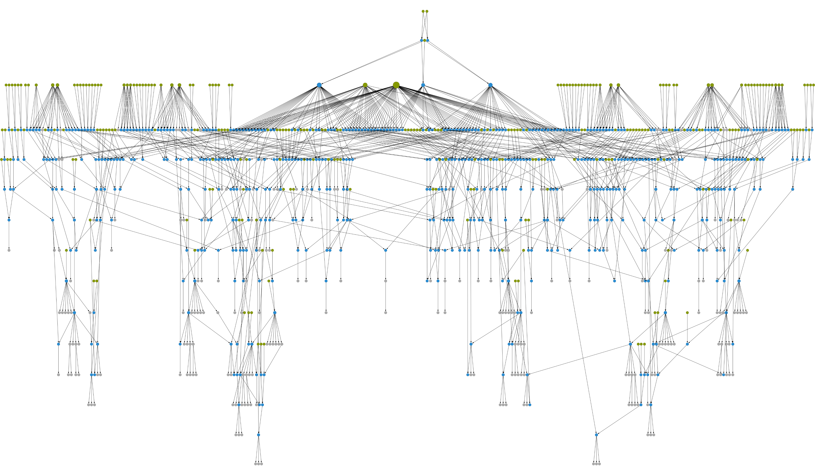
Reachability : Case Study
MUNIN
Diagnostic Bayesian-network benchmark
Largest network in the set: broad, shallow diamonds (depth 3) despite 1,041 nodes.
1,041 nodes · 1,397 edges
259 sources → 183 sinks
Max depth 3 · Max |C| 8
IPA: 2.843s total (216 diamonds)
● source nodes ● diamond/join nodes ● other nodes
[1] S. Andreassen, F. V. Jensen, S. K. Andersen, B. Falck, U. Kjærulff, M. Woldbye, A. R. Sørensen, A. Rosenfalck, and F. Jensen. MUNIN — an Expert EMG Assistant. In Computer-Aided Electromyography and Expert Systems, Chapter 21. Elsevier (North-Holland), 1989. Network data: bnlearn.com/bnrepository/discrete-massive.html#munin

Slide 32
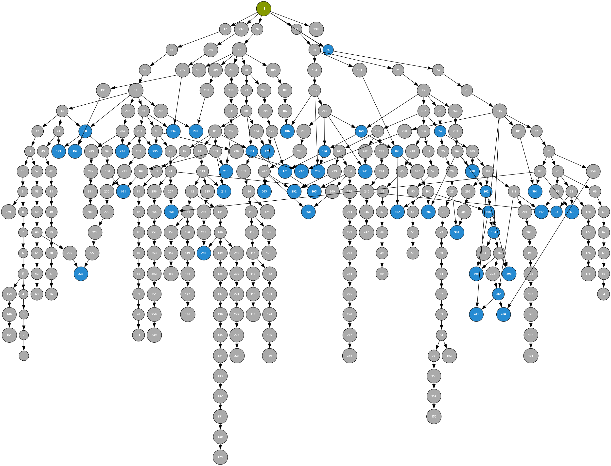
Reachability : Case Study
METRO
Berlin transit network (single-source DAG)
Real transit network converted to a DAG: all edges are oriented outward from the central hub.
Hub and transfer connections are treated as the most reliable links; ordinary station-to-station hops are somewhat more failure-prone.
306 nodes · 350 edges
1 source → 61 sinks
Max depth 5 · Max |C| 2
IPA: 0.141s total (99 diamonds)
● source nodes ● diamond/join nodes ● other nodes
[1] J. Salomon, M. Broggi, S. Kruse, S. Weber, and M. Beer, ‘Resilience Decision-Making for Complex Systems’, ASCE-ASME J Risk and Uncert in Engrg Sys Part B Mech Engrg, vol. 6, no. 020901, Mar. 2020. [2] J. Behrensdorf, T.-E. Regenhardt, M. Broggi, and M. Beer, ‘Numerically efficient computation of the survival signature for the reliability analysis of large networks’, Reliability Engineering & System Safety, vol. 216, p. 107935, 2021.

Slide 33
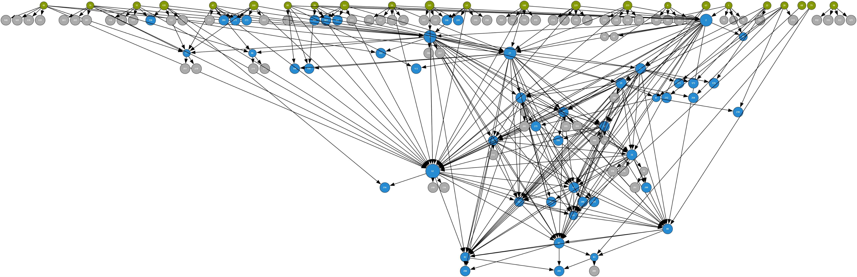
Reachability : Case Study
Pareto Point 1
High Resilience ( Fixed-Wing Heavy)
Densest configuration: full airport mesh + local VTOL clusters. Deepest nesting in the set.
Link reliability decays with distance.
Shorter VTOL/fixed-wing hops are more dependable than long ones; supply hubs are treated as always available.
145 nodes · 327 edges
23 sources → 99 sinks
Max depth 16 · Max |C| 1
IPA: 33.352s total (206 diamonds)
● source nodes ● diamond/join nodes ● other nodes
[1] B. Jones, G. Filippi, T. Basu, B. Parsonage, E. Patelli, C. Maddock, M. Vasile, and M. Fossati, ‘Conceptual design of a medical drone logistics network for Scotland’. Mechanical & Aerospace Engineering and Civil & Environmental Engineering, University of Strathclyde; School of Mathematics, Statistics and Physics, Newcastle University, 2025.

Slide 34
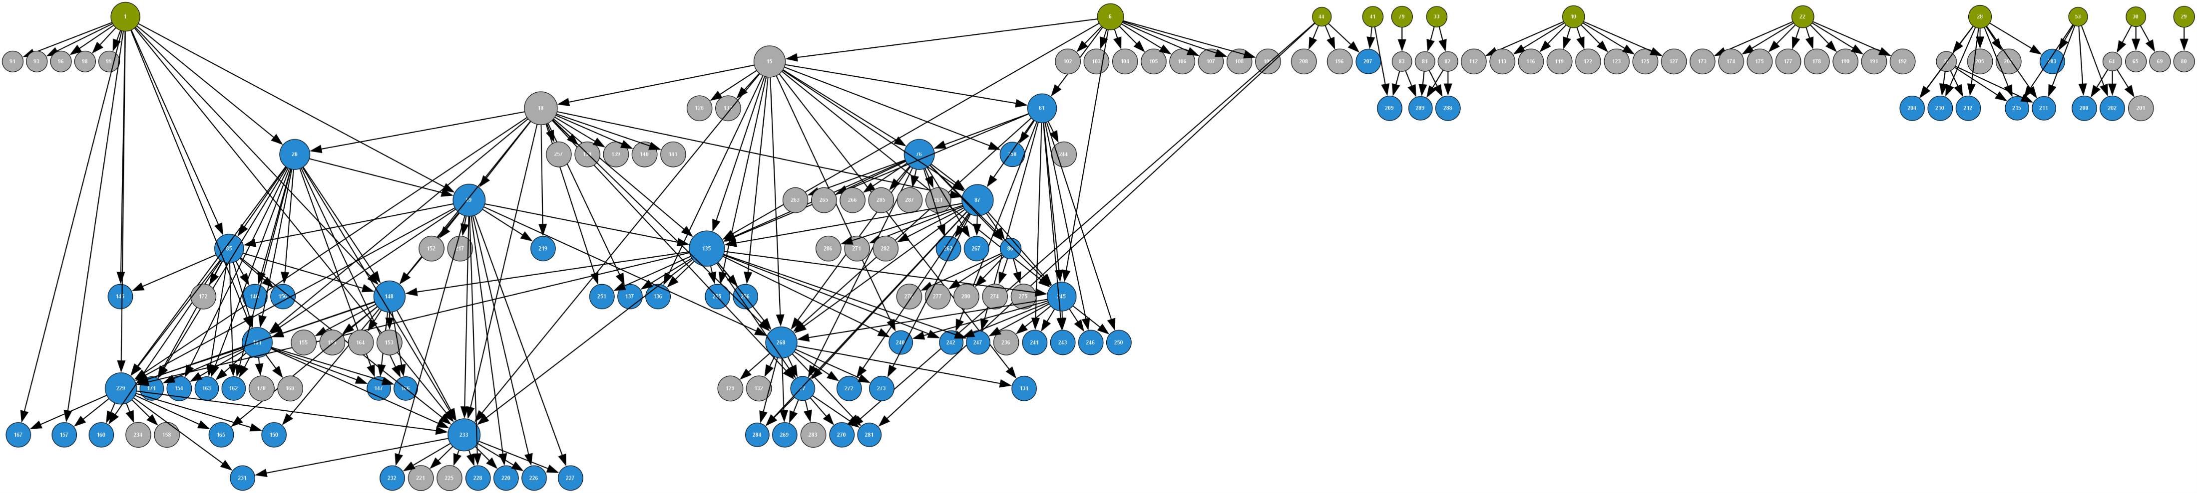
Reachability : Case Study
Pareto Point 2
High Resilience ( Dense VTOL Mesh)
Equivalent resilience to Pareto Point 1 via a different topology: dense VTOL mesh, minimal fixed-wing.
Same distance-decay reliability model as Pareto Point 1, applied to a more decentralised mesh.
165 nodes · 280 edges
12 sources → 131 sinks
Max depth 8 · Max |C| 2
IPA: 0.108s total (155 diamonds)
● source nodes ● diamond/join nodes ● other nodes
[1] B. Jones et al., ‘Conceptual design of a medical drone logistics network for Scotland’, 2025 (full citation on Pareto Point 1).

Slide 35
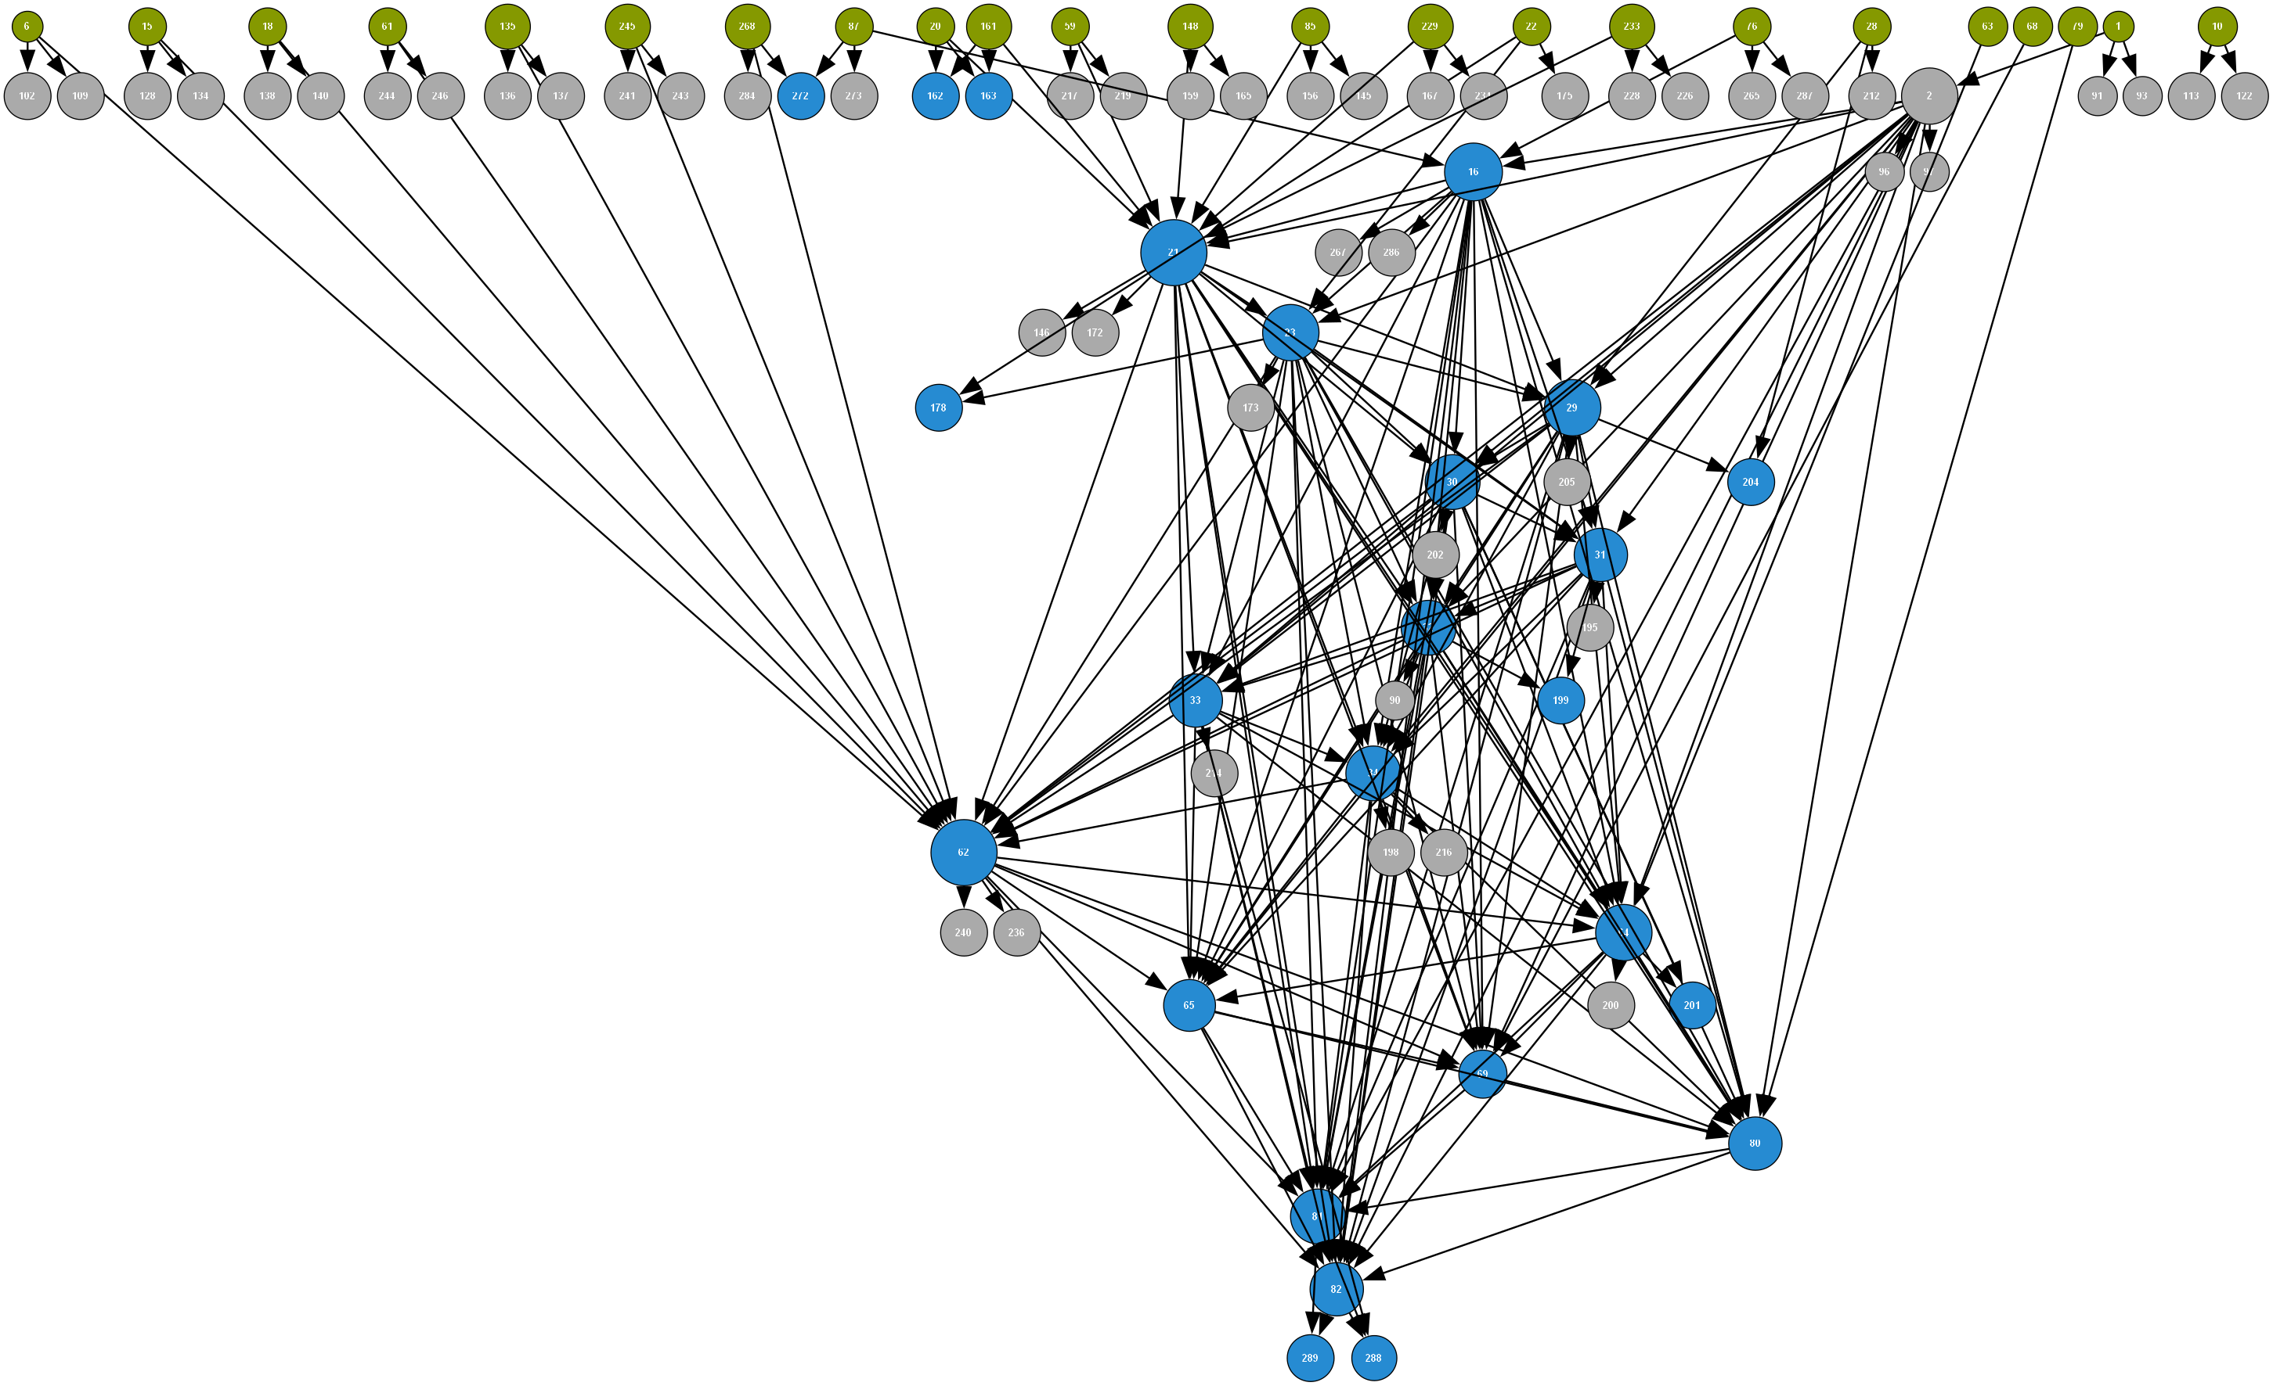
Reachability : Case Study
Pareto Point 3
Medium Resilience (Sparse)
Cost-reduced design: only major airports activated, no intermediate stations. Still depth 16.
Fewer active links overall, but the same distance-based reliability pattern as the denser configurations.
98 nodes · 223 edges
23 sources → 58 sinks
Max depth 16 · Max |C| 1
IPA: 8.325s total (165 diamonds)
● source nodes ● diamond/join nodes ● other nodes
[1] B. Jones et al., ‘Conceptual design of a medical drone logistics network for Scotland’, 2025 (full citation on Pareto Point 1).

Slide 36
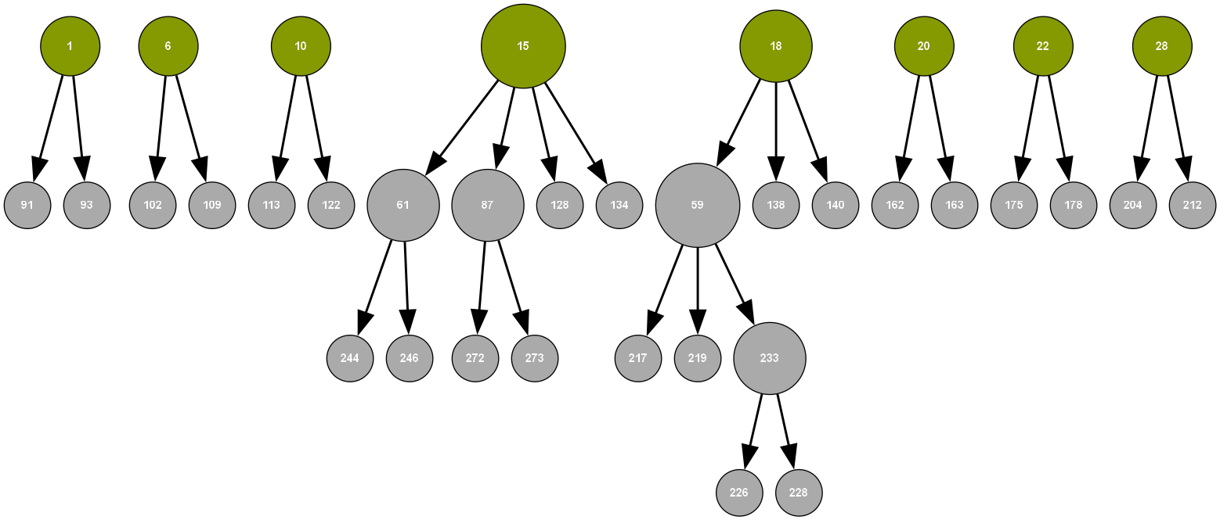
Reachability : Case Study
Pareto Point 4
Low Resilience ( Minimal Tree)
Minimum-cost extreme: one hub per region, spanning tree only. Zero diamonds.
No redundant paths exist, so every receiver depends on exactly one chain of links staying up.
36 nodes · 28 edges
8 sources → 24 sinks
Max depth 0 · Max |C| 0
IPA: <1 ms (0 diamonds - tree structured)
● source nodes ● diamond/join nodes ● other nodes
[1] B. Jones et al., ‘Conceptual design of a medical drone logistics network for Scotland’, 2025 (full citation on Pareto Point 1).

Slide 37
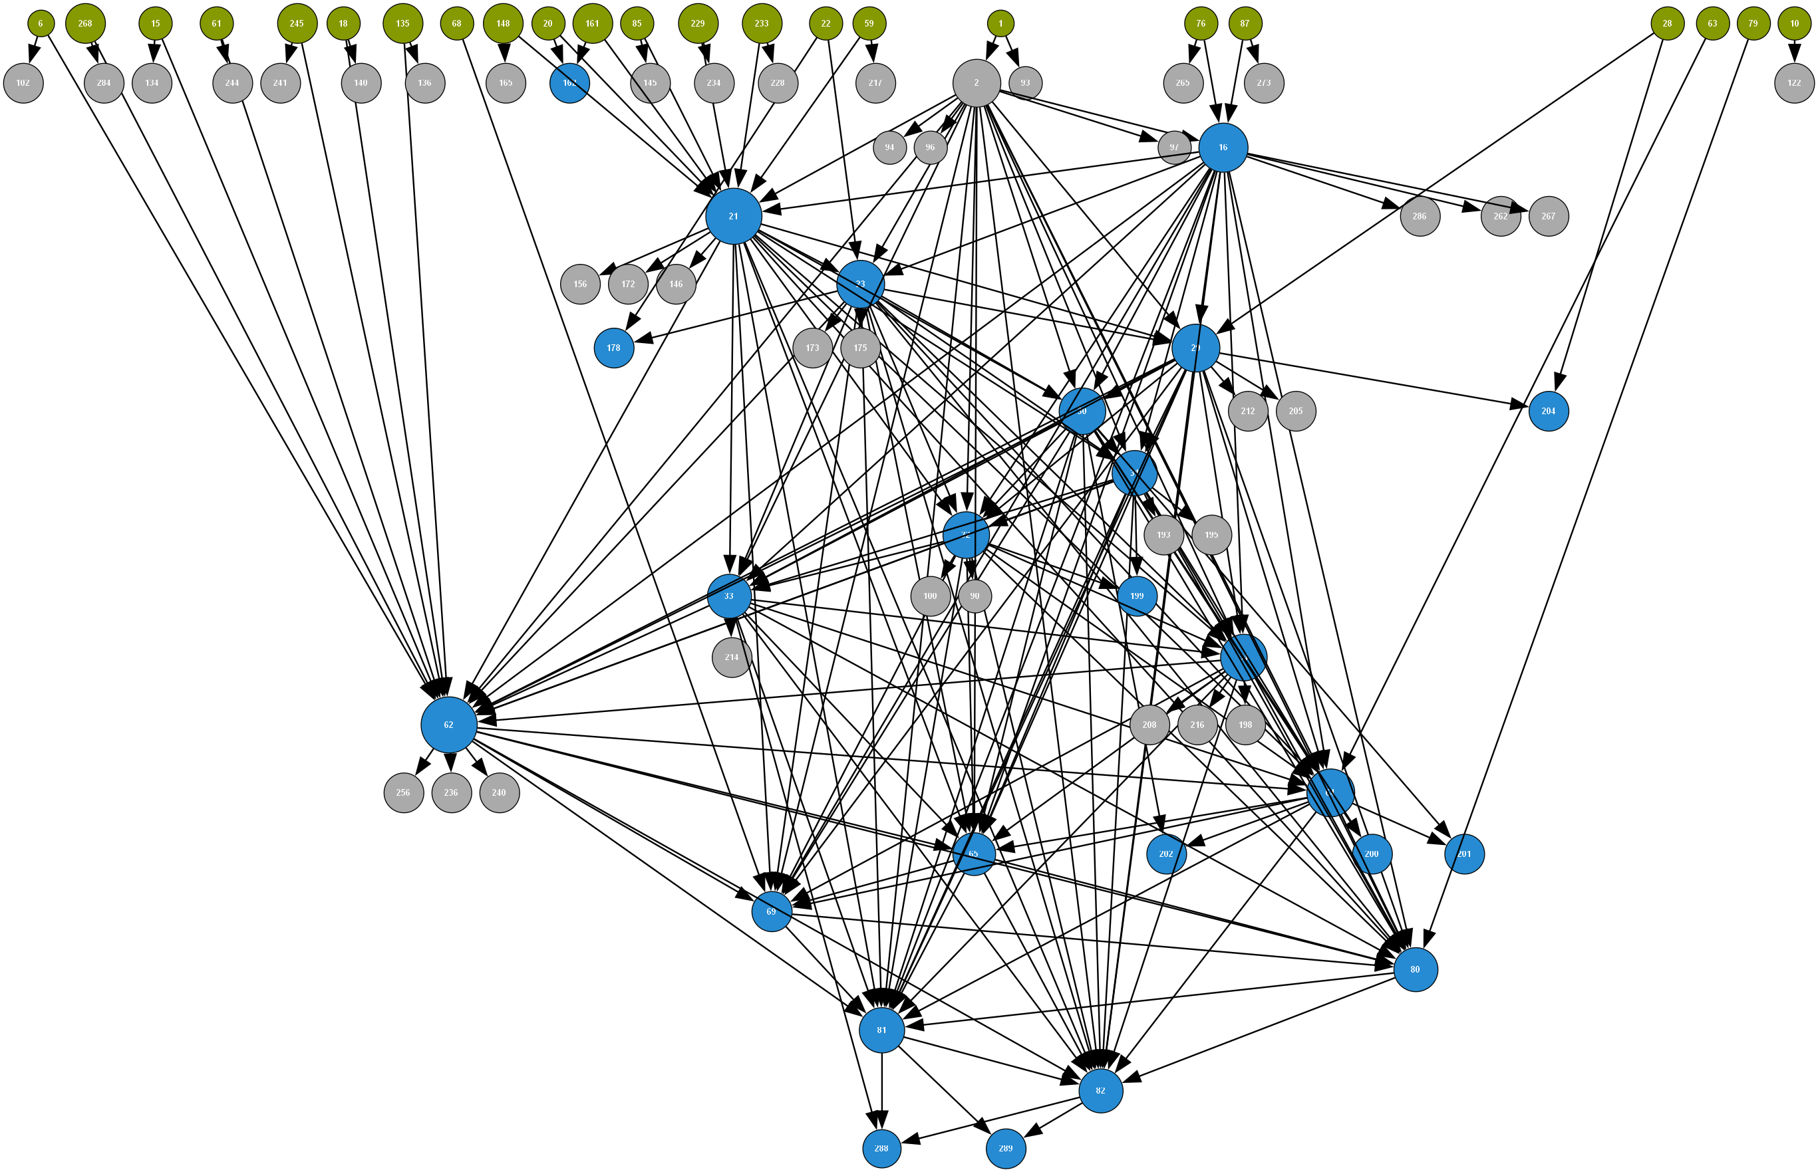
Reachability : Case Study
Pareto Point 5
Medium Resilience (Fixed-Wing Variant)
Airport-centric variant: full airport mesh, single hub-to-airport links. Depth-16 nesting.
Reliability is concentrated in the airport backbone; each hub leans on a single feeder link.
89 nodes · 214 edges
23 sources → 49 sinks
Max depth 16 · Max |C| 1
IPA: 7.733s total (177 diamonds)
● source nodes ● diamond/join nodes ● other nodes
[1] B. Jones et al., ‘Conceptual design of a medical drone logistics network for Scotland’, 2025 (full citation on Pareto Point 1).

Slide 38
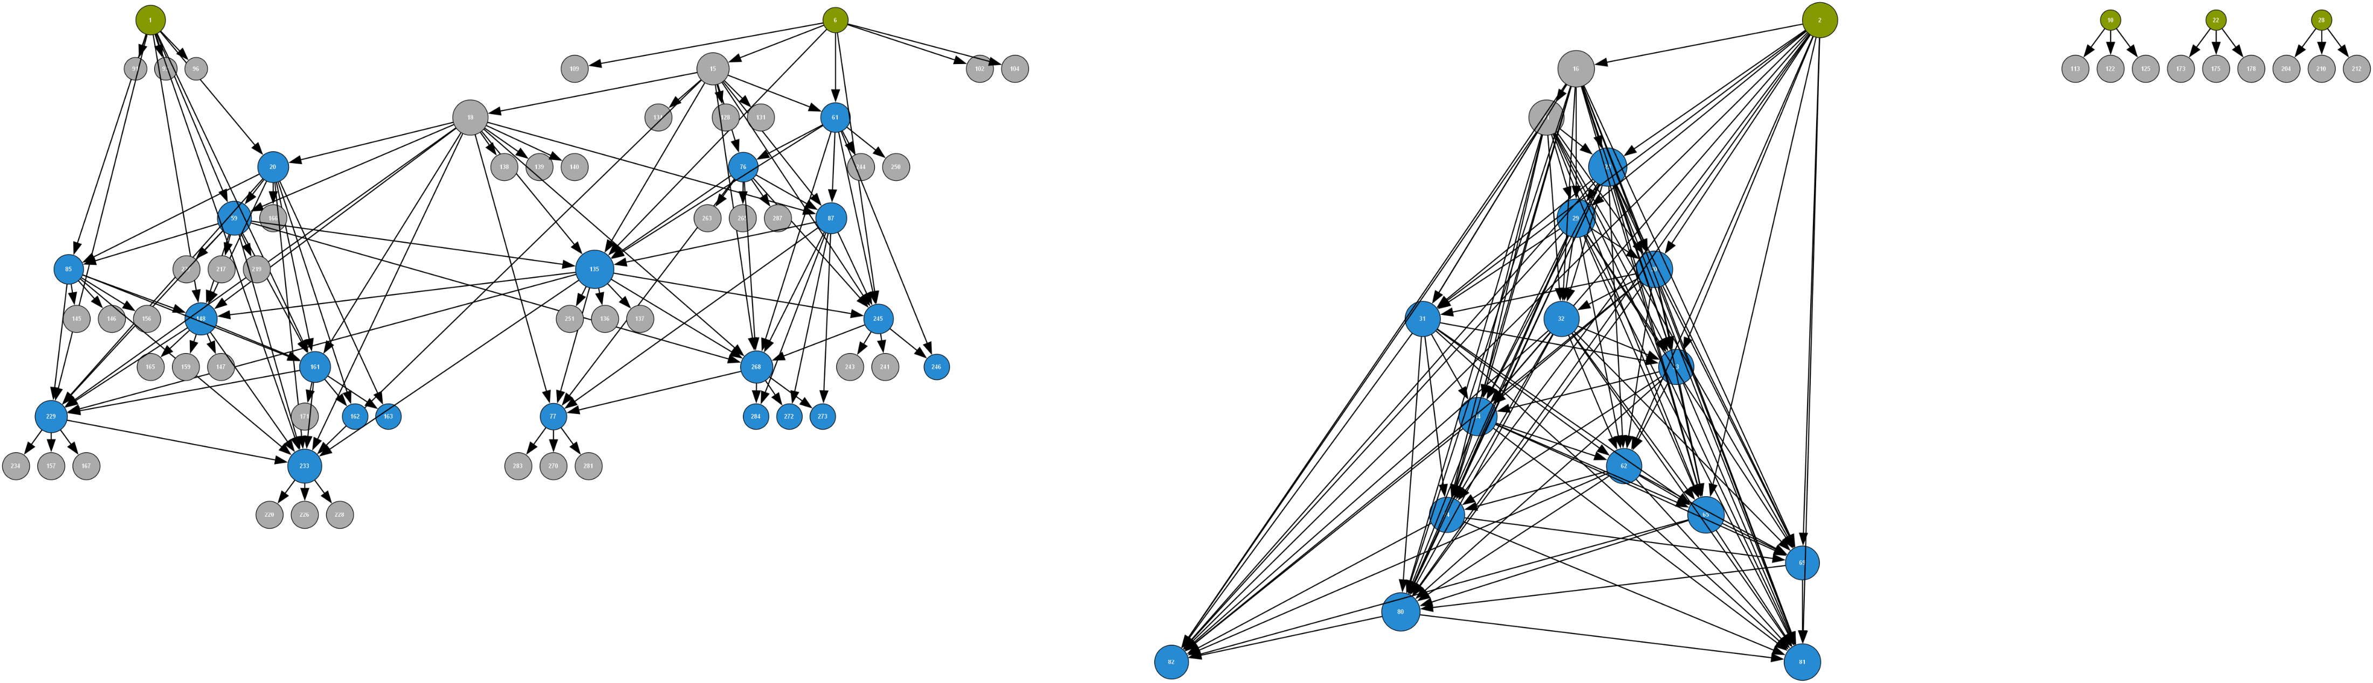
Reachability : Case Study
Pareto Point 6
Balanced
Balanced trade-off: moderate VTOL mesh plus selectively activated bridge stations.
A middle ground between the dense and sparse extremes, in both connectivity and reliability.
95 nodes · 261 edges
6 sources → 59 sinks
Max depth 11 · Max |C| 2
IPA: 0.457s total (144 diamonds)
● source nodes ● diamond/join nodes ● other nodes
[1] B. Jones et al., ‘Conceptual design of a medical drone logistics network for Scotland’, 2025 (full citation on Pareto Point 1).

Slide 39
Reachability : Case Study
Network structure and timing for all 8 networks
Network | Nodes | Diamonds | Max Depth | Max |C| | Decomp (s) | Prop (s) | Total (s)
PP4 | 36 | 0 | 0 | 0 | 0.000 | 0.000 | 0.000
MUNIN | 1,041 | 216 | 3 | 8 | 0.535 | 2.308 | 2.843
METRO | 306 | 99 | 5 | 2 | 0.084 | 0.057 | 0.141
PP2 | 165 | 155 | 8 | 2 | 0.036 | 0.071 | 0.108
PP6 | 95 | 144 | 11 | 2 | 0.025 | 0.432 | 0.457
PP5 | 89 | 177 | 16 | 1 | 0.088 | 7.645 | 7.733
PP3 | 98 | 165 | 16 | 1 | 0.095 | 8.230 | 8.325
PP1 | 145 | 206 | 16 | 1 | 0.993 | 32.359 | 33.352
Max depth drives runtime more than node count. The three MaxD=16 networks span a 1.6× size range yet all fall in the 7–33s band
Within that band, the secondary driver is unique diamond count (177 → 165 → 206), consistent with PP1 being the slowest despite mid-range node count.
MUNIN is the |C| counterpoint. It is the shallowest network and should be fast, and it is (2.84s). But it costs more than METRO, PP2, and PP6 combined, solely because Max|C|=8 forces 2^8=256 conditioning states per diamond join.
Depth and conditioning width are independent cost axes; neither can be ignored.
In deeply nested networks, the propagation phase which in the worst case of no cache hits enumerates all conditional state combinations recursively dominates computing time

Slide 40
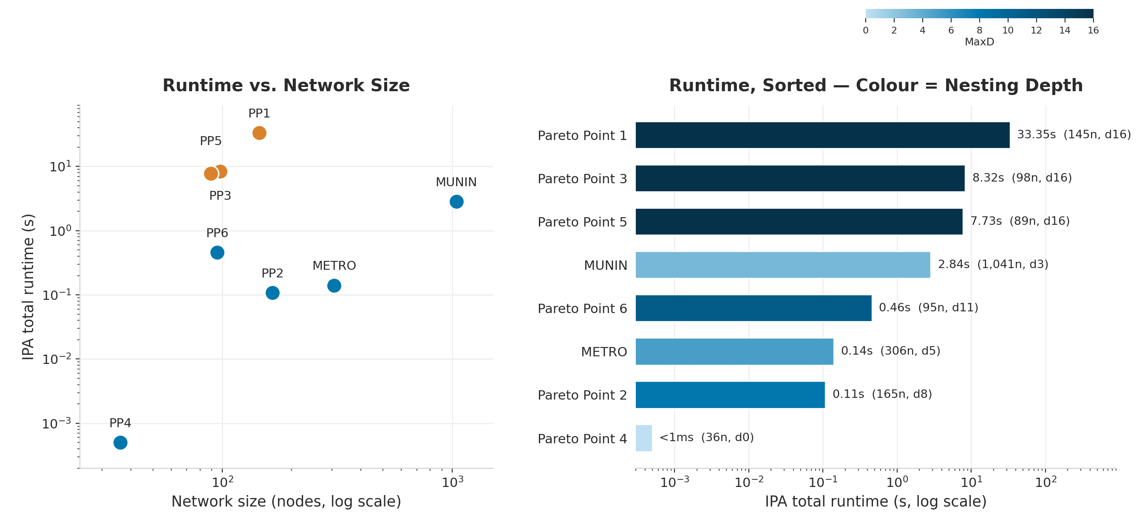
Reachability : Case Study
(1) Depth predicts cost
Network size ranges 36–1,041 nodes with no consistent relationship to runtime
Two orthogonal axes set the worst case per join (right): nesting depth (MaxD) and conditioning width (|C|).
MUNIN is shallow but wide with 2⁸ = 256 states, across only 3 levels.
The drone networks are narrow but deep with 2¹ = 2 states, across 16 nested levels
Among networks at the same depth, diamond count is the secondary driver: Pareto Point 1's 206 diamonds vs. Point 3/5's ~170 explains its 4× longer runtime, despite all three sharing MaxD = 16

Slide 41
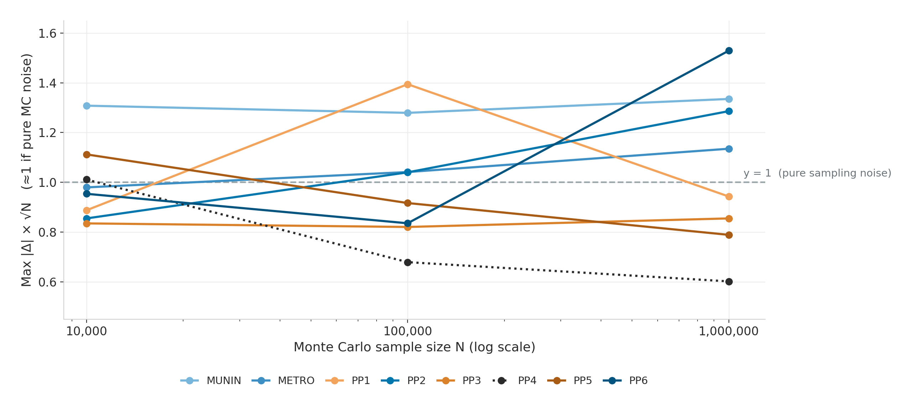
Reachability : Case Study
(2) Still exact, for all nodes
IPA accuracy for every node is validated against Monte Carlo runs at three sample sizes (10K, 100K, 1M), across all 8 networks
Every network tracks the theoretical 1/√N sampling-noise floor almost exactly regardless of size, depth, or structure
The practical trade-off: IPA matches or beats MC even at 10K samples for most networks; where it's slower (the depth-16 trio, 10–30s), it still gives an exact answer that MC at 1M samples still can't guarantee

Slide 42

The Information Propagation Framework
One shared network model, defined once, reused across all three:
Critical Path
best/worst outcome along dependency paths
exact via forward/backward pass, single pass
Flow Capacity
how much can actually be delivered
exact via max-flow + reusable diagnostics
same F⋆, very different bottleneck and upgrade story
Reachability
probability a path survives despite failures
exact via diamond decomposition + supernode caching
nesting depth, not size, governs tractability

