Slide 1


Trans-ethnic GWAS pipeline
#NEUROHACK
By Code B(re)akers: Eric Yu, Temitope Leke

Slide 2
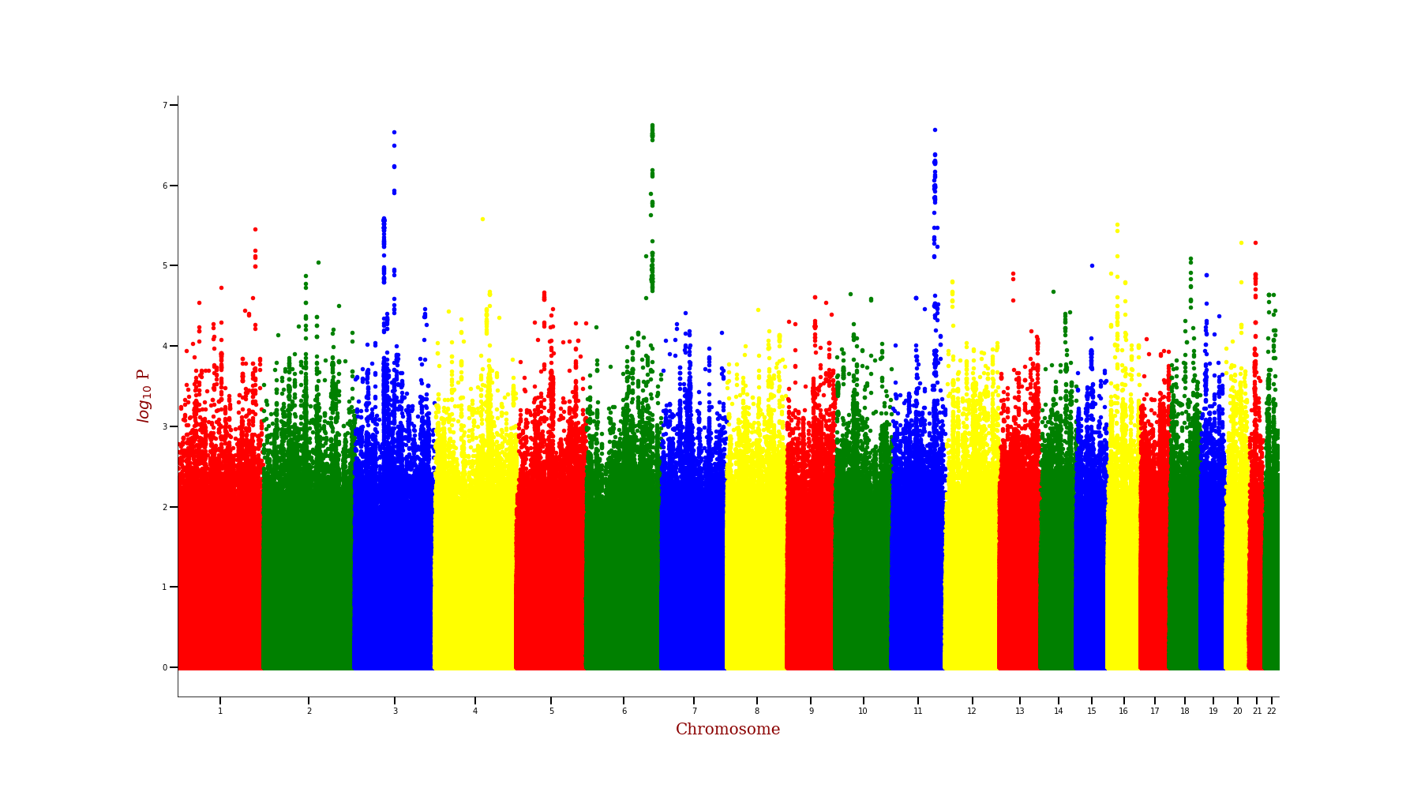
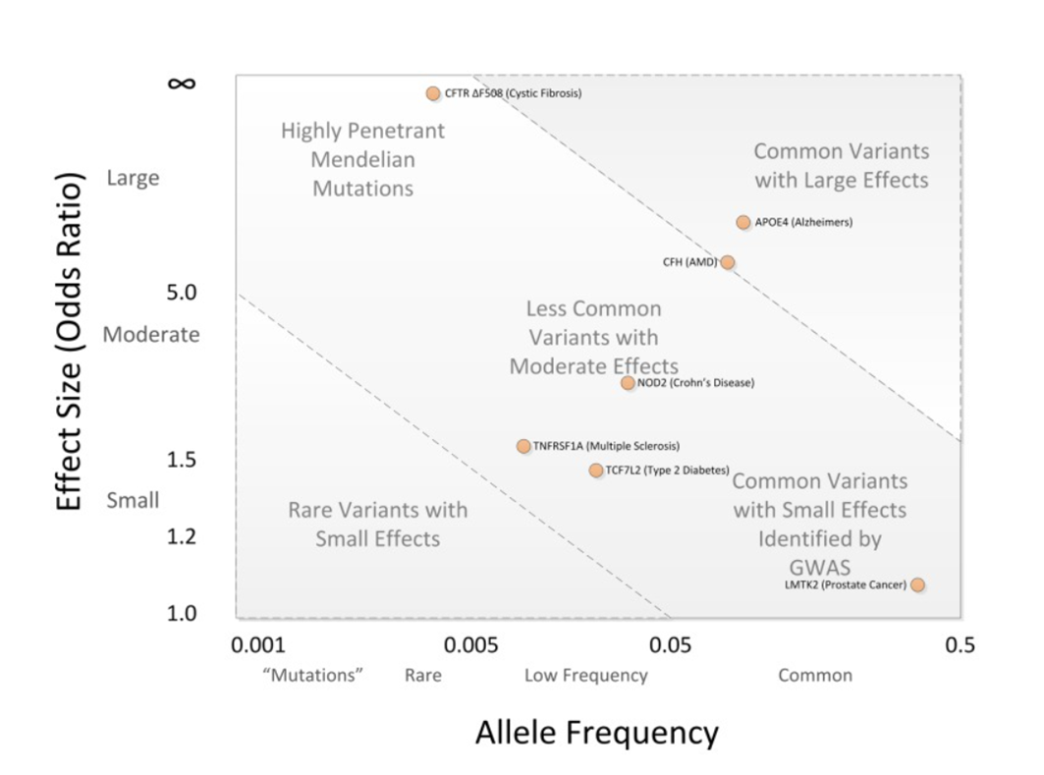
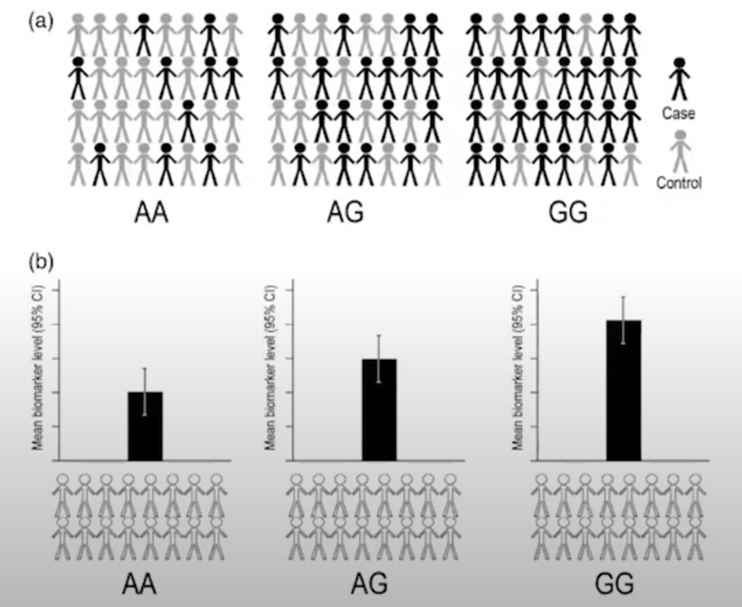
What is a GWAS?

Slide 3
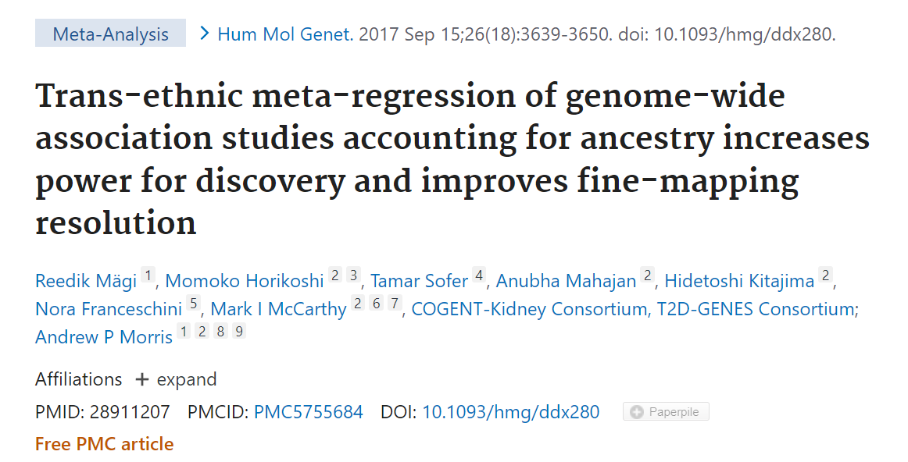
Trans-ethnic analysis
Combine cohorts of different ancestral population
Validate findings from different populations

Slide 4
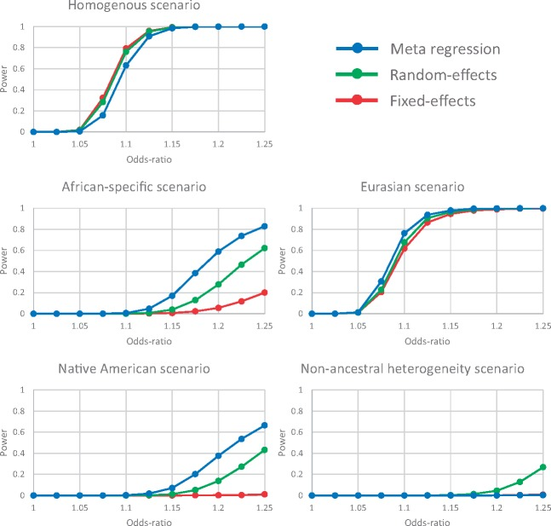
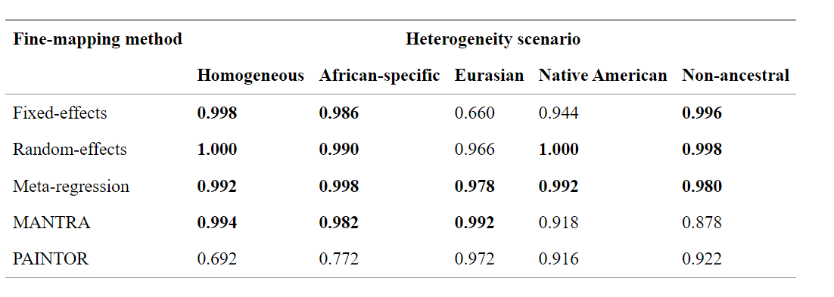
MR-MEGA
Notes:
These scenarios incorporated heterogeneity in allelic effects of the causal variant between ancestry groups: (i) homogenous; (ii) African-specific; (iii) Eurasian; (iv) Native American; (v) random (non-ancestral). Under model (i), the allelic effect of the causal variant is homogeneous across all populations. Under model (ii), the allelic effect of the causal variant is specific to populations of African ancestry. Under model (iii), the allelic effect of the causal variant is zero in populations of African ancestry, and heterogeneous between populations of East Asian ancestry and those of European, South Asian and Native American ancestry. Under model (iv), the allelic effect of the causal variant is specific to, but heterogeneous between, populations of Native American ancestry. Finally, under model (v), the allelic effect of the causal variant is specific to one population in each ancestry group.

Slide 5
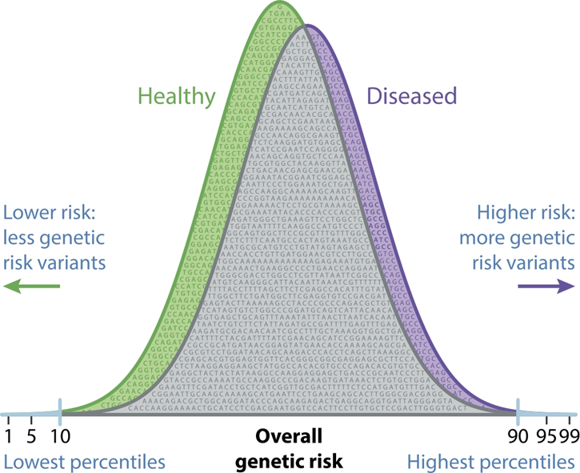
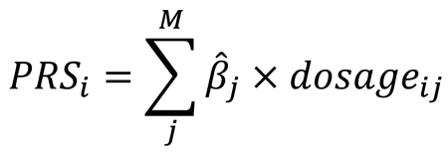
Polygenic risk score
Individual level risk score for heritable trait

Slide 6

Datasets involved
LASI-DAD
Genotype data
Phenotype data
European AD GWAS summary statistics
Japanese AD GWAS summary statistics
Africain AD GWAS summary statistics

Slide 7
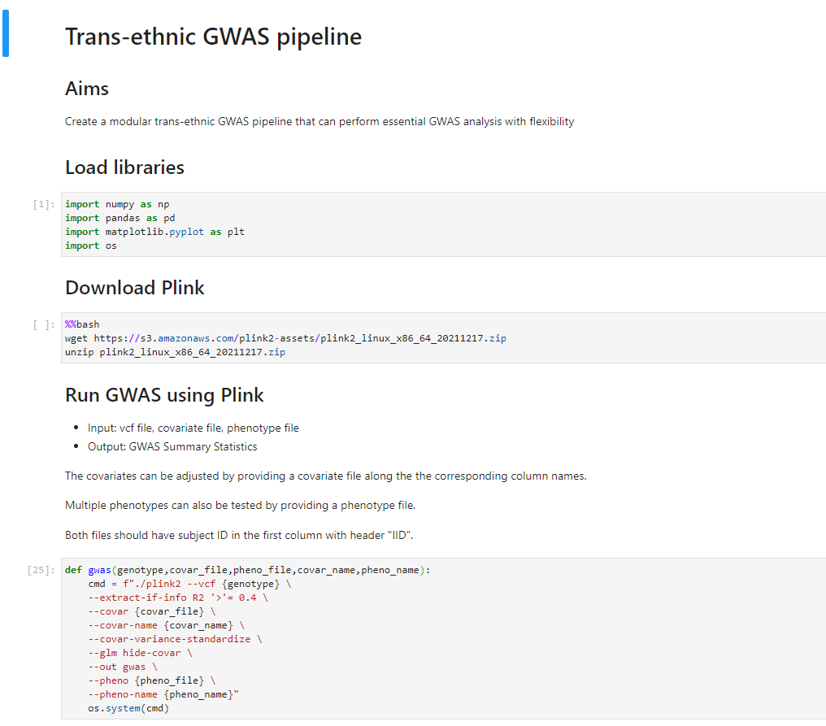
Trans-ethnic GWAS pipeline
Step-by-step instructions
Standard software
GWAS (PLINK)
Trans-ethnic analysis (MR-MEGA)
Polygenic risk score calculations (PRSice)
Includes dedicated function to visualize results, in-depth explanation of required input files for each analysis
Modular functions if the user wishes to employ other methods not implemented in the notebook

Slide 8
Future directions
Additional downstream GWAS analysis
Include forest plots, QQ-plot

Slide 9

Questions

