Slide 1
Developing data pipelines with Azure synapse
By Temi | November 29, 2023

Slide 2
Agenda
Content
Page
Big Data Integration with Azure Synapse
Synapse Features
Pipeline Components
ETL Pipeline Demo – Developer Productivity Tracking
3
4
5
8

Slide 3
Big Data Integration with Azure Synapse
Data Warehousing and Connectors for External Data Sources
Dedicated SQL Pools for Data warehousing
01
02
Data Pipeline Orchestration
Big Data Spark Clusters and Development Environment
Built-in ETL pipeline Orchestration components
03
Spark Pools and Development Notebooks

Slide 4
Azure Synapse Features
1
Linked Services
4
Version Control with Git
Stores connection information to external datasources or compute like storage account, Azure SQL DB (postgres, mysql), Azure Keyvault
Git integration with Github or Azure pipelines
2
Integration Datasets
5
Database Objects
Stores connection information to datasets themselves
Schemas
Tables and Views
Store procedures
3
Integration Runtime
6
Synapse Pipelines and activities
It is referenced by a linked service or a pipeline activity
Provides compute where pipeline activity is dispatched
Types: Azure or Selfhosted
Orchestrate ETL pipelines using components / activities

Slide 5
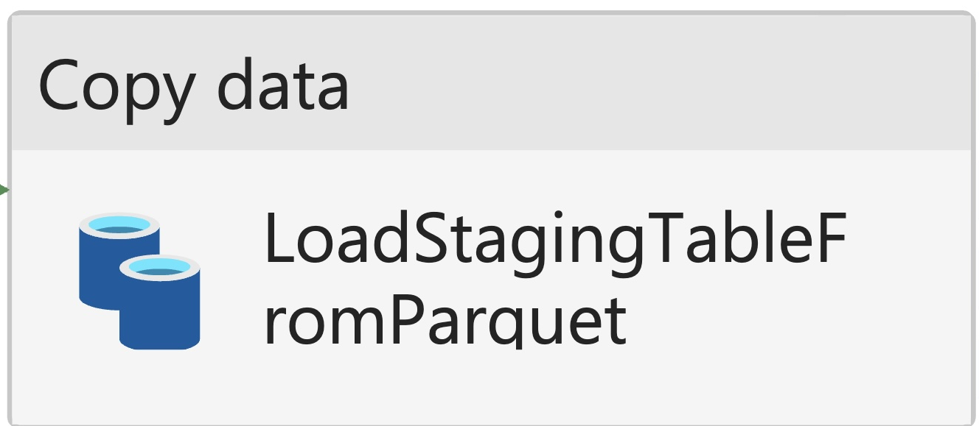
Pipeline Components – Copy Data Activity
Copy data from one location to another
From SQL Server database to Storage account in Parquet format.
Copy text files (CSV) format from an on-premises file system and write Storage account in Avro format.
Copy data from Storage account to SQL Pool

Slide 6
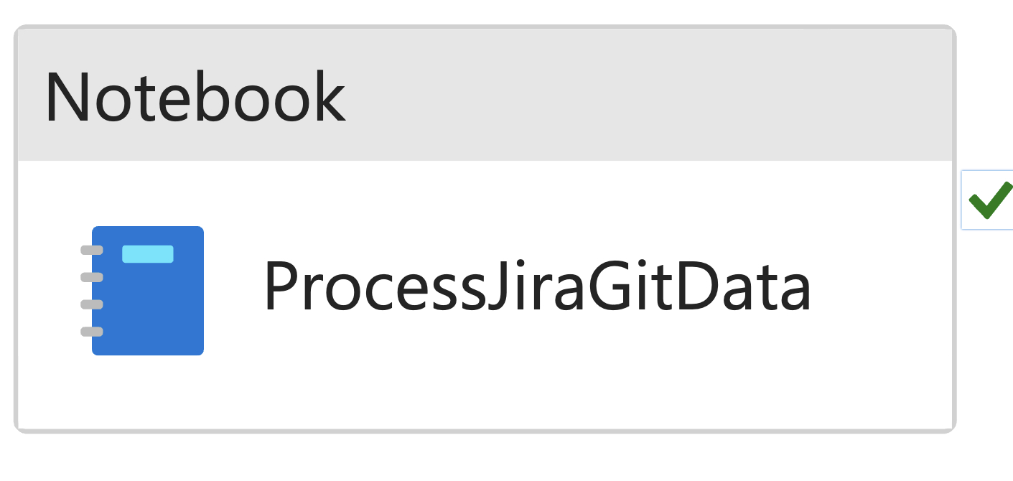
Pipeline Components – Notebook Activity
Run a Notebook on a Spark Pool
Process data in Storage account using Pyspark and Pandas
Save data to storage account using the abfss protocol (managed identity of synapse requires Storage Blob Contributor IAM permission)

Slide 7
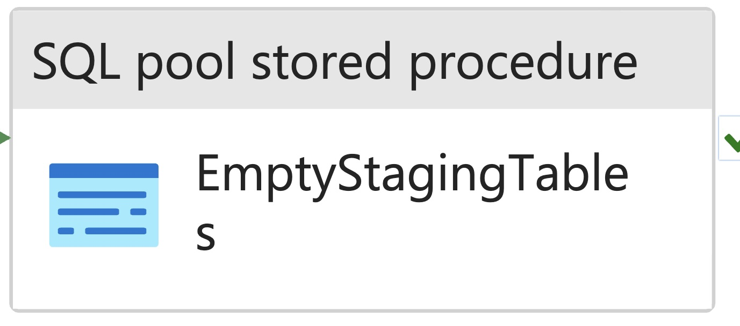
Pipeline Components – Stored Procedure Activity
Run a stored procedure in the Dedicated SQL pool
Execute stored procedures written in TSQL in an ETL pipeline

Slide 8

ETL Pipeline Demo – Developer Productivity Tracking
Scenario
External data from Git and Jira is integrated into our Datawarehouse in Synapse.
Given information on our projects, developers and their activity on Github and Jira, KPIs are created to measure their productivity.

Slide 9
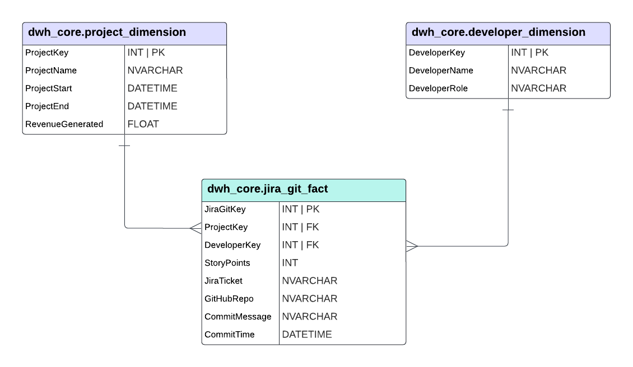
ERD Diagram

Slide 10
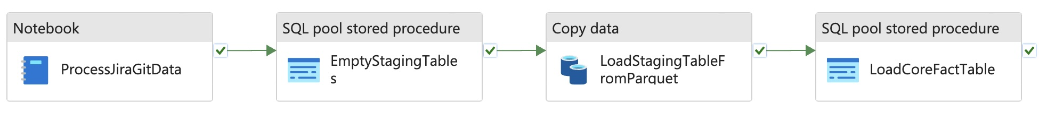
Developer Productivity Pipeline for Jira Git Table
Notebook: process the jira_git_fact.csv into jira_git_fact.parquet
CopyData: copy from jira_git_fact.parquet into staging table – dwh_staging.jira_git_fact
Stored Procedure: copy from dwh_staging.jira_git_fact into core table - dwh_core.jira_git_fact

Slide 11
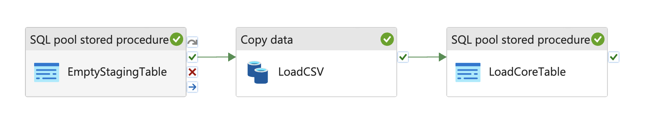
Load CSV Pipeline for Developer and Project Tables
CopyData: copy from developer_dimenson.csv into staging table – dwh_staging.developer_dimension
Stored Procedure: copy from dwh_staging.developer_dimension into core table - dwh_core.developer_dimension

Slide 12
Load CSV Pipeline Parameters
PARAMETER NAME | DEVELOPER_DIM_VALUES | PROJECT DIM VALUES
CsvFolder | bronze/developer_dim | bronze/project_dim
CsvFileName | developer_dimension.csv | project_dimension.csv
StagingStoredProcedure | dwh.empty_staging_tables | dwh.empty_staging_tables
CoreStoredProcedure | dwh.load_core_developer | dwh.load_core_project
StagingTableName | developer_dimension | project_dimension

Slide 13
Thank you

