Slide 1
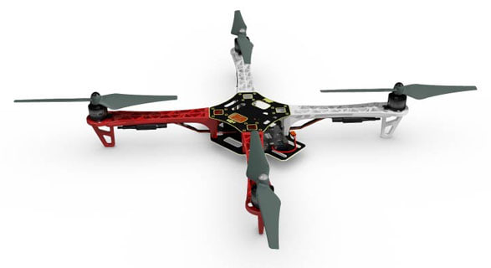
Drone
Done by: Boltay Temirbek

Slide 2
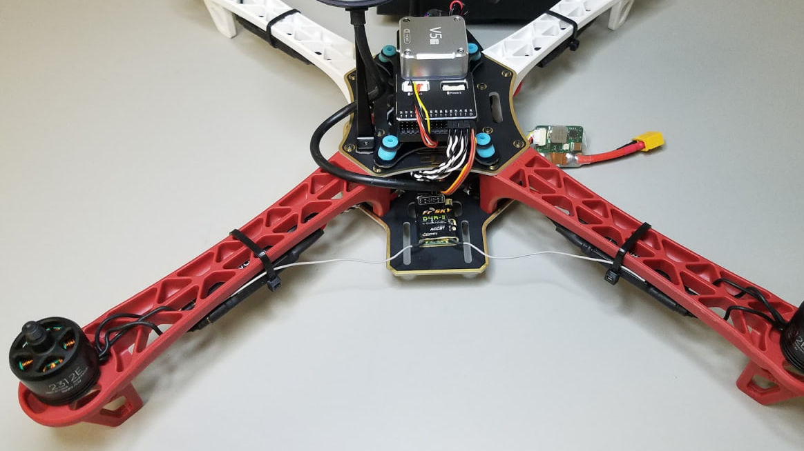
Project Description
This project focuses on designing a fully engineered quadcopter drone using SolidWorks. The goal was to create a lightweight, stable, and structurally efficient frame suitable for educational, prototyping, or experimental use. The design includes four motor arms arranged in an “X” configuration, a central body for electronics, and reinforced motor mounts to maintain rigidity during flight.

Slide 3
Component Descriptions
Part 1
Electrical Connector
Provides electrical interfacing between the power distribution board and individual electronic units. Ensures stable power transfer throughout the drone.
Spider_Base
The lower structural plate of the main body. It serves as the foundation for assembling arms, electronics, and mounting hardware.
Spider_Top
The upper body cover. It protects internal components and provides mounting points for the battery and electronic units.
Battery
The main power source of the quadcopter. Positioned centrally to maintain balance and proper weight distribution.
Motor
Brushless motors that generate the thrust required for lift and maneuvering. Four identical units are mounted at the ends of each arm.
Fan (Propeller)
Rotating blades attached to the motors. They convert motor torque into aerodynamic lift.
Piller
Vertical standoffs used to connect the Spider_Base and Spider_Top while maintaining a fixed spacing between the plates..

Slide 4
Component Descriptions
Part 2
Spinner
The attachment component that secures the propeller to the motor shaft.
Pan
A structural or mounting plate (depending on your design). It assists in supporting smaller electronic modules or reinforcing the frame.
Hex (Hex Bolt)
Fasteners used to secure parts such as arms, plates, and mechanical components.
Spider_Arm
The main frame arms that extend from the body and hold the motors. Designed with lightweight truss geometry to ensure strength with minimal mass.
Spacer
Small cylindrical components used to maintain precise distances between assembled parts.
Distribution_Board
The power distribution board that routes battery input to motors and electronic modules. Central to the drone’s electrical system.
Electrical_Unit1 & Electrical_Unit2
Electronic modules (such as flight controller, ESC, or sensor units). These components manage control signals, stabilization, and power regulation

Slide 5
Table Of Components
Component | Quantity | Purpose / Function
Spider_Base | 1 | Lower main body structure
Spider_Top | 1 | Upper protective body cover
Spider_Arm | 4 | Arms supporting motors & propellers
Motor | 4 | Provides rotational thrust
Fan (Propeller) | 4 | Generates lift from motor rotation
Spinner | 4 | Secures propellers to motor shafts
Electrical Connector | 4 | Power and signal connection
Distribution_Board | 1 | Distributes power to electrical units & motors
Electrical_Unit1 | 1 | Control/power electronics
Electrical_Unit2 | 1 | Control/power electronics
Battery | 1 | Power supply for entire drone
Piller (Standoff) | 4 | Maintains spacing between top and base
Spacer | 4 | Ensures correct spacing/alignment
Pan | 1 | Support or mounting plate
Hex (Bolts/Screws) | Many | Fastens arms, plates, and components

Slide 6
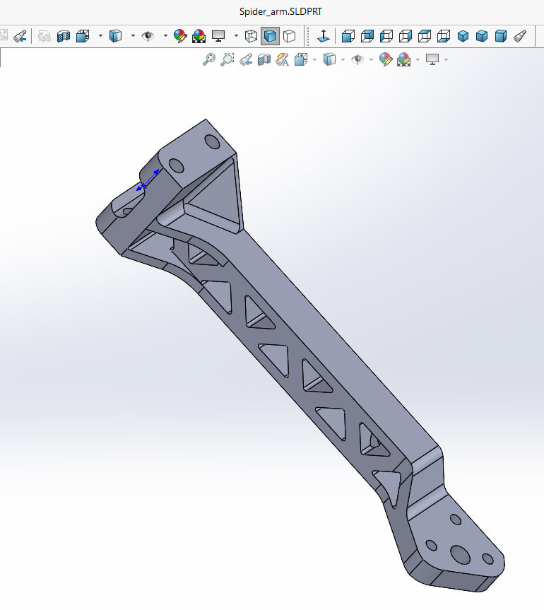
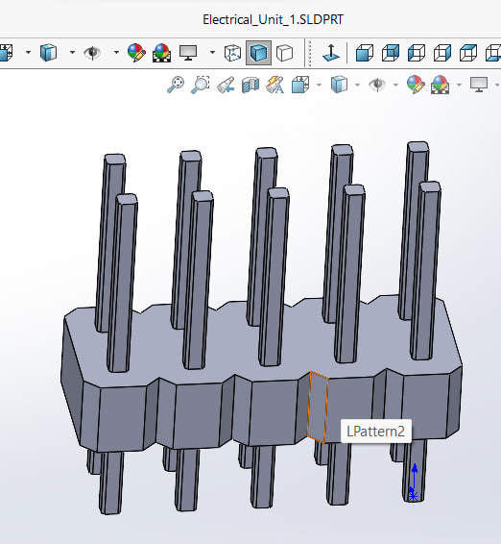
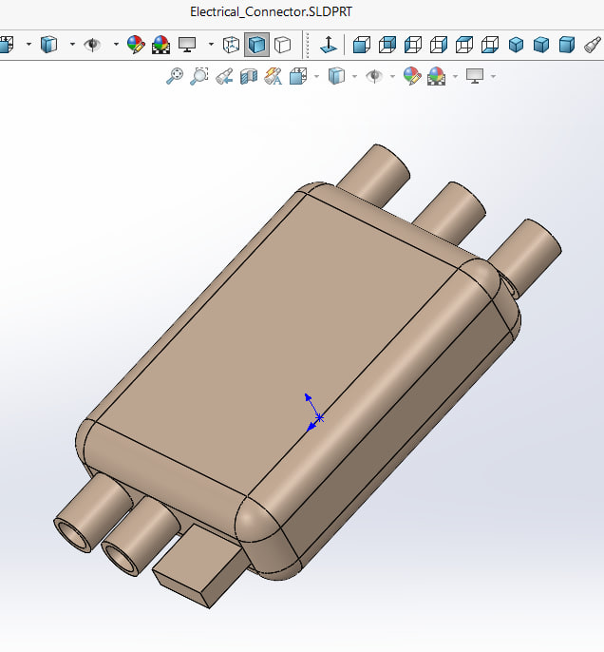
3D Models Of Components Part 1
Electrical Connector
Provides electrical interfacing between the power distribution board and individual electronic units. Ensures stable power transfer throughout the drone.
Electrical_Unit1 & Electrical_Unit2
Electronic modules (such as flight controller, ESC, or sensor units). These components manage control signals, stabilization, and power regulation
Spider_Arm
The main frame arms that extend from the body and hold the motors. Designed with lightweight truss geometry to ensure strength with minimal mass.

Slide 7
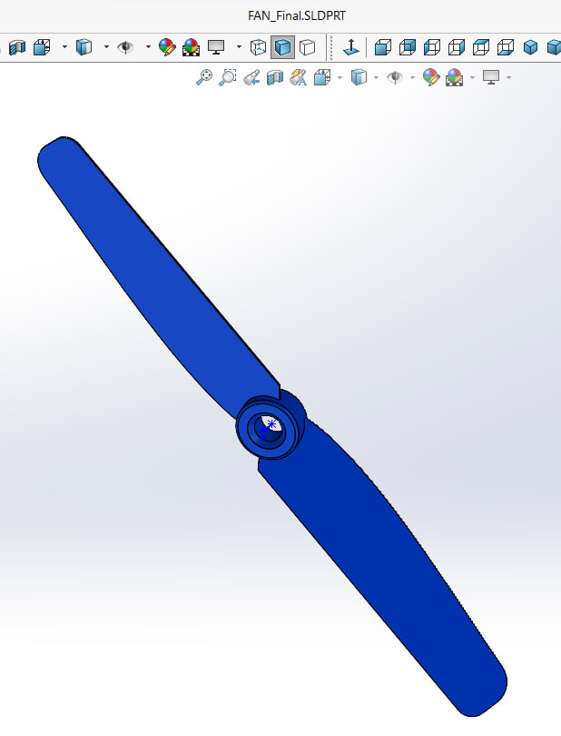
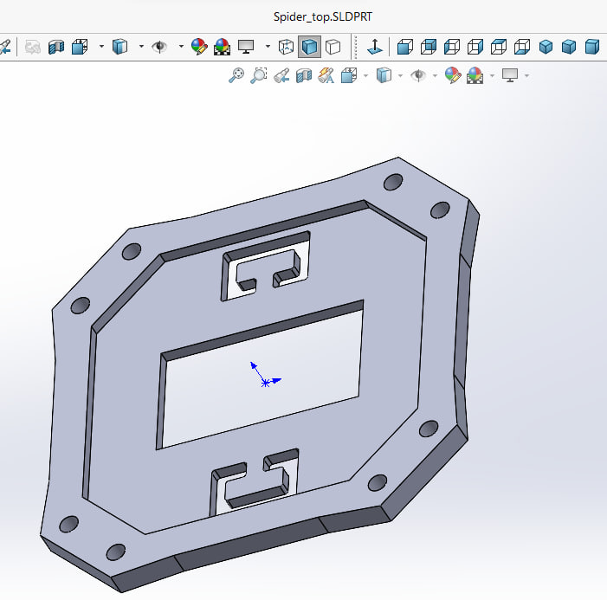
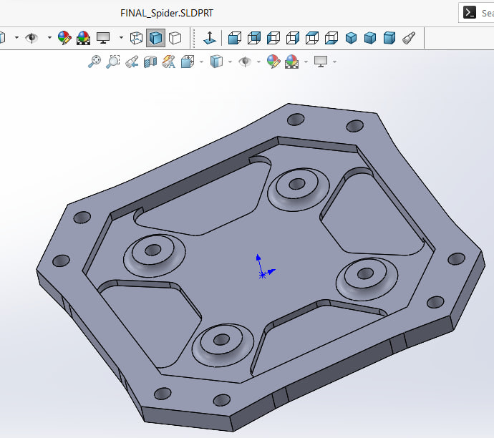
3D Models Of Components Part 2
Fan (Propeller)
Rotating blades attached to the motors. They convert motor torque into aerodynamic lift.
Spider_Base
The lower structural plate of the main body. It serves as the foundation for assembling arms, electronics, and mounting hardware.
Spider_Top
The upper body cover. It protects internal components and provides mounting points for the battery and electronic units.

Slide 8
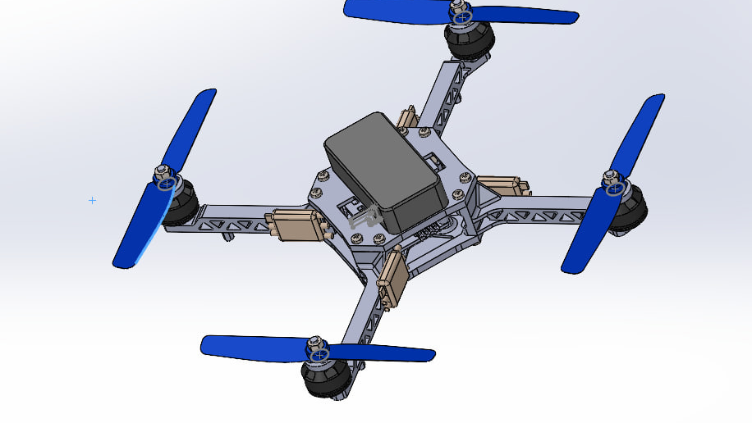
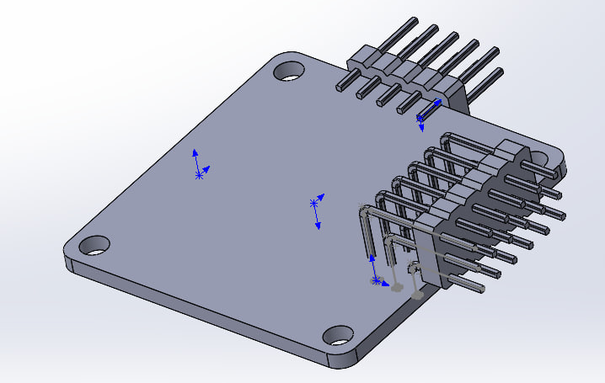
3D Models Of Assemblies
Here I used only two assemblies before constructing whole drone. First, I assembled both electrical Units with Distribution Board. Then Final Project – Drone.

Slide 9
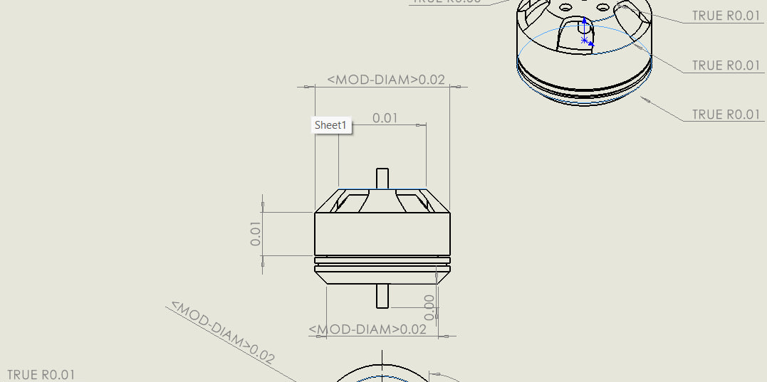
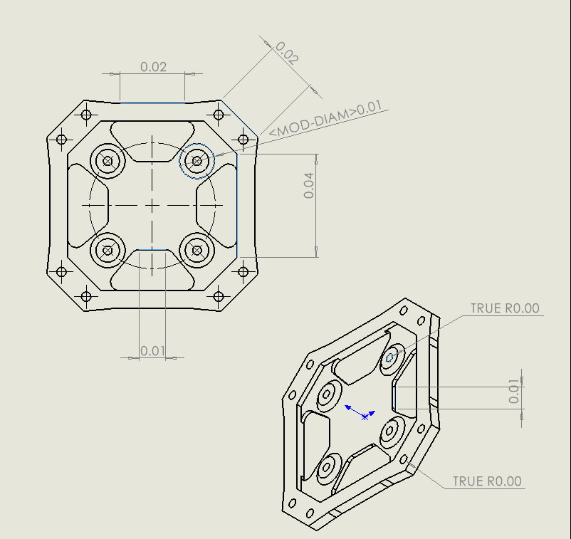
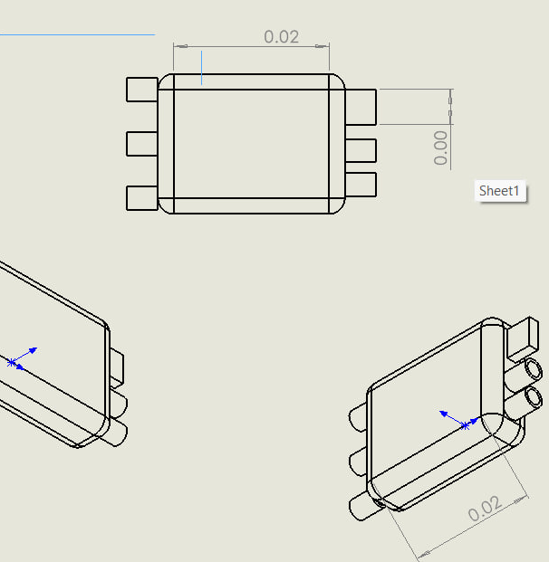
3D Engineering Drawings & Documentation Part 1

Slide 10
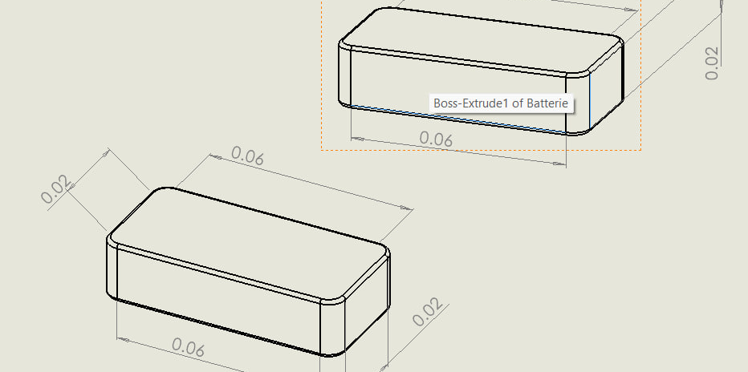
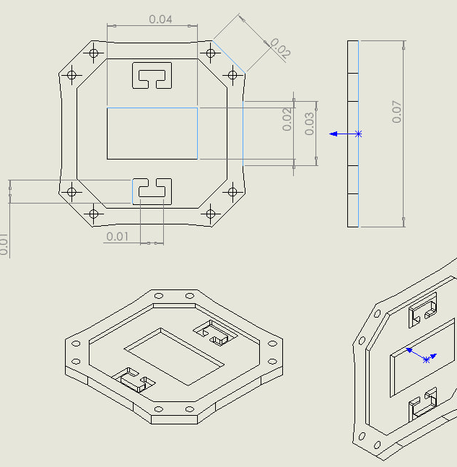
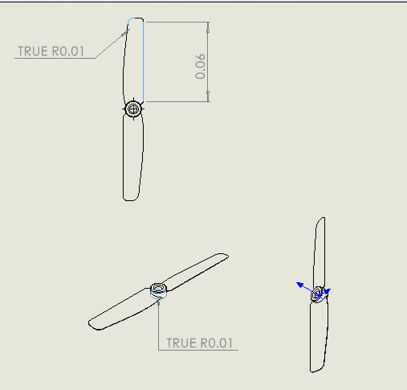
3D Engineering Drawings & Documentation Part 2

