Slide 1


Accelerating SocialBuzz's Growth Through Data-Driven Content

Slide 2


Today's agenda
Project recap
Problem
The Analytics team
Process
Insights
Recommendations
Summary

Slide 3
Social Buzz, launched in 2008 by two ex-engineers, tracks user reactions to content anonymously. They offer over 16 reaction types to emphasize trending content rather than individual users.
Assess Social Buzz's current data management practices to ensure they are scalable and efficient.
Extract and merge datasets (content and reactions) to analyze user interactions and content popularity.
Identify the top 5 most popular content categories based on aggregated user reactions.
Provide data-driven insights and best practices to help Social Buzz scale effectively and prepare for their IPO.
Project Recap
Notes:
IPO – Initial Public Offering

Slide 4

Problem
Social Buzz, managing 500 million active users and 100,000 daily content posts, faces challenges with its 1TB+ of unstructured data. To support their upcoming IPO, they need advanced analytics to analyze content popularity, streamline data practices, and identify key trends from their extensive data. Without these insights, they risk inefficient scaling and a potentially unsuccessful IPO.

Slide 5



Giwa Temitopeoluwa Data Analyst
The Analytics team
Julia Hendrie Industry Associate
Andrew Fleming Chief Technical Architect

Slide 6
Process
1
Requirements Gathering
2
Data Cleaning
3
Data Modelling
4
Data Analysis
5
Data Reporting

Slide 7

Insights
-47.97%
16
January
% month over month change in content popularity
number of unique reaction types
month that had the most posts put up

Slide 8
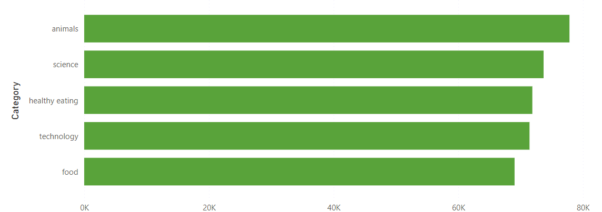
Top 5 most popular content categories

Slide 9
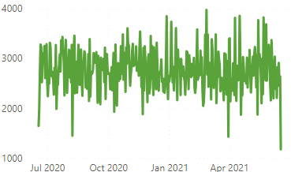
Rapid decrease in content popularity over the years

Slide 10
Recommendations
Focus on promoting top categories like Animals and Technology to drive higher user engagement and visibility..
Utilize reaction insights to tailor content recommendations, ensuring that users see more of what they enjoy and engage with positively.
Introduce new interactive content such as polls, challenges, and live events to re-engage users and stimulate more frequent interactions.
Enhance data management systems to efficiently handle growth and ensure they meet the necessary standards for a successful IPO.

Slide 11

The analysis revealed that Animals and Technology are the most engaging content categories, while overall content popularity has declined by 47.97%. By leveraging reaction data to personalize content, introducing interactive formats, and upgrading data infrastructure, SocialBuzz can address these challenges effectively. Implementing these strategies will help boost user engagement, prepare for the IPO, and ensure continued growth and success.
Summary

Slide 12

Thank you!
ANY QUESTIONS?

