Slide 1
COASTAL NEST MOTEL
MIS775: DECISION MODELLING FOR BUSINESS ANALYTICS
Name: Duong Ngoc Phuong Trang
Student ID: 223990468

Slide 2
Company background
About company
Coastal Nest Motel is a boutique-style accommodation inspired by the Airbnb model. It is located along a popular beachside tourist route that attracts a large number of domestic and international visitors, particularly during holidays and peak travel seasons. With a total of 20 standard rooms, the motel provides a cosy and private experience ideal for families, couples, and solo travellers seeking affordable and distinctive stays.
Business Context & Challenges
As the travel season approaches, the motel faces several operational challenges:
Managing fluctuating room availability and booking patterns.
Optimising daily room rates to maximise revenue while maintaining guest satisfaction.
Handling late cancellations and overbooking risks that can lead to lost income and negative customer experiences.
Leveraging digital marketing, especially social media channels like Instagram and TikTok, to boost online reservations and engagement.

Slide 3
Company background
Strategic Goals
The motel’s management is seeking to develop a spreadsheet-based decision model that will support:
Room pricing strategies based on demand fluctuations.
Forecasting customer behaviours (online booking, walk-ins, social referrals).
Calculating and controlling operating costs and miscellaneous expenses.
Performing scenario and risk analysis to support data-driven strategic planning.
Purpose of the Excel Model
This decision model will help the Sales Manager to:
Monitor daily revenue and cost metrics in real time.
Predict future occupancy under different market scenarios.
Evaluate the effectiveness of marketing investments.
Make informed decisions grounded in quantitative data and simulations, rather than assumptions.

Slide 4
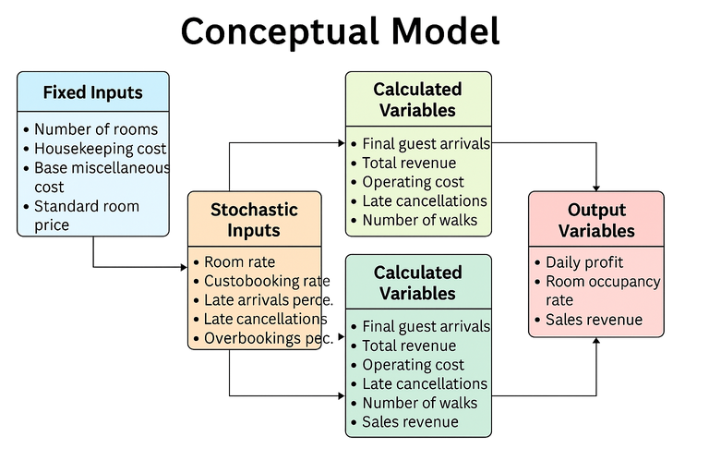
Conceptual Model
Model Assumptions
To ensure the model reflects realistic business operations while maintaining simplicity, several assumptions have been made.
The motel offers only one type of standard room, with a fixed capacity of 20 rooms per day. Guests may book rooms through online channels, via social media campaigns, or arrive directly as walk-in customers without prior reservations. Cancellations made within 48 hours of the check-in time are considered “late cancellations” and may incur a penalty fee as determined by the motel’s policy. Overbooking is allowed within a controlled limit, and if the number of arriving guests exceeds the room capacity, the motel must compensate the excess guests with the equivalent of the nightly room rate.
Daily operational costs, including miscellaneous expenses and flexible services, vary based on the number of guests and their requests. Room rates, service flexibility fees, and the frequency of social media marketing campaigns are treated as decision variables, enabling the Sales Manager to experiment with strategies to maximise profitability.
All stochastic variables in the model are simulated using appropriate probability distributions to represent the uncertainty in guest behaviours and daily fluctuations in demand.
Relationships Between Variables in the Model
The variables in the model are linked through a clear and logical flow.
Fixed inputs such as the number of rooms, housekeeping cost, and base miscellaneous cost provide the foundation for calculating daily operating expenses. Stochastic inputs like online bookings, late cancellations, walk-ins, and social media-driven bookings influence the final number of guests who stay at the motel, which in turn affects daily revenue, operational costs, and room occupancy rates.
Decision variables such as room rate, overbooking limit, late cancellation fee, and service flexibility fee allow the Sales Manager to adjust strategic levers and observe their effects on performance. For instance, increasing the room rate can boost revenue per guest but may reduce overall bookings. Similarly, increasing the frequency of social media campaigns can drive more bookings but also raises marketing costs and the risk of overbooking.
Finally, calculated variables such as total revenue, total operating cost, and actual guest arrivals are used to derive key output metrics, including daily profit, occupancy rate, and sold-out status.

Slide 5
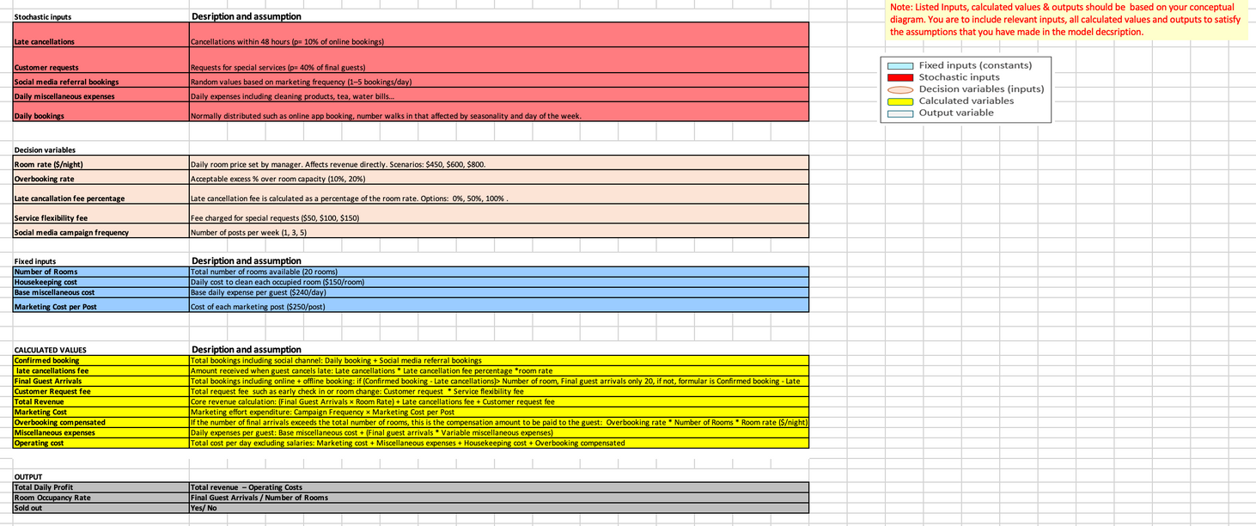
Decision Model
Model Description
The decision model was built in Excel to assist the hotel manager in making strategic decisions related to room pricing, overbooking capacity, and policies regarding cancellation fees and flexible service charges. The model includes fixed inputs, stochastic inputs, decision variables, intermediate calculated variables, and output variables that reflect the daily operational performance of the motel.
The model is structured as follows
Fixed input variables: Number of rooms, housekeeping cost, and basic miscellaneous cost per guest.
Stochastic input variables: Number of online bookings per day, late cancellations, walk-in guests, social media referral bookings, and daily miscellaneous expenses.
Decision variables: Room rate, overbooking rate, late cancellation fee percentage, flexible service fee, and frequency of social media advertising.
Calculated variables: Actual number of guest arrivals, individual revenue components (room, cancellation, service), and total operating costs...
Output variables: Daily profit, room occupancy rate, and “sold-out” status.
Model Purpose
The model allows:
Automatic result updates when any input value is changed.
Scenario testing with different pricing strategies and overbooking policies.
Daily performance assessment and support for data-driven, profit-optimising decisions.

Slide 6
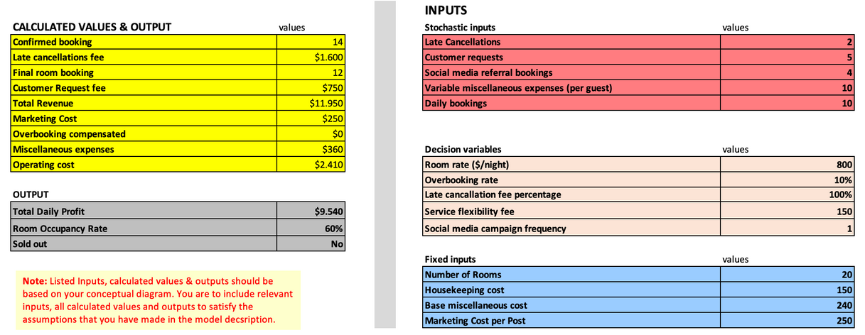
Model - Best Estimate
Purpose of the Model:
This model is used to test the effectiveness of a high pricing strategy ($800/night), strict cancellation policy (100% fee), and premium flexible services ($150/request). It represents a stable, controlled operational scenario.
Key Results:
Confirmed bookings: 14 → Final arrivals: 12
Total Revenue: $11,950
Operating Cost: $2,410
Daily Profit: $9,540
Occupancy Rate: 60%
Sold out: No
→ The model shows that high profit is achievable even without full occupancy, if the pricing and fee strategies are well-balanced.
Limitations of the Model:
The model assumes stable and predictable demand, which may not reflect real-world volatility.
Random inputs are static per run and don’t capture day-to-day variation unless simulation is applied.
Customer behaviour is oversimplified (e.g., booking probability, price sensitivity).
Results are sensitive to input assumptions – slight changes in demand or costs can significantly affect outputs.

Slide 7
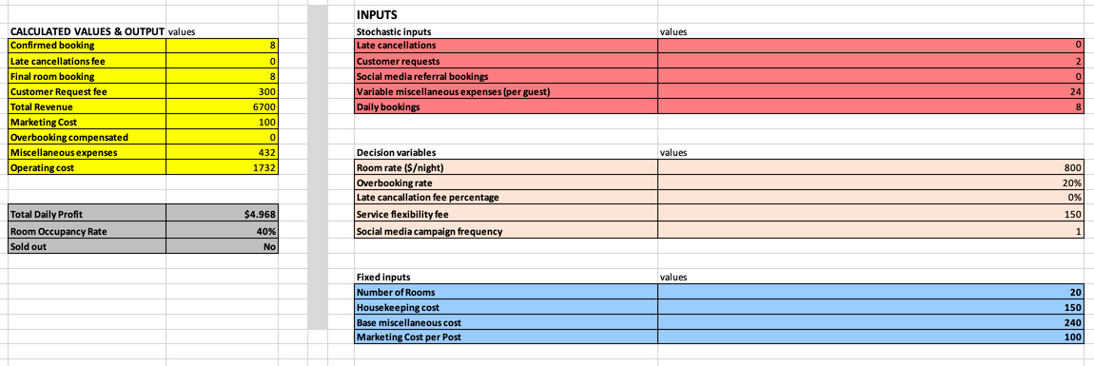
Model - Best Estimate
Purpose of the Model:
The simulated model uses randomised inputs to reflect real-world uncertainties such as cancellations, variable expenses, and special service requests. It helps test how the system performs under unpredictable conditions.
Key Results (Sample Run):
Final bookings: 8
Total revenue: $6,700
Operating cost: $1,732
Daily profit: $4,968
Occupancy rate: 40%
Sold out: No
→ The model shows positive profit even with low occupancy and no social media bookings.
Insights:
Most outcomes are profitable, but there is still risk of negative profit due to cancellations or insufficient demand.
Low occupancy probabilities suggest the need to optimise pricing or marketing strategies.
Model Limitations:
Results vary by run, making them less reliable unless multiple simulations are conducted.
Single run does not reflect long-term trends.
Lacks built-in risk probability or distribution visualisation.

Slide 8
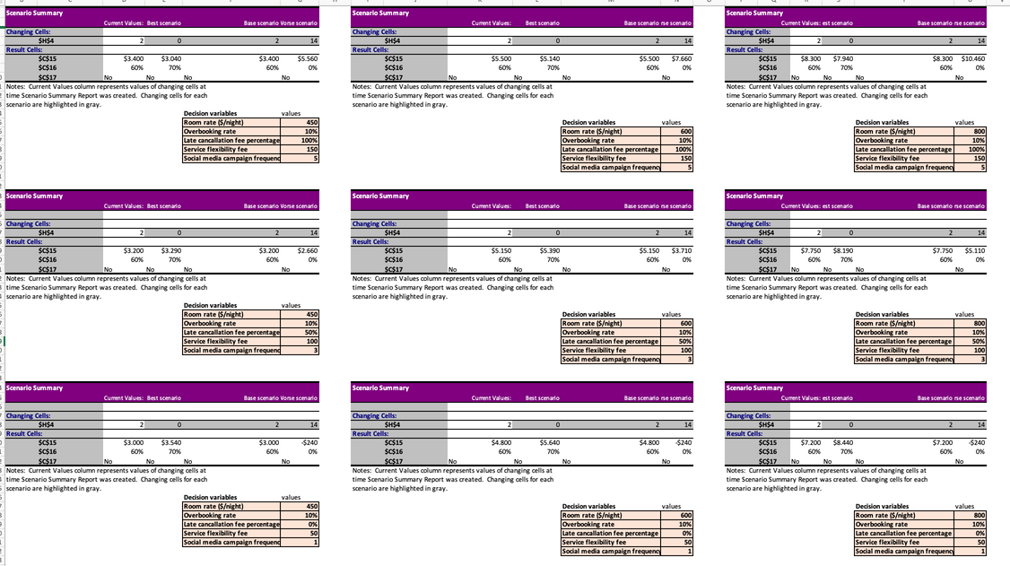
Scenario Analysis: Late Cancellation Fee
Room Rate: $450
At a low price point, charging a cancellation fee has limited impact on profit.
When cancellations are low, strict fees do not significantly increase revenue.
A moderate 50% fee is sufficient—no need to apply harsh penalties.
Room Rate: $600
This is the most balanced and optimal setup.
A cancellation fee of 50–100% significantly improves profit without affecting occupancy.
Best cost-benefit ratio for standard operations.
Room Rate: $800
At high price points, profit becomes volatile if cancellations aren’t controlled.
Charging 100% cancellation fee protects revenue even when demand is uncertain.
Occupancy remains stable, meaning premium pricing works when well-supported.
Comparison of Late Cancellation Strategies
0% Fee: Lower profit, higher risk – useful only for customer acquisition or a “friendly” brand image.
50% Fee: Best balance between customer acceptance and revenue protection.
100% Fee: Highest profitability and protection – but requires clear communication and trust.
Strategic Conclusion
Room Rate $600 + Late Fee 50–100% is the most reliable strategy for profit and operational stability.
$800 pricing is only viable when strong marketing and customer willingness to pay are in place.
Varying fee policies by room rate gives flexibility without harming customer experience.

Slide 9
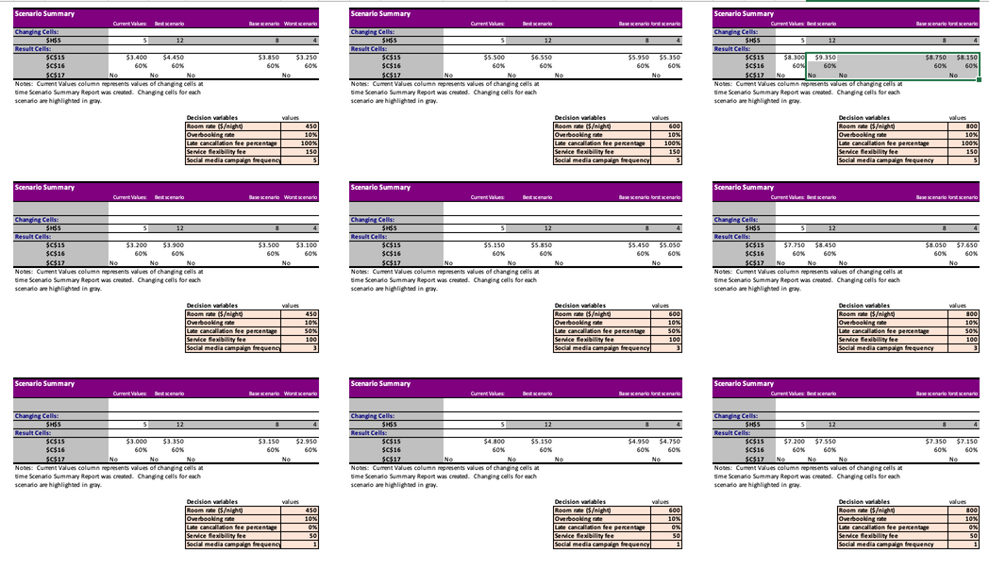
Scenario Analysis: Customer Requests
Room Rate: $450
Even at a low price point, raising service fees can significantly increase revenue.
Occupancy remains unchanged → more profit without additional rooms.
Best performance seen at $150 flexibility fee without hurting customer volume.
Room Rate: $600
$600 with $150 flexibility fee is optimal — balances affordability and service profit.
Service fee adds significant marginal revenue even when bookings stay flat.
A safe default configuration if targeting both revenue and stability.
Room Rate: $800
At premium price, service fees greatly enhance revenue potential.
Occupancy plateaus at 60% suggests that willingness to pay exists for high-end clients.
Flexibility fees are crucial revenue drivers at this level.
Strategic Conclusion
Customer Request Fee is a controllable revenue stream that boosts profit without altering occupancy.
The impact of service fee increases is most significant at high room rates, but still beneficial at all levels.
No trade-off in occupancy, meaning price-sensitive segments are unaffected by service options.

Slide 10
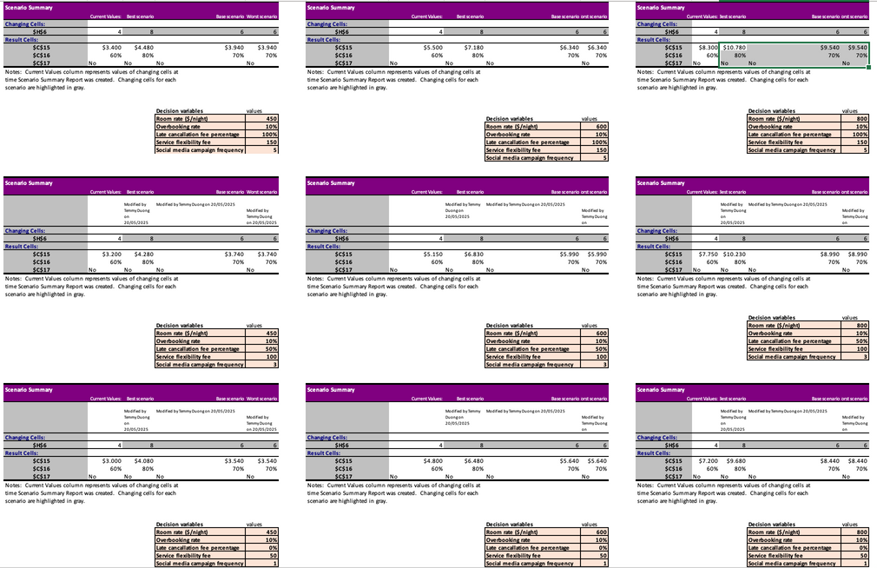
Scenario Analysis: Social Media Referal Bookings
Room Rate: $450
Even at a low price point, more frequent posting clearly boosts occupancy.
Profit increases up to 40% from 1 to 5 posts.
3–5 posts/week is a cost-effective strategy to increase volume without relying on price cuts.
Room Rate: $600
Social media frequency has consistent positive impact.
Moving from 1 to 5 posts delivers up to $1,700 more profit per day.
At this price, 5 posts/week is highly profitable and sustainable.
Room Rate: $800
High room rates need aggressive digital marketing to maintain high occupancy.
5 posts/week leads to record-high profits, proving ROI of digital media at scale.
Shows that premium pricing + engagement strategy is the most lucrative configuration.
Limitations
Does not account for content quality or campaign costs.
Assumes linear impact of campaign frequency, which may not reflect saturation points.
External trends (seasonality, market events) not included.
Strategic Conclusion
More posts = more bookings = higher profit, regardless of pricing level.
Optimal strategy is: higher frequency (3–5/week), especially when room rates ≥ $600.
Social media campaigns are low-risk, high-impact levers in revenue management.

Slide 11
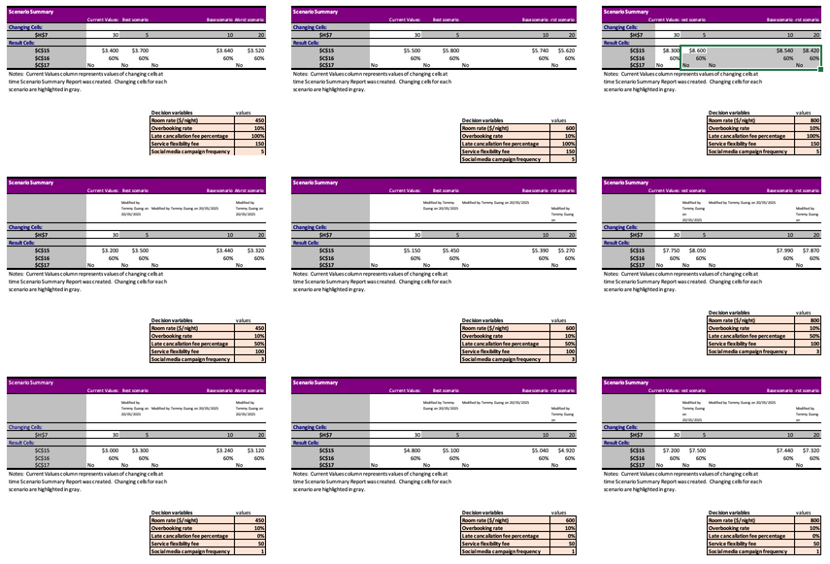
Scenario Analysis: Variable Miscellaneous Expenses
Room Rate: $450
At a lower price point, increased expenses quickly erode margin.
Suggests that low-price rooms should minimise added guest perks to remain profitable.
Room Rate: $600
Mid-tier pricing can absorb higher variable costs better.
Recommends capping guest expense at ~$20 to balance experience and margin.
Room Rate: $800
At high pricing, guests expect more service, so higher expenses are justifiable.
Profit remains high even with $30/guest cost — ideal for premium offering.
Limitations
Doesn’t factor in guest satisfaction scores or retention from better service.
Assumes all guests incur the same expense level.
No variation by length of stay or group size.
Strategic Conclusion
Higher guest expenses reduce profit but impact is mitigated at higher room rates.
At $450, best to keep expenses minimal.
At $800, it’s feasible to offer more — the margin can support it.
$600 pricing benefits from moderate investment ($10–$20/guest).

Slide 12
Scenario Analysis: Daily Bookings
Room Rate: $450
Increasing daily bookings improves occupancy and stabilises revenue.
Profit rises by ~40% between 8 and 12 bookings/day.
Volume-based growth is essential at low price levels.
Room Rate: $600
Optimal zone for balancing pricing and volume.
Higher booking volumes fully leverage capacity, leading to +$1,500 gain in profit.
Room Rate: $800
Daily bookings are crucial to justify premium pricing.
From 8 to 12 bookings → +35% increase in daily profit.
Works best when combined with active marketing or partnerships to ensure traffic.
Limitations
Does not factor in booking source mix (social vs direct vs OTA).
Assumes constant guest behaviour and conversion rate.
No analysis on marketing cost to acquire more bookings.
Strategic Conclusion
Higher daily booking volume consistently improves profitability.
The impact is strongest at $800, but all pricing levels benefit.
Keeping booking volume at ≥10/day is an effective operational target.

Slide 13
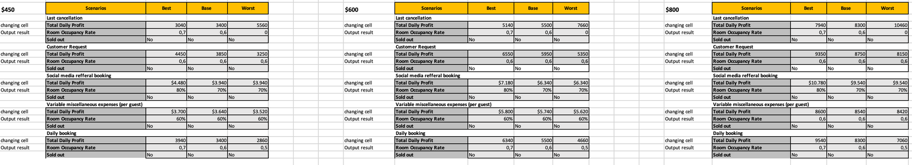
Summary of Scenario Analyses & Recommendation
Most Profitable Configuration
Room Rate: $800
Late Cancellation Fee: 100%
Customer Request Fee: $150
Overbooking Rate: 30%
Miscellaneous Expense per Guest: ≤ $20
Daily Bookings: ≥ 12
Social Media Frequency: 5 posts/week
→ Daily Profit: up to $10,780 | Occupancy: 80% | Sold Out: Yes
Recommendation
To maximize daily profit while maintaining healthy occupancy, the business should adopt a premium pricing strategy ($800) supported by robust operational controls:
Strict cancellation and service fee policies to stabilize revenue.
Active marketing (5 posts/week) to stimulate demand.
Moderate overbooking (30%) to offset cancellations and maximise room usage.
Keep per-guest expenses controlled to protect profit margin.
If aiming for lower risk with stable returns, a $600 pricing strategy with mid-level cancellation and marketing policies still ensures high, consistent profitability.

Slide 14
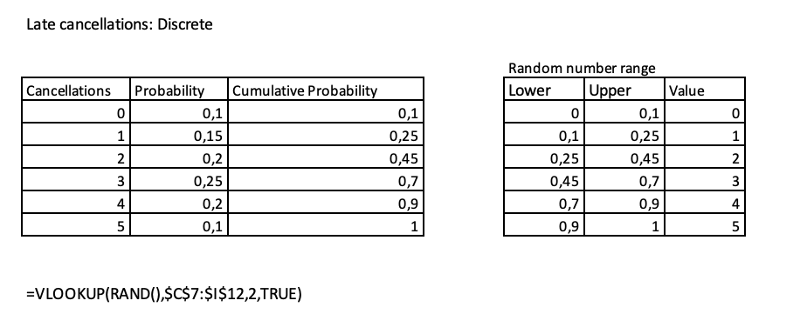
Probability Distribution - Late cancellations
Modeling Details:
Values range from 0 to 5 cancellations/day, with non-uniform probabilities based on historical or assumed data.
Implemented using =VLOOKUP(RAND(), $C$7:$I$12,2, TRUE) to assign cancellation outcomes by cumulative probability.
Why Discrete Distribution?
Cancellations occur in whole numbers, and follow a skewed, non-symmetric pattern—not suitable for Normal distribution.
A custom table allows accurate control of frequency, matching real-world operational data.
Insight:
The highest probability (25%) occurs at 3 cancellations/day, indicating a moderate but recurring risk of lost bookings.
Helps management decide on a proper overbooking buffer to offset last-minute losses.
Enables testing of worst-case scenarios (e.g., 5 cancellations) to examine financial resilience of the strategy.

Slide 15
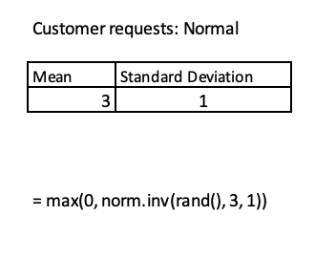
Probability Distribution - Customer Requests
Modeling Details:
Mean = 3, Standard Deviation = 1 represents an average of 3 customer service requests per day (e.g., early check-in, room changes).
The formula =MAX(0, NORM.INV(RAND(), 3, 1)) is used to generate realistic values, avoiding negatives.
Why Normal Distribution?
The Normal distribution is commonly used to model behaviours that naturally fluctuate around a central value.
It reflects the typical variation in daily customer demand, without extreme outliers.
Insight:
A small standard deviation (1) suggests customer request behaviour is consistent – meaning it's easier to plan around.
Repeated simulation can help identify risk of service overload when requests exceed expectations.
Useful for staffing or operational planning to maintain service quality during high-demand days.

Slide 16
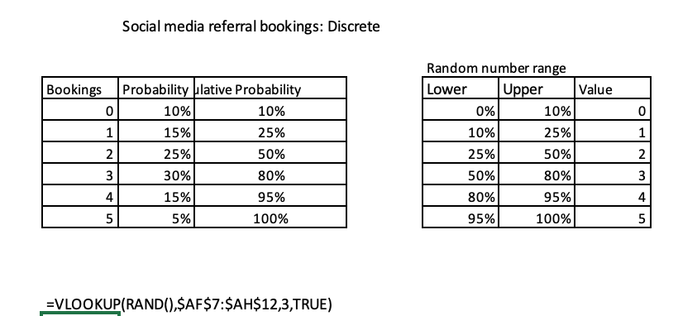
Probability Distribution - Social media referral bookings
Modeling Details:
Distribution Type: Custom Discrete
Bookings/day & Probability: 0 → 10%; 1 → 15%; 2 → 25%; 3 → 30%; 4 → 15%; 5 → 5%
Formula:
=VLOOKUP(RAND(), $AF$7:$AH$12, 3, TRUE)
Why Normal Distribution?
Social media booking outcomes are discrete and non-uniform, often depending on campaign type, day, or influencer effect.
Custom discrete distribution allows realistic mapping of historical or expected engagement conversion patterns.
Insight:
Reflects the non-linear and campaign-dependent nature of social media lead generation.
Skewed distribution (mode = 3) shows most campaigns generate moderate success, with occasional spikes (5 bookings).
Simulation allows for performance testing of various digital strategies (frequency, content style, influencer campaigns).
Helps assess Return on Marketing Investment (ROMI) by comparing booking outcomes against cost per post.
Enables managers to test promotional tactics under uncertainty, guiding more data-driven digital media planning.

Slide 17
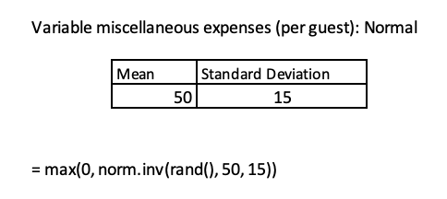
Probability Distribution - Variable Miscellaneous Expenses
Modeling Details:
Distribution Type: Normal (Continuous)
Mean = $50, Standard Deviation = $15
Formula:
=MAX(0, NORM.INV(RAND(), 50, 15))
Why Normal Distribution?
Guest spending varies naturally and symmetrically around a central expected value.
Normal distribution captures variability without bias, appropriate for operational expenses.
Insight:
Represents per-guest variable costs such as cleaning materials, utilities, refreshments, or unexpected service expenses.
High standard deviation (+30% of mean) reflects the uncontrollable and guest-specific nature of these costs.
Highlights need for robust profit margin buffers to absorb cost variability.
Allows for sensitivity testing: managers can simulate best- and worst-case cost scenarios, aligning pricing or promotional discounts accordingly.
Supports cost forecasting and inventory planning, particularly under seasonality or group bookings.

Slide 18
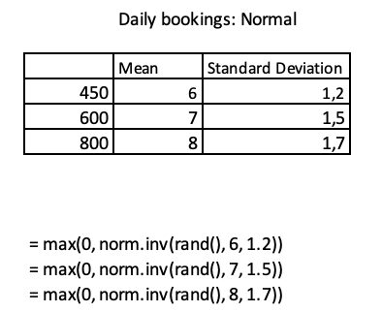
Probability Distribution - Daily bookings
Modeling Details:
Distribution Type: Normal (Continuous)
Mean & Standard Deviation (based on Room Rate):
$450 → μ = 6, σ = 1.2
$600 → μ = 7, σ = 1.5
$800 → μ = 8, σ = 1.7
Formula:
=MAX(0, NORM.INV(RAND(), mean, stdev))
Why Normal Distribution?
Daily bookings fluctuate due to external and internal factors like promotions, day-of-week, and price sensitivity.
Normal distribution is suitable for random variables that center around a mean and vary symmetrically without extreme skew.
Insight:
Dynamic mean reflects the assumption that higher-priced rooms attract more premium-seeking or loyal customers.
Increasing standard deviation simulates greater uncertainty at higher prices, where customers are more sensitive to perceived value, and booking behaviour becomes more volatile.
The model mimics realistic booking patterns over weekdays/weekends or in response to promotions, improving scenario realism.
Ensures accurate modeling of revenue volatility and capacity risk under different pricing tiers.

Slide 19
Selection of 4 Simulation Scenarios
To evaluate the impact of stochastic variables on daily profit, I selected four representative scenarios from the simulation results to conduct an in-depth risk analysis:
Scenario 1 – Room rate $450 (default configuration):
This is the base scenario with the lowest room rate, used as a benchmark to compare against higher-end strategies.
The average daily profit is approximately $2,300, reflecting low risk and high stability, though the profit margin remains modest.
Scenario 2 – Room rate $600 (default configuration):
With a mid-range price, this model delivers a profit of around $3,540, showing improved financial efficiency while maintaining stable input conditions.
This scenario was chosen to represent a balanced strategy between risk and return.
Scenario 3 – Room rate $800 (default configuration):
Raising the price to the maximum level without adjusting other settings leads to an average profit of around $5,150.
However, this scenario does not fully realise its potential due to ongoing risks from late cancellations and unregulated costs.
Scenario 4 – Room rate $800 with optimised configuration
(Late cancellation fee = 50%, Service flexibility fee = $100, Social media post frequency = 3):
This is the optimal strategic scenario, where all decision variables are adjusted to mitigate risk and boost customer acquisition.
Simulation results show the highest average profit (~$5,990) across all scenarios tested.

Slide 20
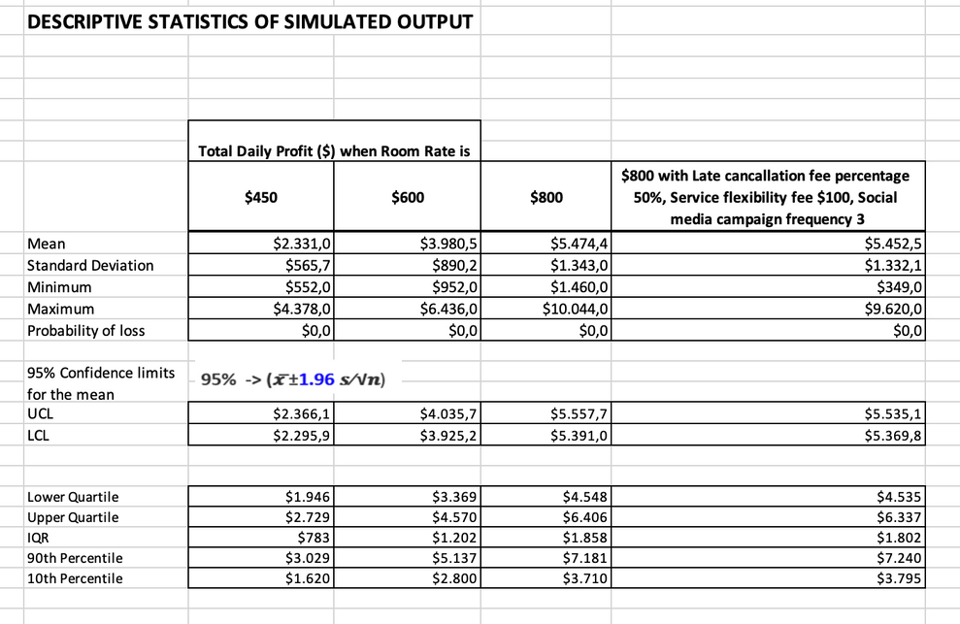
Simulated Output Distribution
Profit Volatility (Standard Deviation):
The $450 scenario has the lowest standard deviation ($565.7), indicating low risk and high stability, though it also delivers the lowest average profit.
The $800 optimised scenario shows higher volatility ($1,332.1) but delivers the highest average profit ($5,452.5), suggesting that risk is well-managed through strategic settings (e.g. late cancellation fees, social media campaign frequency, service flexibility).
95% Confidence Interval Analysis:
All confidence intervals are relatively narrow, for example:
$450: [2,295.9 ; 2,366.1]
$800 optimised: [5,369.8 ; 5,535.1]
This indicates that the simulation results are statistically reliable and converge well after 1,000 trials.
Probability of Loss:
Across all scenarios, there were no trials with negative profit, meaning the probability of loss is 0%.
This gives businesses the confidence to proceed with the selected price and configuration.
Interquartile Range (IQR) Analysis:
The IQR for $450 is the narrowest ($783), suggesting profits fall within a safer, more predictable range.
The IQR for $800 optimised is the widest ($1,802), reflecting greater variability, but still with consistently higher profit outcomes than the other scenarios.

Slide 21
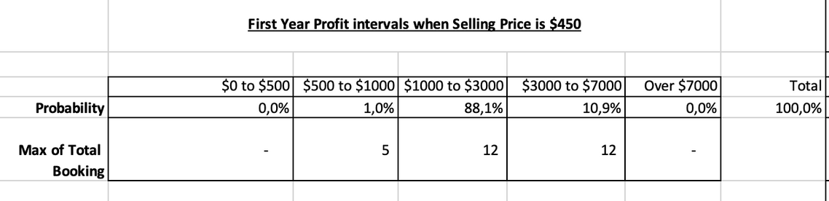
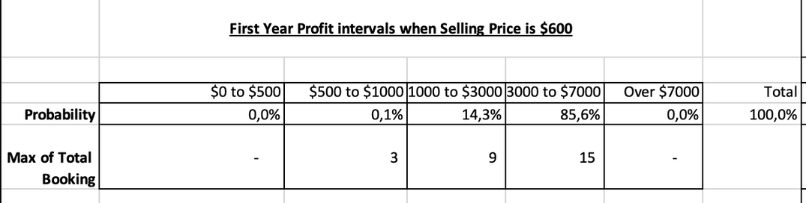
Interpretation Summary for Risk Analysis
Scenario 1 – $450 (default settings):
Interpretation: This scenario delivers the lowest average profit ($2,331) but comes with the least risk.
Implication: Suitable for a conservative strategy with low volatility. However, it doesn't maximise revenue potential. Ideal for price-sensitive markets or during low-demand periods.
Scenario 2 – $600 (default settings):
Interpretation: Achieves a solid average profit of around $3,980, with moderate risk.
Implication: A balanced approach, ideal for businesses looking to increase profitability without significantly raising operational risks or marketing expenses. Well-suited for markets with mid-level purchasing power.

Slide 22
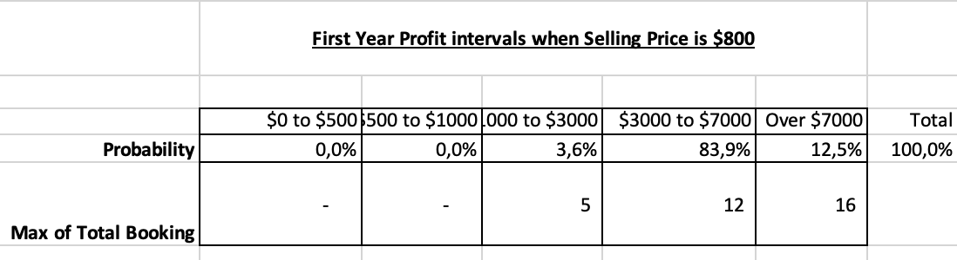
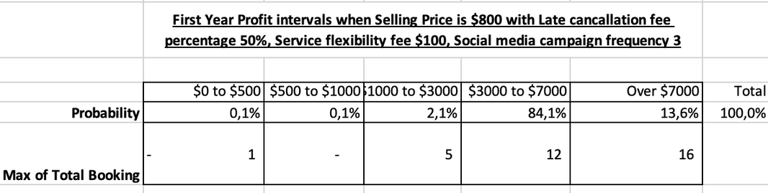
Interpretation Summary for Risk Analysis
Scenario 3 – $800 (default settings):
Interpretation: Delivers higher profits ($5,442), but with less control over late cancellations and fluctuating costs.
Implication: Offers strong revenue potential, but requires careful risk management. Without adjusting key decision variables, profits may fluctuate heavily depending on external factors.
Scenario 4 – $800 (optimised settings):
Interpretation: Generates the highest average profit ($5,452) with excellent reliability. No simulations resulted in a loss.
Implication: The optimal pricing and operational strategy, suited for hotels willing to invest in flexible services and digital marketing. Sustainable for long-term growth-focused operations.

Slide 23
Conclusions & Recommendations
Conclusions:
Recommendations:
The 1,000-run simulation analysis demonstrated that stochastic inputs such as late cancellations, miscellaneous expenses, and booking volumes significantly affect daily profit outcomes.
Among the tested scenarios, the $800 room rate with optimised configuration (50% cancellation fee, $100 service flexibility fee, 3 social media posts per week) achieved:
The highest average daily profit ($5,452)
Zero probability of loss
Strong convergence and stability after ~150 simulation trials
The simulation outputs provided clear evidence to distinguish between conservative, balanced, and profit-maximising strategies, allowing for more confident pricing and operational decisions.
Adopt the $800 room rate with the optimised settings, as this configuration produced the strongest financial outcomes.
Maintain social media activity at 3–5 posts per week to boost referral-based bookings, particularly during high-demand periods.
Implement a minimum 50% late cancellation fee to protect revenue from last-minute cancellations and promote responsible customer behaviour.
Introduce a $100 service flexibility fee (e.g. for early check-in or room changes) to increase ancillary revenue while enhancing guest experience.
Closely monitor average variable expenses per guest. If the cost exceeds $70 per guest, review service offerings or adjust the target customer segment.
Continue using simulation modelling to test other strategies (e.g. discount pricing, capacity expansion, promotions) before real-world implementation.

