Slide 1

React.js
Allan Crisostomo
https://github.com/Temoto-kun
allan.Crisostomo@whitecloak.com

Slide 2
Notes:
Ask questions “What the heck is React?”
“If you’ve used something like Angular before, you will see the concept behind,
If not, then you will understand how frameworks function”

Slide 3
The Framework
Made in March 2013 by Facebook
Licensed under BSD + Patents, but changed to MIT
112M total downloads since its inception (as of April 2018)
Notes:
Explain the reason for changing BSD+Patents to MIT

Slide 4
The Purpose
A library for managing views
A consistent, declarative way for templates
An easy approach for data-driven documents

Slide 5
The Limitations
Manages only the view, not the data
Enforces its own paradigm (configuration, boilerplate, tools, etc.)
Not advisable to run with other DOM manipulation libraries

Slide 6
The Features
Unidirectional data flow
Declarative component definition
Virtual DOM

Slide 7
Getting Started
React fundamentals

Slide 8
JSX and Syntax Additions
JSX is syntactic sugar for easier declaration of templates
JSX is just JS with additional XML
Requires Babel

Slide 9
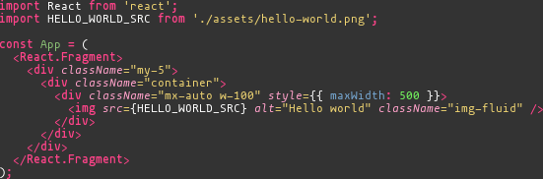
JSX - Before

Slide 10
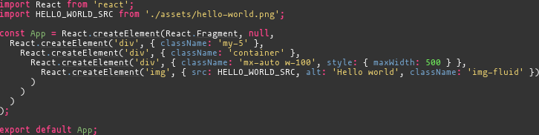
JSX - After

Slide 11
Components
A container for passing props (properties) and rendering a template
Can be stateless (simple) or stateful (with state + optional lifecycle overrides)
Additional implementation can be integrated to components, producing higher-order components

Slide 12
Props
A simple key-value pair collection
Passed to components/elements via attributes
Note that anything inside the element is a prop as well (props.children)

Slide 13
State
Same with props, but internal to the component instance
Prop changes may trigger state changes
Optional

Slide 14
When Will Re-rendering Happen?
Prop changes
State changes
forceUpdate()

Slide 15
Warming Up
Looking into the workings of React

Slide 16
What Constitutes a Component?
If there needs to have a certain structure in the rendered template
If it’s possible to contain a behavior
If it can stand alone

Slide 17
Stateless Components
Uses function syntax
Simple mapping of props to templates
No lifecycle method overriding

Slide 18
Stateful Components
Uses class syntax
Added capability of storing internal state
Lifecycle method overriding

Slide 19
Higher-order Components
Components with added functionality
Produced by inserting the component into a function returning another component
You can put a higher-order component into another function

Slide 20

YO DAWG
I HEARD YOU LIKE FUNCTIONS

Slide 21
Higher-order Components
Components with added functionality
Produced by inserting the component into a function returning another component
You can put a higher-order component into another function

Slide 22
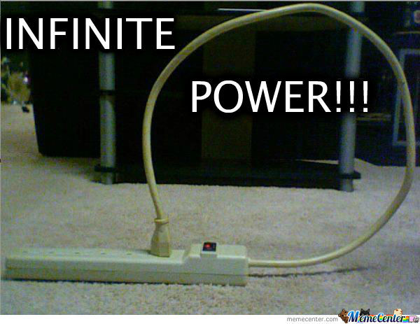

Slide 23
What’s Next?
Additional resources for deeper understanding

Slide 24
Where are the references?
In my GitHub (https://github.com/Temoto-kun/react-workshop-2018)
You can access the demos at (https://Temoto-kun.github.io/react-workshop-2018/)
The slides are included in the repo, and is accessible in the online site as well (https://Temoto-kun.github.io/react-workshop-2018/React.js.pptx)

Slide 25
Libraries
create-react-app generator library (maintained by Facebook)
Redux + other middleware (for managing state)
prop-types (for declaring props)
ESLint
Flow

Slide 26
We’re Hiring!
Shoot me an email at allan.crisostomo@whitecloak.com
Add subject line [APPLICATION] (Position Desired)
Will contact you as soon as the application is received

Slide 27
Developer Job Openings
Web (React)
Mobile (Android/iOS)
Backend (Java)

Slide 28
Thank You!
Hack on!

