Slide 1


EL7363 Communication Networks II
Final Project
Shortest Path Finding
In Selfish Network
Yuanzhi Yao
Tianpei Cai

Slide 2

Part 1.
Project Definition

Slide 3
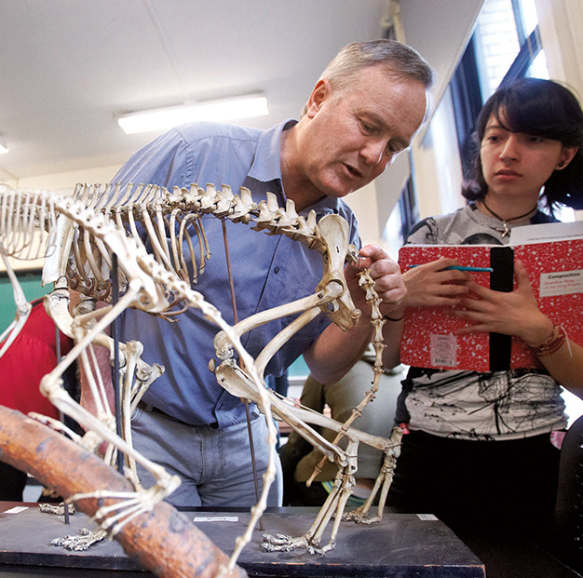
Project Definition
What is our goal?
Generating a solution to a common topic we have met through most of our network allocation and dimension problem: Shortest Path Routing within the selfish routing strategy.
So finding out all the shortest paths for certain demand pair is an important step before we moving to next stage.

Slide 4
Project Definition
Which kind of Network?
· Any Selfish Network
· Our goal is to find out the shortest path for any given network.
· But in current stage, we deal with topology generated by BRITE， which can generates network topology randomly in any size.
(https://www.cs.bu.edu/brite/)

Slide 5
Project Definition
Why we want to solve this problem?
· We using Shortest path for lot’s of Network design and allocation problems.
· How to figure out the Shortest path became a core problem.
· In further steps, we want to design some model for Braess Paradox Problem. (How can each flow or say cars do selfish routing ? – Shortest path)

Slide 6
Project Definition
Which tools we use?
· BRITE Network Topology Generator
· Programming Language: Java 1.8
· Version Control & Collaboration: GIT

Slide 7
Part 2.
Design Models

Slide 8
Design Models
Shortest Path Routing:
· Cost： Propagation delays, length of path, number of jumps (hops) …
· In our project: length of path ( length can be regarded as a kind of delay)

Slide 9
Design Models
Two different models:
· Non-Congestion Model
Do not consider the additional delay cost by traffic volume on each link.
· Congestion Model
Consider the delay cost by the traffic volume on each link, if there are more traffic on link, the delay will be greater.

Slide 10
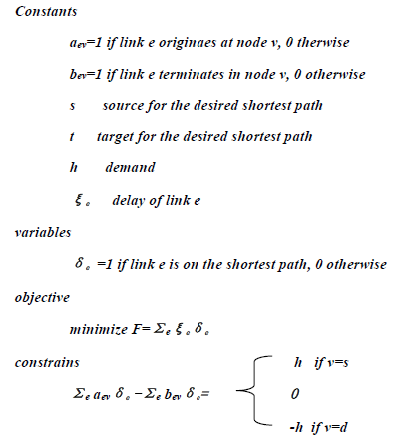
Design Models
Non-Congestion
Model

Slide 11
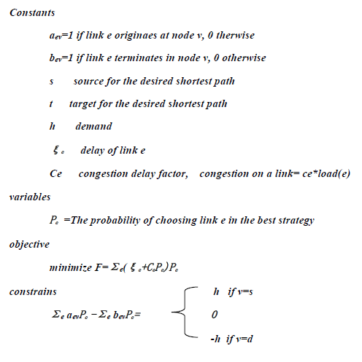
Design Models
Congestion
Model

Slide 12
Part 3.
Solution Techniques

Slide 13
Solution Techniques
· An approach towards universal topology generation
· Supports multiple generation models
· Models can be enhanced by assigning links attributes
· Implemented in Java and C++ with a user friendly GUI
BRITE

Slide 14
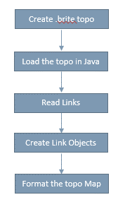
Solution Techniques
Java IO
Bridge between our algorithm
and BRITE topology file

Slide 15
Solution Techniques
Non-Congestion
Step 1 build a map to keep shortest paths for each source to the same target;
Step2 if s is already in the map, return the value in the map
Step 3 if s is not in the map, find shortest path from each m to t, where m is connected to s. (recursion, goto objective (m,t))
Step 4 find the shortest path among step 3, and save it in the map.

Slide 16
Solution Techniques
Congestion
Objective: find the probability of choosing each path
for (i=1-100) {
find the shortest path in current situation
add delay to each link of the shortest path
the probability of choosing this path+1%
}

Slide 17
Part 4.
Demo

Slide 18
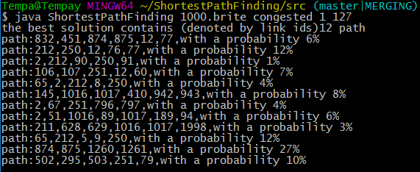
Demo
1000 Nodes

Slide 19

Demo
1000 Nodes

Slide 20
Part 5.
Extension –
Braess Paradox

Slide 21
Extension
Braess Paradox
“Adding extra capacity to a network when the moving entities selfishly choose their route can in some cases reduce overall performance.”
-- somehow against human intuition. As showing below, after we add an ideal link to this network, the overall delay increasing.

Slide 22
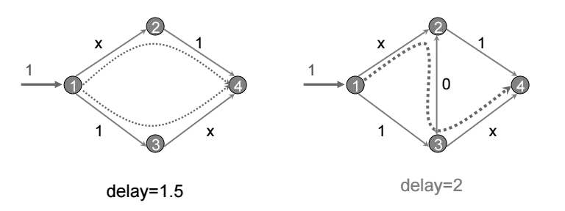
Extension
Braess Paradox

Slide 23
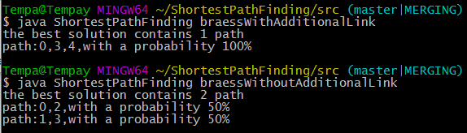
Extension
Braess Paradox
It’s shows that with additional link, all traffic go through 1 path, which, we all know,
will increasing the network delay.

Slide 24
Part 6.
Conclusion

Slide 25
Conclusion
· Developed an algorithm for Shortest Path Finding in Selfish Netowk.
· Two models: Congestion / Non-Congestion
· Braess Paradox Test
· Future Extension

