Slide 1
Pi Pico OOP Mini Project
Ben Jones
Tempe High School
Lecture 3

Slide 2
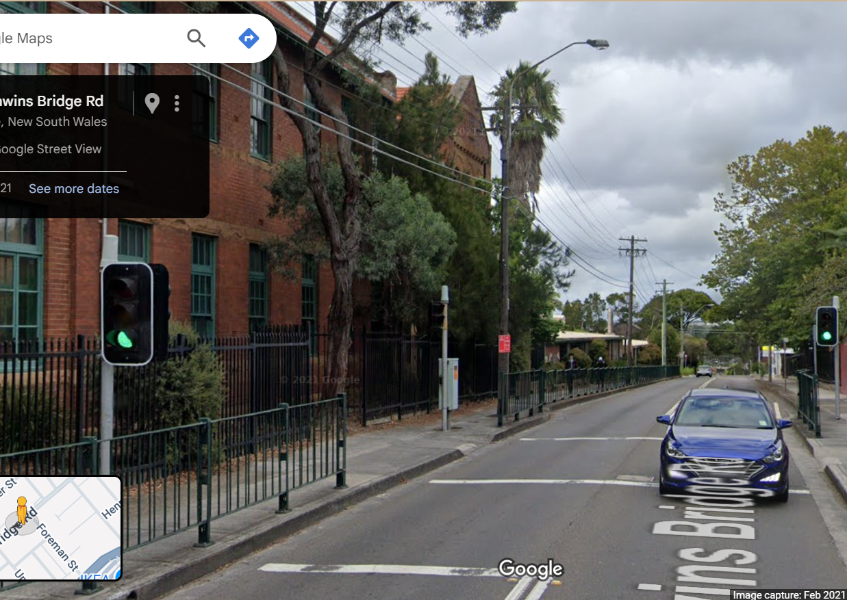
Simple Open Loop Control System
Traffic Lights remain green until pressed (idle state).
Button pressed triggers state change.
Lights rotate through a pattern based on time.
System returns to idle state

Slide 3
Today
Abstraction
Implement a non blocking flash method
Complete and Unit Test led light class

Slide 4
Abstraction
Abstraction in Object-Oriented Programming (OOP) is a principle that focuses on exposing only the essential features of an object while hiding the unnecessary details. The primary goal is to offer a simplified, high-level interface for interacting with complex systems, thereby making your code easier to use and understand.
- What vs. How: Abstraction tells you what an object does, not how it does it.
- Simplification: It reduces complexity by hiding implementation details.
Interface: Abstraction is often achieved by hiding the complex implementation and providing only the interface methods or attributes.

Slide 5
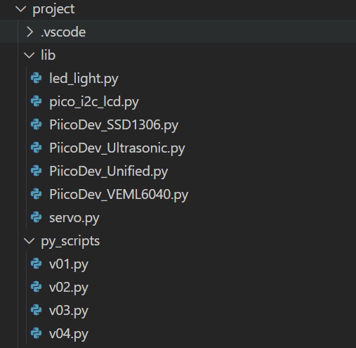
Create new files
v04.py in project\py_scripts\
led_light.py in project\lib\
Then copy the relevant imports and class to led_light.py

Slide 6
Test the abstraction
from project.py_scripts.LL_unit_Test import Led_Light
from time import sleep
red_light = Led_Light(3, True, True)
while True:
print(red_light.led_light_state)
red_light.led_light_state = 1
sleep(0.25)
print(red_light.led_light_state)
red_light.led_light_state = 0
sleep(0.25)

Slide 7
Add a led_light_state attribute
class Led_Light(Pin):
# child class inherits the parent 'Pin' class
def __init__(self, pin, flashing=False, debug=False):
super().__init__(pin, Pin.OUT)
self.led_light_state
self.__debug = debug
self.__pin = pin
self.__flashing = flashing
self.__last_toggle_time = time()

Slide 8
Create a .flash() method
def flash(self):
# Non-blocking flash: toggles LED every 0.5s for the given duration
now = time()
if self.__flashing and now - self.__last_toggle_time >= 0.5:
self.toggle()
self.__last_toggle_time = now

Slide 9
Test the non blocking .flash() method
red_light = Led_Light(3, True, True)
while True:
red_light.flash()
sleep(0.1)

Slide 10
Unit Test the Led_Light class
https://github.com/TempeHS/MicroPython_OOP_Pi_Pico_Mini_Project_Source/blob/main/tutorials/Lecture3.md#complete-led-light-class
Your unit test should test all methods, where possible, using the self.value() method to automate the test if possible.
Pause the video, design your unit test, then check your unit tests against my suggested batch of unit tests.

