Slide 1
Pi Pico OOP Mini Project
Ben Jones
Tempe High School
Lecture 4

Slide 2
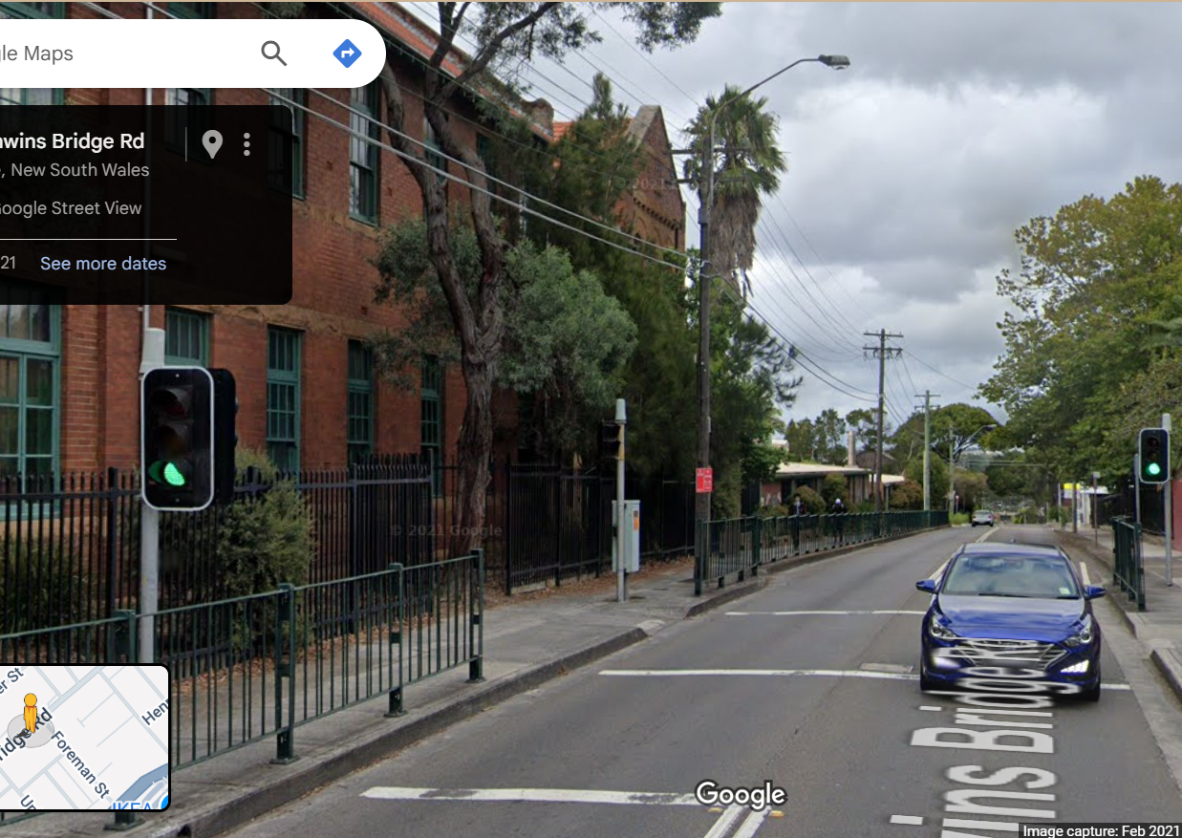
Simple Open Loop Control System
Traffic Lights remain green until pressed (idle state).
Button pressed triggers state change.
Lights rotate through a pattern based on time.
System returns to idle state

Slide 3
Today
Implement a basic button class
Create an interrupt and debounce the button
Unit test the pedestrian button

Slide 4
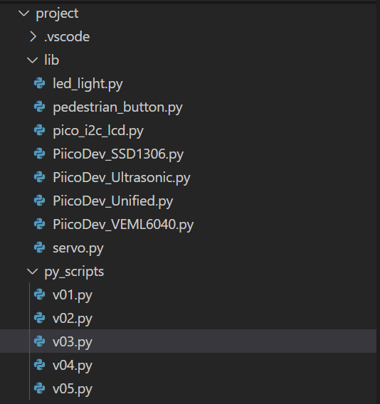
Create new files
v05.py in project\py_scripts\
pedestrian_button.py in project\lib\

Slide 5
Pedestrian_Button Imports
from machine import Pin
import time

Slide 6
Pedestrian_Button Class Attributes
class Pedestrian_Button(Pin):
# child class inherits the parent 'Pin' class
def __init__(self, pin, debug):
super().__init__(pin, Pin.IN, Pin.PULL_DOWN)
self.__debug = debug
self.__pin = pin
self.__last_pressed = 0 # Track the last time the button was pressed
self.__pedestrian_waiting = False
self.button_state

Slide 7
Pedestrian_Button “Getter”
@property
def button_state(self):
if self.__debug:
print(f"Button connected to Pin {self.__pin} is {'WAITING' if self.__pedestrian_waiting else 'NOT WAITING'}")
return self.__pedestrian_waiting

Slide 8
Pedestrian_Button “Setter”
@button_state.setter
def button_state(self, value):
self.__pedestrian_waiting = value
if self.__debug:
print(f"Button state on Pin {self.__pin} set to {value}")

Slide 9
Pedestrian_Button Interrupt
class Pedestrian_Button(Pin):
# child class inherits the parent 'Pin' class
def __init__(self, pin, debug):
…
# Set up interrupt on rising edge
self.irq(trigger=Pin.IRQ_RISING, handler=self.callback)

Slide 10
Pedestrian_Button Interrupt Callback Method
def callback(self, pin):
current_time = time.ticks_ms() # Get the current time in milliseconds
if (time.ticks_diff(current_time, self.__last_pressed) > 200): # 200ms debounce delay
self.__last_pressed = current_time
self.__pedestrian_waiting = True
if self.__debug:
print(f"Button pressed on Pin {self.__pin} at {current_time}ms")

Slide 11
Unit Test the Pedestrian_Button class
Your unit test should test all methods, where possible, because it involves a physical button you should design a manual test.
Pause the video, design your unit test, then check your unit tests against my suggested batch of unit tests.

