Slide 1
Pi Pico OOP Mini Project
Ben Jones
Tempe High School
Lecture 3

Slide 2
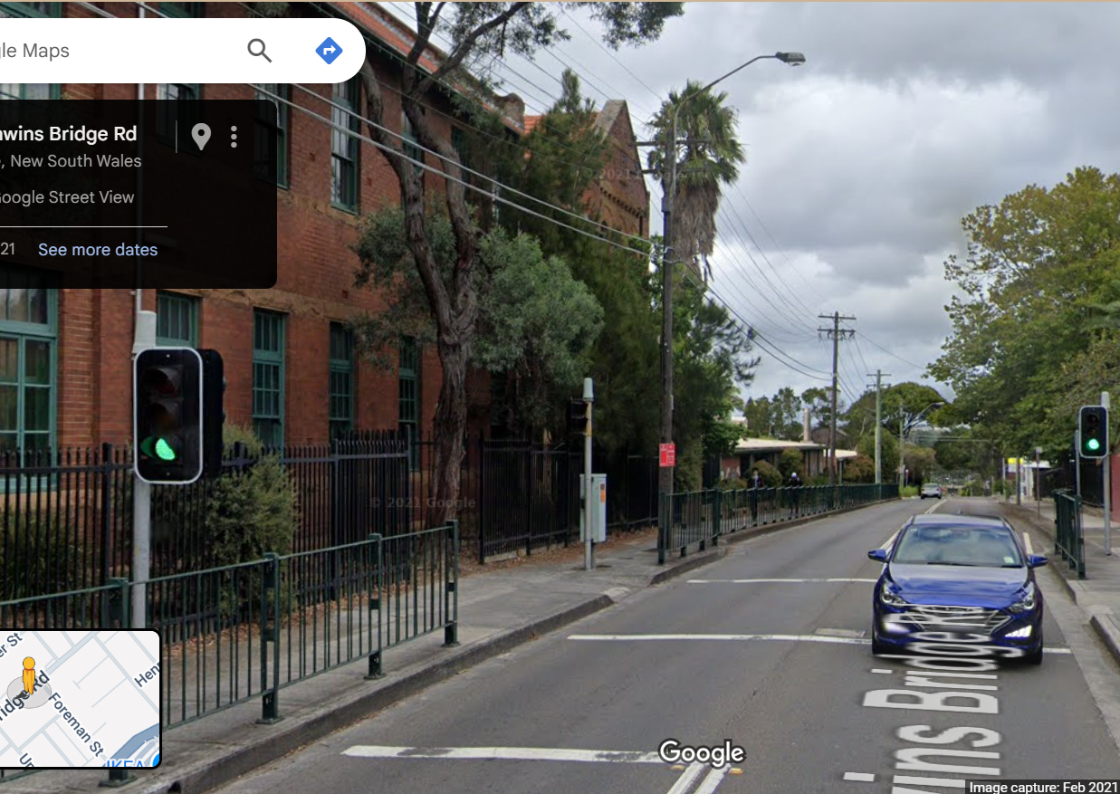
Simple Open Loop Control System
Traffic Lights remain green until pressed (idle state).
Button pressed triggers state change.
Lights rotate through a pattern based on time.
System returns to idle state

Slide 3
Today
Encapsulation
Setters & Getters
Abstraction
Extend LED functionality
Complete and Unit Test led light class

Slide 4
Abstraction
Abstraction in Object-Oriented Programming (OOP) is a principle that focuses on exposing only the essential features of an object while hiding the unnecessary details. The primary goal is to offer a simplified, high-level interface for interacting with complex systems, thereby making your code easier to use and understand.
- What vs. How: Abstraction tells you what an object does, not how it does it.
- Simplification: It reduces complexity by hiding implementation details.
Interface: Abstraction is often achieved by hiding the complex implementation and providing only the interface methods or attributes.
Create: project\lib\led_light.py
Copy the Class to: project\lib\led_light.py
Run: v10.py

Slide 5
Extend LED Functionality
https://github.com/TempeHS/MicroPython_OOP_Pi_Pico_Mini_Project_Source/blob/main/tutorials/Lecture3.md#extend-the-functionality-of-the-led_light-class
Run v11.py

Slide 6
Complete & Unit Test the Led_Light class
https://github.com/TempeHS/MicroPython_OOP_Pi_Pico_Mini_Project_Source/blob/main/tutorials/Lecture3.md#complete-led-light-class
Run: v12.py

