Slide 1
Pi Pico OOP Mini Project
Ben Jones
Tempe High School
Lecture 2

Slide 2
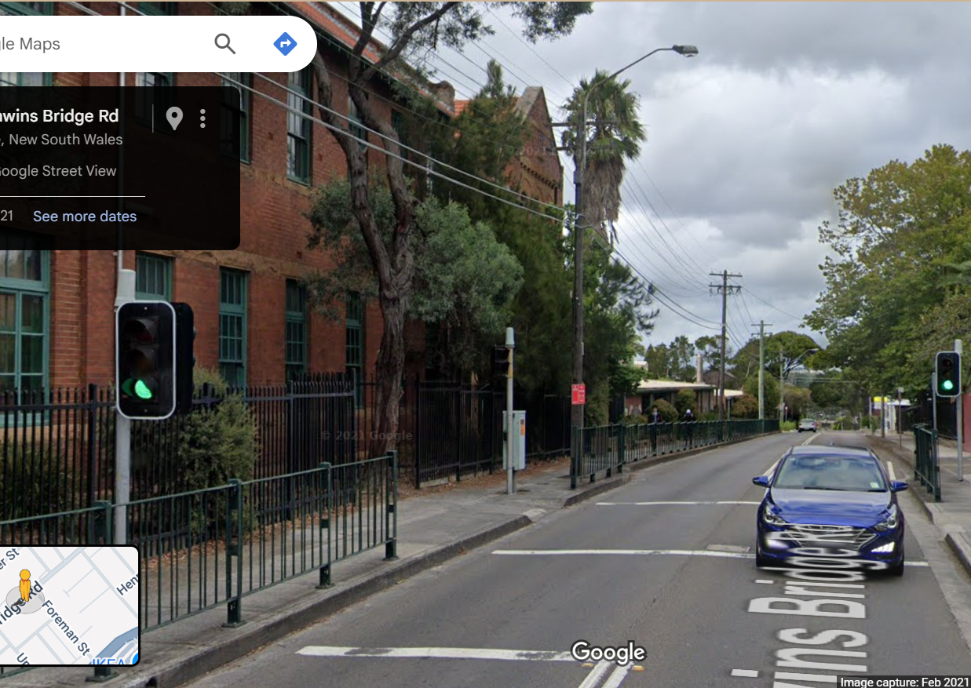
Simple Open Loop Control System
Traffic Lights remain green until pressed (idle state).
Button pressed triggers state change.
Lights rotate through a pattern based on time.
System returns to idle state

Slide 3
Today
Overriding Polymorphism
DRY
Encapsulation
Setters & Getters
Overloading Polymorphism

Slide 4
Overriding Polymorphism
Polymorphism Overriding occurs when a child class (subclass) provides a new implementation for a method it inherits from its parent class (superclass).
The method in the child class has the same name and parameters as the one in the parent class. When the method is called on an object of the child class, Python (or any object-oriented language) uses the child’s version—even if the object is referenced using the parent type.
Run: v05.py

Slide 5
Led_Light Class Attributes
class Led_Light(Pin):
# child class inherits the parent 'Pin' class
def __init__(self, pin, flashing=False, debug=False):
super().__init__(pin, Pin.OUT)
self.__debug = debug
self.__pin = pin
self.__flashing = flashing

Slide 6
Overriding .on() method
def on(self):
# method overriding polymorphism
self.high()
if self.__debug:
print(f"LED connected to Pin {self.__pin} is high")

Slide 7
Overriding .off() method
def off(self):
# method overriding polymorphism of the parent class
self.low()
if self.__debug:
print(f"LED connected to Pin {self.__pin} is low")

Slide 8
Instantiate & test
from machine import Pin
from time import sleep
red_light = Led_Light(3)
while True:
red_light.on()
sleep(1)
red_light.off()
sleep(1)

Slide 9
Overriding .toggle() method
def toggle(self):
# method overriding polymorphism of the parent class
if self.value() == 0:
self.high()
if self.__debug:
print(f"LED connected to Pin {self.__pin} is high")
elif self.value() == 1:
self.low()
if self.__debug:
print(f"LED connected to Pin {self.__pin} is low")

Slide 10
Instantiate & test
from machine import Pin
from time import sleep
red_light = Led_Light(3)
while True:
red_light.toggle()
sleep(1)

Slide 11
WET v DRY
DRY = “Don’t Repeat Yourself”
WET = “Write Every Thought”
What are the issues with this implementation?
How can the DRY pattern address these issues?

Slide 12
DRY Implementation
def toggle(self):
# method overriding polymorphism of the parent class
if self.value() == 0:
self.on()
elif self.value() == 1:
self.off()

Slide 13
Encapsulation
Encapsulation restricts direct access to some of an object's components (such as attributes or methods), meaning the internal representation of the object is hidden from the outside. This is typically achieved by making certain attributes or methods private (i.e., inaccessible from outside the class) and providing public methods (such as getters and setters) to access or modify those private members.
In Python we use “__” to define an encapsulated attribute, and in Pseudocode, we use the PRIVATE modifier.

Slide 14
Encapsulation in Python
while True:
print(red_light.led_light_state) # Allowed
red_light.led_light_state = 1 # Allowed
print(f"Not allowed: {red_light.__pin} ???") # Not allowed, should raise AttributeError

Slide 15
Setter & Getters
Setters and getters are special methods used in object-oriented programming to access (get) or modify (set) the values of private or protected attributes of a class. They help encapsulate the internal state of an object, providing controlled access.
A getter is a method that retrieves (gets) the value of a private attribute. It allows you to read the value without providing direct access to the underlying variable.
A setter is a method that sets (updates) the value of a private attribute. It allows you to validate or restrict changes before updating the attribute.

Slide 16
Add a led_light_state attribute
class Led_Light(Pin):
# child class inherits the parent 'Pin' class
def __init__(self, pin, flashing=False, debug=False):
super().__init__(pin, Pin.OUT)
self.led_light_state
self.__debug = debug
self.__pin = pin
self.__flashing = flashing

Slide 17
Create a “getter”
@property
def led_light_state(self):
# method overloading polymorphism in this class
return self.value()

Slide 18
Create a “setter”
@led_light_state.setter
def led_light_state(self, value):
# method overloading polymorphism in this class
if value == 1:
self.off()
elif value == 0:
self.on()

Slide 19
Instantiate & test
from machine import Pin
from time import sleep
red_light = Led_Light(3)
while True:
print(red_light.led_light_state)
red_light.led_light_state = 1
sleep(0.25)
print(red_light.led_light_state)
red_light.led_light_state = 0
sleep(0.25)

Slide 20
Overloading Polymorphism
Overloading occurs when a child (subclass) and/or parent (superclass) have multiple methods with the same name but different parameters (number or type).
When you call the method, depending on the parameters passed, the corresponding method is executed.
Because Python is dynamically typed, it does not support overloaded polymorphism, as the last definition of a method overwrites any previous ones.
https://github.com/TempeHS/MicroPython_OOP_Pi_Pico_Mini_Project_Source/blob/main/tutorials/Lecture2.md#overloading-polymorphism

