Slide 1
Pi Pico OOP Mini Project
Ben Jones
Tempe High School
Lecture 2

Slide 2
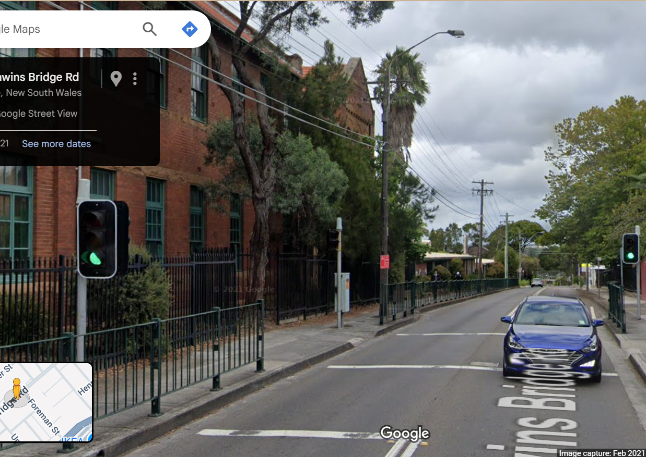
Simple Open Loop Control System
Traffic Lights remain green until pressed (idle state).
Button pressed triggers state change.
Lights rotate through a pattern based on time.
System returns to idle state

Slide 3
Today
UML (Unified Modelling Language)
Overriding Polymorphism
DRY
Overloading Polymorphism

Slide 4
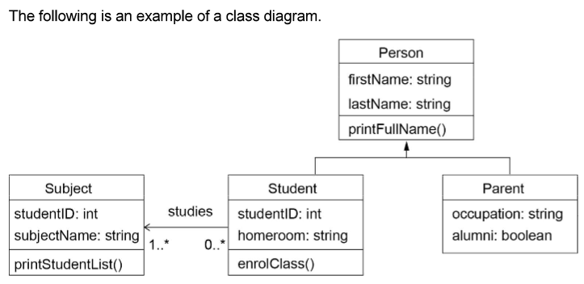
UML
Class Name (Top Section): This is the uppermost part of the box. It displays the name of the class (e.g., Student, Order, Car).
Attributes (Middle Section): This section lists the attributes (or properties/fields) of the class. Each attribute is typically shown with its visibility (+ for public, - for private, # for protected), name, and type.
Methods (Bottom Section): This section lists the methods (or operations/functions) that belong to the class. Each method is shown with its visibility, name, parameters, and return type.
Connections (lines and arrows): These lines and arrows represent relationships (such as inheritance, association, aggregation, and composition) between class boxes.

Slide 5
Overriding Polymorphism
Polymorphism Overriding occurs when a child class (subclass) provides a new implementation for a method it inherits from its parent class (superclass).
The method in the child class has the same name and parameters as the one in the parent class. When the method is called on an object of the child class, Python (or any object-oriented language) uses the child’s version—even if the object is referenced using the parent type.
Run: v05.py

Slide 6
WET v DRY
Let’s implement overriding toggle with the same pattern as on() and off().
Run: v06.py
What are the issues with this implementation?
How can the DRY pattern address these issues?

Slide 7
Overloading Polymorphism
Overloading occurs when a child (subclass) and/or parent (superclass) have multiple methods with the same name but different parameters (number or type).
When you call the method, depending on the parameters passed, the corresponding method is executed.
Because Python is dynamically typed, it does not support overloaded polymorphism, as the last definition of a method overwrites any previous ones.
https://github.com/TempeHS/MicroPython_OOP_Pi_Pico_Mini_Project_Source/blob/main/tutorials/Lecture2.md#overloading-polymorphism
Run: v07.py

