Slide 1
Pi Pico OOP Mini Project
Ben Jones
Tempe High School
Lecture 3

Slide 2
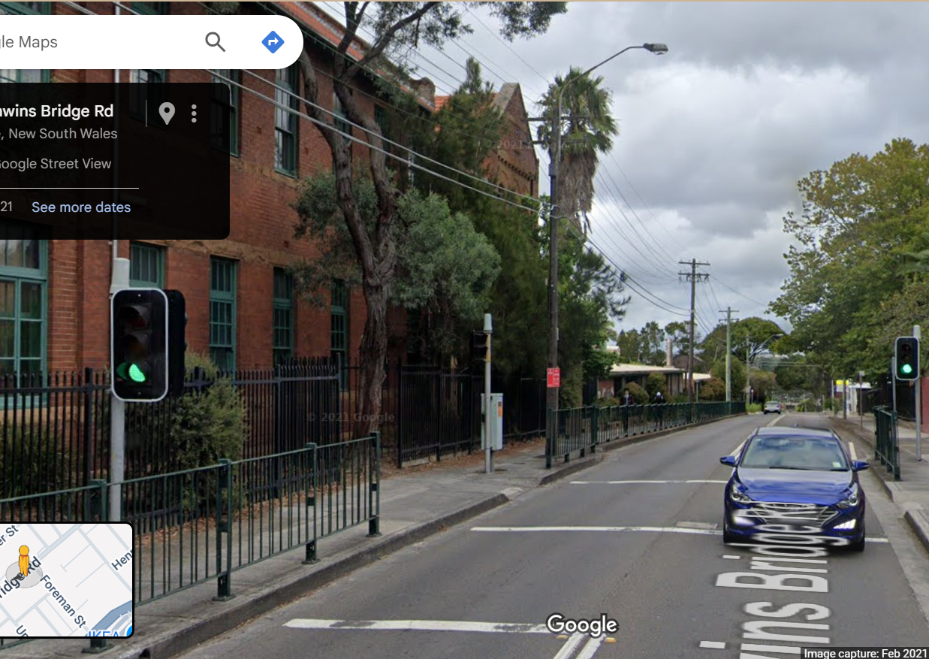
Simple Open Loop Control System
Traffic Lights remain green until pressed (idle state).
Button pressed triggers state change.
Lights rotate through a pattern based on time.
System returns to idle state

Slide 3
Today
Encapsulation
Setters & Getters
Abstraction
Extend LED functionality
Complete and Unit Test led light class

Slide 4
Encapsulation
Encapsulation restricts direct access to some of an object's components (such as attributes or methods), meaning the internal representation of the object is hidden from the outside. This is typically achieved by making certain attributes or methods private (i.e., inaccessible from outside the class) and providing public methods (such as getters and setters) to access or modify those private members.
Run: v08.py

Slide 5
Setter & Getters
Setters and getters are special methods used in object-oriented programming to access (get) or modify (set) the values of private or protected attributes of a class. They help encapsulate the internal state of an object, providing controlled access.
A getter is a method that retrieves (gets) the value of a private attribute. It allows you to read the value without providing direct access to the underlying variable.
A setter is a method that sets (updates) the value of a private attribute. It allows you to validate or restrict changes before updating the attribute.
Run: v09.py

Slide 6
Abstraction
Abstraction in Object-Oriented Programming (OOP) is a principle that focuses on exposing only the essential features of an object while hiding the unnecessary details. The primary goal is to offer a simplified, high-level interface for interacting with complex systems, thereby making your code easier to use and understand.
- What vs. How: Abstraction tells you what an object does, not how it does it.
- Simplification: It reduces complexity by hiding implementation details.
Interface: Abstraction is often achieved by hiding the complex implementation and providing only the interface methods or attributes.
Create: project\lib\led_light.py
Copy the Class to: project\lib\led_light.py
Run: v10.py

Slide 7
Extend LED Functionality
https://github.com/TempeHS/MicroPython_OOP_Pi_Pico_Mini_Project_Source/blob/main/tutorials/Lecture3.md#extend-the-functionality-of-the-led_light-class
Run v11.py

Slide 8
Complete & Unit Test the Led_Light class
https://github.com/TempeHS/MicroPython_OOP_Pi_Pico_Mini_Project_Source/blob/main/tutorials/Lecture3.md#complete-led-light-class
Run: v12.py

