Slide 1
Pi Pico OOP Mini Project
Ben Jones
Tempe High School
Lecture 4

Slide 2
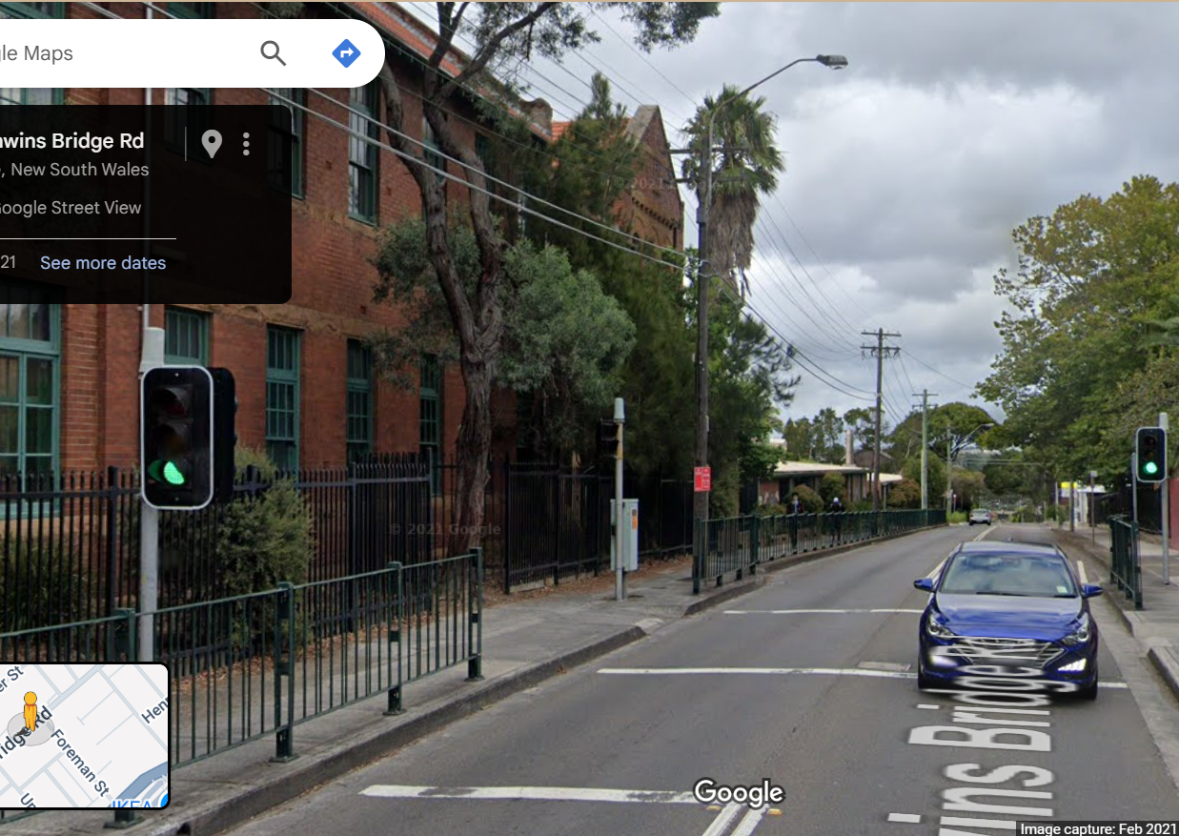
Simple Open Loop Control System
Traffic Lights remain green until pressed (idle state).
Button pressed triggers state change.
Lights rotate through a pattern based on time.
System returns to idle state

Slide 3
Today
Implement and Unit Test advanced button class
Implement and Unit Test audio notification class

Slide 4
Complete & Unit Test the Pedestrian_Button class
https://github.com/TempeHS/MicroPython_OOP_Pi_Pico_Mini_Project_Source/blob/main/tutorials/Lecture4.md#advanced-button-with-debouncing-and-interrupt
Run v13.py

Slide 5
Complete & Unit Test the Audio_Notification class
https://github.com/TempeHS/MicroPython_OOP_Pi_Pico_Mini_Project_Source/blob/main/tutorials/Lecture4.md#audio-notification
Run: v14.py

