Slide 1

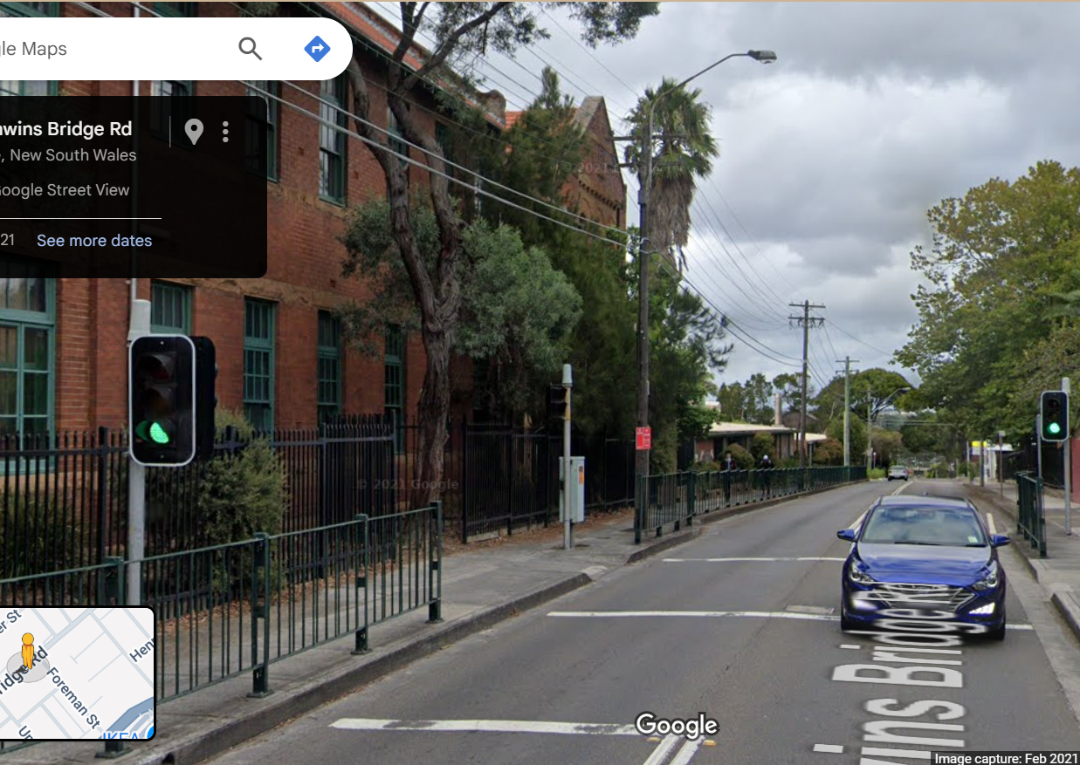
Pi Pico OOP Mini Project
Ben Jones
Tempe High School
Lecture 6
Notes:
Welcome to Lecture 6! So far, we have created fully functioning classes for each of our components: the LED, Audio, and Button. In addition, we’ve written unit tests for all of these classes.

Slide 2
Simple Open Loop Control System
Traffic Lights remain green until pressed (idle state).
Button pressed triggers state change.
Lights rotate through a pattern based on time.
System returns to idle state
Notes:
This lecture will focus on different relationships in Object Oriented Programming and will we start to build our final controller Class.

Slide 3
Today
Multiple Inheritance
Association
Setup controller states
Notes:
Today we will learn about
Multiple Inheritance
Association
We will also set the different controller states
ready for our state machine

Slide 4

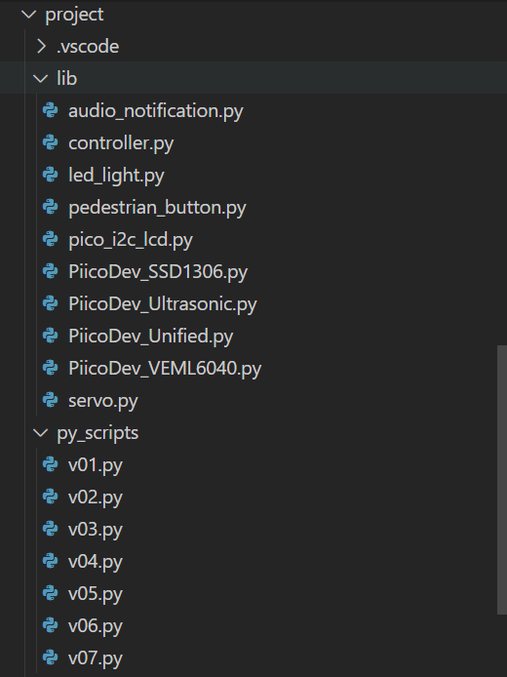
Create new files
v07.py in project\py_scripts\
controller.py in project\lib\

Slide 5
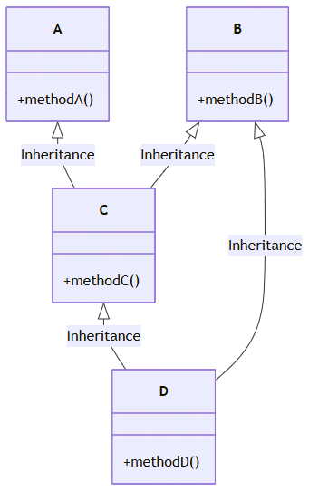
Multiple Inheritance
Multiple Inheritance is used to inherit the properties of multiple Classes. However, Python does not allow multiple inheritance from Classes that have incompatible memory layouts, which is common with hardware Classes in MicroPython/Pi Pico.

Slide 6
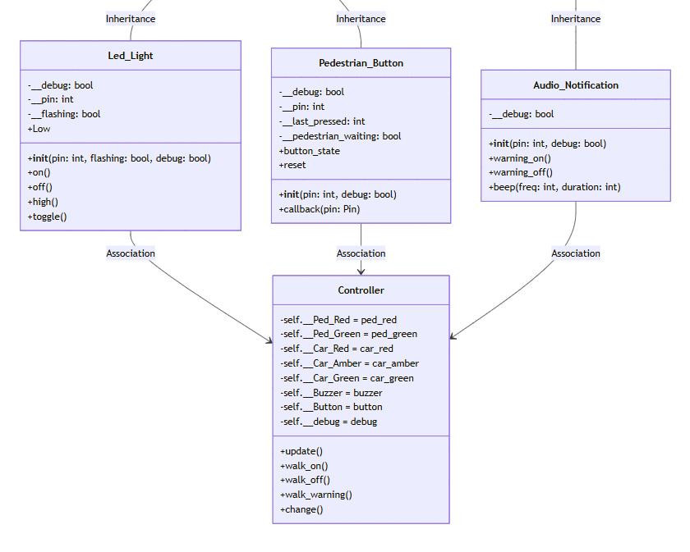
Association
Association in Object-Oriented Programming (OOP) describes the relationship between two separate Classes that are connected, but neither “inherits" the other. It simply means that objects of one Class interact with or use objects of another Class.

Slide 7
Setup Controller States
In the context of a microcontroller, state refers to the current values or conditions of the system’s internal variables, inputs, outputs, and memory at a specific moment in time. State is crucial for determining how the microcontroller should behave next.
For example, in a simple traffic light controller, one of the states could be “Traffic_Go” in which the green lights are on() while both the red and amber lights are off().

Slide 8
Describe the states
Think about this system and describe the states and to triggers for each statte

Slide 9
States
State | Trigger | Light Pattern
Idle | Button Press
Changing
Walk
Walk stop warning

Slide 10
States
 | Change Trigger | Light Pattern
Idle | Button Press | Ped Red On Car Green On Rest Off
Changing | Time | Ped Red On Car Amber On Rest Off
Walk | Time | Ped Green On Car Red On Audio Warning Rest Off
Walk stop warning | Timer | Ped Red Flashing Car Red On Rest Off

Slide 11
Pedestrian_Button Imports
from led_light import Led_Light
from pedestrian_button import Pedestrian_Button
from audio_notification import Audio_Notification
from time import sleep, time

Slide 12
Pedestrian_Button Class Attributes
Class Controller:
def __init__(
self, ped_red, ped_green, car_red, car_amber, car_green, button, buzzer, debug):
self.__Ped_Red = ped_red
self.__Ped_Green = ped_green
self.__Car_Red = car_red
self.__Car_Amber = car_amber
self.__Car_Green = car_green
self.__Buzzer = buzzer
self.__Button = button
self.__debug = debug

Slide 13
Create a method for each state
def idle(self):
def change(self):
def walk(self):
def walk_warning(self):
Pause the video, design your states, then check your states against my suggested states.

