Slide 1

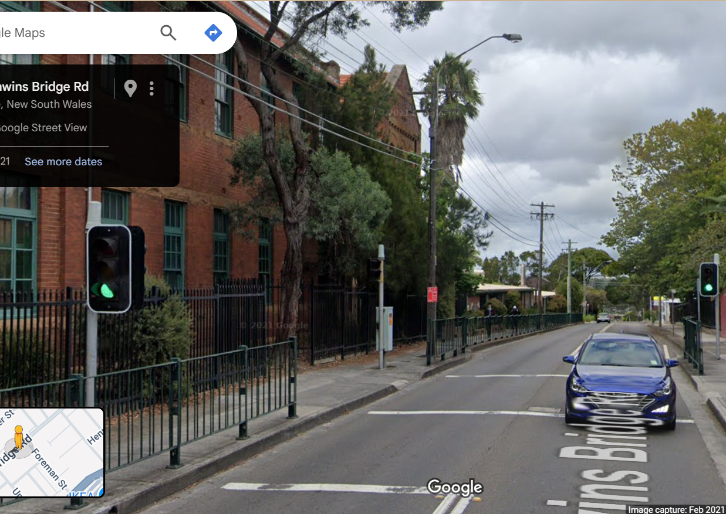
Pi Pico OOP Mini Project
Ben Jones
Tempe High School
Lecture 7

Slide 2
Simple Open Loop Control System
Traffic Lights remain green until pressed (idle state).
Button pressed triggers state change.
Lights rotate through a pattern based on time.
System returns to idle state

Slide 3
Today
Open & Closed Loop Control Systems
Open Loop State Machine
Implement an Open Loop State Machine
System Test

Slide 4
Open-Loop Control Systems
An open-loop control system is a type of system in which the control action is independent of the desired output or the actual system output.
How it works:
The system receives an input (command or reference signal).
The controller processes this input and sends a control signal to the actuator.
The actuator executes the control action, affecting the system or process.
There is no feedback mechanism to compare the output with the input.
Example:
A microwave oven: You set the cooking time, and the microwave runs for that duration regardless of how hot the food actually gets.

Slide 5
Closed-Loop Control Systems
A closed-loop control system (also called a feedback control system) is a system in which the control action is dependent on the desired output and the actual system output.
How it works:
The system receives an input (desired value or setpoint).
The controller processes this input and sends a control signal to the actuator.
The actuator operates on the system.
A sensor measures the actual output.
The output is fed back and compared with the input (setpoint).
The difference (error) is used to adjust the control action to reduce the error.
A home thermostat works by allowing the homeowner to set a desired temperature. The system then measures the actual room temperature and adjusts the heater or cooler to reach and maintain the set temperature. As the system approaches—or overshoots—the desired temperature, it modifies its output accordingly.

Slide 6
State Machine
A state machine (also known as a finite state machine or FSM) is a computational model used to design and describe systems that can be in one of a finite number of states at any given time. It transitions between these states in response to external inputs or events such as time, button presses of sensor values.
Key concepts:
- States: Distinct modes or conditions in which the system can exist.
- Transitions: Rules that define how and when the system moves from one state to another, often triggered by events or inputs.
- Events/Inputs: External actions or signals that cause state transitions.
- A State Machine can be open or closed

Slide 7

Add Controller Class Attributes
Class Controller:
def __init__(
self, ped_red, ped_green, car_red, car_amber, car_green, button, buzzer, debug):
…
self.state = "IDLE"
self.last_state_change = time()

Slide 8
State Machine
def update(self):
# State machine logic
if self.state == "IDLE":
if self.__Button.button_state:
if self.__debug:
print("Pedestrian waiting detected, switching to CHANGE")
self.state = "CHANGE"
self.last_state_change = time()
self.change()
else:
self.idle()

Slide 9
State Machine , (cont)
def update(self):
…
elif self.state == "CHANGE":
# Wait 10 seconds before allowing walk
self.change()
if time() - self.last_state_change > 5:
self.state = "WALK"
self.last_state_change = time()
self.walk()

Slide 10
State Machine , (cont)
def update(self):
…
elif self.state == "WALK":
# Walk signal for 5 seconds
self.walk()
if time() - self.last_state_change > 5:
if self.__debug:
print("Switching to WALK WARNING")
self.state = "WALK_WARNING"
self.last_state_change = time()
self.walk_warning()

Slide 11
State Machine , (cont)
def update(self):
…
elif self.state == "WALK_WARNING":
# Walk signal for 5 seconds
self.walk_warning()
if time() - self.last_state_change > 5:
if self.__debug:
print("Returning to IDLE")
self.state = "IDLE"
self.last_state_change = time()
self.walk_off()
self.__Button.button_state = False

Slide 12
State Machine , (cont)
def update(self):
…
else: # error
self.__Ped_Red.on()
self.__Ped_Green.off()
self.__Car_Green.off()
self.__Car_Amber.toggle()
self.__Car_Red.off()
self.__Ped_Green.off()
sleep(1)

Slide 13
Implement the Class & system test
from project.py_scripts.LL_unit_Test import Led_Light
from pedestrian_button import Pedestrian_Button
from audio_notification import Audio_Notification
from controller import Controller
from time import sleep, time
led_pedestrian_red = Led_Light(19, True, False)
led_pedestrian_green = Led_Light(17, False, False)
led_car_red = Led_Light(3, False, False)
led_car_orange = Led_Light(5, False, False)
led_car_green = Led_Light(6, False, False) pedestrian_button = Pedestrian_Button(22, False) buzzer = Audio_Notification(27, False)

Slide 14
Implement the Class & system test, (cont)
controller = Controller( led_pedestrian_red, led_pedestrian_green, led_car_red, led_car_orange, led_car_green, pedestrian_button, buzzer, True )
while True:
controller.update()
sleep(0.1)

