Slide 1
Pi Pico OOP Mini Project
Ben Jones
Tempe High School
Lecture 4

Slide 2
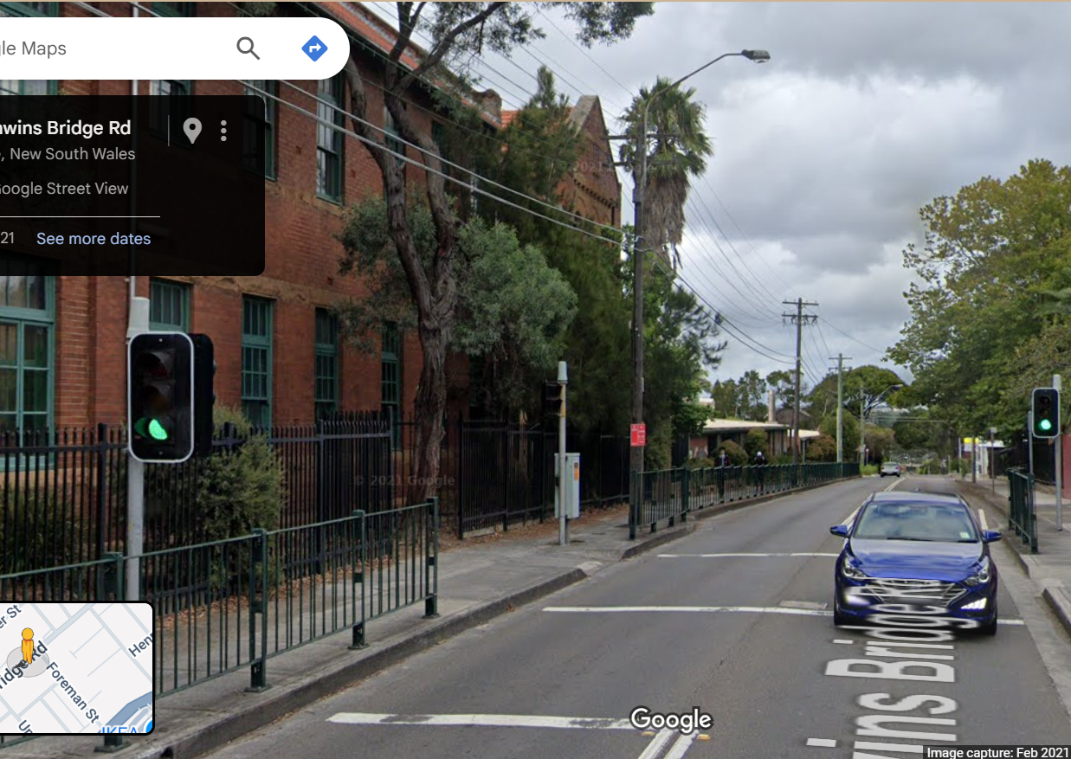
Simple Open Loop Control System
Traffic Lights remain green until pressed (idle state).
Button pressed triggers state change.
Lights rotate through a pattern based on time.
System returns to idle state

Slide 3
Today
Implement an audio notification class
Implement a non-blocking beep
Unit test the audio notification

Slide 4
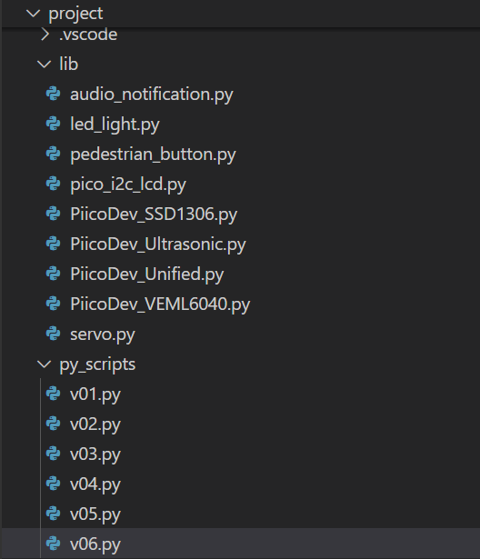
Create new files
v06.py in project\py_scripts\
audio_notification.py in project\lib\

Slide 5
Audio_Notification Imports
from machine import Pin, PWM
from time import sleep, time

Slide 6
Audio_Notification Class Attributes
class Audio_Notification(PWM):
def __init__(self, pin, debug=False):
super().__init__(Pin(pin))
self.__debug = debug
self.duty_u16(0) # Start with buzzer off
self._last_toggle_time = time()

Slide 7
Audio_Notification .beep() Method
def beep(self, freq=1000, duration=500):
if self.__debug:
print("Beep")
self.freq(freq)
self.duty_u16(32768) # 50% duty cycle
sleep(duration / 1000)
self.duty_u16(0) # Turn off after beep

Slide 8
Audio_Notification .warning_on() Method
def warning_on(self):
if self.__debug:
print("Warning on")
now = time()
if now - self._last_toggle_time >= 0.5:
self.beep(freq=500, duration=100)
self._last_toggle_time = now

Slide 9
Audio_Notification .warning_off() Method
def warning_off(self):
if self.__debug:
print("Warning off")
self.duty_u16(0) # Turn off sound

Slide 10
Unit Test the Audio_Notification class
Your unit test should test all methods, where possible, because it involves an auditory sound you should design a manual test.
Pause the video, design your unit test, then check your unit tests against my suggested batch of unit tests.

