Slide 1
Pi Pico OOP Mini Project
Ben Jones
Tempe High School
Lecture 3

Slide 2
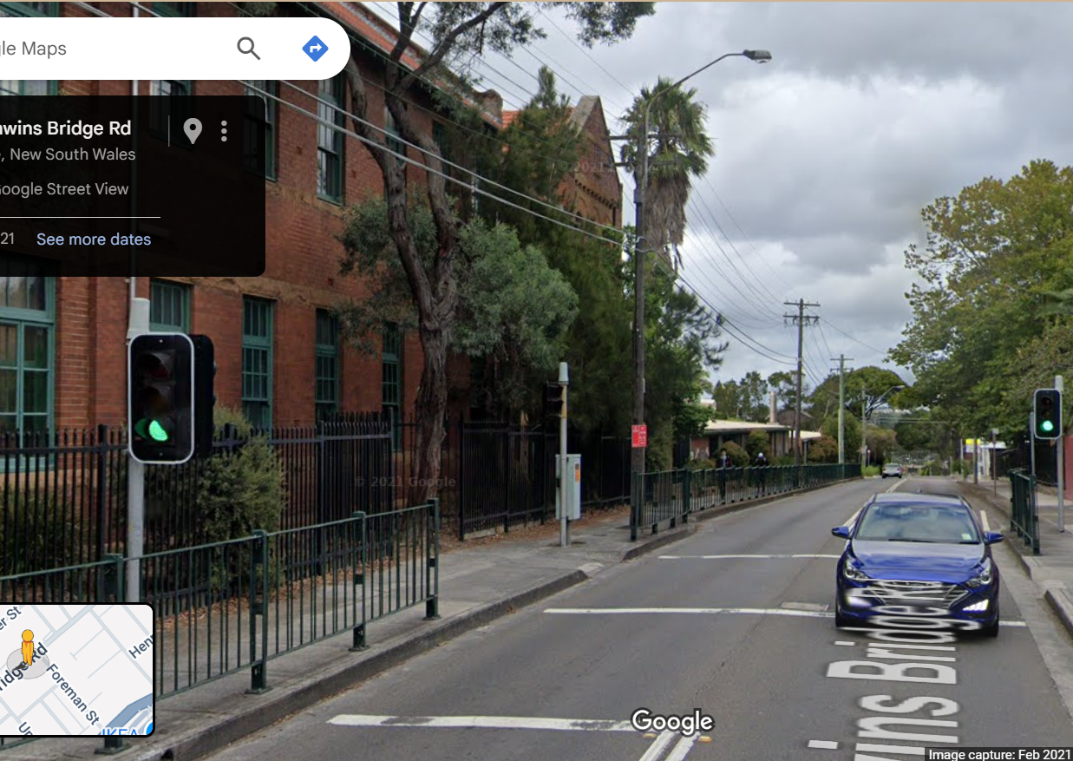
Simple Open Loop Control System
Traffic Lights remain green until pressed (idle state).
Button pressed triggers state change.
Lights rotate through a pattern based on time.
System returns to idle state

Slide 3
Today
Multiple Inheritance
Association
Setup controller states

Slide 4
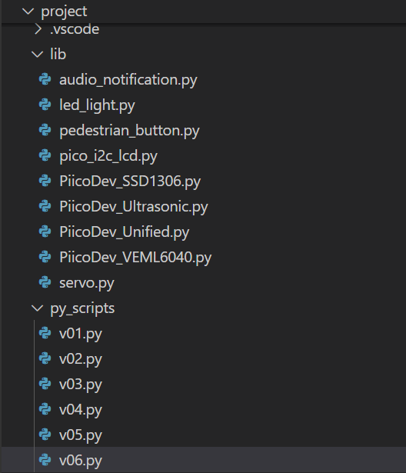
Create new files
v07.py in project\py_scripts\
controller.py in project\lib\

Slide 5
Multiple Inheritance
Multiple Inheritance is used to inherit the properties of multiple classes. However, Python does not allow multiple inheritance from classes that have incompatible memory layouts at the C level, which is common with hardware classes in MicroPython.
https://github.com/TempeHS/MicroPython_OOP_Pi_Pico_Mini_Project_Source/blob/main/tutorials/Lecture5.md#multiple-inheritance

Slide 6
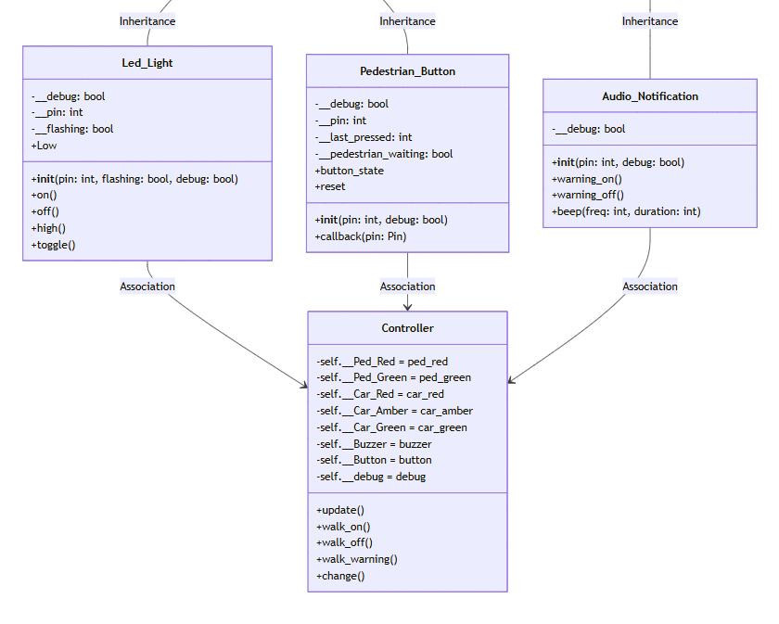
Association
Association in Object-Oriented Programming (OOP) describes the relationship between two separate classes that are connected, but neither "owns" the other. It simply means that objects of one class use or interact with objects of another class.
Run: v15.py

Slide 7
Setup Controller States
In the context of a microcontroller, state refers to the current values or conditions of the system’s internal variables, inputs, outputs, and memory at a specific moment in time. State is crucial for determining how the microcontroller should behave next.
For example, in a simple traffic light controller, one of the states could be “Traffic_Go” in which the green lights are on() while both the red and amber lights are off().
Run v15.py

