Slide 1
IEEE CNS CRW 2024
A Resilient RAP Solution Using Market-based Multi-Agent Systems Li Bai Anway Bose Zhuo Li

Slide 2
Background

Slide 3
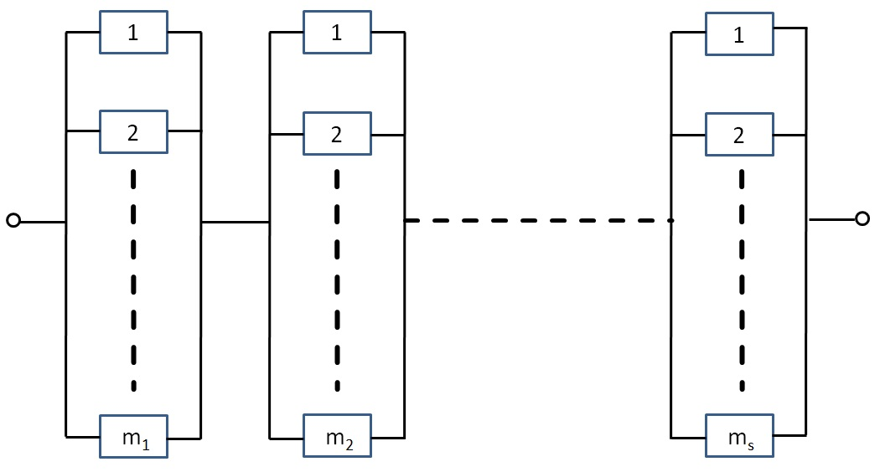
The RAP Problem
Fig 1: A series-parallel system configuration

Slide 4
Application

Slide 5
RAP Applications
Circuit design
Power plant components replacement
Consumer electronics industry

Slide 6
Problem Formulation

Slide 7
Mathamtical Formulation
Reliability

Slide 8
Subsystem Reliability
$R_{i}\left(X_{i}\right)=1−\prod_{j=1}^{m_{i}}{{\left(1−r_{ij}\right)}^{x_{ij}}}$

Slide 9
Reliability

Slide 10
Subsystem Reliability
$R_{i}\left(X_{i}\right)=1−\prod_{j=1}^{m_{i}}{{\left(1−r_{ij}\right)}^{x_{ij}}}$
overall system reliability
$R=\prod_{i=1}^{s}{R_{i}}\left(X_{i}\right)=\prod_{i=1}^{s}{\left(1−\prod_{j=1}^{m_{i}}{{\left(1−r_{ij}\right)}^{x_{ij}}}\right)}$

Slide 11
Maximize System Reliability

Slide 12
RAP Problem
$arg\max_{X}\left\{\prod_{i=1}^{s}{\left(1−\prod_{j=1}^{m_{i}}{{\left(1−r_{ij}\right)}^{x_{ij}}}\right)}\right\}$
such that
$\sum_{i=1}^{s}{\sum_{j=1}^{m_{i}}{c_{ij}}}x_{ij}≤C, x_{ij}∈Z^{+}$ and
$\sum_{i=1}^{s}{\sum_{j=1}^{m_{i}}{w_{ij}}}x_{ij}≤W, x_{ij}∈Z^{+}$

Slide 13
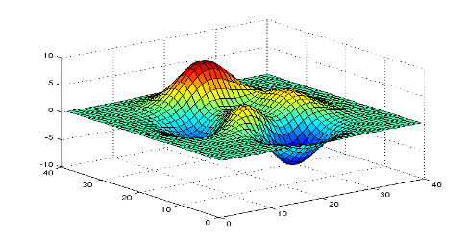
Problem Ananlysis
RAP Problem
$arg\max_{X}\left\{\prod_{i=1}^{s}{\left(1−\prod_{j=1}^{m_{i}}{{\left(1−r_{ij}\right)}^{x_{ij}}}\right)}\right\}$
such that
$\sum_{i=1}^{s}{\sum_{j=1}^{m_{i}}{c_{ij}}}x_{ij}≤C, x_{ij}∈Z^{+}$ and
$\sum_{i=1}^{s}{\sum_{j=1}^{m_{i}}{w_{ij}}}x_{ij}≤W, x_{ij}∈Z^{+}$

Slide 14
Difficulties in finding exact solution
Non Linear Objective
Problem is N-P hard
Search space for RAP is immense (e.g., Test Problem 1 has a search space on the order of $7.6×{10}^{33}$)
Traversal algorithms are infeasible and impractical

Slide 15
Related Works

Slide 16
Related Works
Exact algorithms
Nonlinear Integer Programming
Dynamic programming
Heuristic methods
GA (genetic algorithm)
TS (Tabu search)
ACO (ant colony optimization)
VNS (variable neighborhood search algorithm)

Slide 17
Related Works
Multi-Objective Genetic Algorithm Approach
$$argmax\prod_{i=1}^{s}{R_{i}}\left(X_{i}\right)=\left\{arg\max_{X_{1}}R_{1}\left(X_{1}\right), arg\max_{X_{2}}R_{2}\left(X_{2}\right), ⋯, arg\max_{X_{s}}R_{s}\left(X_{s}\right)\right\}$$

Slide 18
Related Works
Multi-Objective Genetic Algorithm Approach
$$argmax\prod_{i=1}^{s}{R_{i}}\left(X_{i}\right)=\left\{arg\max_{X_{1}}R_{1}\left(X_{1}\right), arg\max_{X_{2}}R_{2}\left(X_{2}\right), ⋯, arg\max_{X_{s}}R_{s}\left(X_{s}\right)\right\}$$
$$=\left\{arg\min_{X_{1}}\prod_{j=1}^{m_{1}}{{\left(1−r_{1j}\right)}^{x_{1j}}}, ⋯, arg\min_{X_{s}}\prod_{j=1}^{m_{s}}{{\left(1−r_{sj}\right)}^{x_{sj}}}\right\}$$

Slide 19
Related Works
Multi-Objective Genetic Algorithm Approach
$$argmax\prod_{i=1}^{s}{R_{i}}\left(X_{i}\right)=\left\{arg\max_{X_{1}}R_{1}\left(X_{1}\right), arg\max_{X_{2}}R_{2}\left(X_{2}\right), ⋯, arg\max_{X_{s}}R_{s}\left(X_{s}\right)\right\}$$
$$=\left\{arg\min_{X_{1}}\prod_{j=1}^{m_{1}}{{\left(1−r_{1j}\right)}^{x_{1j}}}, ⋯, arg\min_{X_{s}}\prod_{j=1}^{m_{s}}{{\left(1−r_{sj}\right)}^{x_{sj}}}\right\}$$
$$=\left\{arg\min_{X_{1}}\left(\sum_{j=1}^{m_{1}}{α_{1j}}x_{1j}\right), ⋯, arg\min_{X_{s}}\left(\sum_{j=1}^{m_{s}}{α_{sj}}x_{sj}\right)\right\}$$
where $α_{ij}=ln\left(1−r_{ij}\right)$

Slide 20
Related Works
Multi-Objective Genetic Algorithm Approach
$$arg\min_{X}\left(\sum_{i=1}^{s}{\sum_{j=1}^{m_{i}}{ω_{i}}}α_{ij}x_{ij}\right)$$
subject to
$$\sum_{i=1}^{s}{ω_{i}}=1, \sum_{i=1}^{s}{\sum_{j=1}^{m_{i}}{c_{ij}}}x_{ij}≤C,$$
$$\sum_{i=1}^{s}{\sum_{j=1}^{m_{i}}{w_{ij}}}x_{ij}≤W, \sum_{j=1}^{m_{i}}{α_{ij}}x_{ij}<ln\left(1−R_{i}^{min}\right), i=1,2,…,s,$$
and $x_{ij}∈Z^{+}$

Slide 21
Proposed Architecture

Slide 22
Multi-agent based approach
Our goal is to develop a decentralized agent based algorithm to solve the RAP
Agent sub problem
$$arg\min_{X}\sum_{j=1}^{m_{i}}{α_{ij}}x_{ij}$$
such that
$$\sum_{j=1}^{m_{i}}{c_{ij}}x_{ij}≤{\tilde{c}}_{i}, \sum_{j=1}^{m_{i}}{w_{ij}}x_{ij}≤{\tilde{w}}_{i},$$
where $i=1,2,…,s$, and ${\tilde{c}}_{i}$ and ${\tilde{w}}_{i}$ are subsystem-specific cost and weight constraints derived from the overall constraints $C$ and $W$: $\sum_{i=1}^{s}{{\tilde{c}}_{i}}≤C, \sum_{i=1}^{s}{{\tilde{w}}_{i}}≤W.$

Slide 23
Multi-Agent Systems
Multi-Agent Systems
assume all agents are honest and deliver authenticated messages

Slide 24
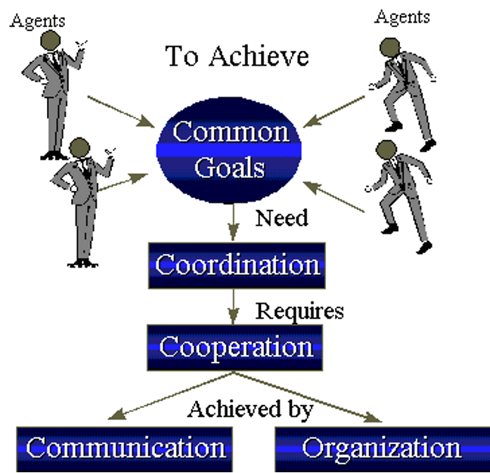
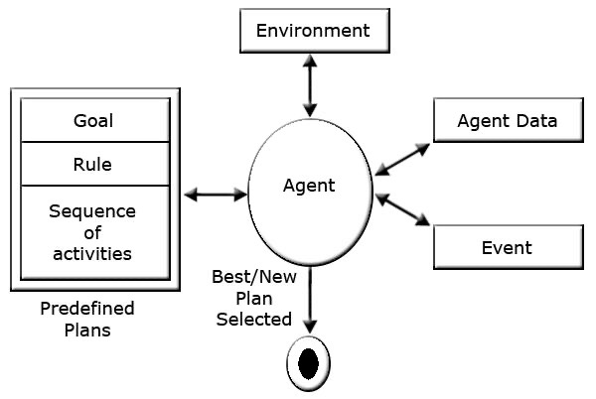

Slide 25
Multi-Agent Systems
Multi-Agent Systems
assume all agents are honest and deliver authenticated messages
each agent provides its lowest cost and weight among its component selections to the Centralized Broker Agent as
$$⌊c_{i}^{⋆}⌋=min\{c_{i1},c_{i2},…,c_{im_{i}}\},$$
$$⌊w_{i}^{⋆}⌋=min\{w_{i1},w_{i2},…,w_{im_{i}}\},$$
for $\left(i=1,2,…,s\right)$

Slide 26
Multi-Agent based Trading Approach
Multi-Agent based Trading Approach
the Centralized Broker Agent (CBA) initiates the trading process. Once the CBA makes a decision, all agents accept it. The trading procedure involves a three- tier optimization process:
Local Optimization for Permissible Performance Sets
Group Trading Among Agents
CBA Winning Agent Algorithm

Slide 27
Multi-Agent based Trading Approach
1.Local Optimization for Permissible Performance Sets
$$\min_{X}\left\{\sum_{j=1}^{m_{i}}{α_{ij}}x_{ij}\right\}$$
such that $\sum_{j=1}^{m_{i}}{x_{ij}}c_{ij}≤{\tilde{c}}_{i}, \sum_{j=1}^{m_{i}}{x_{ij}}w_{ij}≤{\tilde{w}}_{i},$
By varying ${\tilde{c}}_{i}$ and ${\tilde{w}}_{i}$, up to $C×W$ linear integer programming problems are solved to determine all possible $x_{ij}$. Each solution provides $r_{i}$, $c_{i}$, and $w_{i}$ for the agent, forming the set $Γ_{i}$:
$$Γ_{i}=\{\left(r_{l}^{\left(i\right)},c_{l}^{\left(i\right)},w_{l}^{\left(i\right)}\right)\},$$
where $r_{l}^{\left(i\right)}=1−\prod_{j=1}^{m_{i}}{{\left(1−r_{ij}\right)}^{x_{ij}^{\left(l\right)}}}, c_{l}^{\left(i\right)}=\sum_{j=1}^{m_{i}}{c_{ij}}x_{ij}^{\left(l\right)}, w_{l}^{\left(i\right)}=\sum_{j=1}^{m_{i}}{w_{ij}}x_{ij}^{\left(l\right)}.$
Note that if $c_{l}^{\left(i\right)}≥c_{k}^{\left(i\right)}$ and $w_{l}^{\left(i\right)}≥w_{k}^{\left(i\right)}$, then $r_{l}^{\left(i\right)}≥r_{k}^{\left(i\right)}$, but the converse is not necessarily true.

Slide 28
Multi-Agent based Trading Approach
2.Group Trading Among Agents
Once an agent’s local belief is established, it must select a performance choice from its permissible performance set $Γ_{i}$.
To optimize the selection, a recursive formulation is used:
$$R\left(Γ_{1:p},C,W\right)=arg\max_{X}\left\{R\left(Γ_{p},c,w\right)R\left(Γ_{1:p−1},C−c,C−w\right)\right\}$$
subject to: $0<c≤C,$ and $0<w≤W,$, where
$$R\left(Γ_{p},c,w\right)=\left\{\begin{matrix}r_{l}^{\left(p\right)} & \text{if }c=c_{l}^{\left(p\right)}\text{ and }w=w_{l}^{\left(p\right)}, \\ r_{l}^{\left(p\right)} & \text{if }c_{l}^{\left(p\right)}≤c<c_{l+1}^{\left(p\right)}\text{ and }w≥w_{l}^{\left(p\right)}, \\ r_{l}^{\left(p\right)} & \text{if }w_{l}^{\left(p\right)}≤w<w_{l+1}^{\left(p\right)}\text{ and }c≥c_{l}^{\left(p\right)}, \\ 0 & \text{otherwise}.\end{matrix}\right.$$

Slide 29
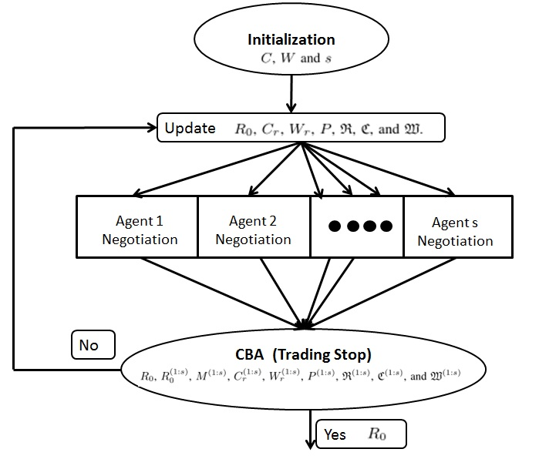
Multi-Agent based Trading Approach
3.CBA Winning Agent Algorithm
Upon receiving all trading messages from agents, the CBA selects the agent group that can proceed with a trade. Agents then process the trade and update their performance indexes

Slide 30
Simulation Results

Slide 31
Test Problem 1
$*$ denotes no design alternative.
Problem Comparison
Conclusion
Conclusion & Future Work
Conclusion
We introduced a market-based multi-agent approach for solving RAP problems
The method features three levels of optimization, and we reduce computational complexity by constructing a permissible performance set for each subsystem
By using a trading group of two agents, we significantly lower the computation requirements, allowing for relatively fast resolution of RAP problems.
Future Work
include evaluating the algorithm’s computational complexity, robustness, and sensitivity
Exploring trading methods involving more than two agents and applying the algorithm to different RAP problems within cyber-resilient systems
THANK YOU

